Slide 1




ACAI '21 Course:
An Introduction to Intelligent User Interfaces
Albrecht Schmidt, Sven Mayer, Daniel Buschek

Slide 2



Introduction
Albrecht Schmidt
Sven Mayer
Daniel Buschek

Slide 3
Examples & Motivation

Slide 4
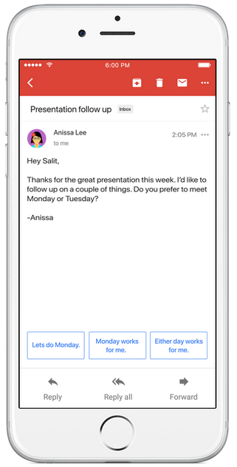
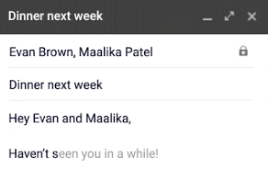

Text Suggestions
Google‘s Smart Reply & Smart Compose
Language model, given email text
https://blog.google/products/gmail/save-time-with-smart-reply-in-gmail/
https://ai.googleblog.com/2018/05/smart-compose-using-neural-networks-to.html
Introduction and Motivation

Slide 5
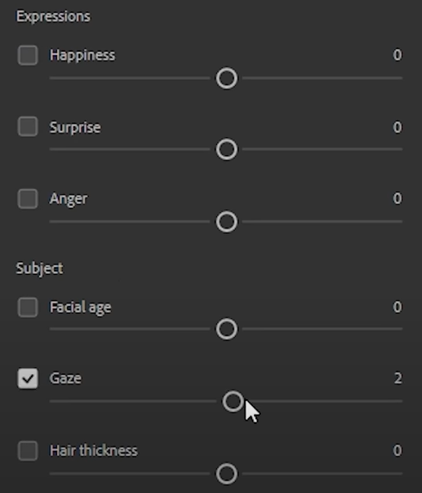
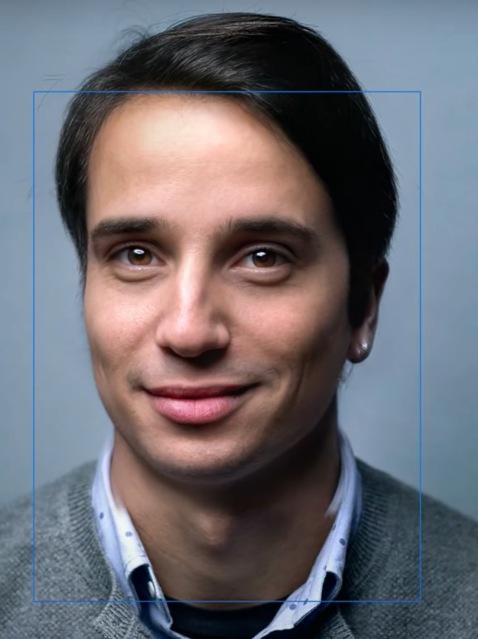
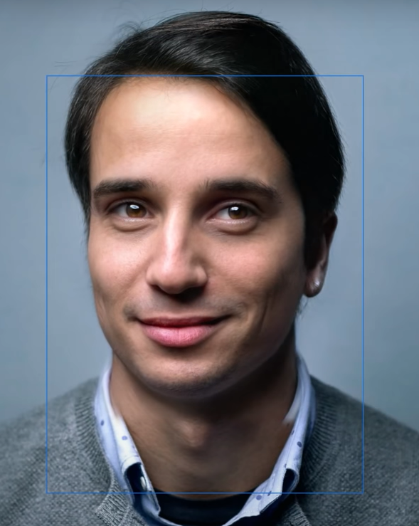
Semantic Image Manipulation
„Smart Portrait Filters“ in Adobe‘s Photoshop
Generative model, learned from many portraits
https://blog.adobe.com/en/2020/10/20/photoshop-the-worlds-most-advanced-ai-application-for-creatives.html https://blogs.nvidia.com/blog/2020/10/20/adobe-max-ai/, https://github.com/NVlabs/stylegan2
Introduction and Motivation

Slide 6
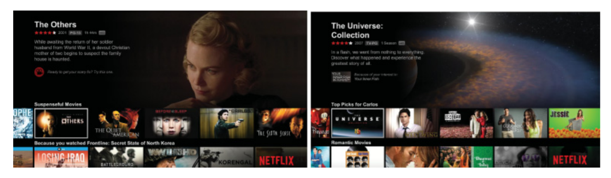





Recommender Systems
How do recommender systems impact the user experience?
Carlos A. Gomez-Uribe and Neil Hunt. 2015. The Netflix Recommender System: Algorithms, Business Value, and Innovation. ACM Trans. Manage. Inf. Syst. 6, 4, Article 13 (December 2015), 19 pages. DOI: https://doi.org/10.1145/2843948
Why are recommender systems used?
How do recommender work?
What data do recommender systems require?
Introduction and Motivation
Notes:
OK

Slide 7
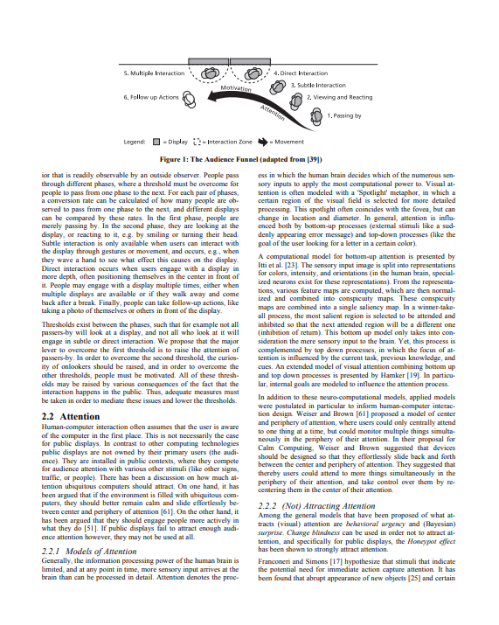
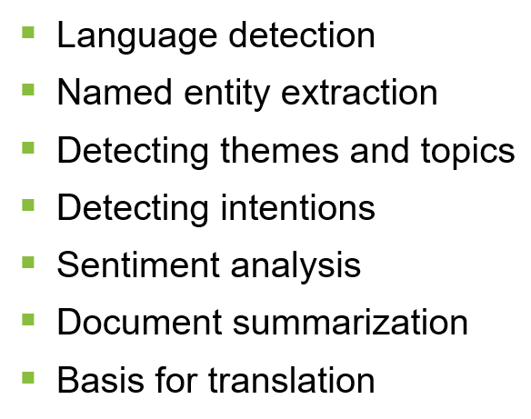
Text analytics
Where can we use it and how can it improve interaction?
Answering questions like
What is this text about?
What did the person communicate?
What is the key information in this document?
What feelings are communicated?
Is this different from what was said before?
Application areas
Social media analytics, e.g. twitter
Communication and reading interfaces
Customer reviews and feedback
Chat bots
Text Forensics
http://www.medien.ifi.lmu.de/pubdb/publications/pub/mueller2010mm/mueller2010mm.pdf
Introduction and Motivation
Notes:
http://www.medien.ifi.lmu.de/pubdb/publications/pub/mueller2010mm/mueller2010mm.pdf

Slide 8
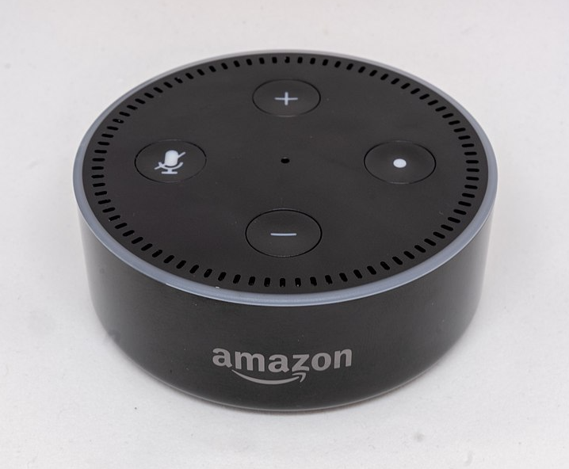
VUI design process
How to design a dialog structure?
Think of alternatives
structure
wording
Try out your dialog
wizard of Oz technique!
use outside people
Refine, Revise, Repeat
Image by Gregory Varnum, CC BY-SA 4.0 via Wikimedia Commons
https://commons.wikimedia.org/wiki/File:Amazon_Echo_Dot_-_June_2018_(1952).jpg
Introduction and Motivation
Notes:
https://de.m.wikipedia.org/wiki/Datei:Amazon_Echo_Dot_-_June_2018_(1952).jpg

Slide 9
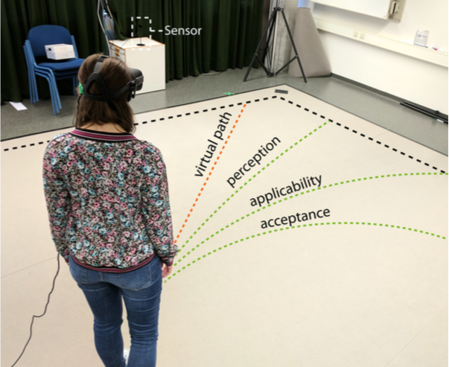
A Deceptive UI: redirected Walking
What is real in an intelligent UI?
M. Rietzler, J. Gugenheimer, T. Hirzle, M. Deubzer, E. Langbehn and E. Rukzio, "Rethinking Redirected Walking: On the Use of Curvature Gains Beyond Perceptual Limitations and Revisiting Bending Gains," 2018 IEEE International Symposium on Mixed and Augmented Reality (ISMAR), Munich, Germany, 2018, pp. 115-122, doi: 10.1109/ISMAR.2018.00041. Image from https://ieeexplore.ieee.org/abstract/document/8613757
Introduction and Motivation

Slide 10


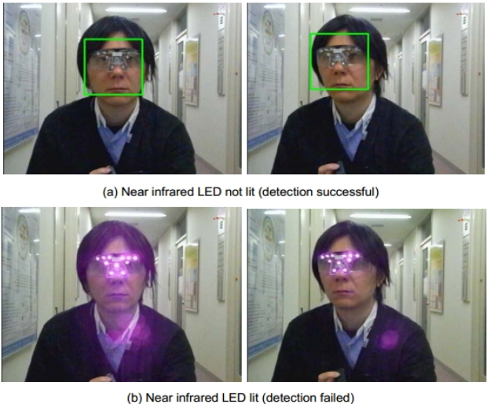
Facial Recognition
Convenient biometric or overly powerful?
Unlock your phone
Hands-free identification
What are the major issues?
Surveillance
Privacy
Tricks to „hide“ from facial recognition technology
https://www.bbc.com/news/uk-51237665
http://research.nii.ac.jp/~iechizen/official/research-e.html#research2c
Introduction and Motivation
Notes:
https://pxhere.com/en/photo/1620437

Slide 11
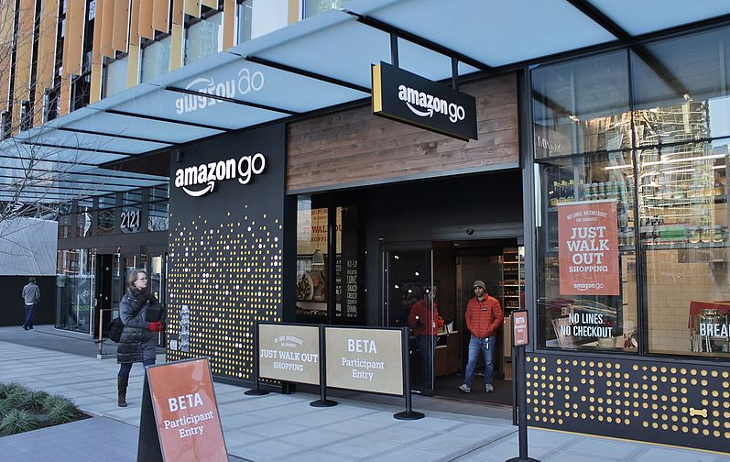
HCI Replacing HHI in Stores
„Just Walk Out“ shopping experience at Amazon Go
Surveillance-powered shopping
Does not use facial recognition
How does it work?
Is it „intelligent“? How so?
Image by SounderBruce, CC BY-SA 4.0 via Wikimedia Commons https://commons.wikimedia.org/wiki/File:Amazon_Go_in_Seattle,_December_2016.jpg
Introduction and Motivation

Slide 12



AI Recruiting
Is an AI a “fairer“ recruiter?
Introduction and Motivation
Notes:
https://pixabay.com/illustrations/word-cloud-recruitment-process-1758159/
https://pxhere.com/de/photo/1446003
Visualisation created ourselves using free-to-use images from Pexels and Unsplash

Slide 13
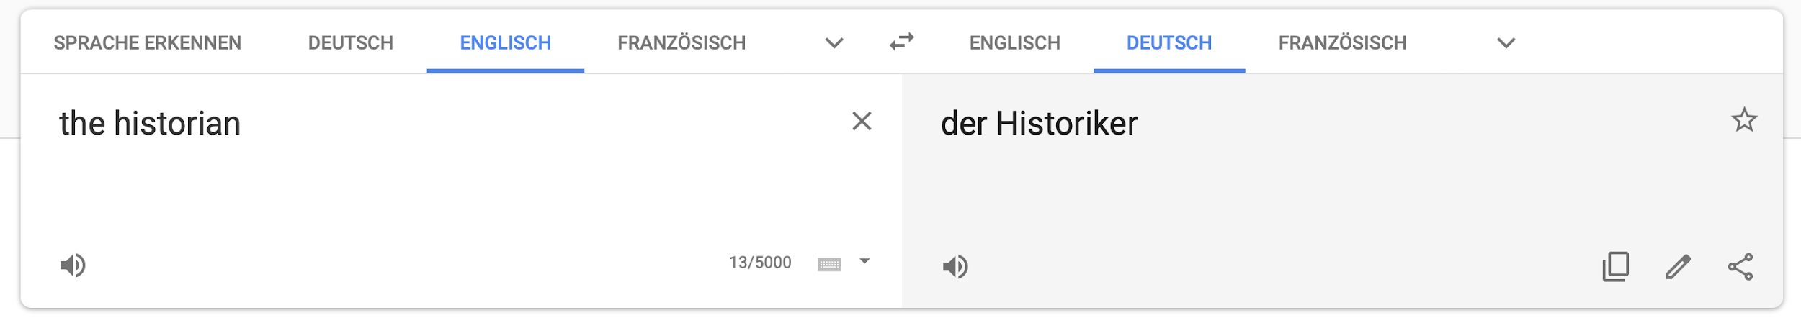

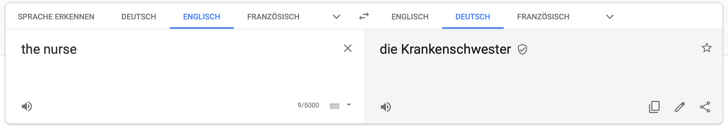
Natural Language Translation
Female historians and male nurses do not exist?
https://translate.google.com
https://algorithmwatch.org/en/story/google-translate-gender-bias/
Introduction and Motivation

Slide 14
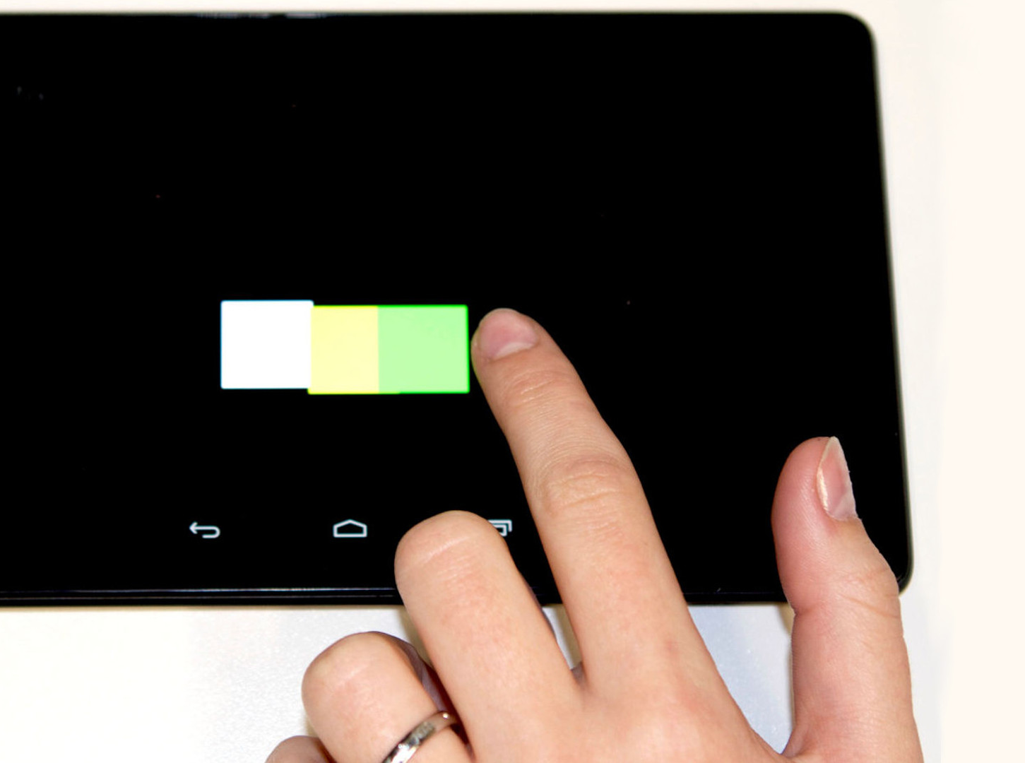
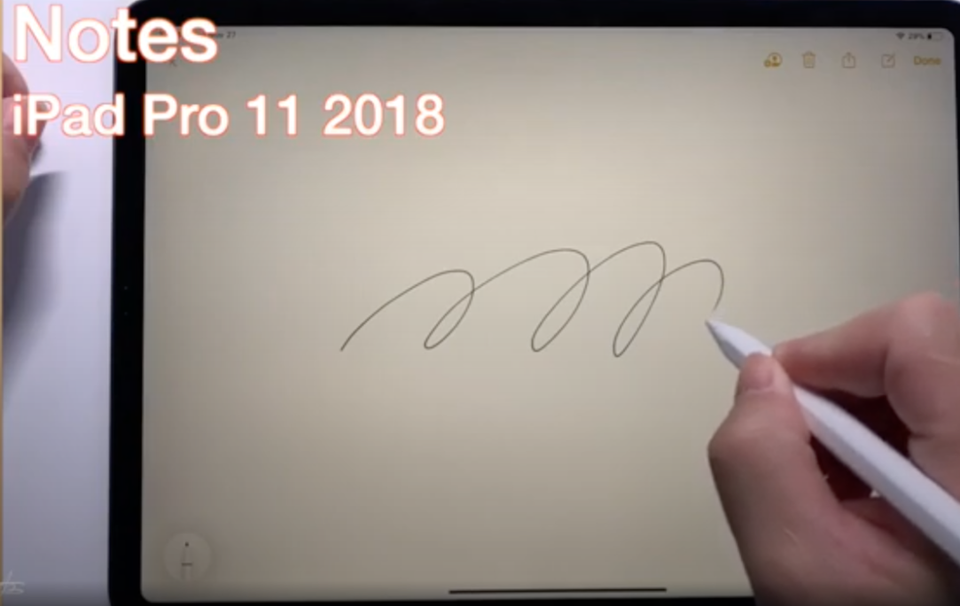
Intelligent Touch
Why are we so precise with our fingers on a screen?
Nexus 7 2013
Henze, N., Mayer, S., Le, H.V. and Schwind, V. Improving software-reduced touchscreen latency. Proc. MobileHCI ’17 https://doi.org/10.1145/3098279.3122150
https://www.youtube.com/watch?v=l6Nz8wVUU74
Introduction and Motivation

Slide 15
Intelligence and Artificial Intelligence
HCI perspective

Slide 16
What is considered Artificial Intelligence?
What is AI?

Slide 17
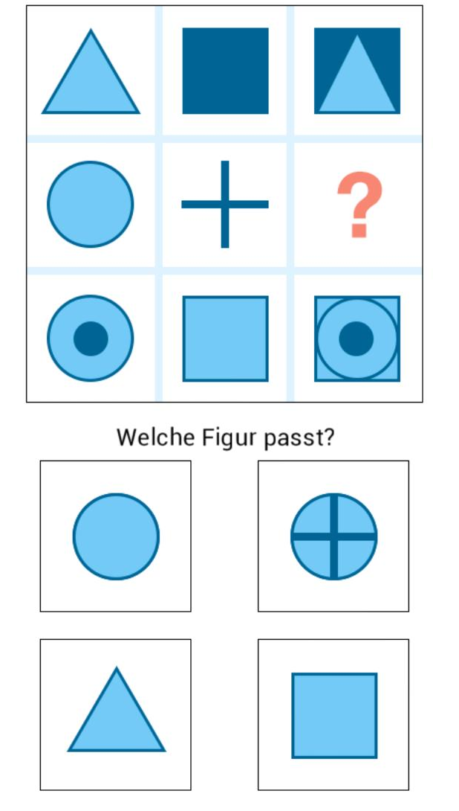
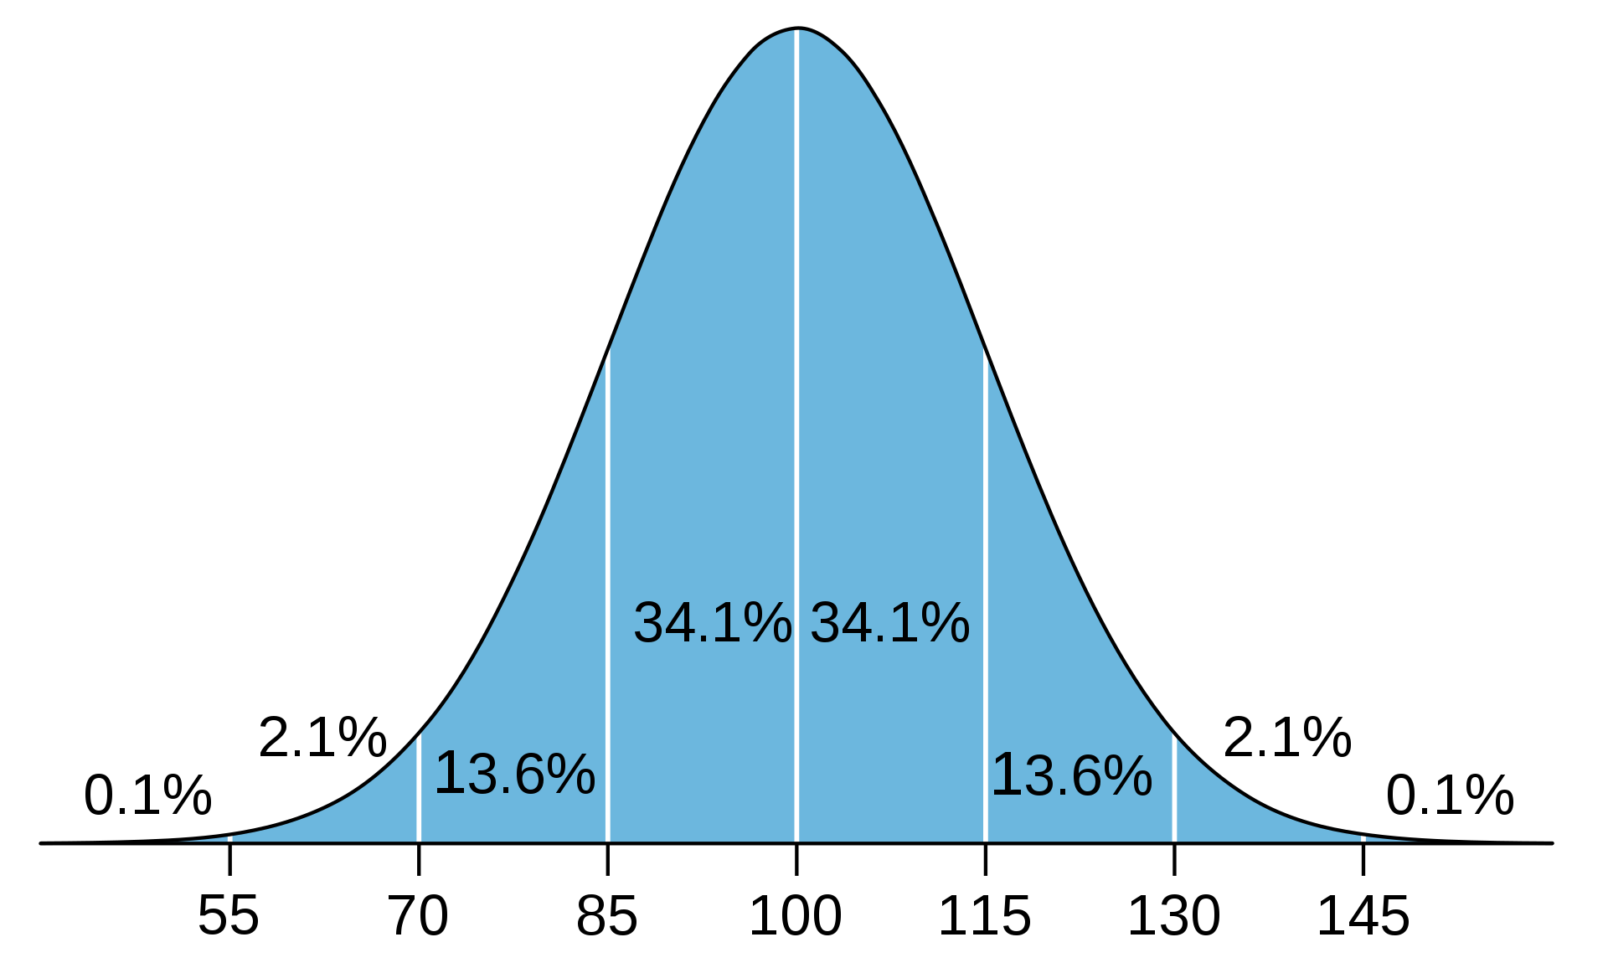
What is considered Artifical Intelligence?
What is Human Intelligence?
Which figure fits?
What is AI?
Notes:
What tasks are in an IQ test?
Why are the solution requiring an intelligent person/actor?
Predict the future from know examples 🡪 regresion, prediction
Classify based on previous examples 🡪 NN, SVM
The odd

Slide 18
What is in an IQ test?
Many different types… typical questions include:
Finding Analogies (math and verbal)
Pen and writing, cup and ???
Finding / extending Pattern (graphical and math)
45 … 40 … 60 … 55 … 75 … 70 … ???
Classification tasks
Make two groups: apple, plate, grape, cake, spoon, knife
Making sense spatial and visual representations
Reasoning and logical
General knowedge
What is AI?

Slide 19
Goal: Design Human-machine systems outperform humans as well as machines
Intuitive cooperation between humans and computers is the key challenge

Slide 20
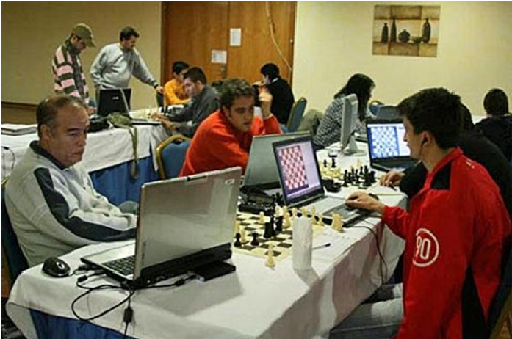
Cyborg chess - centaur chess' advanced chess - freestyle chess
People play and use computer assistance
… not sure about this in chess, however in open problems this is the way forward
https://labs.sogeti.com/decision-support-better-than-machine-intelligence/

Slide 21
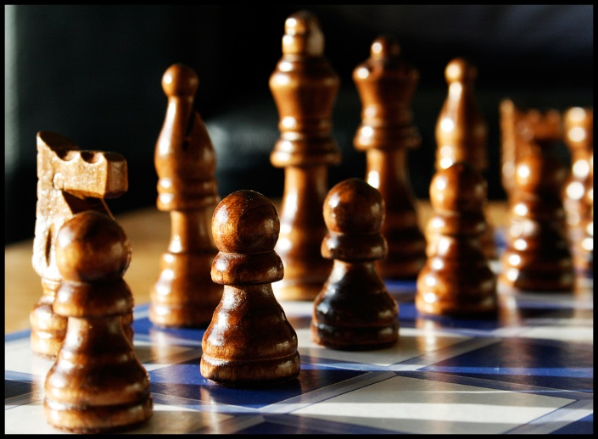
Who is more intelligent? Who appears more intelligent?
Technologies make us (observable) intelligent!
https://www.flickr.com/photos/tenspeedphotography/3536942268 by Richard Heaven [CC BY 2.0]
Question
Human with no Augmentation
Human with Augmentation
Answer

Slide 22
Automation or Augmentation?
Who is in Control?

Slide 23
Augmenting – Amplifying Human Cognition
What cognitive and perceptual abilities can we enhance?
Where will cognitive and perceptual enhancement be hard?

Slide 24
Augmentation not automation… or towards amplification?
As We May Think by Vannevar Bush (Bush, 1945)
Joseph Lickider’s idea of a “Man-Computer Symbiosis” (Licklieder, 1960)
Douglas Engelbart’s research on “Augmenting [the] Human Intellect” (Engelbart, 1962)
Ubiquitous Computing as described by Mark Weiser (Weiser, 1992)
Augmented Cognition (DARPA)
Bush, V.,1945. As we may think. The Atlantic, July 1945, pp.101-108.
Licklider, J. C. R., 1960. Man-Computer Symbiosis. IRE Transactions on Human Factors in Electronics, HFE-1, March 1960, pp 4-11
Engelbart, D. C. 1962. Augmenting Human Intellect: A Conceptual Framework. SRI Summary Report AFOSR-3223. October 1962.
Weiser, M., 1991. The computer for the 21st century. Scientific American 265.3, pp94-104, 1991.
Notes:
Conceptually this work is strongly inspired by Joseph Lickider’s idea of a “Man-Computer Symbiosis” (Licklieder, 1960) and by Douglas Engelbart’s research on “Augmenting [the] Human Intellect” (Engelbart, 1962). These first and comprehensive explorations of how interactive computing technology can be used to amplify the human intellect have inspired many developments over the last 50 years. The idea of Ubiquitous Computing as described by Mark Weiser (Weiser, 1992) moved the vision forward to interactive computing technologies pervasively integrated with everyday environments. Our project aims to evaluate and update these concepts to create a new vision for the augmentation and amplification of human cognition and perception fitting technologies and information in the 21st century. Licklieder, Engelbart, and Weiser also inspired the methodology and in particular the experimental research approach to be taken, with a lab implementing the tools for everyday use of the researchers.
Augmented Cognition
DARPA has investigated the notion of augmented cognition from the perspective of cognition aware systems. In particular with an aim at military applications, they investigated how psychophysiological measurements can be used to assess the cognitive state of the user in real-time (John et al., 2004 and Schmorrow et al., 2006). The idea is to build cognitively aware systems that dynamically adapt to the human ability (Schmorrow et al., 2002). The term “augmented cognition” is also used by the Human Factors and Ergonomics Society (HFES, http://tg.hfes.org/actg/) for a technical working group on this topic in a very broad sense. In contrast, we will investigate constructive means for creating tools that amplify cognition and perception rather than measuring cognitive load. We aim at measuring how cognitive tools increase the performance of an individual.

Slide 25
Enhancing and amplifying perception and cognition
Theoretical motivation
Extended mind and active externalization
Distributed cognition
Collaborative knowledge and group cognition
Use of space and external representations
Technology push
Superior sensing and capture systems
Advances in AI, processing, and communication
Devices for embedded presentation and augmented reality
Hollan, J., Hutchins, E. and Kirsh, D., 2000. Distributed cognition: toward a new foundation for human-computer interaction research. ACM Transactions on Computer-Human Interaction (TOCHI), 7(2), pp.174-196.
Clark, A. and Chalmers, D., 1998. The extended mind. analysis, 58(1), pp.7-19.
Kirsh, D., 2010. Thinking with external representations. Ai & Society, 25(4), pp.441-454.
Stahl, G., 2006. Group Cognition: Computer Support for Building Collaborative Knowledge (Acting with Technology).
Notes:
http://consc.net/papers/extended.html

Slide 26
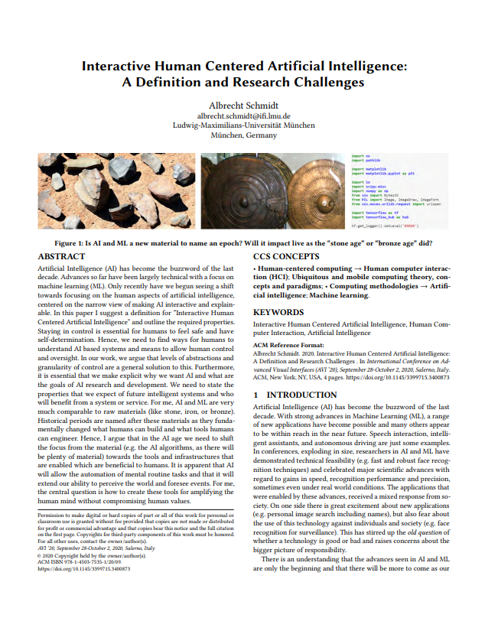
Definition
An Interactive Human Centered Artificial Intelligence is an Artificial Intelligence that enables interactive exploration and manipulation in real time and is designed with a clear purpose for human benefit while being transparent about who has control over data and algorithms.
https://uni.ubicomp.net/as/iHCAI2020.pdf

Slide 27
Properties (1/2) Interactive Human Centered Artificial Intelligence
Individuals can interact in real time with the algorithms, models, and data and can manipulate and control all relevant parameters.
The impact of changes and manipulations made by the user can be observed in real time.
In fast processes the speed can be reduced to allow interactions, interventions, and manipulation.
Individuals can interactively explore why and how specific decisions are made and find out how changes in the parameters, data, and models impact outcomes.

Slide 28
Properties (2/2) Interactive Human Centered Artificial Intelligence
It states how humans can benefit from the artificial intelligence.
It explains what risks the artificial intelligence poses for individuals as well as on societal level.
It is visible who has control of the artificial intelligence, in particular who has the power over data, models, and algorithms.
It is visible what data, knowledge base, and information is used or has been used to create and inform the artificial intelligence.

Slide 29
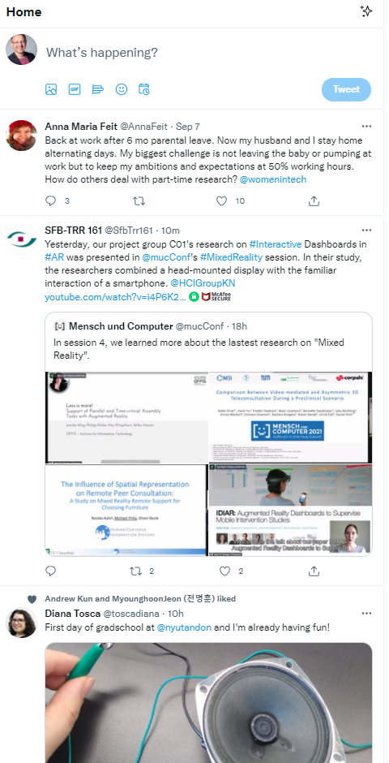
Is the Twitter-Algorithm a iHCAI?
Individuals can interact in real time with the algorithms, models, and data and can manipulate and control all relevant parameters.
The impact of changes and manipulations made by the user can be observed in real time.
In fast processes the speed can be reduced to allow interactions, interventions, and manipulation.
Individuals can interactively explore why and how specific decisions are made and find out how changes in the parameters, data, and models impact outcomes.
It states how humans can benefit from the artificial intelligence.
It explains what risks the artificial intelligence poses for individuals as well as on societal level.
It is visible who has control of the artificial intelligence, in particular who has the power over data, models, and algorithms.
It is visible what data, knowledge base, and information is used or has been used to create and inform the artificial intelligence.

Slide 30
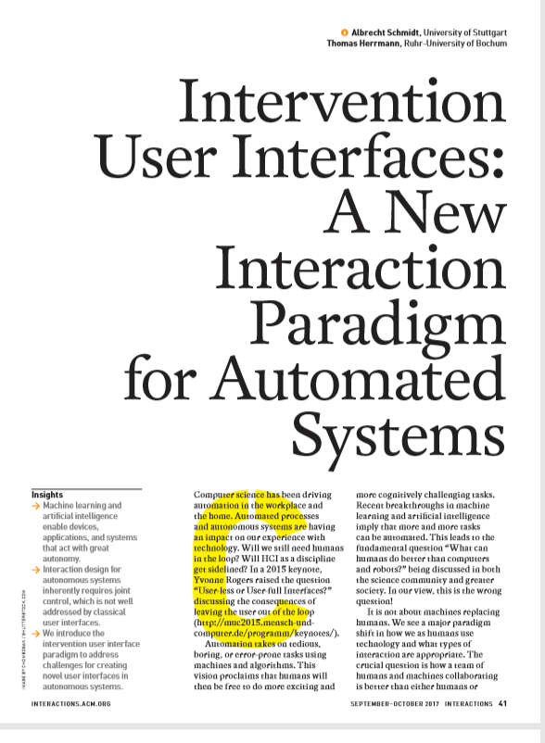
How can humans stay in control?
In the future, we believe that a large class of automated and autonomous systems allow for joint control, where the majority of decisions are automated but where users can intervene.

Slide 31
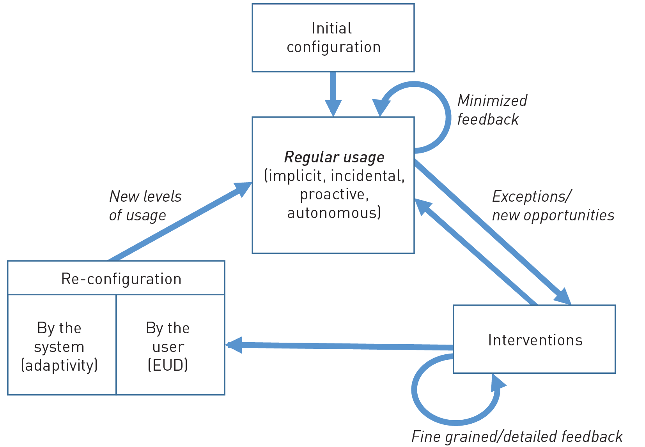
Interaction with Intervention User Interfaces

Slide 32
Design Principles for Intervention user interfaces
Ensure expectability and predictability.
Communicate options for interventions.
Allow easy exploration of interventions.
Easy reversal of automated and intervention actions.
Minimize required attention.
Communicate how control is shared.
For more details and a set of rules see:

Slide 33
The End of Serendipity?
Optimal Solutions for Everything?

Slide 34



… some things just happen
I met her accidentally and we get on well together
it was pure chance that we were there at the same time
we sat next to each other and realized we work on the same thing
Notes:
Until now, many of our major decisions in life, such as the job we work, the people we live with, or whether and with whom we start a family, largely depend on chance and the choices we make. This may be history!

Slide 35
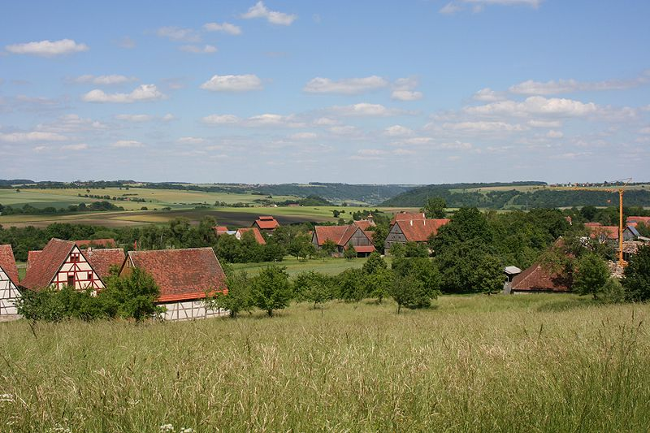
Boundaries are gone
Rosenzweig, CC BY-SA 3.0, https://commons.wikimedia.org/wiki/File:Wackershofen_Freilandmuseum_Blick_von_oben_20070530.jpg
Notes:
Foto:Historic village
Shop, food, School, people, church
In the pre-digital age, the choice was much smaller, since you were, in most cases, essentially limited to your community (local as well as societal). These limitations applied to mundane everyday tasks, such as what and where to buy an item, as well as to big life choices of what school to go to or whom to marry. As the choice was limited, no recommender systems were required. In many cases, chance played a major role as well as the social environment people were in. Decision support, if required, was provided by friends or even by playing a chance game, such as the daisy oracle, depicted in figure~\ref{fig:teaser}, where you alternate choices (e.g. yes, no, yes, no, etc.) while pulling off petals, till all are gone.

Slide 36
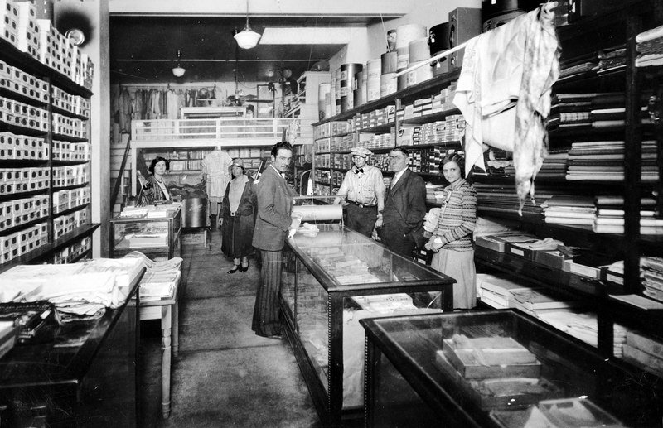
Choice has increased
Jim Evans, CC BY-SA 4.0, https://commons.wikimedia.org/wiki/File:Cochran%27s_Dry_Goods.tif

Slide 37
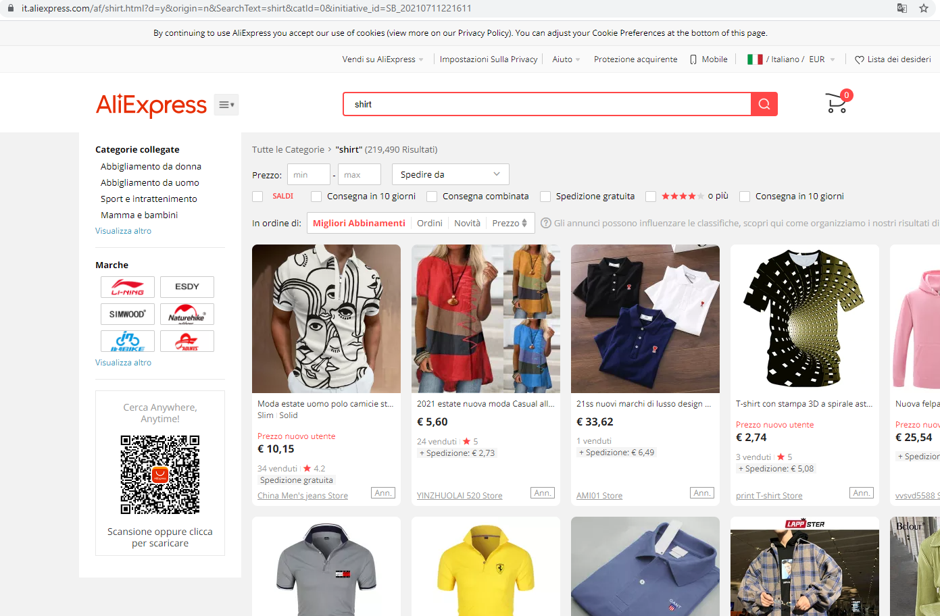
Unlimited content, impossible choice
Notes:
We have gotten used to being supported in our decisions since the early days of the WWW. In the 1990s, there were still web directories (e.g. Yahoo!) that made an effort to create human-curated, hierarchically organized categories of links to websites. It was apparent that this could not scale to the content on a WWW scale. Directories and also search engines only provide access to a fraction of the available content.
In \cite{ilprints422}
the PageRank algorithm is described (which was at the foundation of Google) as "a method for rating Web pages objectively and mechanically, effectively measuring the human interest" highlighting the challenge of finding what is important.
Without algorithmic support for selecting the content that we focus on, most of the popular websites and social media applications would not work. Letâ€™s illustrate the scale of this challenge: The search query â€œBolzanoâ€ on Google lists 37 million hits. We know that users typically look at the first 10 hits on a search page and even the order on within the first hits significantly impacts the users' choice \cite{keane2008people}. There are no â€œrightâ€ 10 to select out of the 37 million. Nevertheless, what is put on the top of the first page will get the attention.

Slide 38
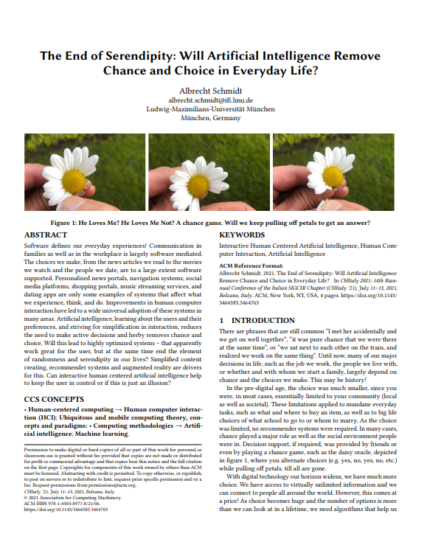
Content Selection Dilemma … random selection of content would not work
We need algorithms, which will inevitably introduce bias, manipulate us, and reduce choice and serendipity.
This also leads to the question of who has control over algorithms?
https://uni.ubicomp.net/as/as-chocie.pdf

Slide 39
There is a dilemma: We cannot consider all options as this would take forever.

Slide 40
Is Human in the Loop the Solution? Who makes the real decisions?
1.000.000 Options
100 Options
In a sorted list
1 Item – My selection
AI / Algorithm
Human
Notes:
Such decision support systems may still have the human in the loop. They preselect and let us choose between options that are similarly optimal with regard to our preferences (or the cost function used for optimization). Pruning the search space will make it easier to find what we like, but at the same time, it limits our personal choice massively. Apparently, a good system will be designed to not offer inefficient or suboptimal solutions to the user.

Slide 41
But it feels all real, I am in control!

Slide 42
Is Human in the Loop the Solution? How makes the real decisions?
1.000.000 Options
100 Options
In a sorted list
1 Item – My selection
AI / Algorithm
Human
Notes:
Such decision support systems may still have the human in the loop. They preselect and let us choose between options that are similarly optimal with regard to our preferences (or the cost function used for optimization). Pruning the search space will make it easier to find what we like, but at the same time, it limits our personal choice massively. Apparently, a good system will be designed to not offer inefficient or suboptimal solutions to the user.

Slide 43
Manipulate vs. Intelligent Assistance

Slide 44
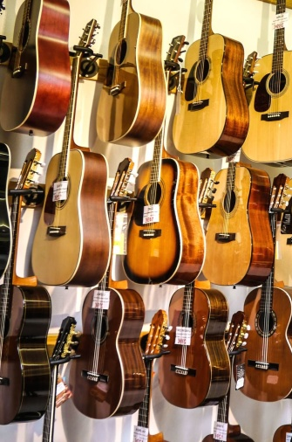
Manipulation is Easy (and it is not new)
Your get 4 items presented:
one that is out of your budget
one that has low user ratings
one that is not available until next week
one we want to sell you
It is your choice! You will believe, that you made your choice
However the system “manipulated” the decision
Pre-selection
presentation
Notes:
https://pixnio.com/objects/guitar-shop-music-instrument-wire-acoustics

Slide 45
Manipulation or Intelligent Assistance?
The interface of how to present intelligent assistance to the user is critical for success
“Users don’t want to be told what to do, they want to choose”
Version 1:
“take the train at 12:17 from platform 6”
Version 2:
“which do you want to take? train at 12:17 from platform 6 (takes 45 minutes) or bus at 12:15 from platform 3 (takes 50 minutes, is unreliable)”
Intelligent assistance is not perfect (and will not be for a long time), and this can be hidden in the user interface

Slide 46
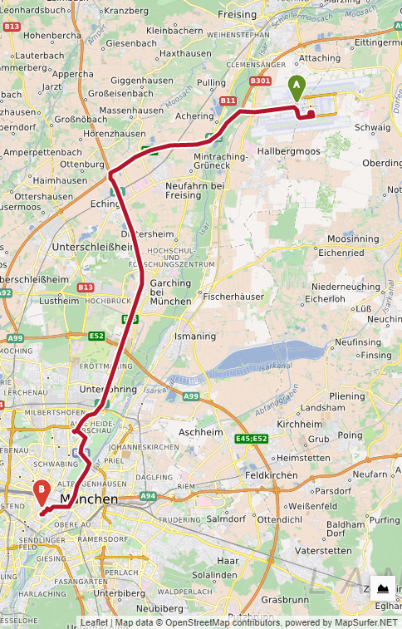
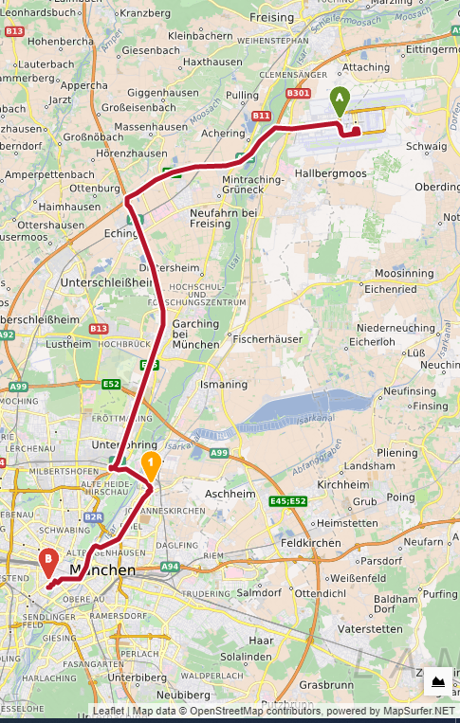
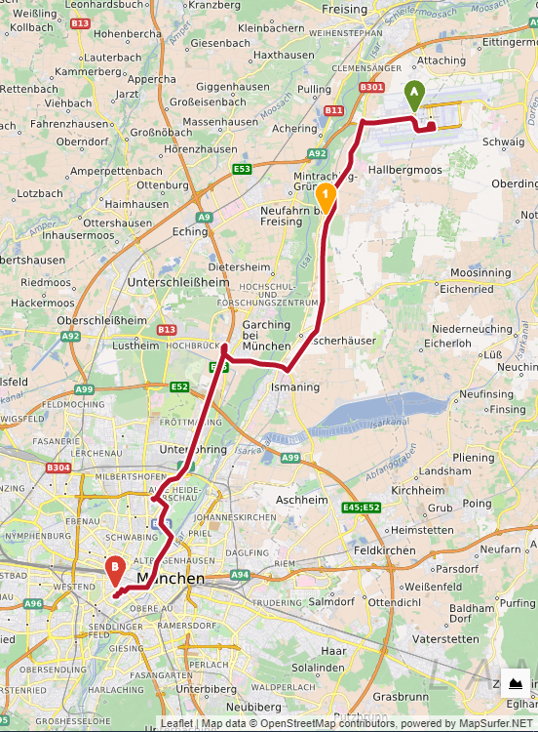
A Dystopian vision: The route you drive
Notes:
{\it Where to drive?} The navigation system impacts our actions and perception. It can pick routes that bring us close to certain locations (and stores) and keep us away from other parts of the town. Depending on the route, we may never see a homeless person, even though they are there. Who makes the decision on what you should be exposed to when you drive? With power over your route it is easy to manipulate where you shop and how safe you feel.

Slide 47
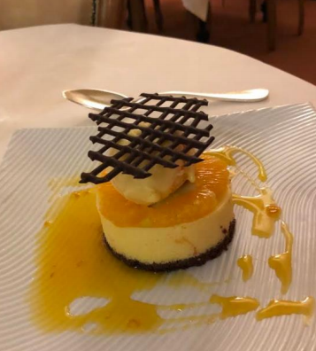
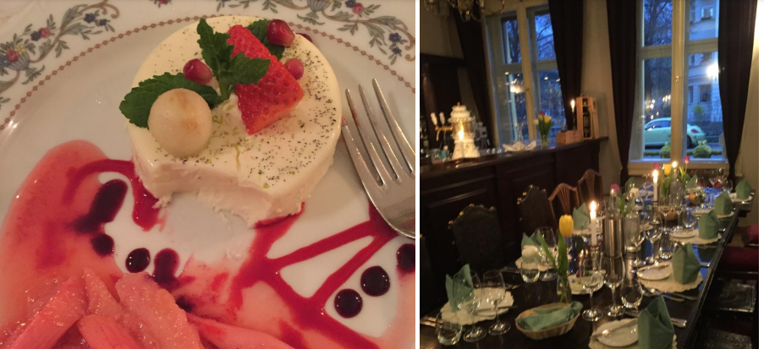
A Dystopian vision: What to eat?
Notes:
{\it Where to eat?} Search sites (e.g. Yelp) can easily nudge you to visit some restaurants and avoid others. They can increase the chance of people meeting in a restaurant, while having the power to make sure they will never meet when going for dinner. Hence, further separating groups in society seems really easy to implement.

Slide 48
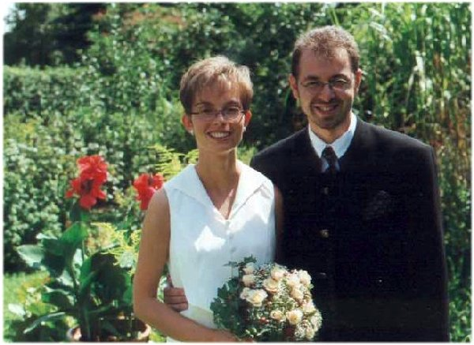
A Dystopian vision: Fundamental life choices
Whom to marry?
Notes:
{\it Whom to marry?} Who will you have a relationship with? Who will choose the person you start a family with? In the digital age, your choice of potential partners for life is huge, even if you limit it to a geographical area. Dating sites use algorithms to reduce the choice from several thousand to 10 or maybe 50. The UI and the interaction design (in particular, how potential partners are presented, when you receive notifications, and communication channels provided) will further impact the user choice. Access to the algorithm and interface can become the basis for a new human breading experiment. Scary!

Slide 49

The (predictive) power of computing Can we predict your future?
Where you go next?
What you will order?
What you will watch?
…
The (life-)partner you choose?
…
Notes:
Abraham Lincoln
https://www.pxfuel.com/en/free-photo-jgfkb
CC0 1.0 Universal (CC0 1.0) Public Domain Dedication

Slide 50
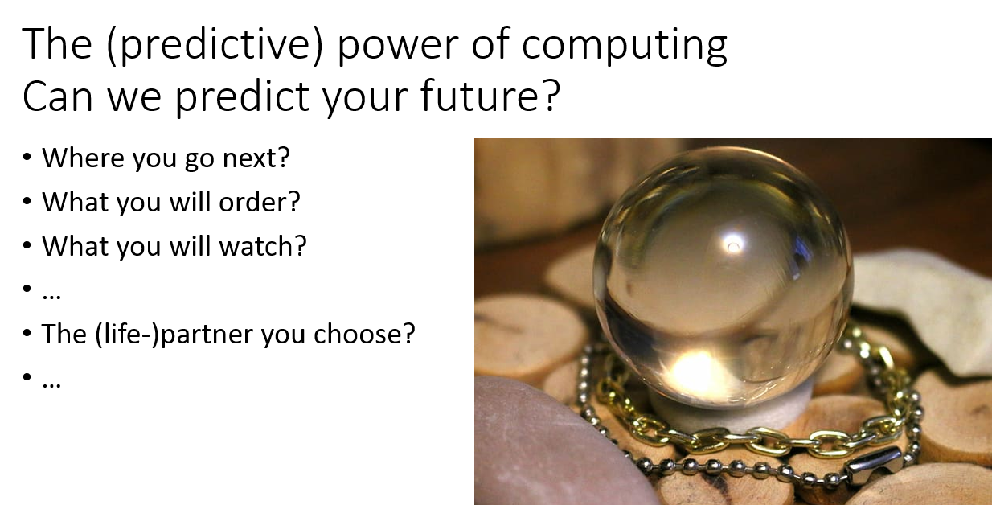
The best way to predict the future is to create it

Slide 51
The best way to predict the future is to create it
… for them - or at least nudge people to go into the right direction (the future you want)

Slide 52
Then End of Serendipity? No Randomness anymore?
Who do you trust to decide …
…what movies you watch? (and eventually like)
…who you are sitting next to on the plane?
…which way you walk?
…who is in the same restaurant as you?
…which flat you buy?
…
…whom you marry?

Slide 53
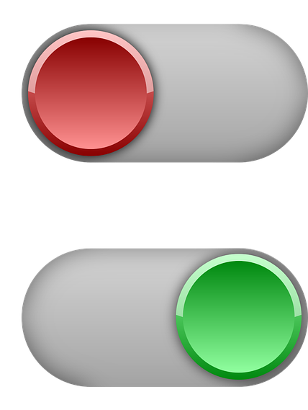
Don’t Autoplay your Life
Off
On
Notes:
If you put YouTube on autoplay you can comfortably watch all evening long, without making any decisions but at the cost of losing control! YouTube will guess what you like and after some time you will probably like it.

Slide 54
Implementing IUIs
Practical advice

Slide 55
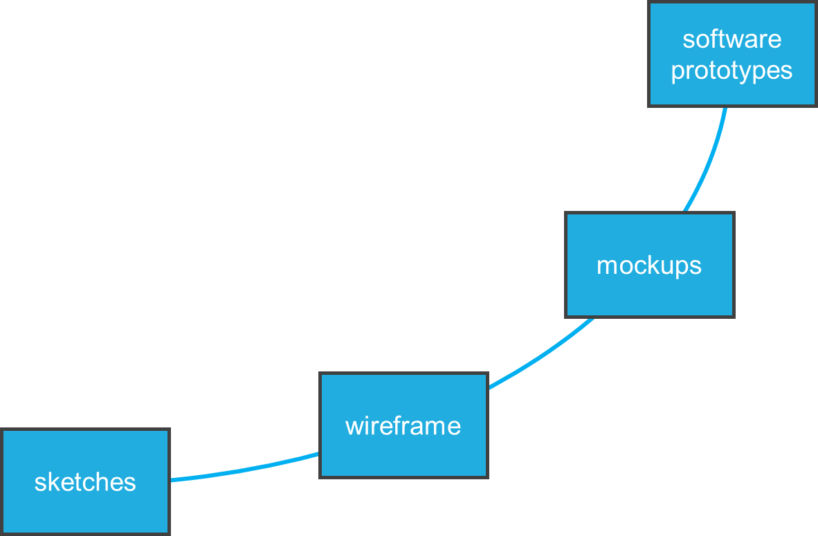
effort
design iteration
fidelity
Introduction to Prototyping

Slide 56

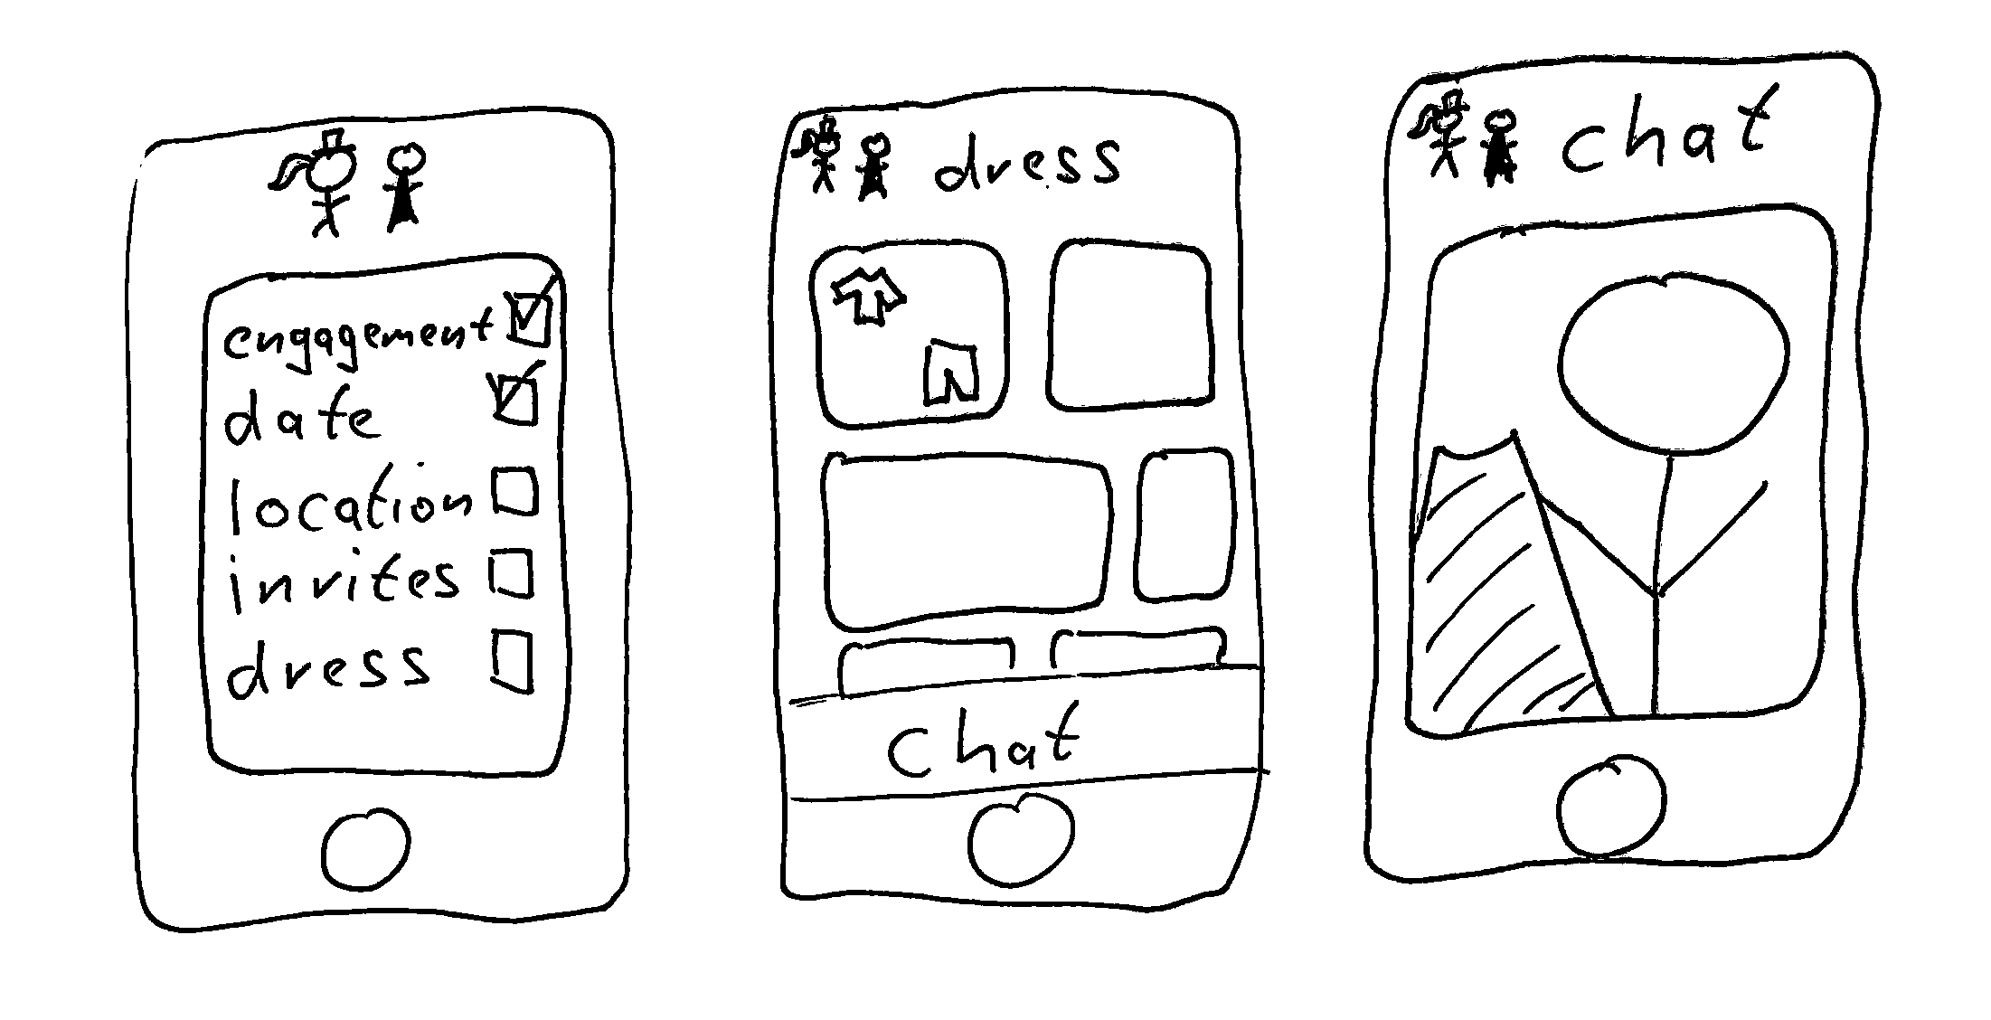
Sketches
Low-Functional Prototypes

Slide 57
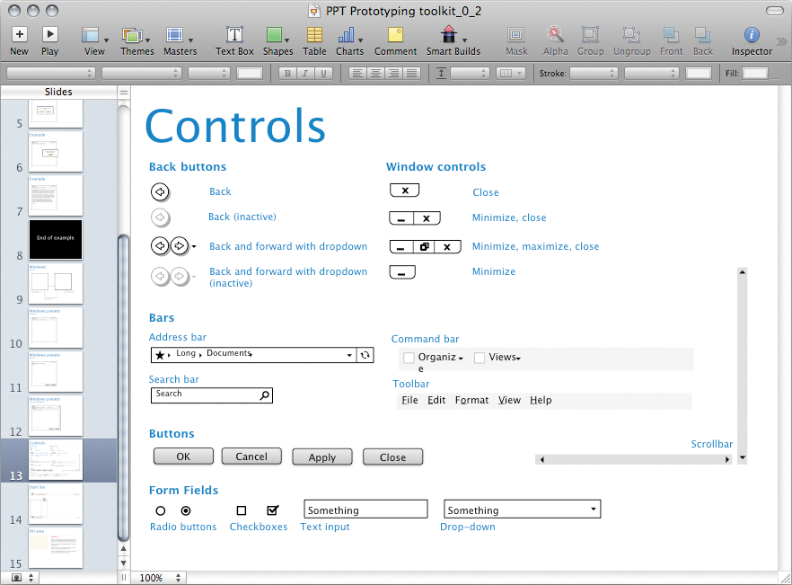
Image by Rosenfeld Media from https://www.flickr.com/photos/rosenfeldmedia/3978127831 (CC-BY 2.0)
Low-Functional Prototypes

Slide 58
ISO 9241-210 Human-Centered Design Process
Plan the human-centered design process
Design solution meets the user requirements
Understand and specify the context of use
Evaluate designs against requirements
Specify the user and organizational requirements
Product design solutions to meet the user requirements
ISO 9241-210:2019 (en) Human-centered design for interactive systems
Systemizing Prototypes

Slide 59
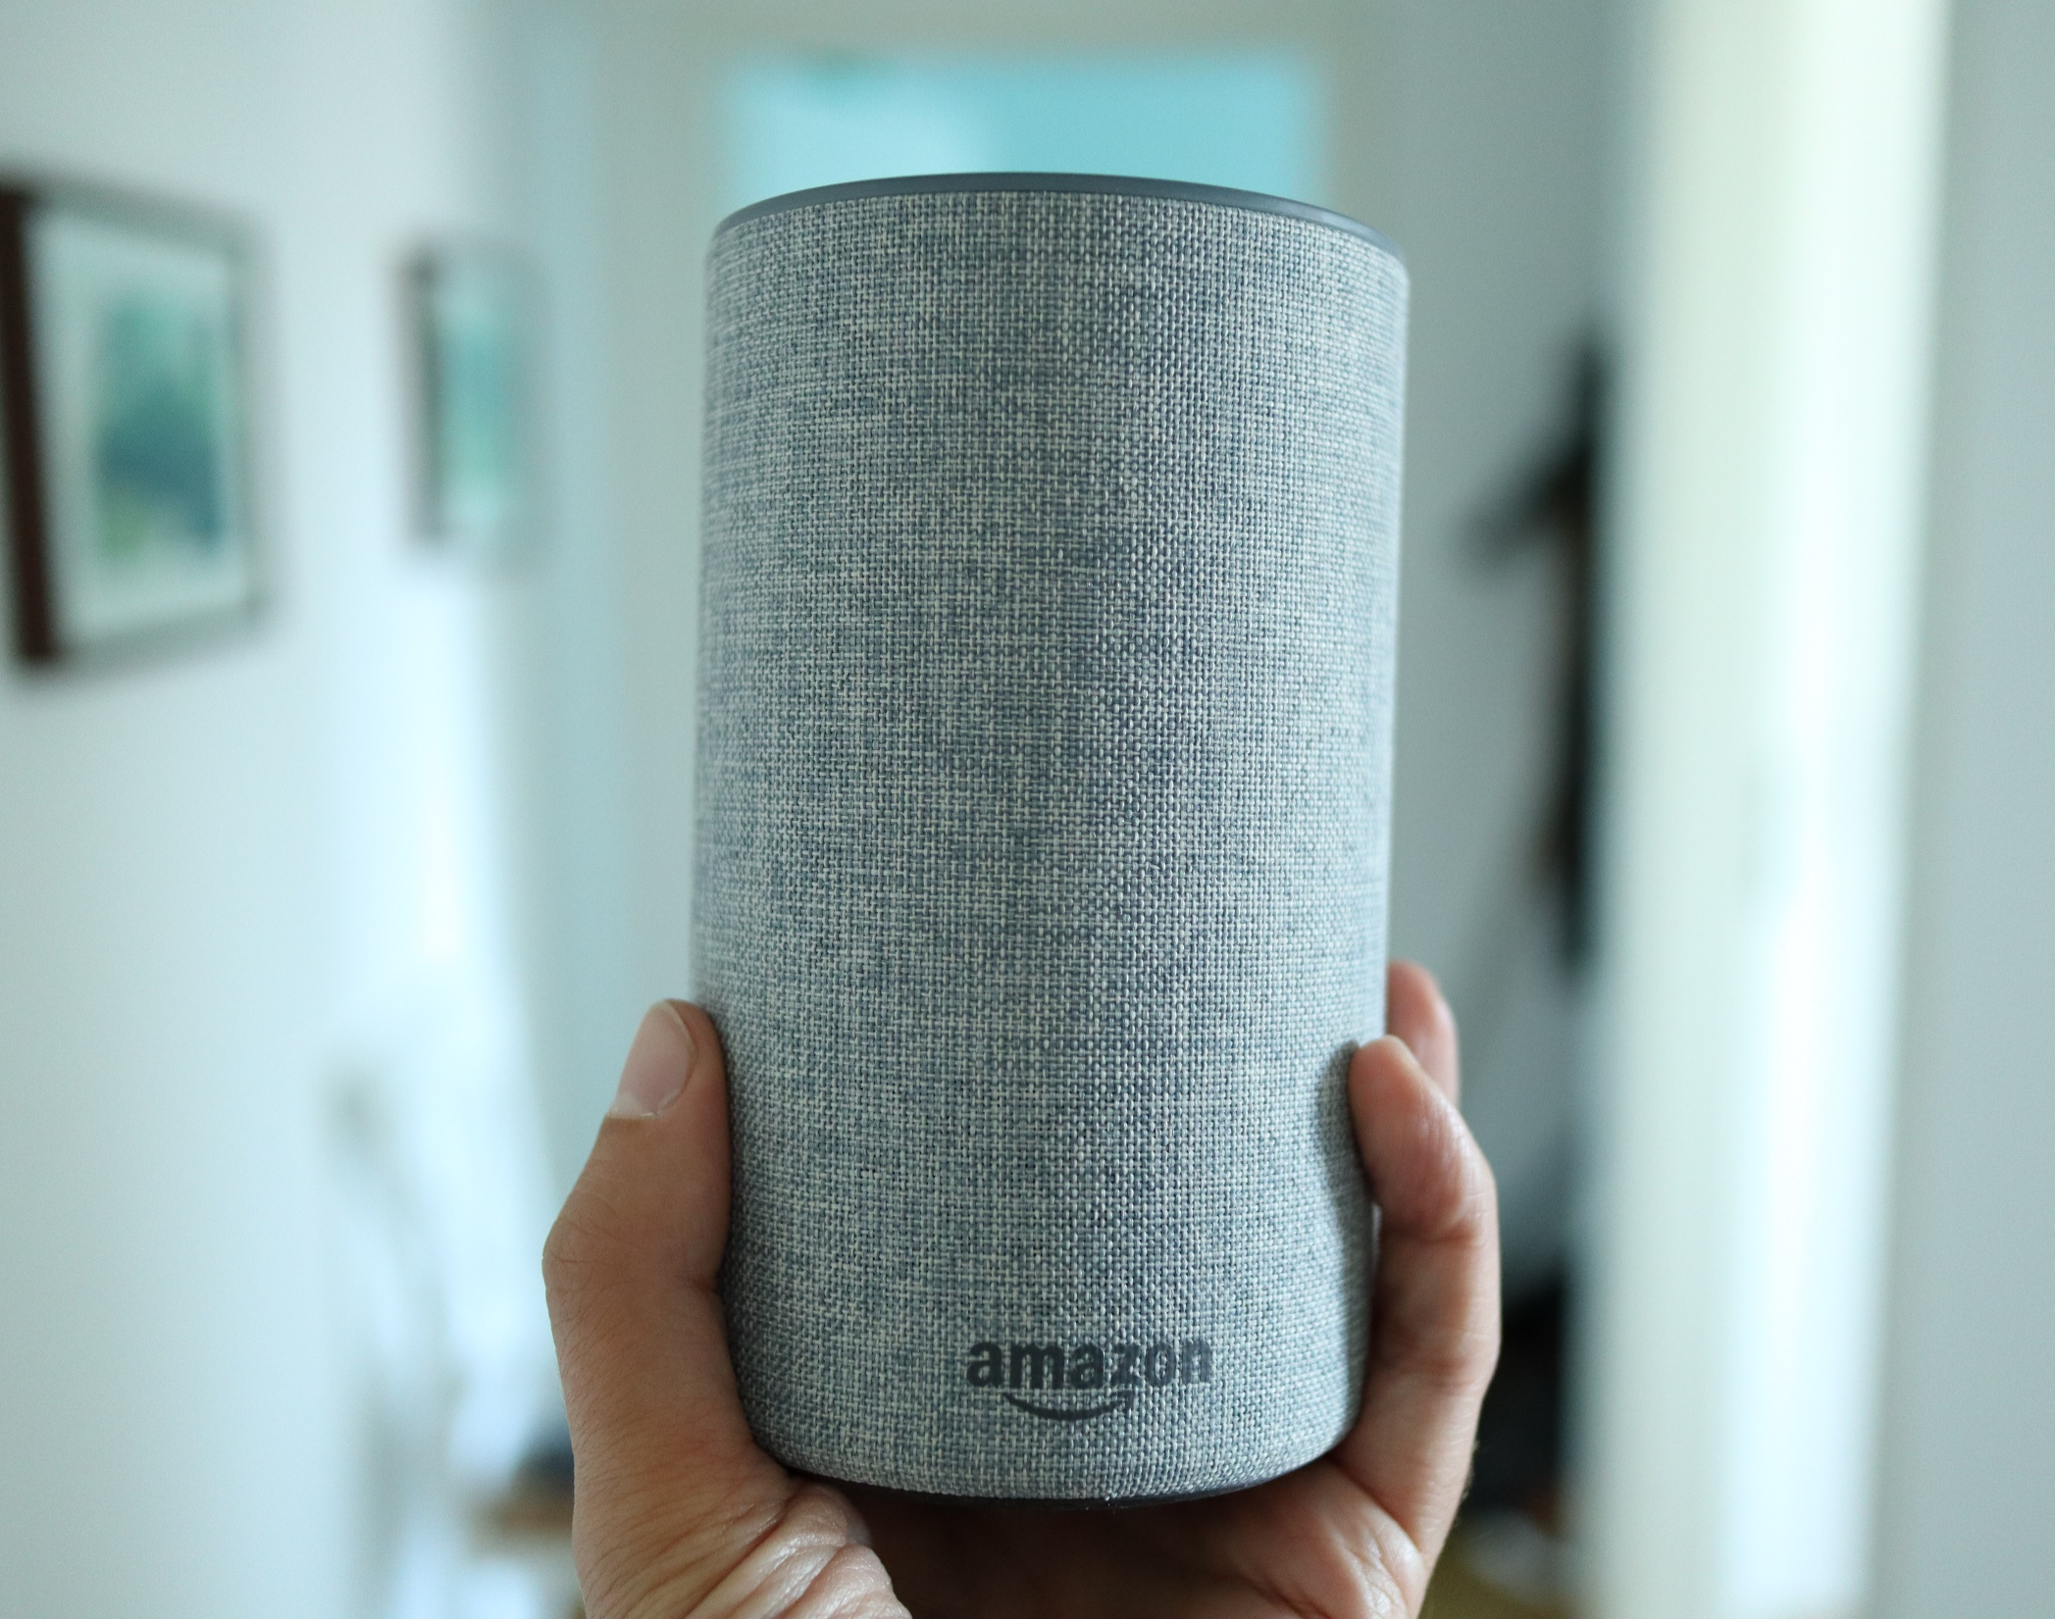
Prototyping IoT devices
How would you build a prototype?
In an hour?
In a day?
In a week?
Wizard of Oz Prototypes
Notes:
Introduced November 2014
Siri: October 2011

Slide 60
Development is hard – not testing is harder
Often unclear if a system is worth the development effort
Especially true for systems requiring novel hardware or algorithms
Learning if the system is useful and the functions users want requires the system
Wizard of Oz Prototypes

Slide 61
Wizard of Oz
An invisible ‘wizard’ controlling parts of the functionality
We only implement the easy parts but leave the hard part to the human operator
Provides the user with the experience without extensive implementation effort for the prototype
Typical areas
Speech recognition
Speech synthesis
Annotation
Reasoning
Computer vision
Wizard of Oz Prototypes

Slide 62

Implementing IUIs
Libraries, Python, web services, …
Pro:
Full flexibility, integrate own models or models from others etc.
Con: More development work, computational costs
Build your own, e.g.:
Web-based frontend
Python backend (e.g. using ML libraries)
Pre-built, e.g.:
External APIs, web-services
Devkits, e.g. https://developers.google.com/ml-kit
Pro:
Faster prototyping
Con: …if it fits your needs; API costs

Slide 63
Implementing IUIs
ML models
HCI & user-centred work is often iterative, uses prototyping
Training e.g. state-of-the-art text or image generator from scratch is costly (time + computation)
Prototyping with pretrained models
NLP e.g.: https://huggingface.co/
Other models e.g.: https://www.tensorflow.org/resources/models-datasets
Many (ML/AI) papers come with code/model releases (e.g. https://paperswithcode.com/)
Also: „Buying a time machine“ for IUI research Models don‘t need to run on your target device
cf. Hudson and Mankoff 2014

Slide 64
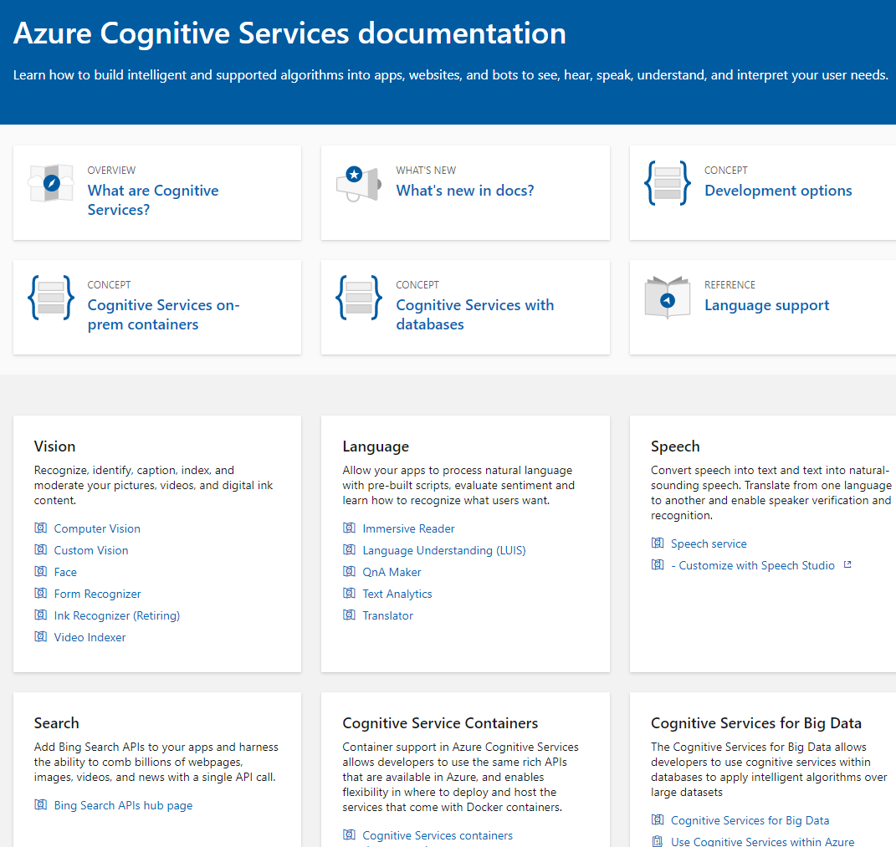
Cloud Services Example: Microsoft Cognitive Services
Cloud Services from:
IBM
Google
Amazon
Microsoft
… and many others
Why do people use them?
What is the risk?
https://docs.microsoft.com/en-us/azure/cognitive-services/
Implementing AI

Slide 65
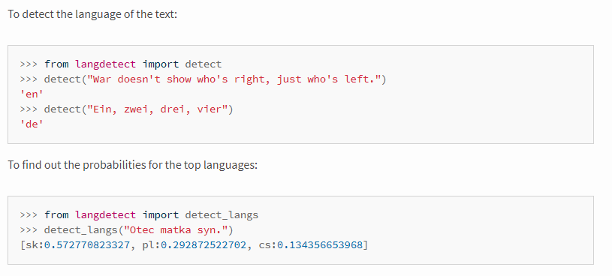
Examples Text Analytics
Identification of the Language
Can tell what language the text is, e.g. English, German, Spanish,…
Relevant for understanding and translation
Example (Online) APIs:
https://console.bluemix.net/apidocs/language-translator
https://docs.microsoft.com/en-us/azure/cognitive-services/translator/
https://cloud.google.com/translate/docs/basic/detecting-language
https://pypi.org/project/langdetect/
Implementing AI

Slide 66

License
This file is licensed under the Creative Commons Attribution-Share Alike 4.0 (CC BY-SA) license:
https://creativecommons.org/licenses/by-sa/4.0
Attribution: Albrecht Schmidt, Sven Mayer, and Daniel Buschek

Slide 67
Some Resources
Frameworks, pretrained models, etc.
TensorFlow Hub, Model Garden, TensorFlow.js models: https://www.tensorflow.org/resources/models-datasets
p5.js & ml5.js: https://p5js.org/ & https://ml5js.org/
Keras: https://keras.io/
PyTorch: https://pytorch.org/
Fast AI: https://docs.fast.ai/
MLKit: https://developers.google.com/ml-kit
Scikit-learn: https://scikit-learn.org/stable/index.html
Hugging Face (NLP): https://huggingface.co/
Teachable Machine: https://teachablemachine.withgoogle.com/
Tensorflow lite, js: https://www.tensorflow.org/lite/, https://www.tensorflow.org/js
Conversational UIs: https://rasa.com/docs/rasa/, https://developers.google.com/learn/pathways/chatbots-dialogflow

