Slide 1




CHI '21 Course:
An Introduction to Intelligent User Interfaces
Overview of AI and ML Terms, Concepts and Tools
Albrecht Schmidt, Sven Mayer, Daniel Buschek

Slide 2



Introduction
Albrecht Schmidt
Sven Mayer
Daniel Buschek

Slide 3
Examples & Motivation

Slide 4
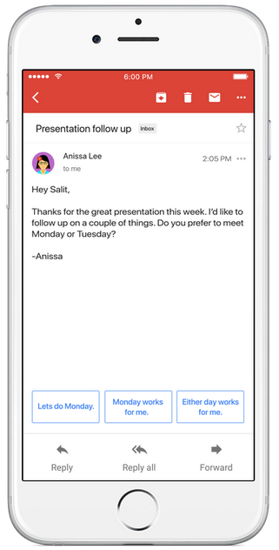
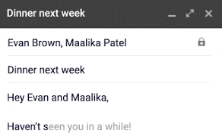

Text Suggestions
Google‘s Smart Reply & Smart Compose
Language model,
given email text
https://blog.google/products/gmail/save-time-with-smart-reply-in-gmail/
https://ai.googleblog.com/2018/05/smart-compose-using-neural-networks-to.html
Introduction and Motivation

Slide 5
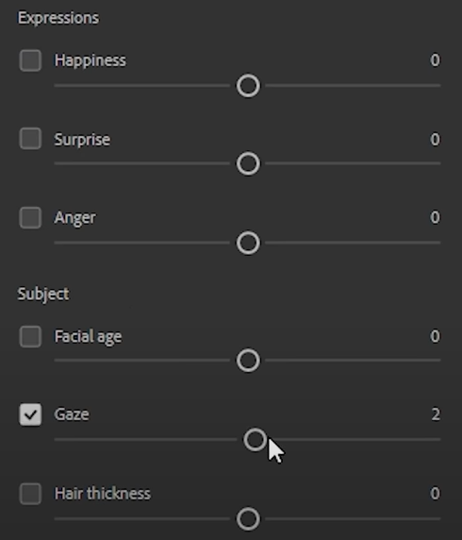
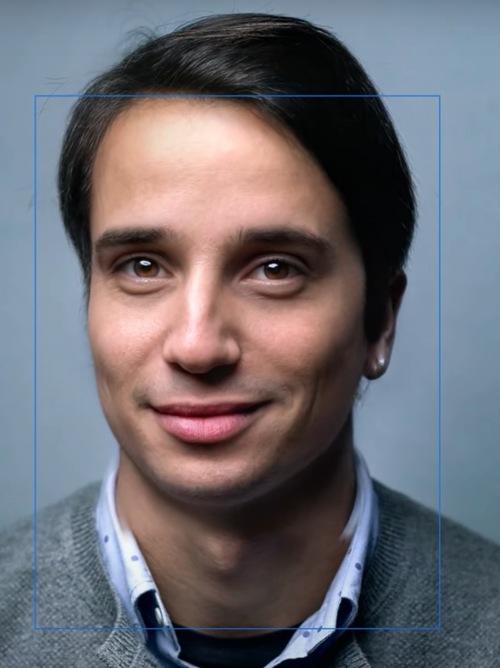

Semantic Image Manipulation
„Smart Portrait Filters“ in Adobe‘s Photoshop
Generative model,
learned from many portraits
https://blog.adobe.com/en/2020/10/20/photoshop-the-worlds-most-advanced-ai-application-for-creatives.html https://blogs.nvidia.com/blog/2020/10/20/adobe-max-ai/, https://github.com/NVlabs/stylegan2
Introduction and Motivation

Slide 6
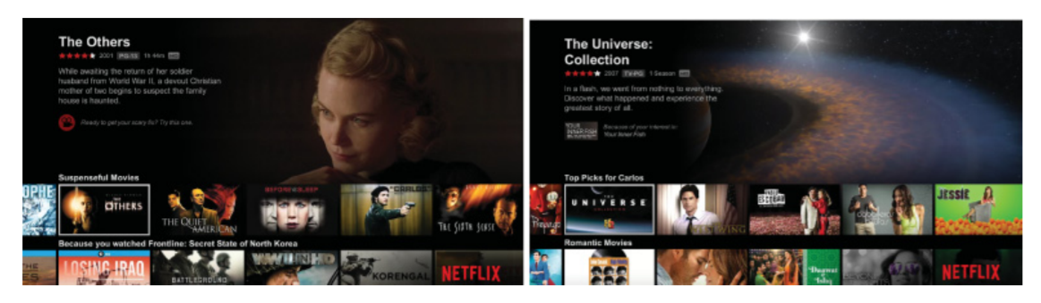





Recommender Systems
How do recommender systems impact the user experience?
Carlos A. Gomez-Uribe and Neil Hunt. 2015. The Netflix Recommender System: Algorithms, Business Value, and Innovation. ACM Trans. Manage. Inf. Syst. 6, 4, Article 13 (December 2015), 19 pages. DOI: https://doi.org/10.1145/2843948
Why are recommender systems used?
How do recommender work?
What data do recommender systems require?
Introduction and Motivation
Notes:
OK

Slide 7
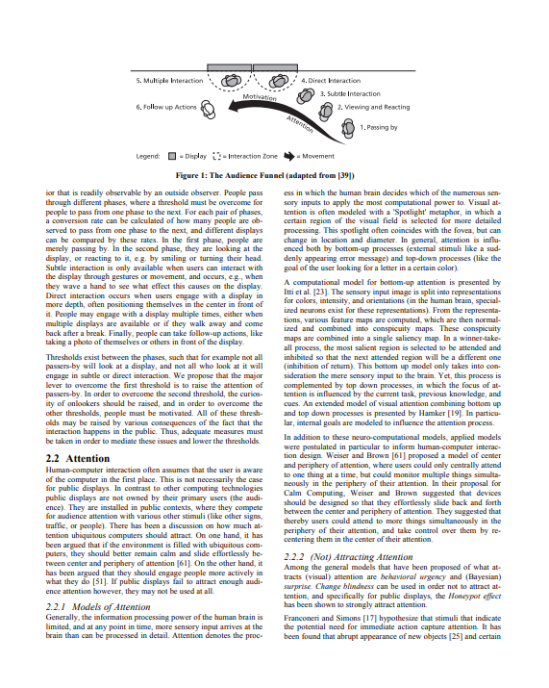
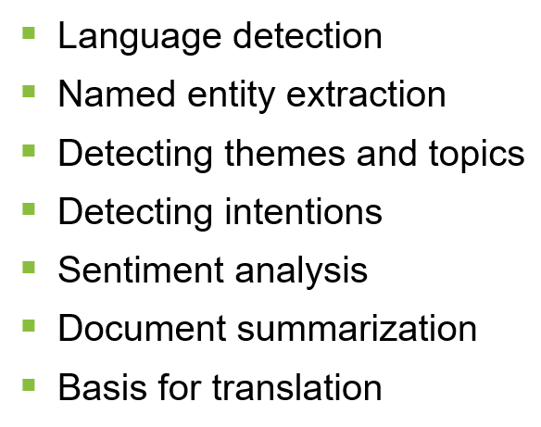
Text analytics
Where can we use it and how can it improve interaction?
Answering questions like
  What is this text about?
  What did the person communicate?
  What is the key information in this document?
  What feelings are communicated?
  Is this different from what was said before?
Application areas
  Social media analytics, e.g. twitter
  Communication and reading interfaces
  Customer reviews and feedback
  Chat bots
  Text Forensics
http://www.medien.ifi.lmu.de/pubdb/publications/pub/mueller2010mm/mueller2010mm.pdf
Introduction and Motivation
Notes:
http://www.medien.ifi.lmu.de/pubdb/publications/pub/mueller2010mm/mueller2010mm.pdf

Slide 8
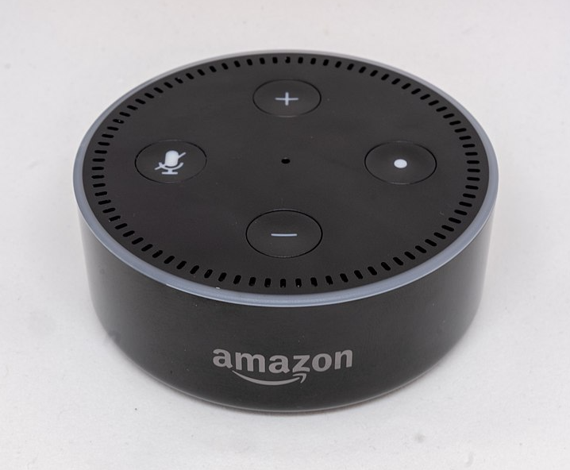
VUI design process
How to design a dialog structure?
Think of alternatives
  structure
  wording
Try out your dialog
  wizard of Oz technique!
  use outside people
Refine, Revise, Repeat
Image by Gregory Varnum, CC BY-SA 4.0 via Wikimedia Commons
https://commons.wikimedia.org/wiki/File:Amazon_Echo_Dot_-_June_2018_(1952).jpg
Introduction and Motivation
Notes:
https://de.m.wikipedia.org/wiki/Datei:Amazon_Echo_Dot_-_June_2018_(1952).jpg

Slide 9
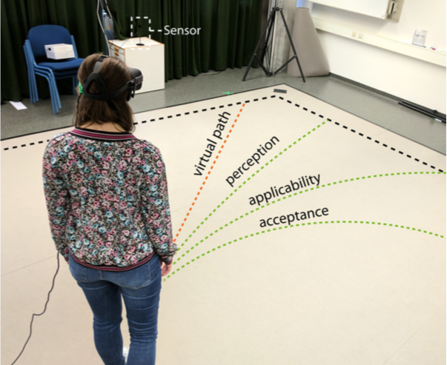
A Deceptive UI: redirected Walking
What is real in an intelligent UI?
M. Rietzler, J. Gugenheimer, T. Hirzle, M. Deubzer, E. Langbehn and E. Rukzio, "Rethinking Redirected Walking: On the Use of Curvature Gains Beyond Perceptual Limitations and Revisiting Bending Gains," 2018 IEEE International Symposium on Mixed and Augmented Reality (ISMAR), Munich, Germany, 2018, pp. 115-122, doi: 10.1109/ISMAR.2018.00041.
Image from https://ieeexplore.ieee.org/abstract/document/8613757
Introduction and Motivation

Slide 10


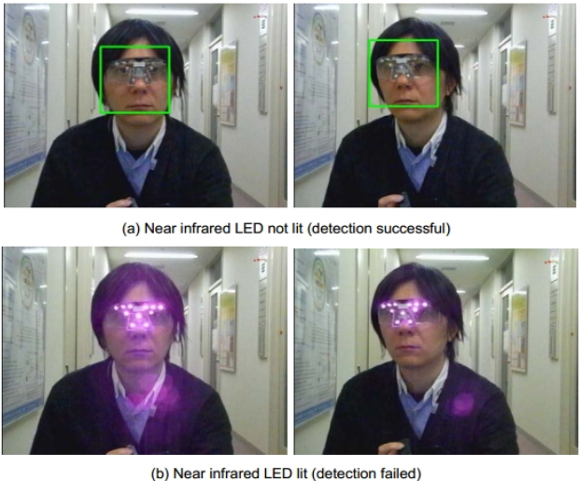
Facial Recognition
Convenient biometric or overly powerful?
Unlock your phone
  Hands-free identification
  What are the major issues?
Surveillance
  Privacy
  Tricks to „hide“ from facial recognition technology
https://www.bbc.com/news/uk-51237665
http://research.nii.ac.jp/~iechizen/official/research-e.html#research2c
Introduction and Motivation
Notes:
https://pxhere.com/en/photo/1620437

Slide 11
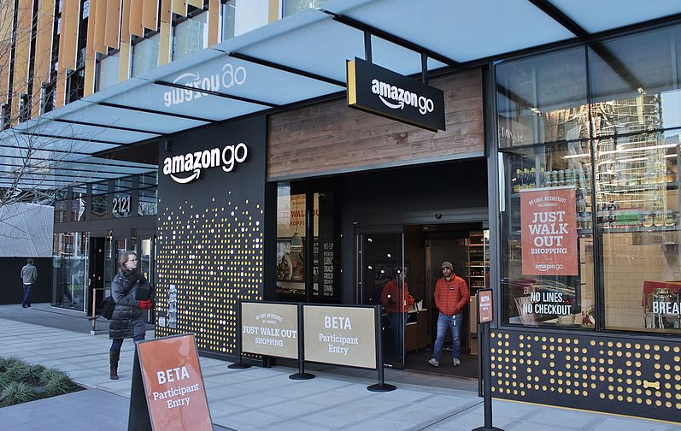
HCI Replacing HHI in Stores
„Just Walk Out“ shopping experience
at Amazon Go
Surveillance-powered shopping
  Does not use facial recognition
How does it work?
  Is it „intelligent“? How so?
Image by SounderBruce, CC BY-SA 4.0 via Wikimedia Commons
https://commons.wikimedia.org/wiki/File:Amazon_Go_in_Seattle,_December_2016.jpg
Introduction and Motivation

Slide 12



AI Recruiting
Is an AI a “fairer“ recruiter?
Introduction and Motivation
Notes:
https://pixabay.com/illustrations/word-cloud-recruitment-process-1758159/
https://pxhere.com/de/photo/1446003
Visualisation created ourselves using free-to-use images from Pexels and Unsplash

Slide 13
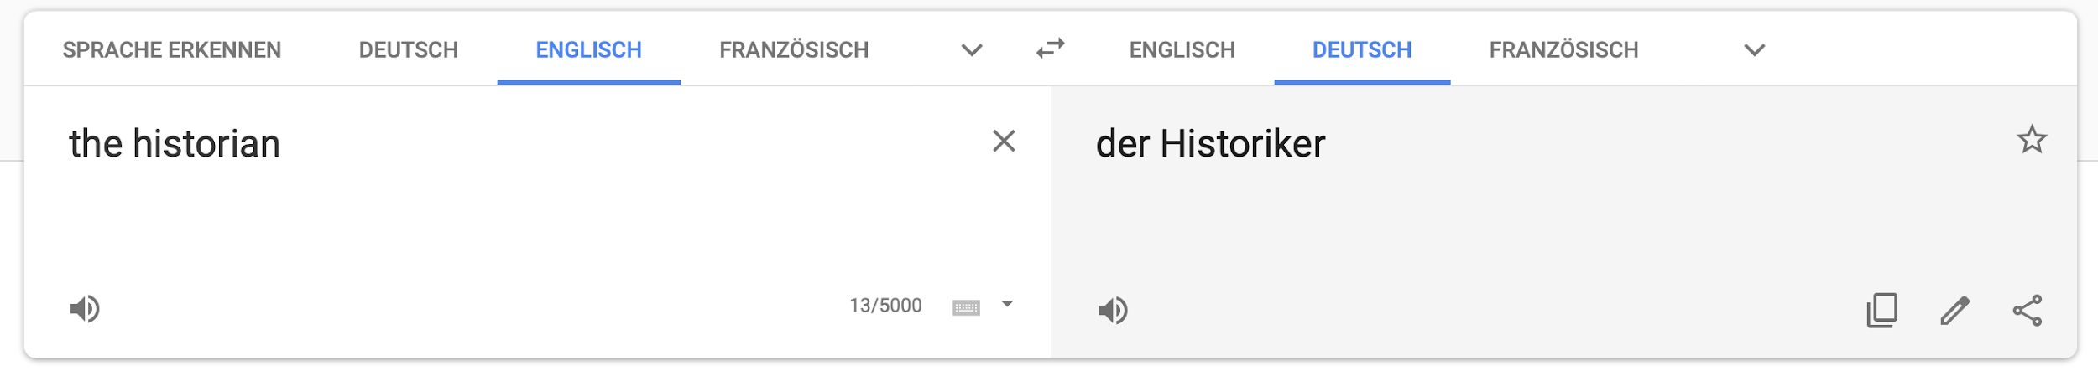

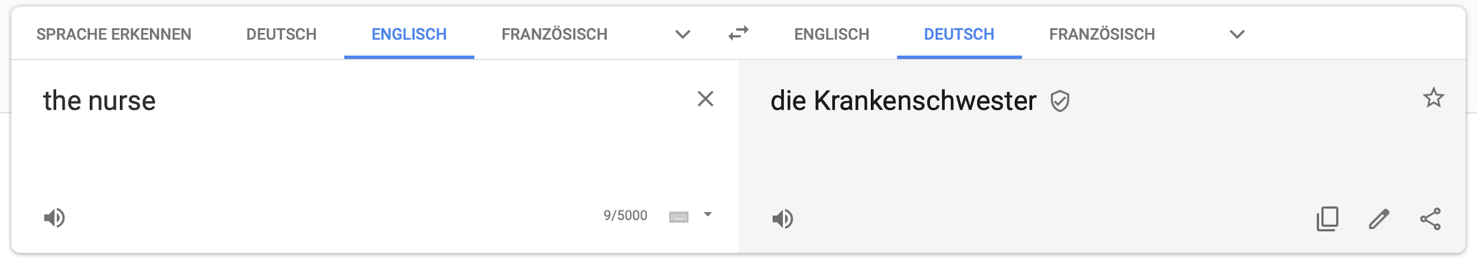
Natural Language Translation
Female historians and male nurses do not exist?
https://translate.google.com
https://algorithmwatch.org/en/story/google-translate-gender-bias/
Introduction and Motivation

Slide 14
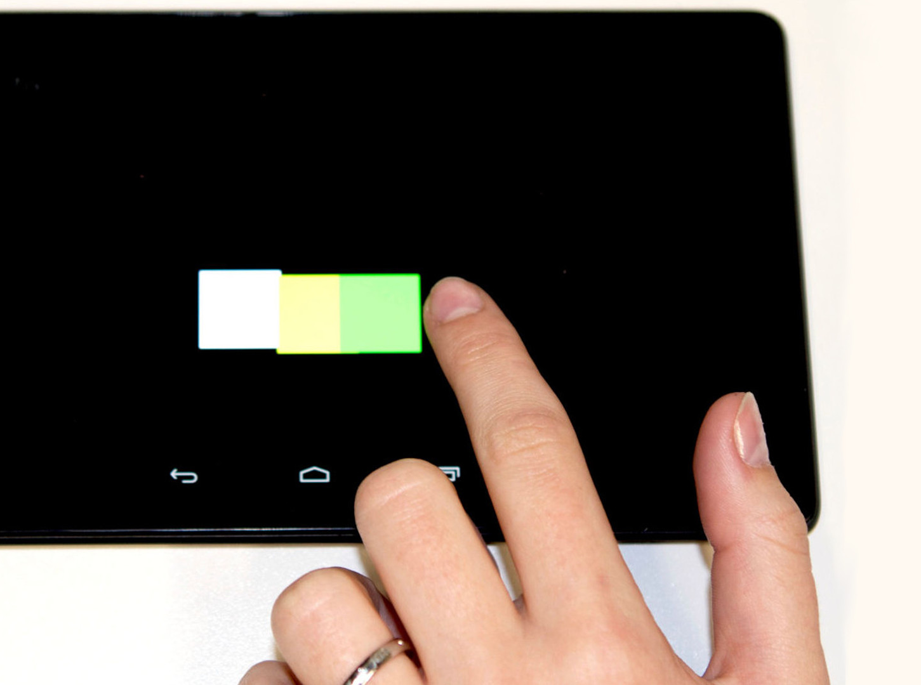
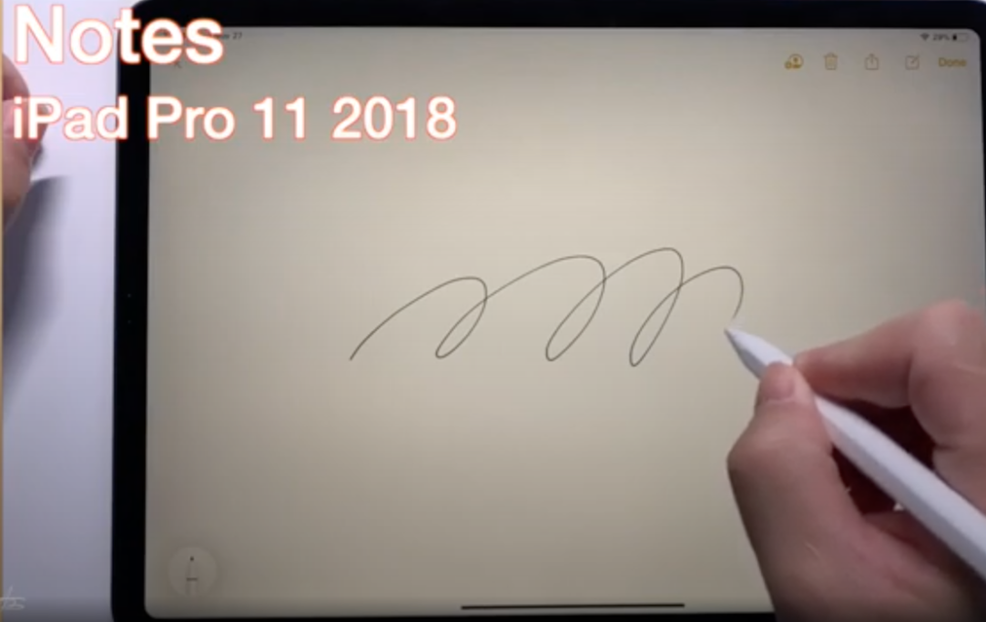
Intelligent Touch
Why are we so precise with our fingers on a screen?
Nexus 7 2013
Henze, N., Mayer, S., Le, H.V. and Schwind, V. Improving software-reduced touchscreen latency. Proc. MobileHCI ’17 https://doi.org/10.1145/3098279.3122150
https://www.youtube.com/watch?v=l6Nz8wVUU74
Introduction and Motivation

Slide 15
AI for IUIs
HCI perspective

Slide 16
What is considered Artificial Intelligence?
What is AI?

Slide 17
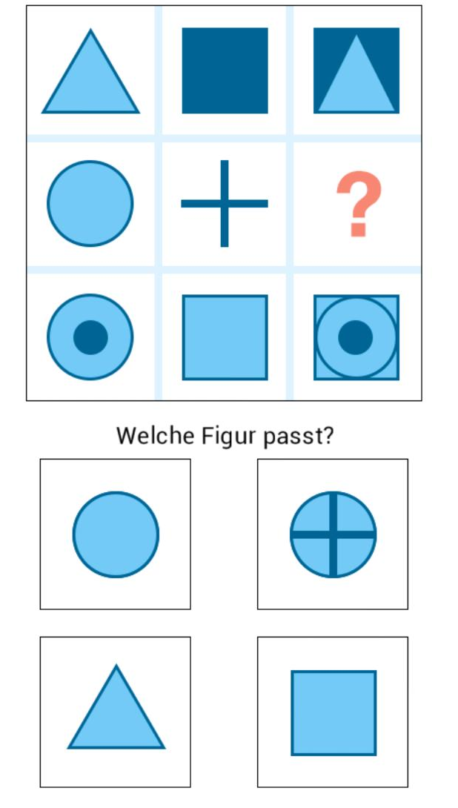
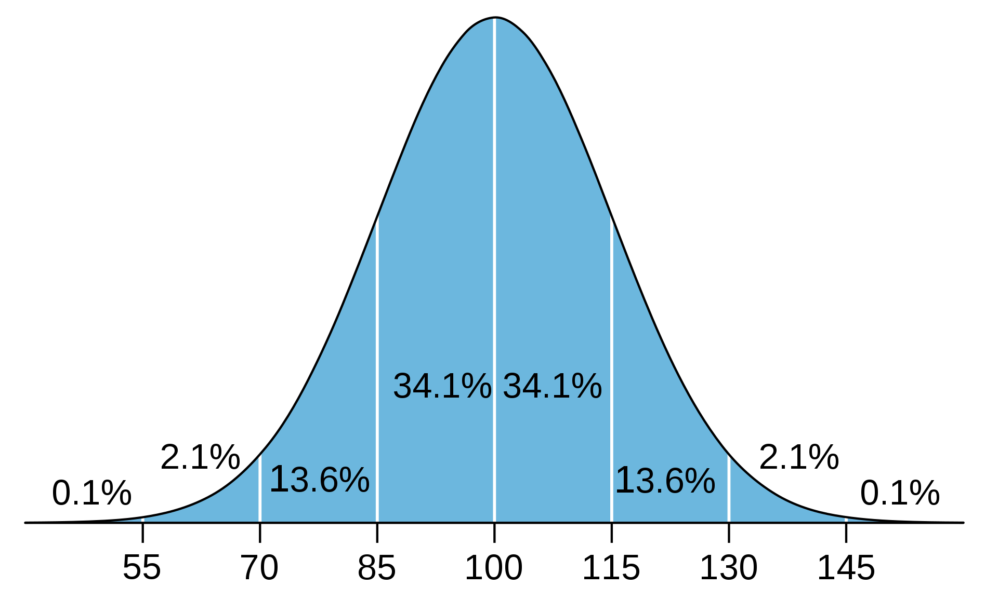
What is considered Artifical Intelligence?
What is Human Intelligence?
Which figure fits?
What is AI?
Notes:
What tasks are in an IQ test?
Why are the solution requiring an intelligent person/actor?
Predict the future from know examples 🡪 regresion, prediction
Classify based on previous examples 🡪 NN, SVM
The odd

Slide 18
What is in an IQ test?
Many different types… typical questions include:
Finding Analogies (math and verbal)
  Pen and writing, cup and ???
Finding / extending Pattern (graphical and math)
  45 … 40 … 60 … 55 … 75 … 70 … ???
Classification tasks
  Make two groups: apple, plate, grape, cake, spoon, knife
Making sense spatial and visual representations
Reasoning and logical
General knowedge

Slide 19
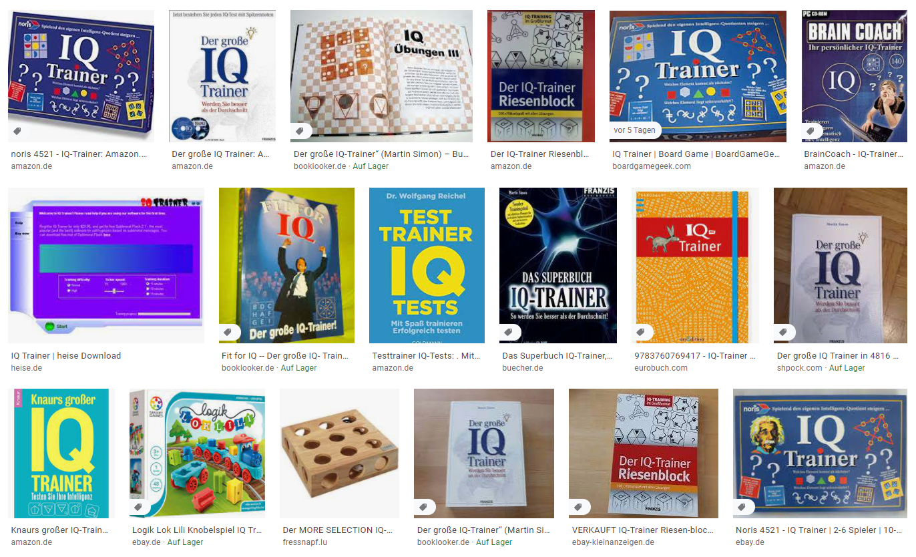
Is the IQ static or can it be learned?
Google Search for IQ trainer…

Slide 20
What is…
Mini In-Class Exercise
Artificial intelligence
Machine Learning
Write a definition for one of the term
  Time limit is 3 minutes
  No more than 20 words
What is AI?

Slide 21
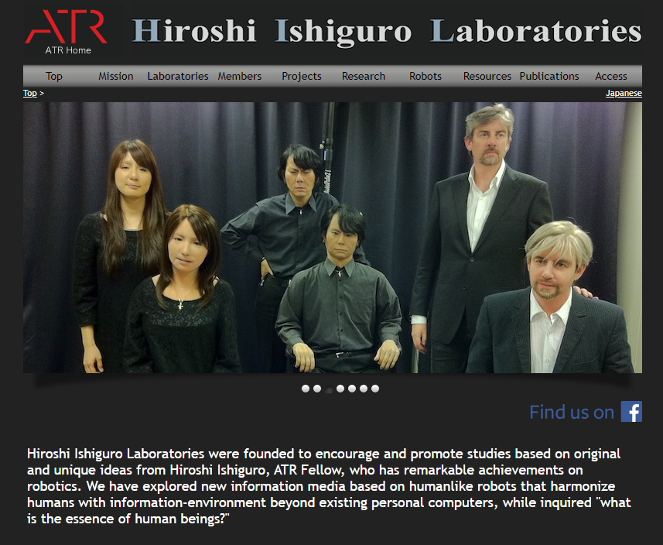
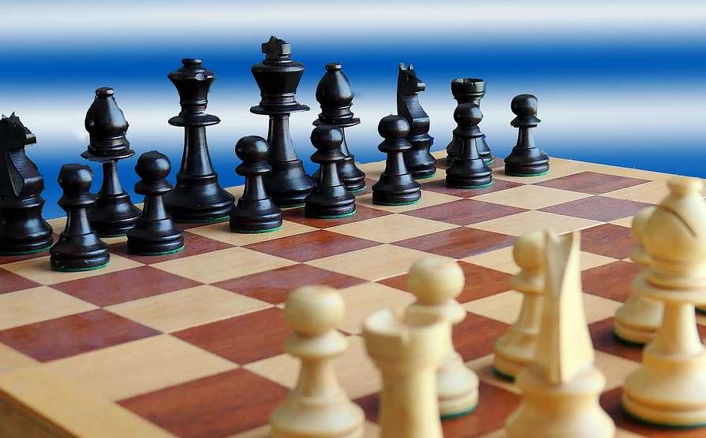
Artificial Intelligence?
Artificial Narrow Intelligence (also Weak AI)
  Solves very specific and well described problems in a specific domain
Artificial General Intelligence (also Strong AI)
  An artificial intelligence that has the ability to mimic human intelligence
  Its behavior cannot be distinguished by observation from a human
Artificial Super Intelligence
  An artificial intelligence that surpasses human intelligence
http://www.geminoid.jp/en
What is AI?

Slide 22
AI Knowledge Map: how to classify AI technologies
A sketch of a new AI technology landscape by Francesco Corea
Technologies
  Logic-based
  Knowledge-based
  Probabilistic methods
  Machine learning
  Embodied intelligence
  Search and optimization
Domains
  Reasoning
  Knowledge
  Planning
  Communication
  Perception
https://medium.com/@Francesco_AI/ai-knowledge-map-how-to-classify-ai-technologies-6c073b969020
What is AI?

Slide 23
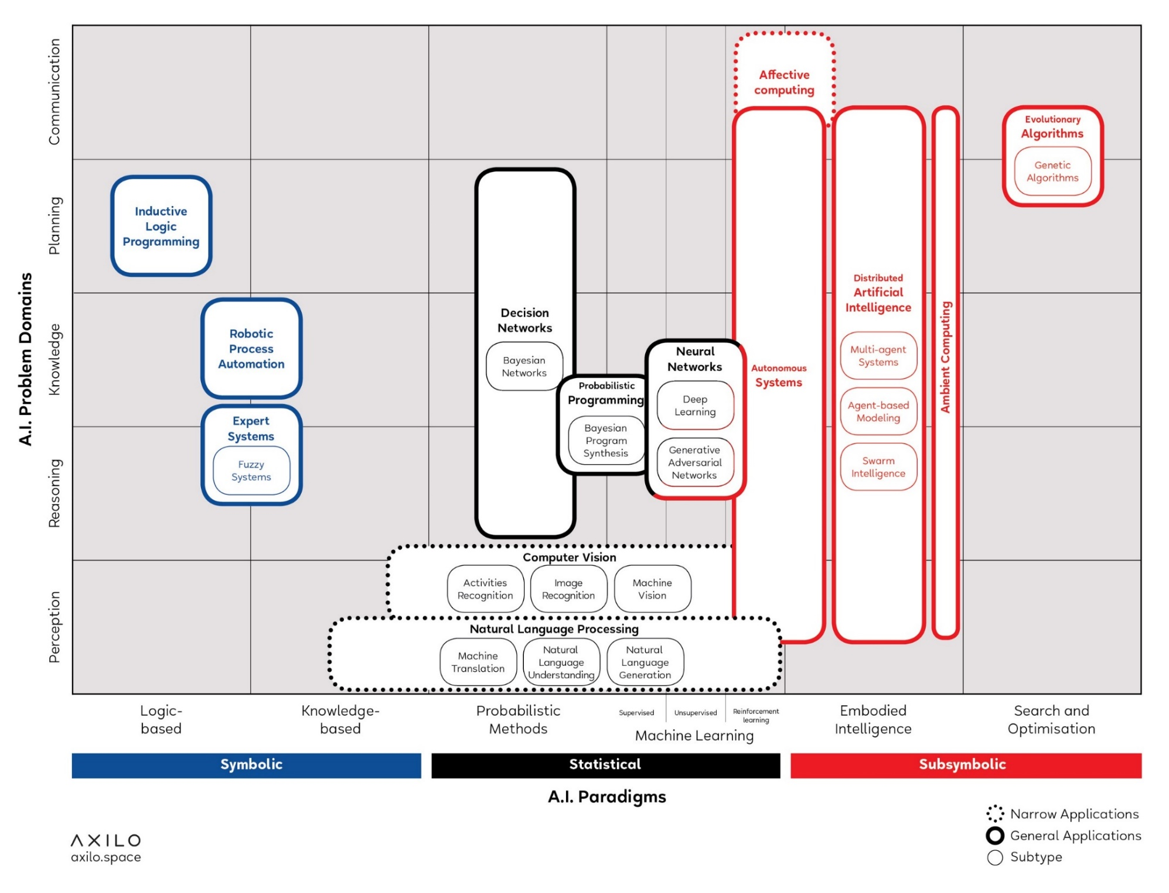
AI Knowledge Map: how to classify AI technologies
A sketch of a new AI technology landscape by Francesco Corea
https://medium.com/@Francesco_AI/ai-knowledge-map-how-to-classify-ai-technologies-6c073b969020
AI Knowledge Map: how to classify AI technologies. A sketch of a new AI technology landscape Francesco Corea
What is AI?

Slide 24
AI Knowledge Map: how to classify AI technologies
A sketch of a new AI technology landscape by Francesco Corea
Technologies
Logic-based tools: tools that are used for knowledge representation and problem-solving
Knowledge-based tools: tools based on ontologies and huge databases of notions, information, and rules
Probabilistic methods: tools that allow agents to act in incomplete information scenarios
Machine learning: tools that allow computers to learn from data
Embodied intelligence: engineering toolbox, which assumes that a body (or at least a partial set of functions such as movement, perception, interaction, and visualization) is required for higher intelligence
Search and optimization: tools that allow intelligently searching through many possible solutions
https://medium.com/@Francesco_AI/ai-knowledge-map-how-to-classify-ai-technologies-6c073b969020
What is AI?

Slide 25
AI Knowledge Map: how to classify AI technologies
A sketch of a new AI technology landscape by Francesco Corea
Domains
Reasoning: the capability to solve problems
Knowledge: the ability to represent and understand the world
Planning: the capability of setting and achieving goals
Communication: the ability to understand language and communicate
Perception: the ability to transform raw sensorial inputs (e.g., images, sounds, etc.) into usable information
https://medium.com/@Francesco_AI/ai-knowledge-map-how-to-classify-ai-technologies-6c073b969020
What is AI?

Slide 26
Supervised vs. Unsupervised Learning

Slide 27
Types of ML Problems
What can we learn just by looking at the data?
🐩
🐆
🐈
🐕
🦍
🐴
🐶

Slide 28
Types of ML Problems
What can we learn just by looking at the data?
🐩
🐆
🐈
🐕
🦍
🐴
🐶

Slide 29
Types of ML Problems
What can we do with binned data?
Wild Animals
🐩
🐆
?
Domestic Animals
🐈
🐈
🐕
🦍
🐴
🐶

Slide 30
Types of ML Problems
What can we do with binned data?
Wild Animals
🐩
🐆
?
Domestic Animals
🐈
🐈
🐕
🐖
🦍
🐘
🐴
🐶

Slide 31
Learning Strategies
Supervised Learning
Unsupervised Learning

Slide 32
Supervised Learning
“Supervised learning is typically done in the context of classification, when we want to map input to output labels, or regression, when we want to map input to a continuous output. Common algorithms in supervised learning include logistic regression, naive bayes, support vector machines, artificial neural networks, and random forests. In both regression and classification, the goal is to find specific relationships or structure in the input data that allow us to effectively produce correct output data. Note that “correct” output is determined entirely from the training data, so while we do have a ground truth that our model will assume is true, it is not to say that data labels are always correct in real-world situations. Noisy, or incorrect, data labels will clearly reduce the effectiveness of your model.”
Regression
Classification
https://towardsdatascience.com/supervised-vs-unsupervised-learning-14f68e32ea8d
What is AI?

Slide 33
Unsupervised Learning
🐈
“The most common tasks within unsupervised learning are clustering, representation learning, and density estimation. In all of these cases, we wish to learn the inherent structure of our data without using explicitly-provided labels. Some common algorithms include k-means clustering, principal component analysis, and autoencoders. Since no labels are provided, there is no specific way to compare model performance in most unsupervised learning methods.
Two common use-cases for unsupervised learning are exploratory analysis and dimensionality reduction.”
🐩
🐖
🐆
🐈
🐘
🐕
🦍
🐴
🐶
https://towardsdatascience.com/supervised-vs-unsupervised-learning-14f68e32ea8d
What is AI?

Slide 34
Learning Strategies
 | Supervised Learning | Unsupervised Learning
Discrete | Classification or Categorization | Clustering
Continuous | Regression | Dimensionality reduction

Slide 35
Classification

Slide 36
Classification

Slide 37
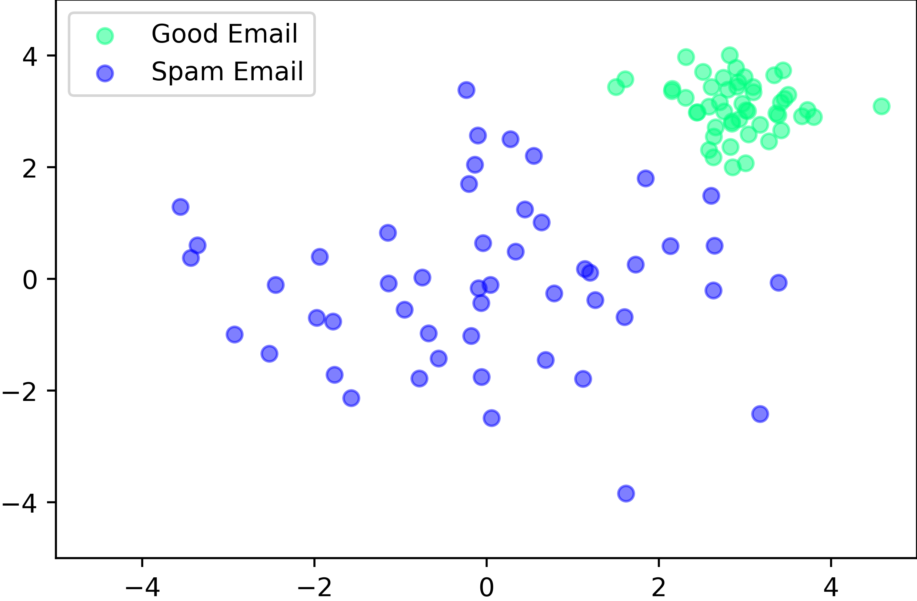
Supervised Learning
SVM Example

Slide 38
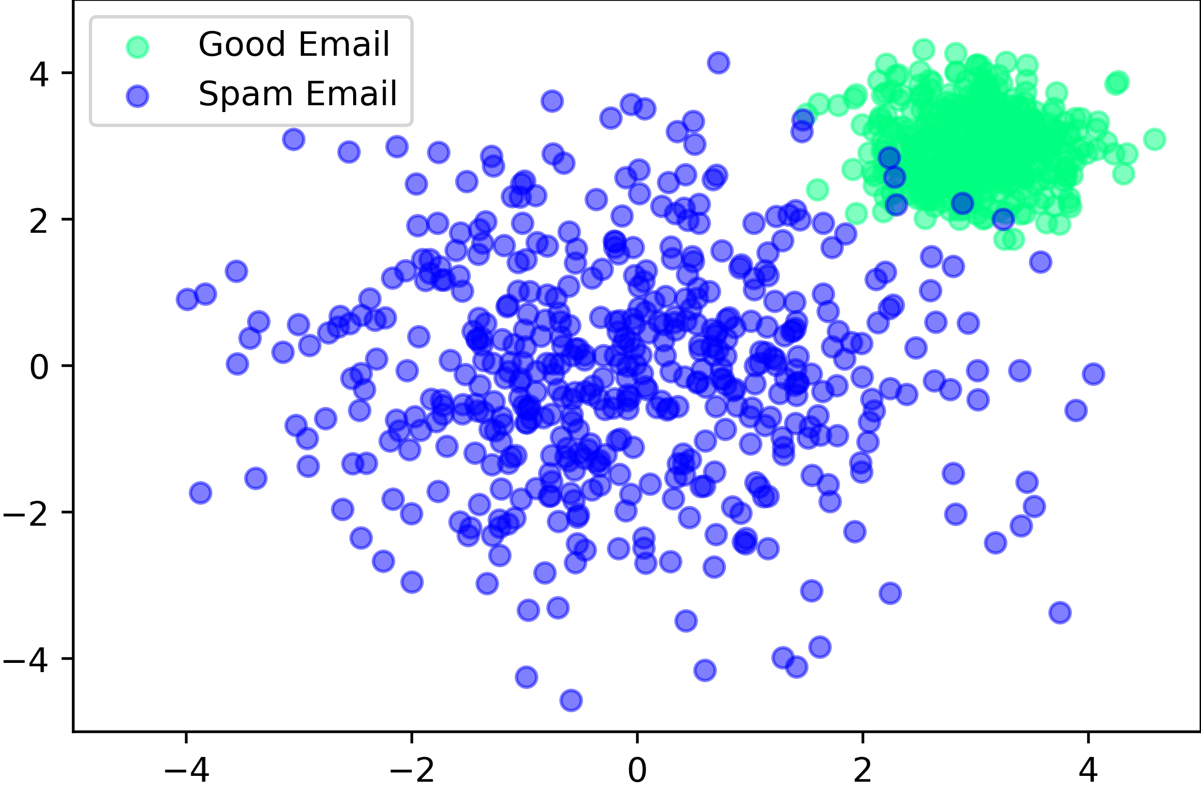
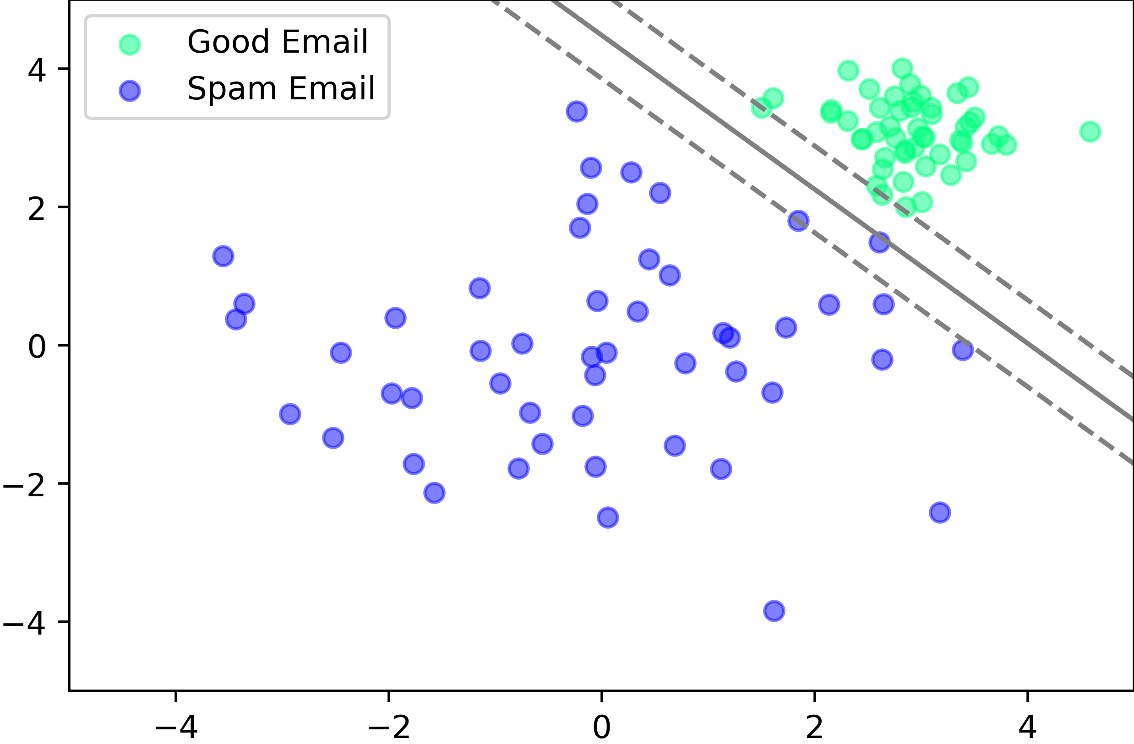
Supervised Learning
SVM Example

Slide 39
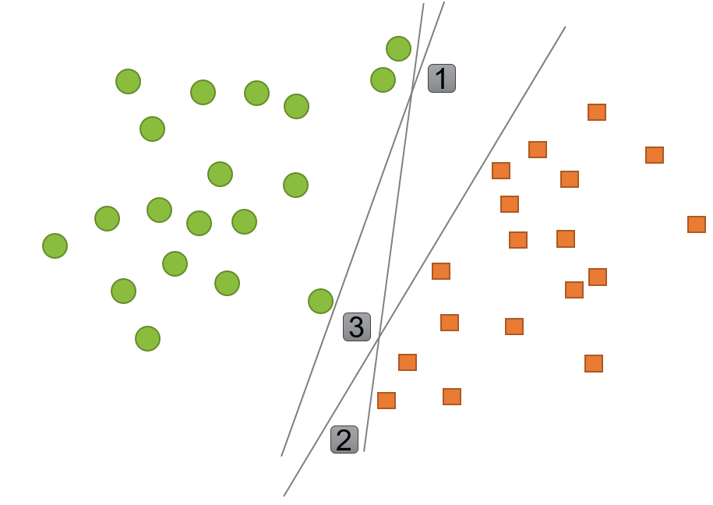
Classification
Example: Support Vector Machines (SVM)
Determine whether a given data point belongs to a certain class or not
Supervised method:
  First training a classifier model on data points for which the class is known (e.g. a set of emails that are labeled as spam or not spam)
  Then use the model to determine
  the class of new, unseen data-points
Find the boundary line that
separates two classes
The boundary line should create
a maximum separation between
the classes
https://www2.deloitte.com/nl/nl/pages/data-analytics/articles/part-2-artificial-intelligence-techniques-explained.html#
What is AI?

Slide 40
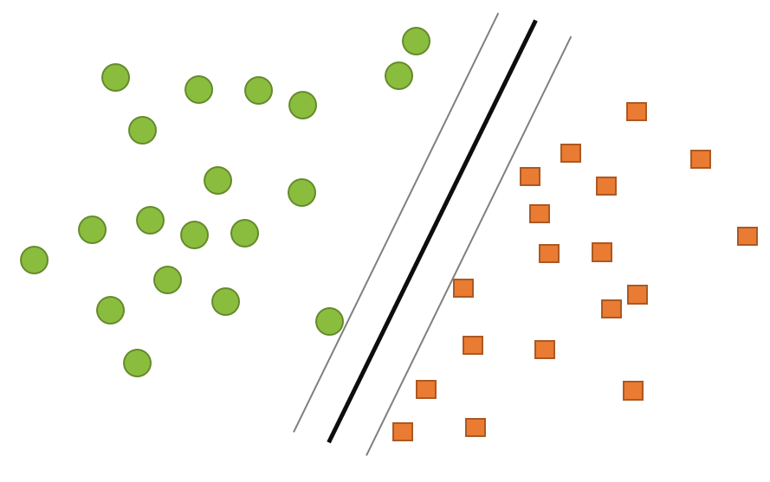
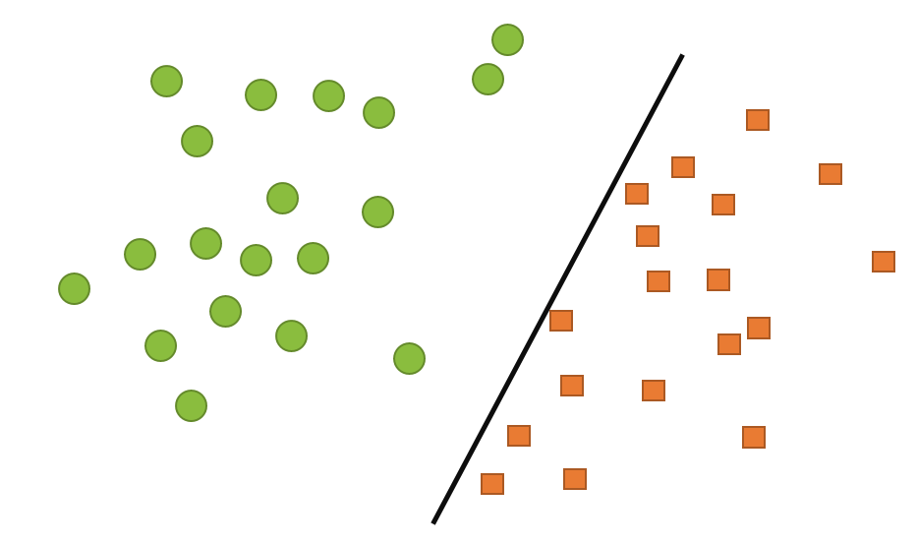
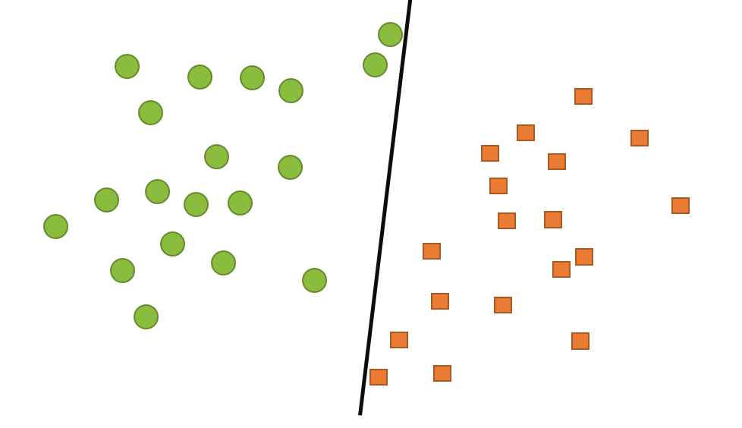
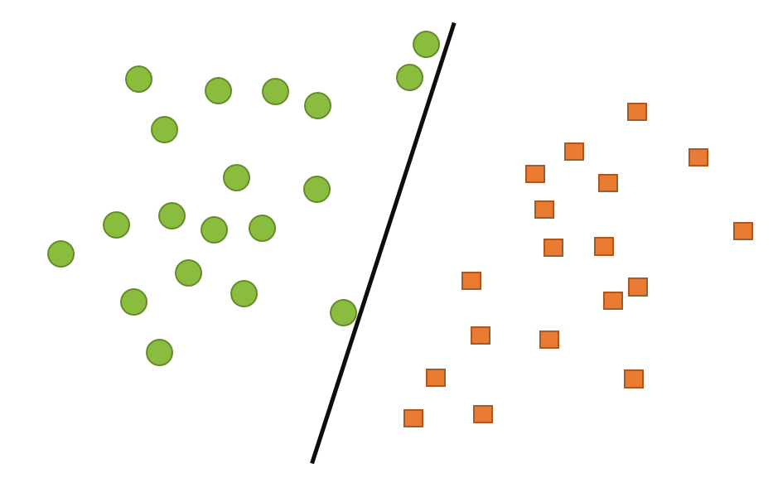
Classification
Example: Support Vector Machines (SVM)
Find the boundary line that separates two classes
The boundary line should create a maximum separation between the classes
What is AI?

Slide 41
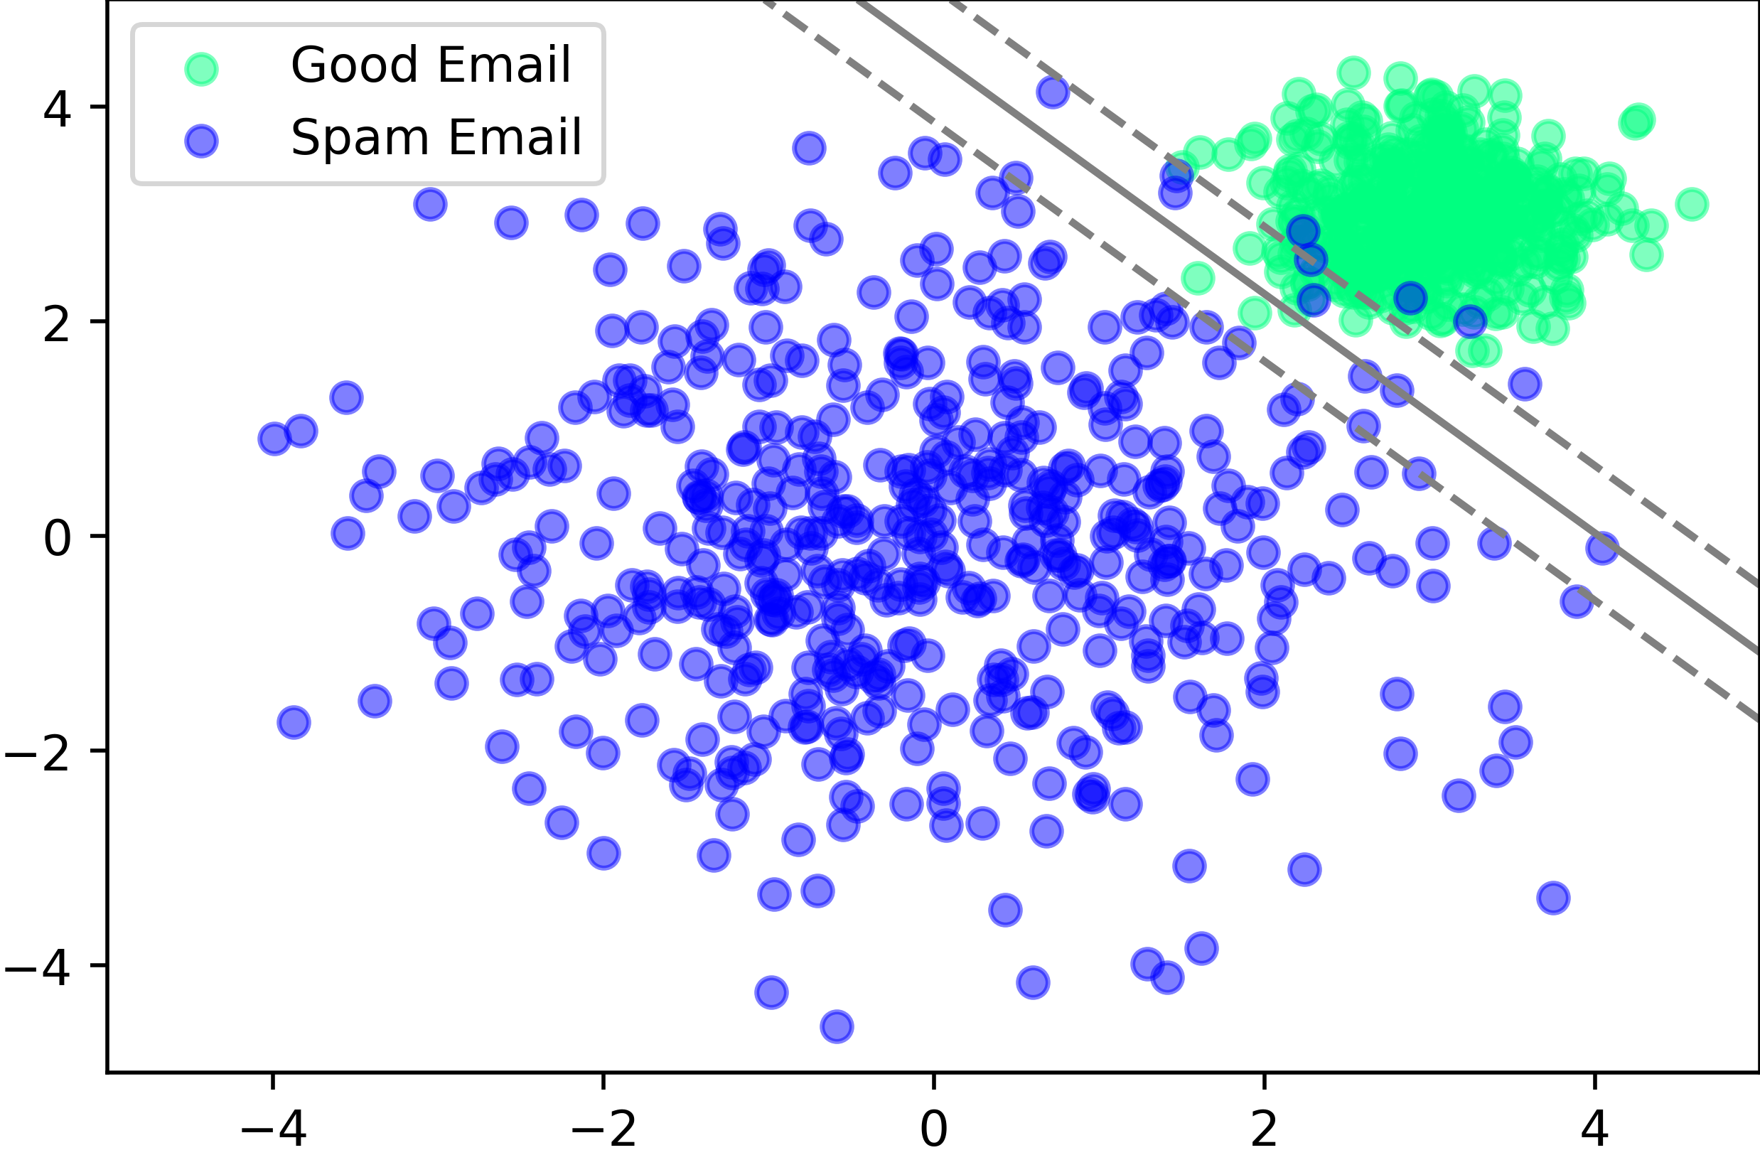
Supervised Learning
SVM Example

Slide 42
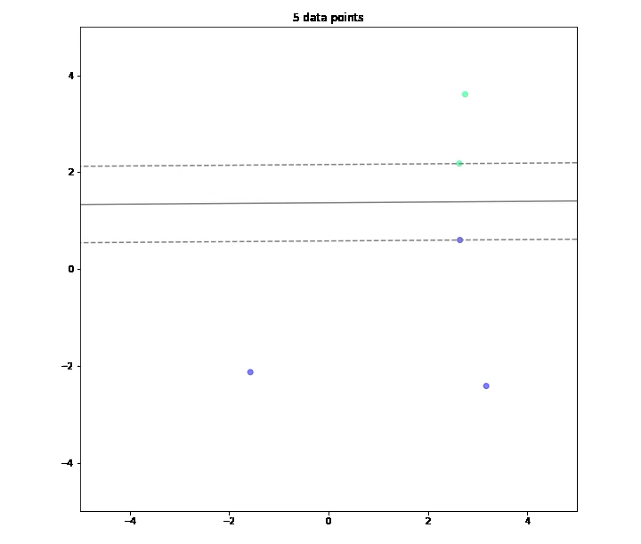
Classification
SVM Example

Slide 43
Supervised Learning
Input
“Training”
Programm (Model)
Output

Slide 44
Supervised Learning
Data
Input
“Training”
Programm (Model)
Output
Labels (Classes)
Continues values

Slide 45
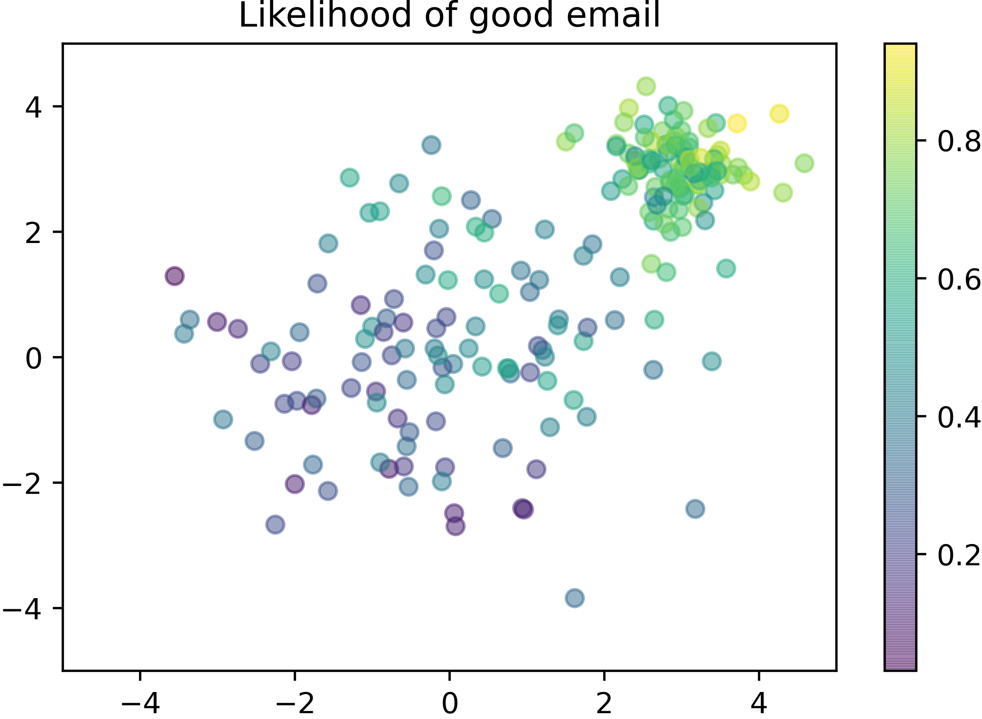
Regression

Slide 46
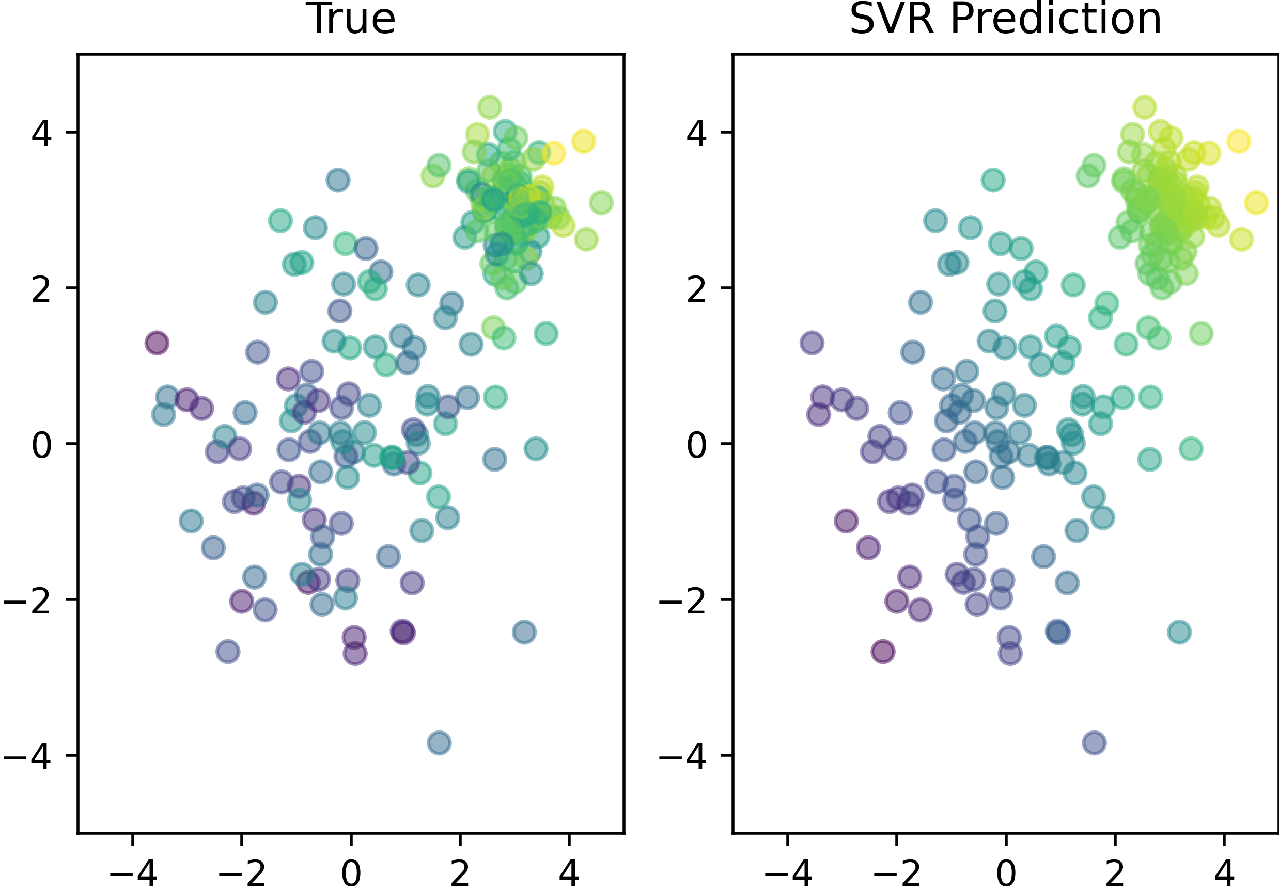
Regression
Linear Support Vector Regression (SVR)

Slide 47
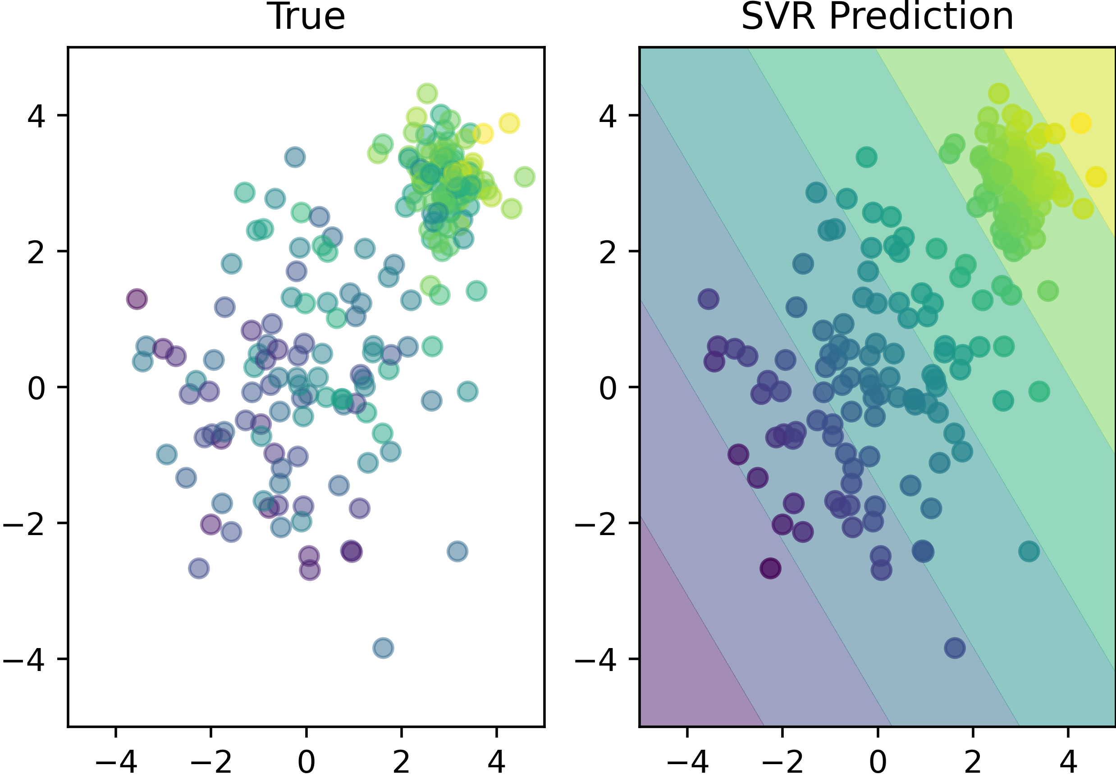
Regression
Linear Support Vector Regression (SVR)

Slide 48
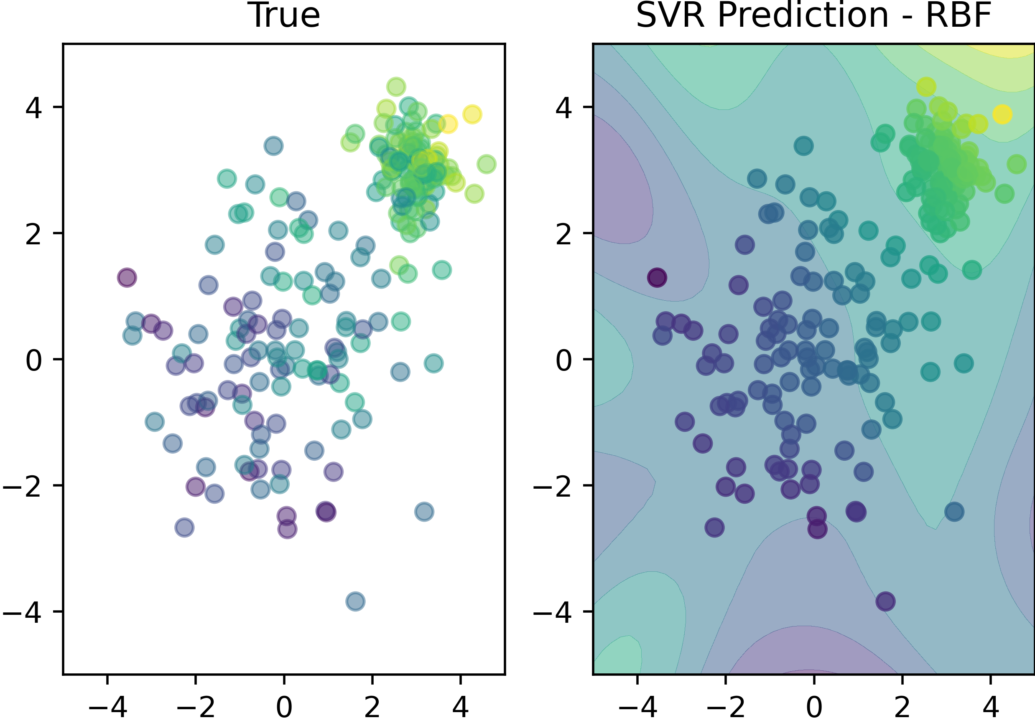
Regression
RBF Support Vector Regression (SVR)

Slide 49
Unsupervised Learning

Slide 50
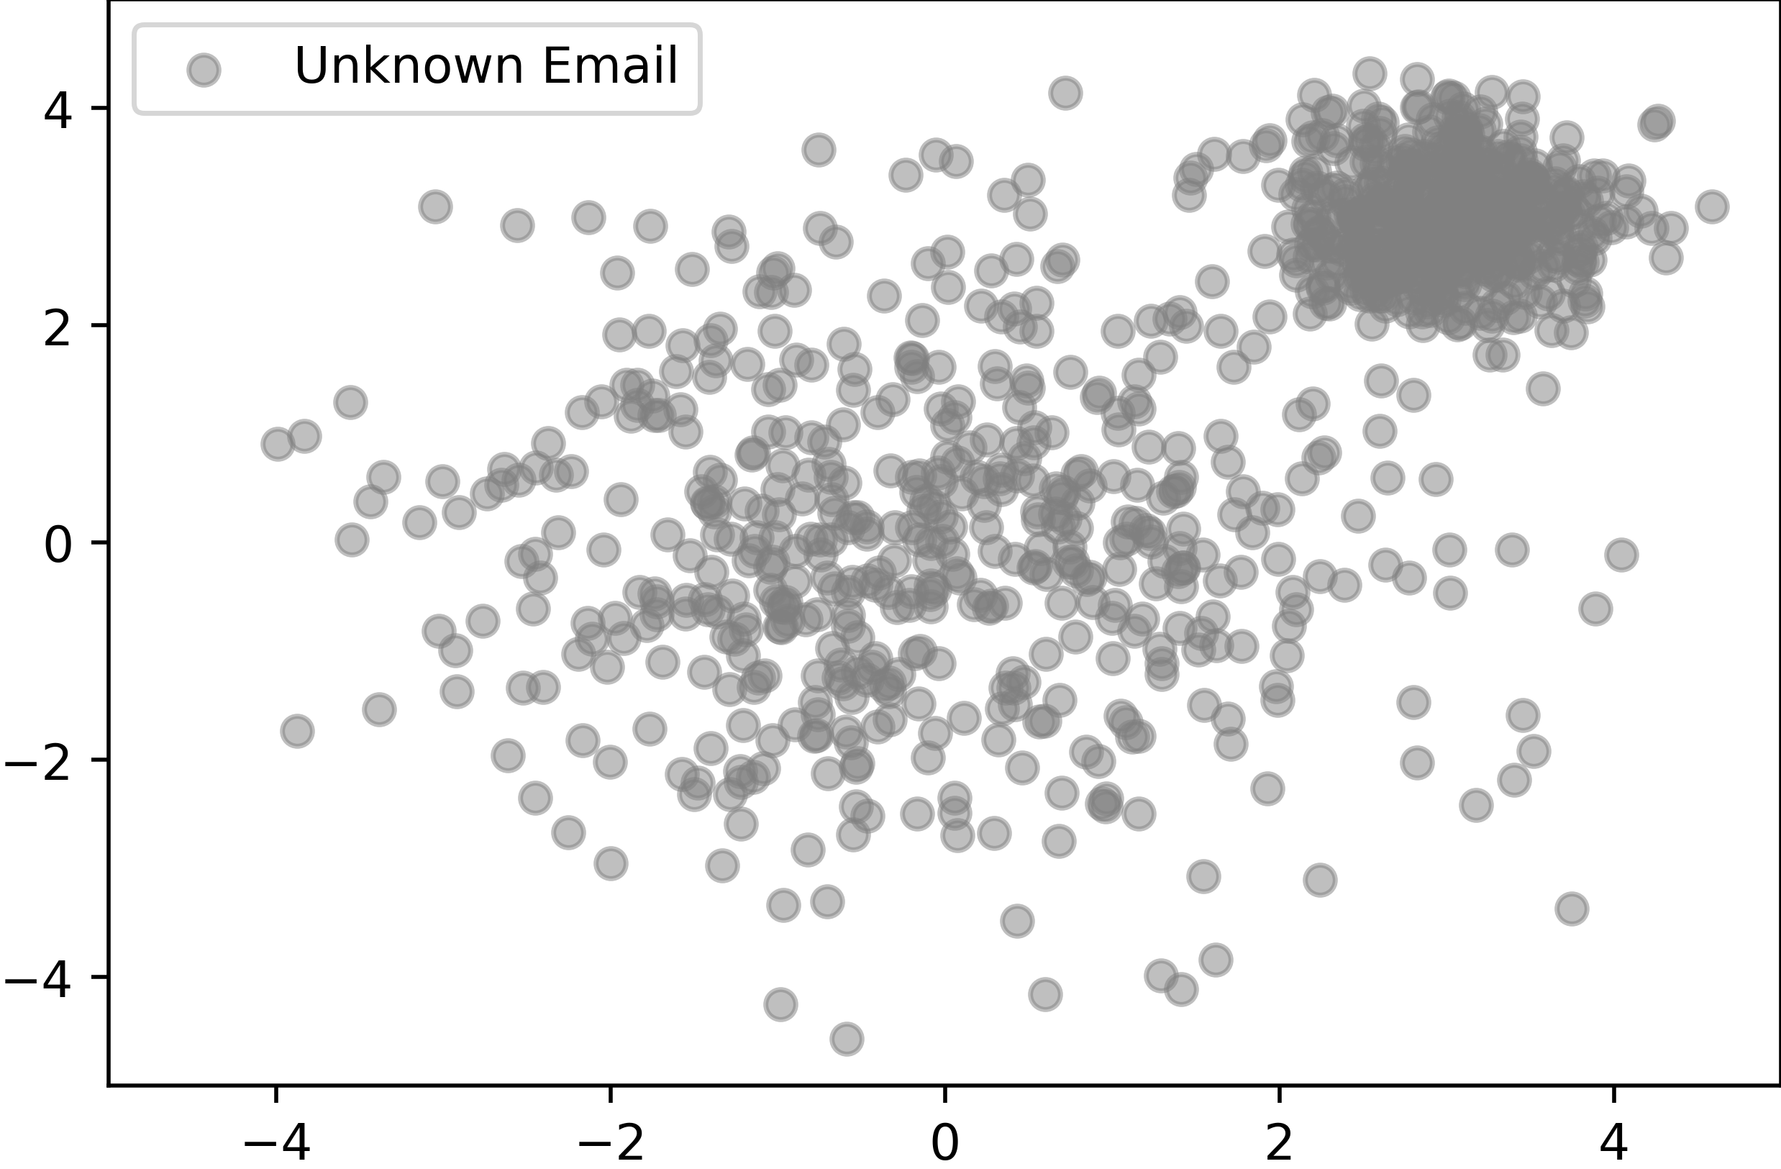
Unsupervised Learning

Slide 51
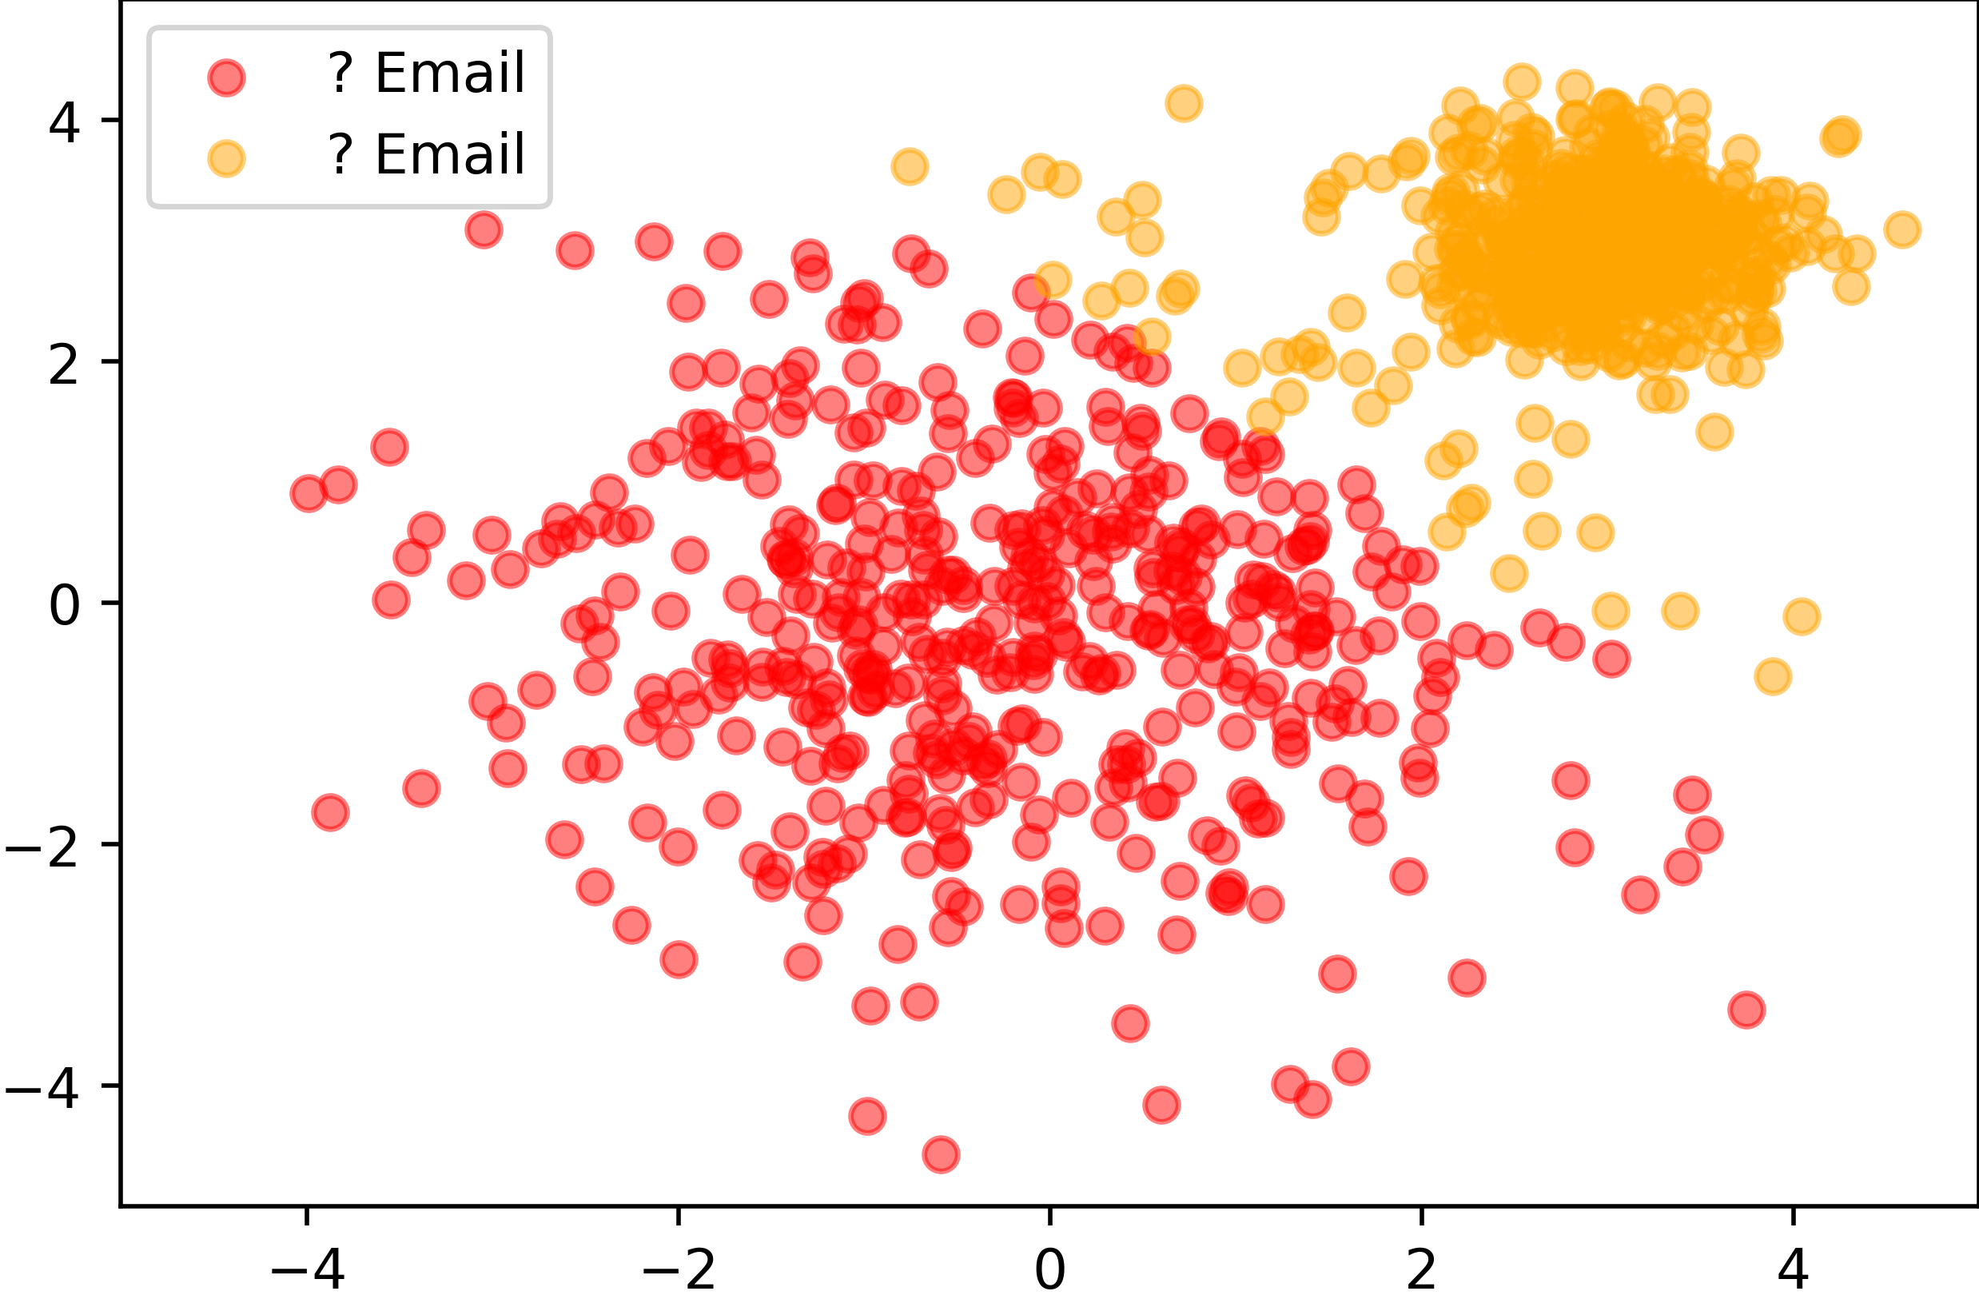
Unsupervised Learning

Slide 52
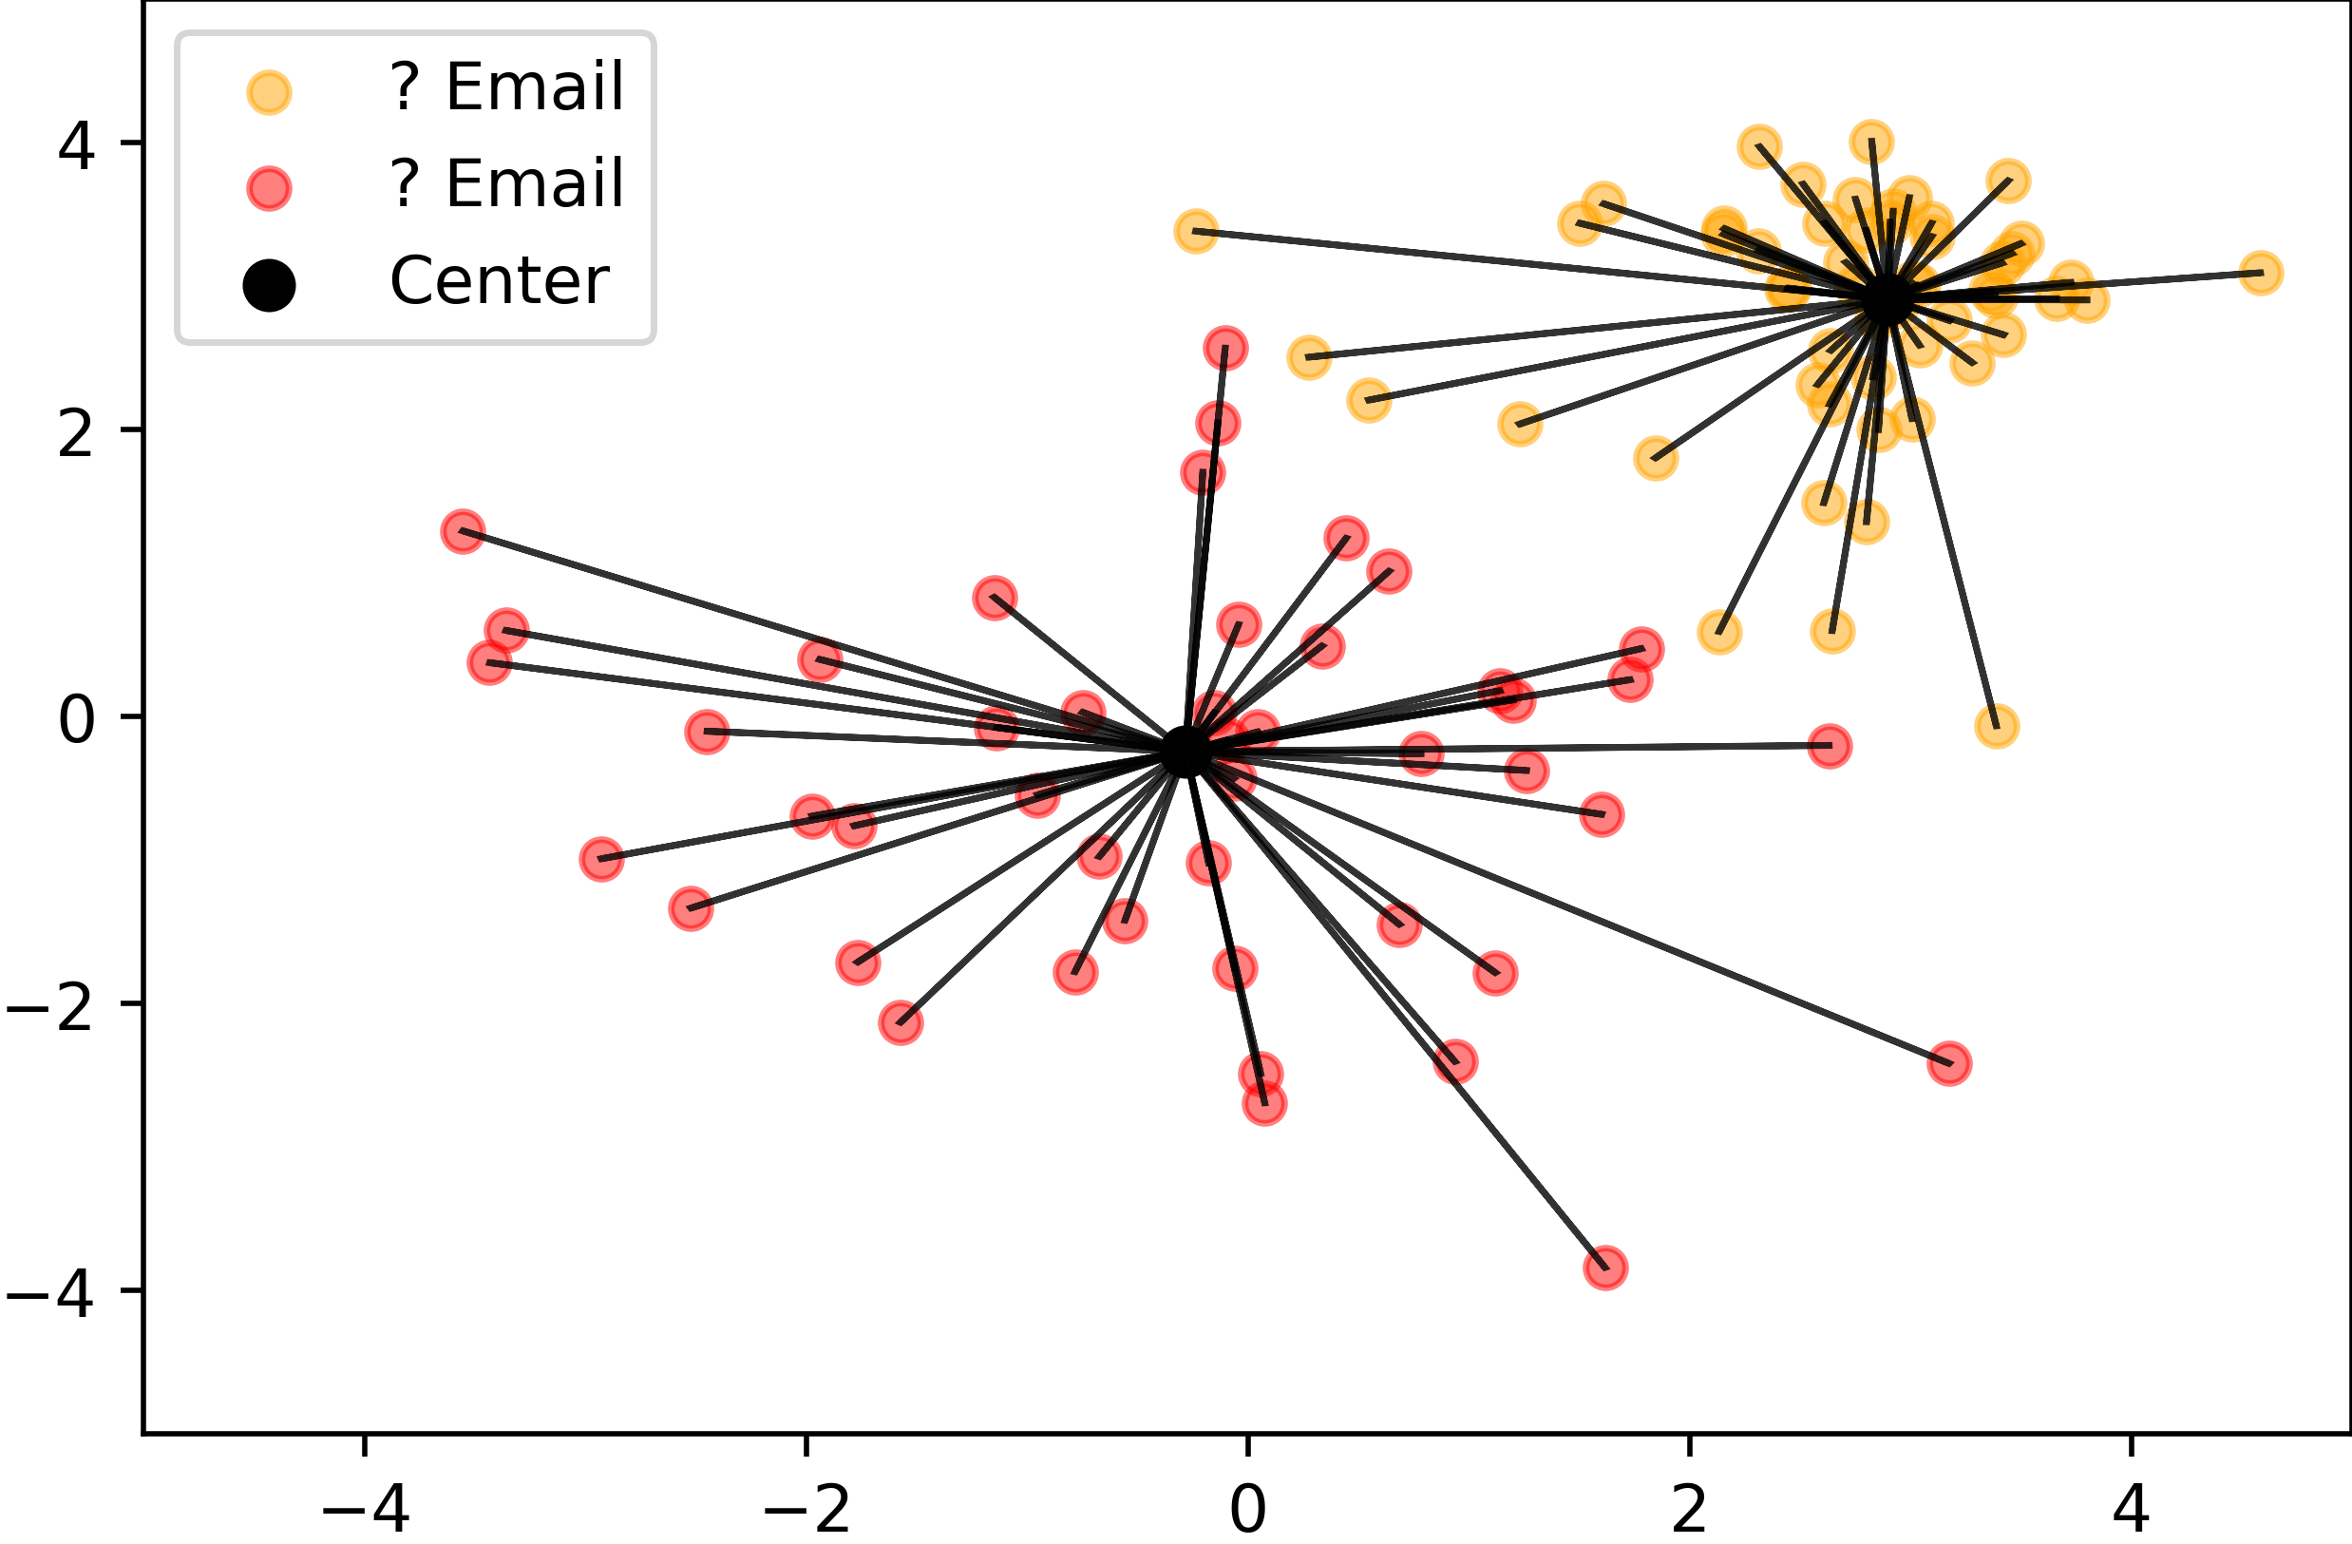
Clustering
K-means clustering

Slide 53
Clustering
K-means clustering
?

Slide 54
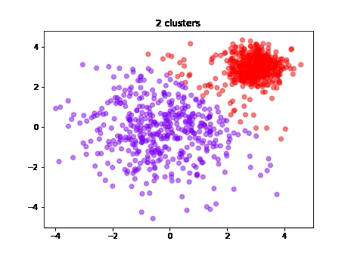
Clustering
Cluster Count?

Slide 55
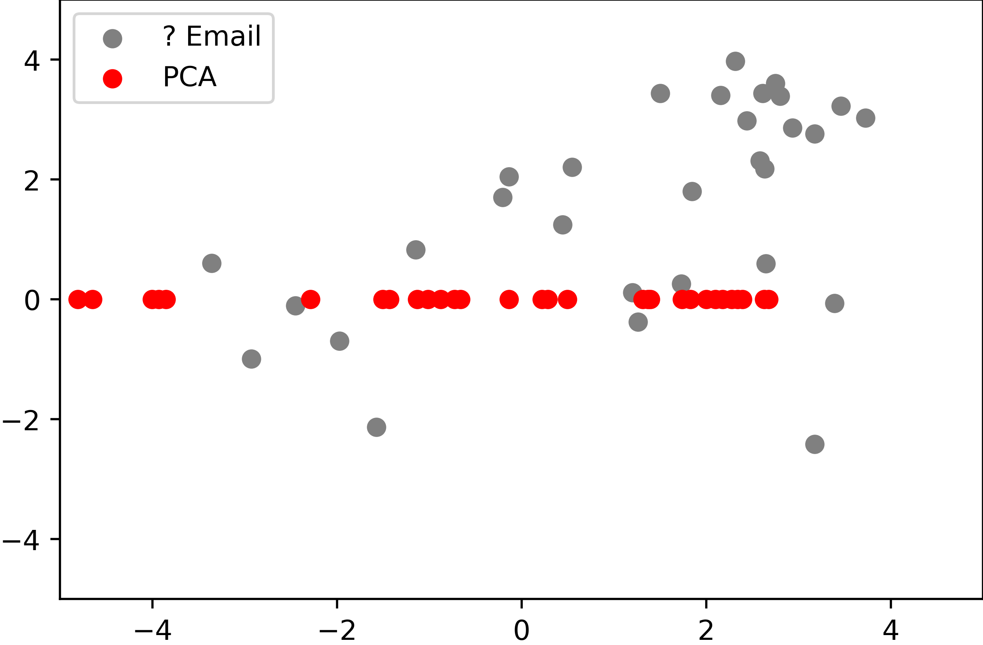
Dimensionality Reduction
Principal Component Analysis (PCA)

Slide 56
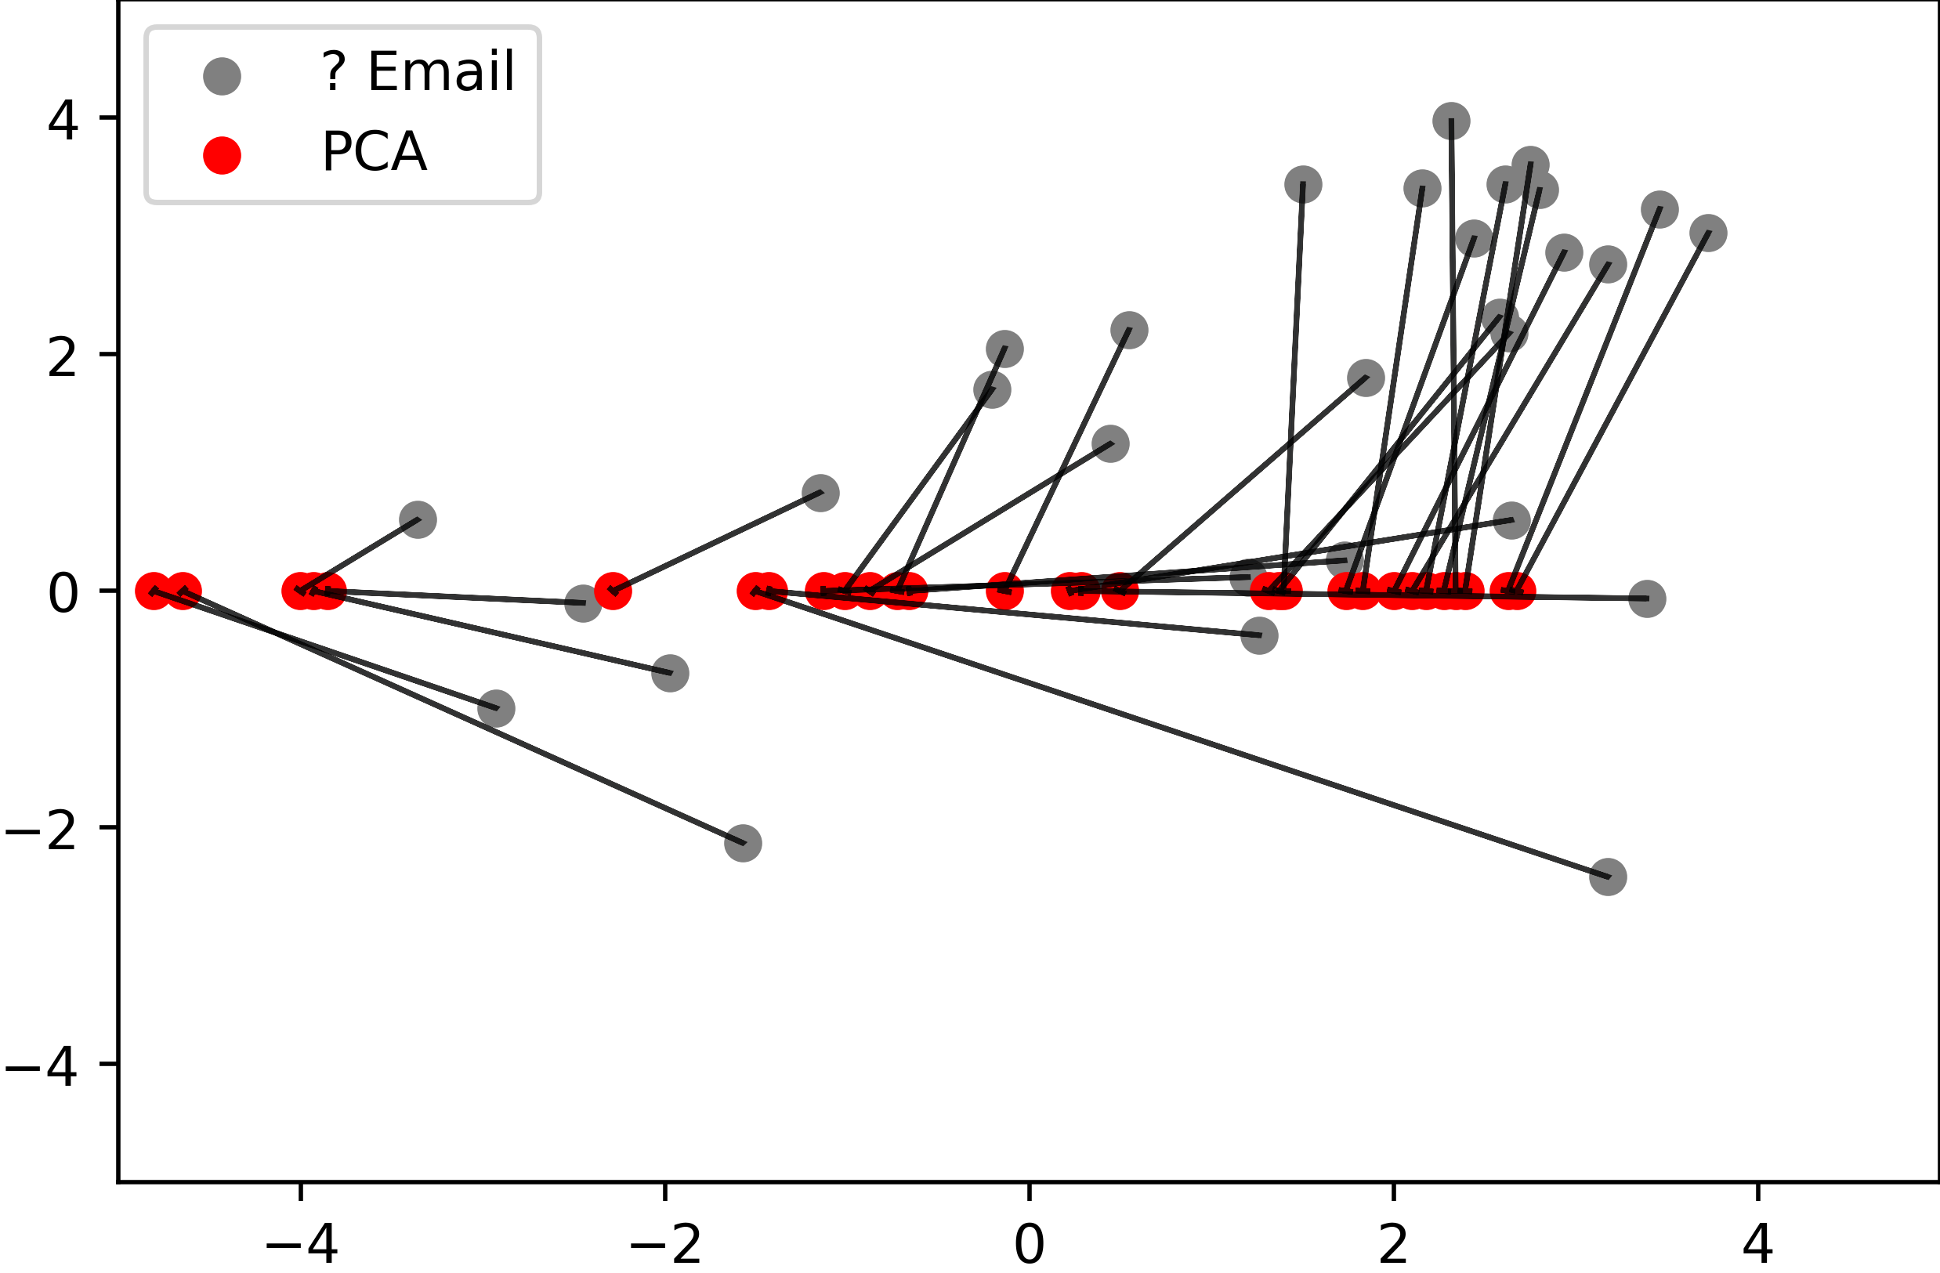
Dimensionality Reduction
Principal Component Analysis (PCA)

Slide 57
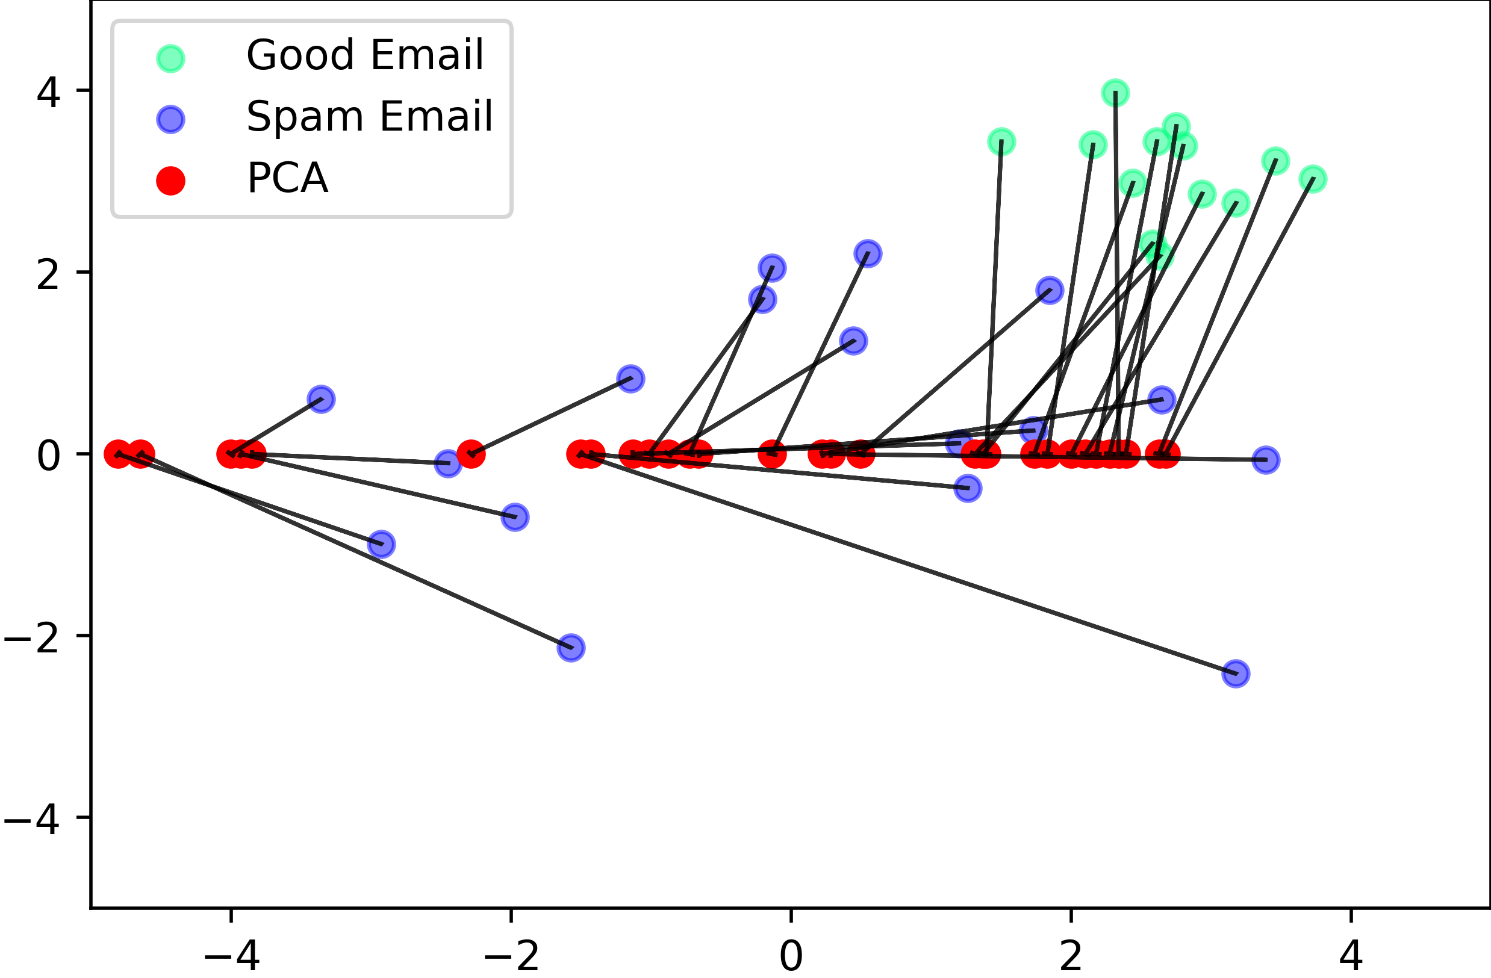
Dimensionality Reduction
Principal Component Analysis (PCA)

Slide 58
Live Coding Example 2
kMeans in Python

Slide 59
Unsupervised Learning
Data
“Training”
Programm (Model)
Input
Not needed:
Labels (Classes)
Continues values

Slide 60
Supervised Learning vs.
Unsupervised Learning
 | Supervised Learning | Unsupervised Learning
Discrete | Classification or Categorization | Clustering
Continuous | Regression | Dimensionality reduction
https://towardsdatascience.com/supervised-vs-unsupervised-learning-14f68e32ea8d
What is AI?

Slide 61
Implementing IUIs
Practical advice

Slide 62

Implementing IUIs
Libraries, Python, web services, …
Pro:
Full flexibility,
integrate own models or models from others etc.
Con:
More development work, computational costs
Build your own, e.g.:
  Web-based frontend
  Python backend
  (e.g. using ML libraries)
Pre-built, e.g.:
  External APIs, web-services
  Devkits, e.g. https://developers.google.com/ml-kit
Pro:
Faster prototyping
Con:
…if it fits your needs;
API costs

Slide 63
Implementing IUIs
ML models
HCI & user-centred work is often iterative, uses prototyping
Training e.g. state-of-the-art text or image generator from scratch is costly (time + computation)
Prototyping with pretrained models
  NLP e.g.: https://huggingface.co/
  Other models e.g.: https://www.tensorflow.org/resources/models-datasets
  Many (ML/AI) papers come with code/model releases
  (e.g. https://paperswithcode.com/)
Also: „Buying a time machine“ for IUI research
🡪 Models don‘t need to run on your target device
cf. Hudson and Mankoff 2014

Slide 64
Some Resources
Frameworks, pretrained models, etc.
TensorFlow Hub, Model Garden, TensorFlow.js models: https://www.tensorflow.org/resources/models-datasets
p5.js & ml5.js: https://p5js.org/ & https://ml5js.org/
Keras: https://keras.io/
PyTorch: https://pytorch.org/
Fast AI: https://docs.fast.ai/
MLKit: https://developers.google.com/ml-kit
Scikit-learn: https://scikit-learn.org/stable/index.html
Hugging Face (NLP): https://huggingface.co/
Teachable Machine: https://teachablemachine.withgoogle.com/
Tensorflow lite, js: https://www.tensorflow.org/lite/, https://www.tensorflow.org/js
Conversational UIs: https://rasa.com/docs/rasa/, https://developers.google.com/learn/pathways/chatbots-dialogflow

Slide 65
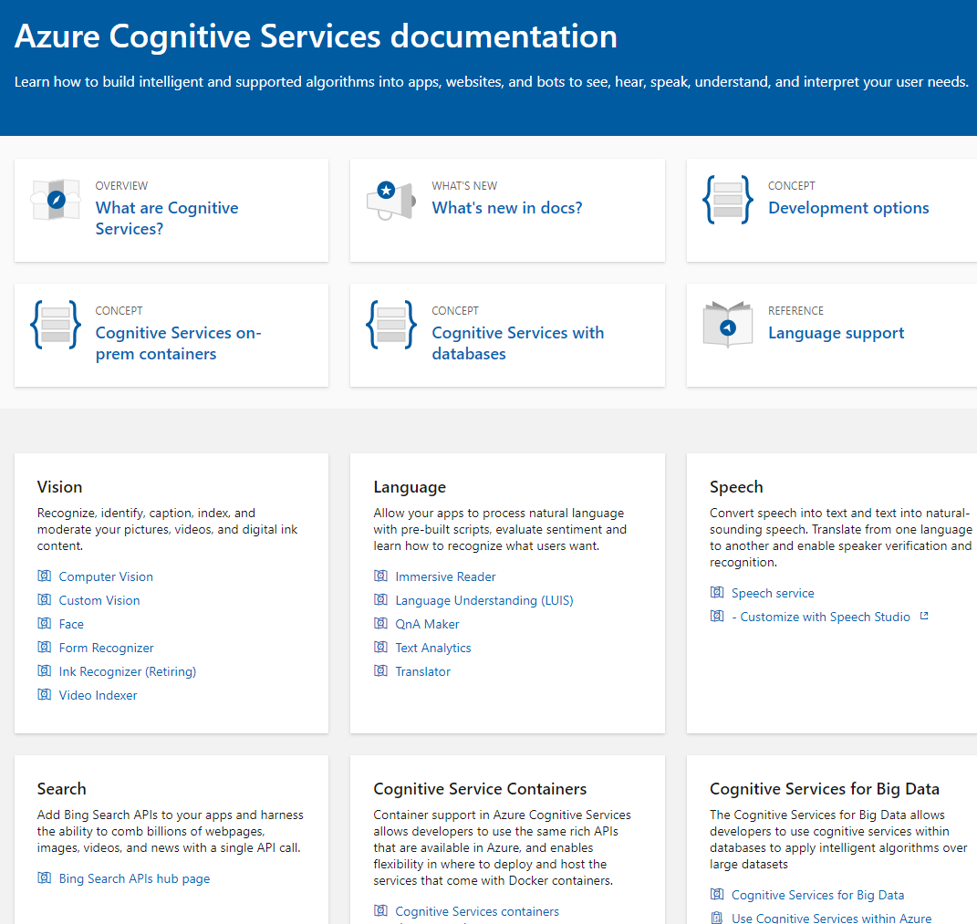
Cloud Services
Example: Microsoft Cognitive Services
Cloud Services from:
IBM
Google
Amazon
Microsoft
… and many others
Why do people use them?
What is the risk?
https://docs.microsoft.com/en-us/azure/cognitive-services/
Implementing AI

Slide 66
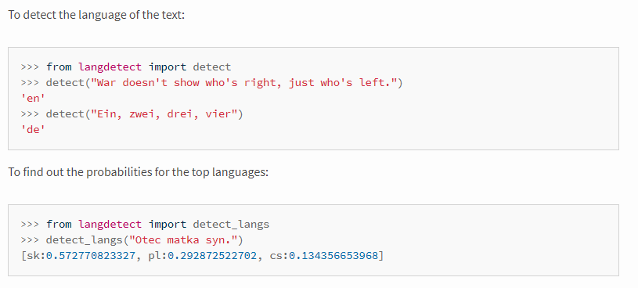
Examples Text Analytics
Identification of the Language
Can tell what language the text is, e.g. English, German, Spanish,…
Relevant for understanding and translation
Example (Online) APIs:
  https://console.bluemix.net/apidocs/language-translator
  https://docs.microsoft.com/en-us/azure/cognitive-services/translator/
  https://cloud.google.com/translate/docs/basic/detecting-language
  https://pypi.org/project/langdetect/
Implementing AI

Slide 67
How to Install Python
Python via Anaconda www.anaconda.com
Python with pip https://www.python.org/downloads/
Python in the web via Google Colab https://colab.research.google.com

Slide 68

License
This file is licensed under the Creative Commons Attribution-Share Alike 4.0 (CC BY-SA) license:
https://creativecommons.org/licenses/by-sa/4.0
Attribution: Albrecht Schmidt, Sven Mayer, and Daniel Buschek

