Slide 1


Recommender Systems and Adaptive UIs

Slide 2






Recommender Systems
Definition
“Recommender Systems (RSs) are software tools and techniques providing suggestions for items to be of use to a user. […] The suggestions relate to various decision-making processes, such as what items to buy, what music to listen to, or what online news to read.” [1, p1]
[1] Francesco Ricci, Lior Rokach and Bracha Shapira. Introduction to Recommender Systems Handbook. In F. Ricci et al. (eds.), Recommender Systems Handbook. Springer Science+Business Media 2011.
Recommender Systems

Slide 3

Recommender Systems – Examples?
How are recommender systems used in these services?
How do recommender systems impact the user experience?
What are user interface patterns used with recommender systems?
Recommender Systems

Slide 4
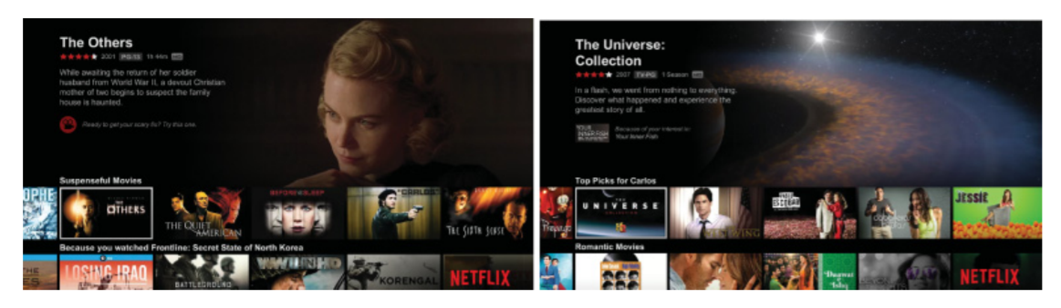
Recommender Systems
Why are recommender systems used?
What is the main function?
What data do recommender systems require?
How do recommender systems make a user interface intelligent?
Carlos A. Gomez-Uribe and Neil Hunt. 2015. The Netflix Recommender System: Algorithms, Business Value, and Innovation. ACM Trans. Manage. Inf. Syst. 6, 4, Article 13 (December 2015). DOI: https://doi.org/10.1145/2843948
Recommender Systems

Slide 5
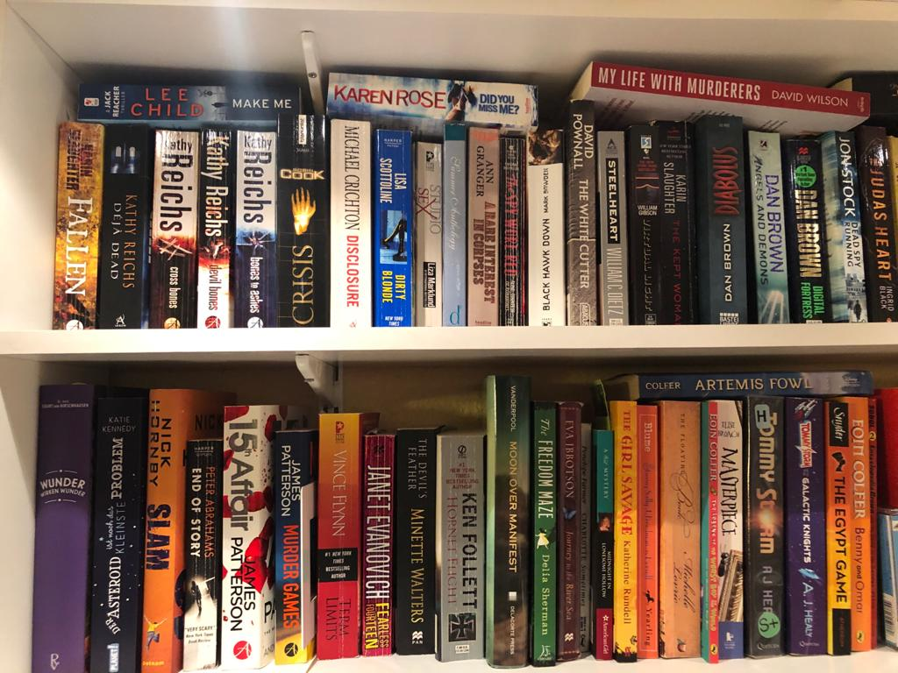
What Book do you Recommend to me?
Recommender Systems
Notes:
Photo Albrecht

Slide 6
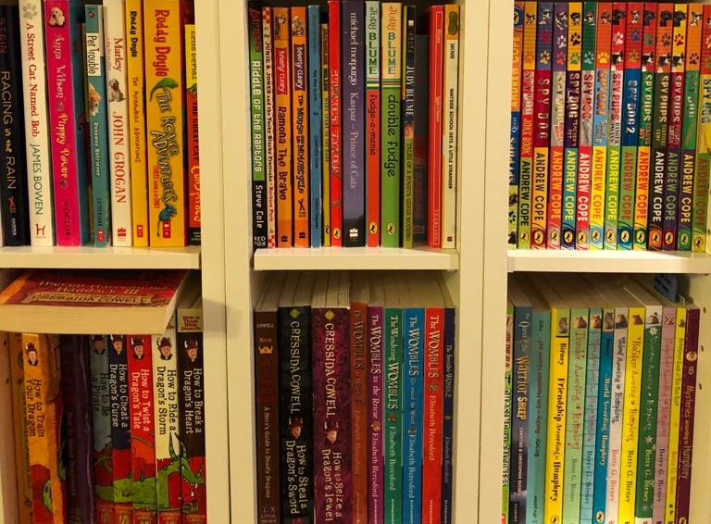
What Book do you Recommend to me?
Recommender Systems
Notes:
Photo Albrecht

Slide 7
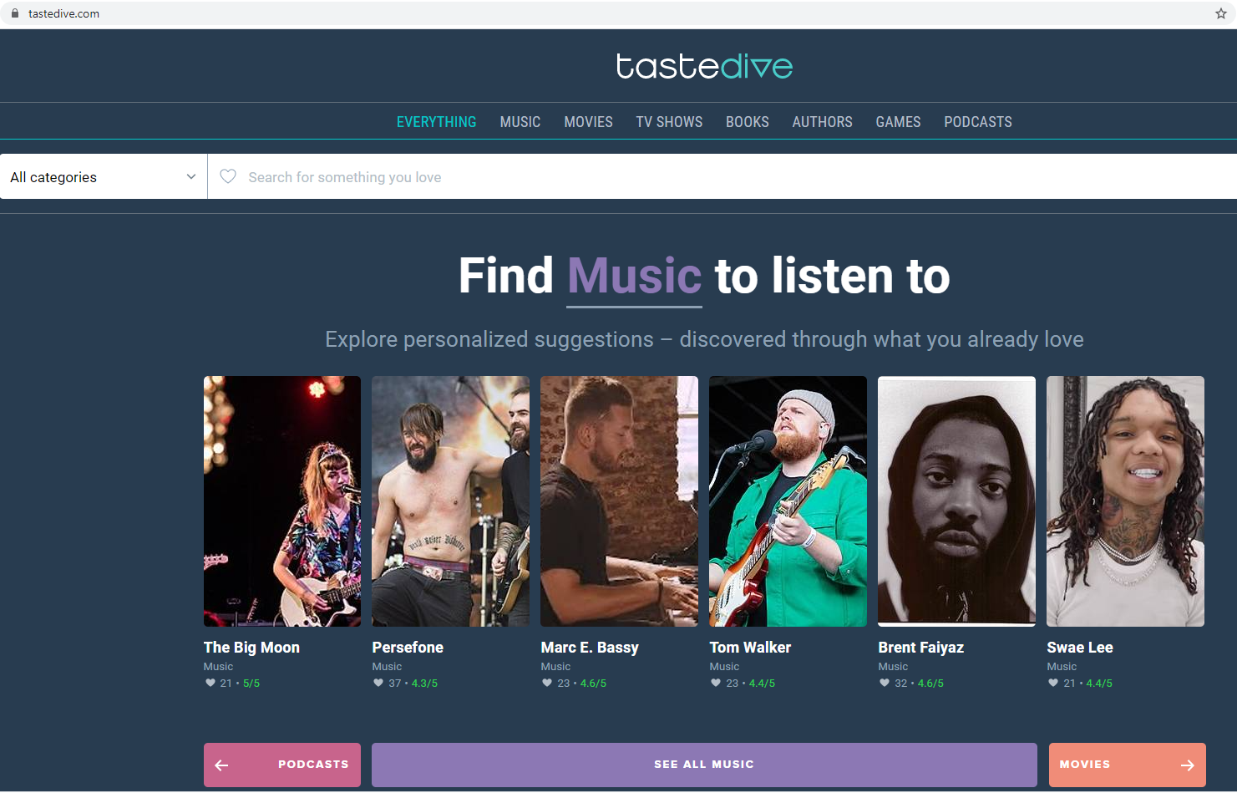
Example: https://tastedive.com/
How does this work?
Recommender Systems

Slide 8

What Book do you Recommend to me?
? ?
Recommender Systems
Notes:
Photo Albrecht

Slide 9
What Book do you Recommend to me?
Content based recommendation
Recommender Systems
Notes:
Photo Albrecht

Slide 10
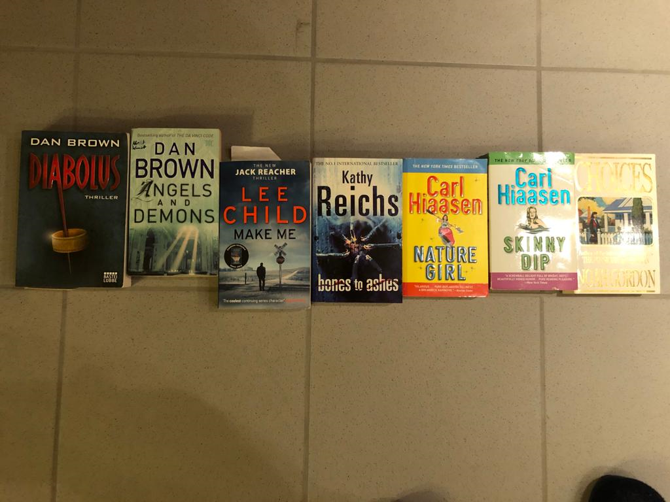
This is what I read…
Which of these books do you suggest?
Recommender Systems

Slide 11
Approaches to Recommender Systems
Collaborative Filtering
“people who liked what you liked also liked X, hence I suggest X to you”
Demographics
“many people of you age, income, family status, and education like X, hence I suggest X to you”
Social Relationships
“people you hang out with, your friend, or friend of you friends like X, hence I suggest X to you”
Content-based Filtering
“X is similar (based on a similarity measure for a domain) to what you liked before, hence I suggest X to you”
Contextual
“many people in you current situation/context/location like X, as you are in now this context , I suggest X to you”
Recommender Systems

Slide 12
Content Based Filtering
Basic Approach
What properties / factors / dimensions are describing and discriminating the products?
  taxonomy, list of dimensions or set of criteria
Each item can be categorized based on the criteria/dimensions/taxonomy
  for each item represent how much it matches these criteria in a vector
How much does the user like products based on the criteria/dimensions/taxonomy?
  vector for the user that represents their relationship to these criteria
Identify and recommend items that fit the
user’s criteria
  calculate the similarity between item vectors and user vectors
Language, genre, time set,
main characters, location/setting,
theme, length, time written,
number of parallel plots,
language complexity,…
Recommender Systems

Slide 13

Idea of User Based Collaborative Filtering
liked
liked
liked
Similar
liked
Recommend
liked
Recommender Systems

Slide 14
Breakout Sessions 1
How to get item ratings?
Explicitly and Implicitly
Scenario 1: Web based reading platform/library
Scenario 2: Public transport application
Scenario 3: Online platform for travel recommendations
  What do you get ratings for? What is the item?
  What relevant questions can you ask to get item ratings?
  How do you get implicit ratings from “automated observation”?
Recommender Systems

Slide 15
Recommender Systems

Slide 16
Recommender Systems

Slide 17
Recommender Systems

Slide 18
8 7 9 4 9 10 4 7
2 6 9
4 6 10 8 9 6 7 9 8
4 ? 6 ? ? ? ? 9 5 ? 10 ?
Recommender Systems

Slide 19
Item1 item2 item3 item4 Item5 item6 item7 item8 Item9 item10 item11 item12
u1
8 7 9 4 9 10 4 7
u2
2 6 9
u3
4 6 10 8 9 6 7 9 8
u4
4 ? 6 ? ? ? ? 9 5 ? 10 ?
Recommender Systems

Slide 20
Discussion: Getting user input?
Where does Ethics come in?
Recommender Systems

Slide 21
Recommender Systems
Getting user data
What are ways to get data from the user for recommender systems?
Explicit:
  Questionnaires at setup time
  Ratings of items
  Feedback questions
Implicit
  Using items (e.g. watching a movie, listen to music, putting something on a watch list, buying a book)
  Sharing items (e.g. recommending an article, retweets)
  Removing items (e.g. deleting a playlist, skipping a suggested song)
Recommender Systems

Slide 22
Collaborative Filtering
Basic Approach
Tables:
  User, Item, Rating
  Item, Item description
Approach
  Users rate items (implicitly, explicitly), e.g. like a movie, buy a book, recommend an hotel, …
    Table: user, item, rating
  Compute similarity between users (or between items)
    set of users (or set of items) that is similar to the user
    (the item) we create a recommendation for
  Predict items (new to the target user) based on the information of similar users
    weighted list of recommendations
Recommender Systems

Slide 23
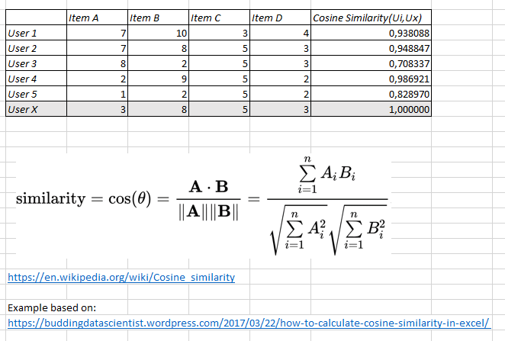
Calculating the similarity
How similar are user to each other?
Calculating the difference between rating vectors, e.g. k-nearest neighbor, Euclidian distance, Pearson correlation, Cosine distance
Heuristic required for tables with missing values!
Recommender Systems

Slide 24
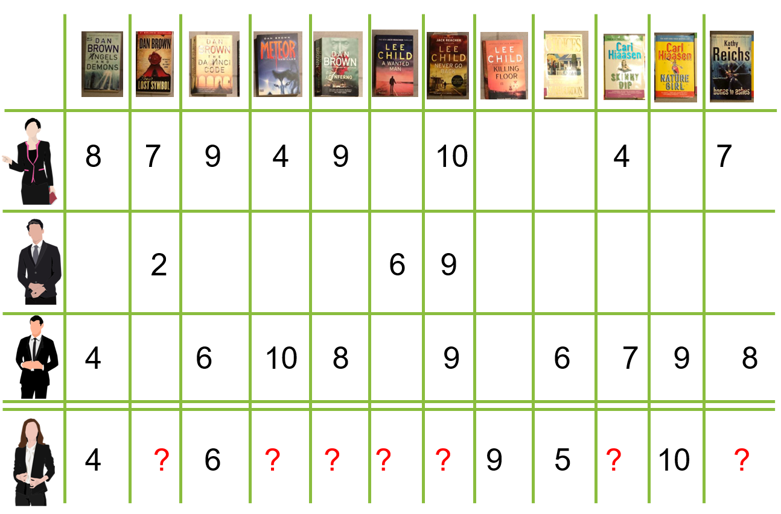
Assessing Similarity?
How could Machine Learning play a role here?
Recommender Systems

Slide 25
Predicting the right item?
Recommender Systems

Slide 26
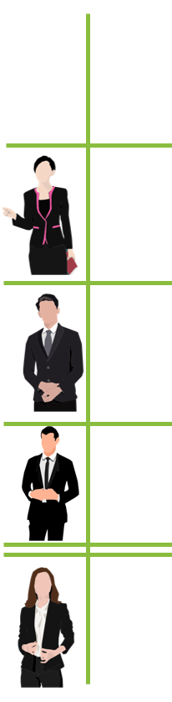
Example Similarity Matrix
Similarities are NOT calculated – for illustration only
Similarity Matrix
0.4
0.7
0.9
1
Based on https://medium.com/swlh/how-to-build-simple-recommender-systems-in-python-647e5bcd78bd
Recommender Systems

Slide 27
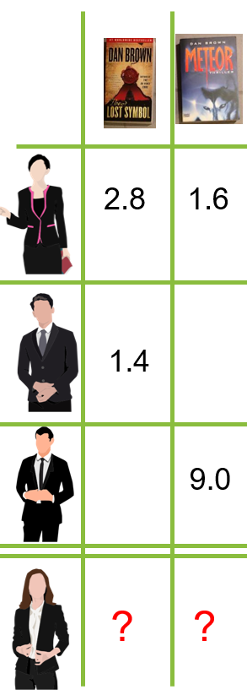
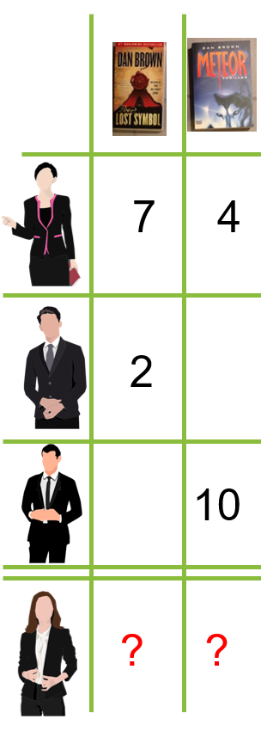
Weighted Rating Matrix
Rating Matrix
(part)
Similarity Matrix
Weighted Rating Matrix
(part)
*
*
*
0.4
=
=
=
0.7
0.9
1
Based on https://medium.com/swlh/how-to-build-simple-recommender-systems-in-python-647e5bcd78bd
Recommender Systems

Slide 28
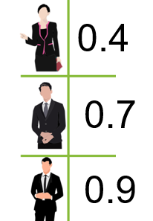
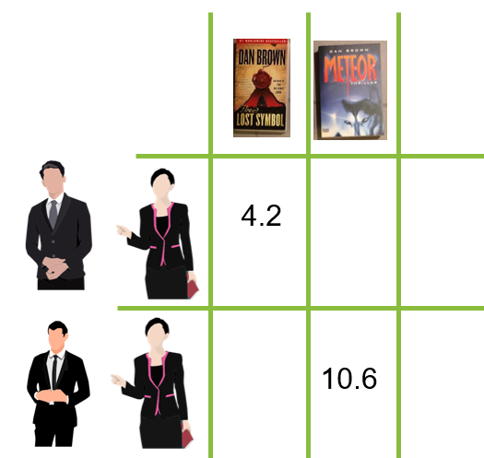
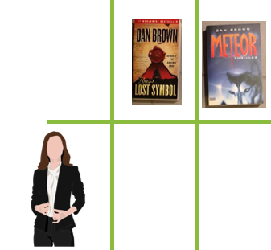
Recommendation
Similarity Matrix
Weighted Rating Matrix
(part)
Summing up
weights
0.4+0.7
/
/
3.8
8.2
0.4+0.9
Summing up weighted ratings
Based on https://medium.com/swlh/how-to-build-simple-recommender-systems-in-python-647e5bcd78bd
Recommender Systems

Slide 29
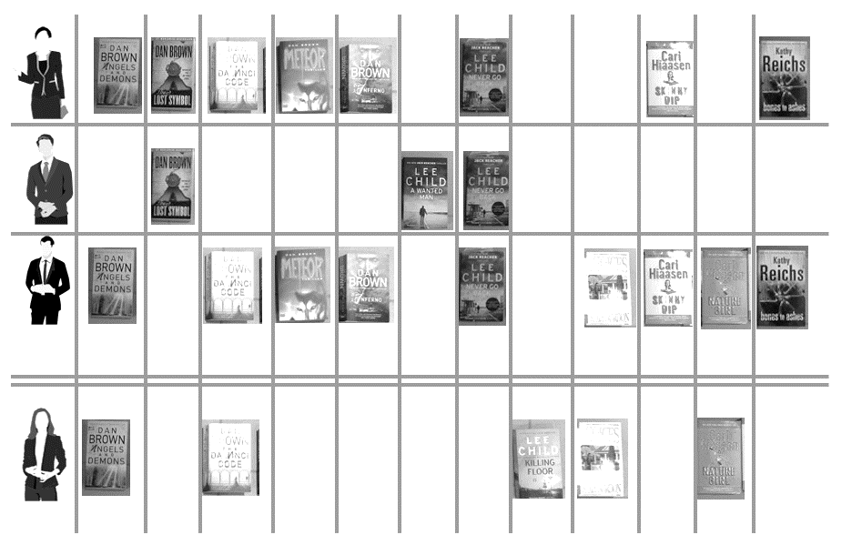
Recommender Systems

Slide 30
Collaborative Filtering
User Based
Calculate similarity between users
Suggest items that similar users liked
Item Based
Calculate similarity between items based on user ratings – no semantics are required!
Suggest item that is similar to item the user already likes
Recommender Systems

Slide 31
Cold-Start Problem
What is n
Basic problem: as a system is created data is missing. The algorithms need initial information (e.g. to calculate similarities).
What could be new? What is the problem?
  User: no information yet, no recorded interaction nor know preferences
  Item: the item has not been “like” or viewed by anyone yet, no knowledge who may like it or how its rating are similar
  Community: new system is created, lack of information about users as well as item
Solutions?
  Hybrid approaches (e.g. using content based filtering to get started and then move more towards collaborative filtering)
  Use social, demographics, context, content to get started
  Require initial interaction (e.g. questionnaire, ask for examples, …)
[1] Bobadilla, Jesús; Ortega, Fernando; Hernando, Antonio; Bernal, Jesús (February 2012). "A collaborative filtering approach to mitigate the new user cold start problem". Knowledge-Based Systems. doi:10.1016/j.knosys.2011.07.021.
[2] https://en.wikipedia.org/wiki/Cold_start_(recommender_systems)
Recommender Systems

Slide 32
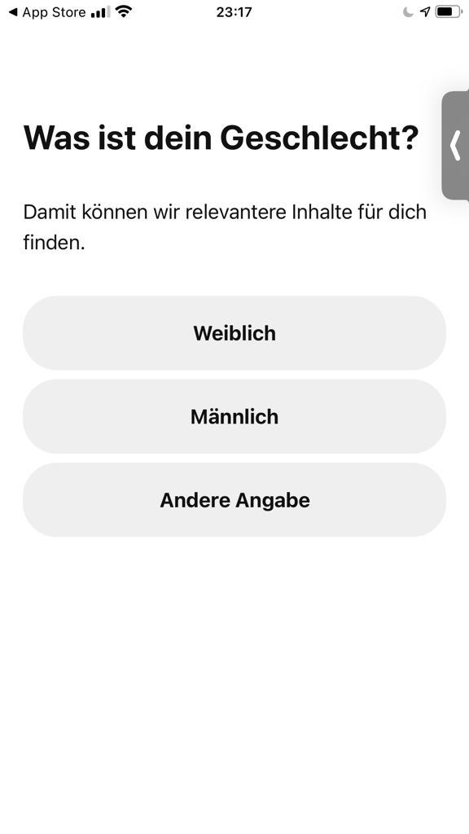
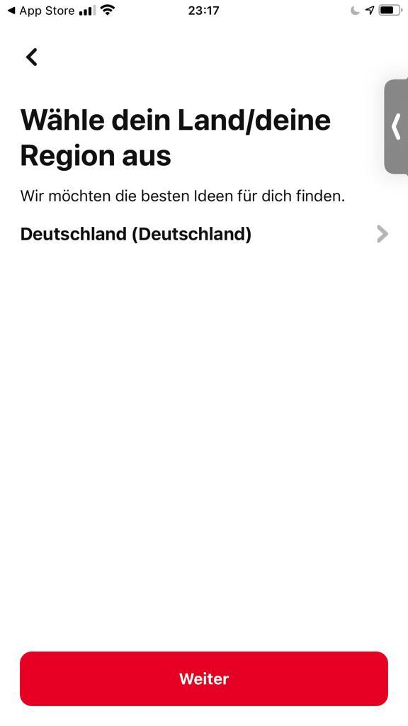
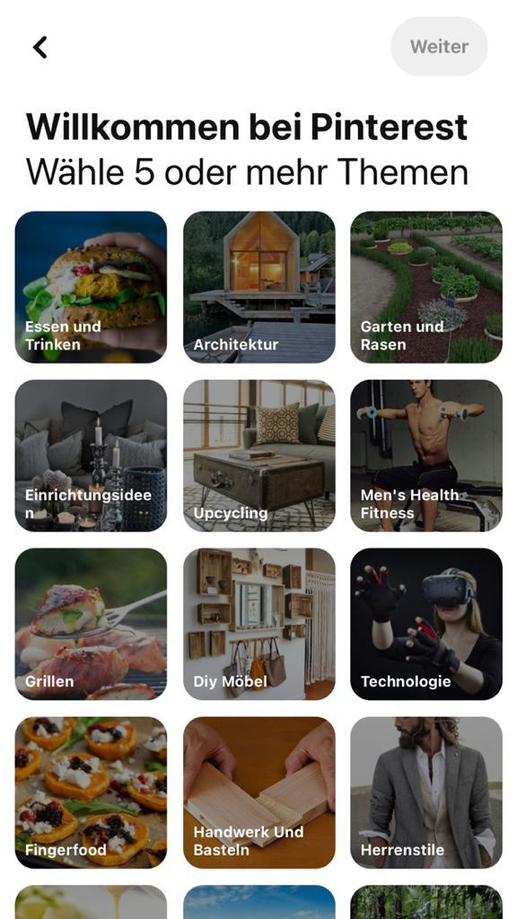
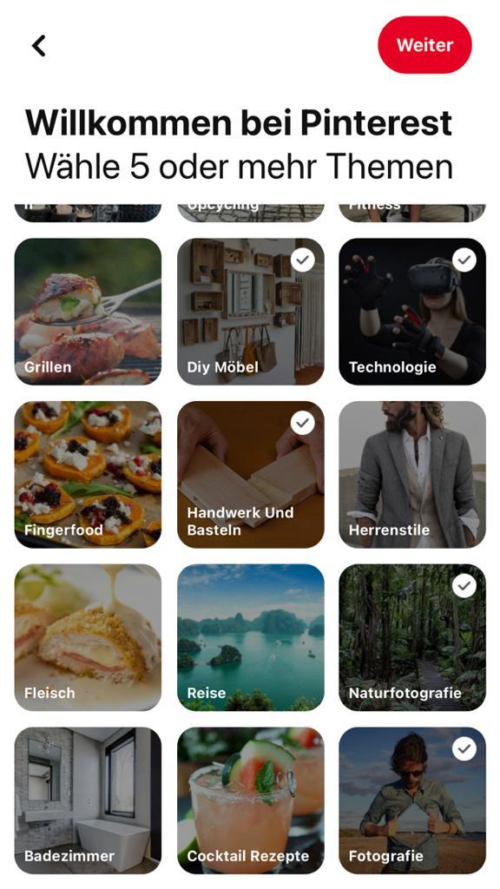
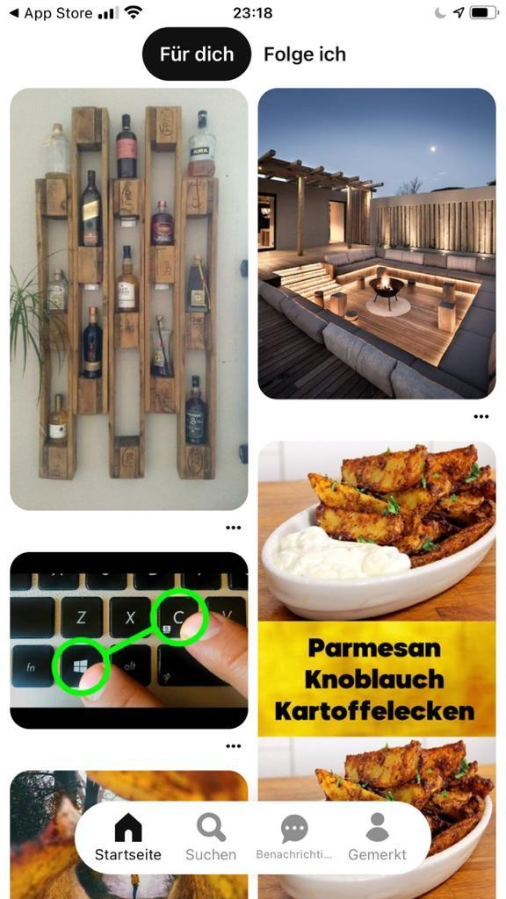
Pinterest
Registration Process and start-up
Demographics Contextual Explicit Interest
Recommender Systems

Slide 33
How to include new item?
Scenario: News Feed
You create a recommender system for a news feed in social media (e.g. twitter style).
How do you add new articles?
Assuming you get a lot of articles….
Recommender Systems

Slide 34
Sparseness of Ratings
E.g. Amazon (low estimates for illustration only)
  Over 10 Million products
  Over 100 Million customer
What is the problem?
Recommender Systems

Slide 35
What Book do you Recommend to me?
Why does the UI matter?
Recommender Systems
Notes:
Size → bigger → more books that I can show… makes it massively easier…

Slide 36
Breakout Sessions 2
Recommendation and User Interface
How can you measure the quality of the user experience of a recommender system?
How does the screen size impact the performance of a recommender system?
Recommender Systems

Slide 37
Recommender Systems
Summary
Content-based
Collaborative Filtering
Based on the similarity of items
How similar is a new item to an item already liked/watched/bought by the user
Advantage
  If similarity is known or can be calculated, no ratings/actions from the user are required
Difficulty:
  Information/meta-data/algorithms for calculating similarity are required
suggestions are made based on users that had similar interests/actions
How has a similar user liked this item?
Advantage:
  Know knowledge about the item is required, no meta data or similarity calculation of items required
Difficulty:
  Data about other users is required
  “cold-start” problem
Recommender Systems

Slide 38
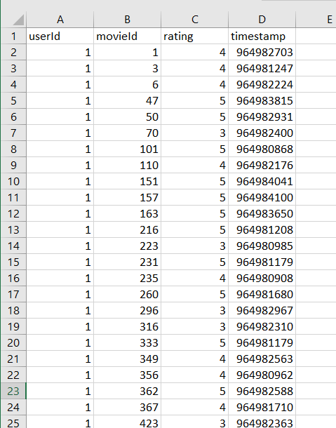
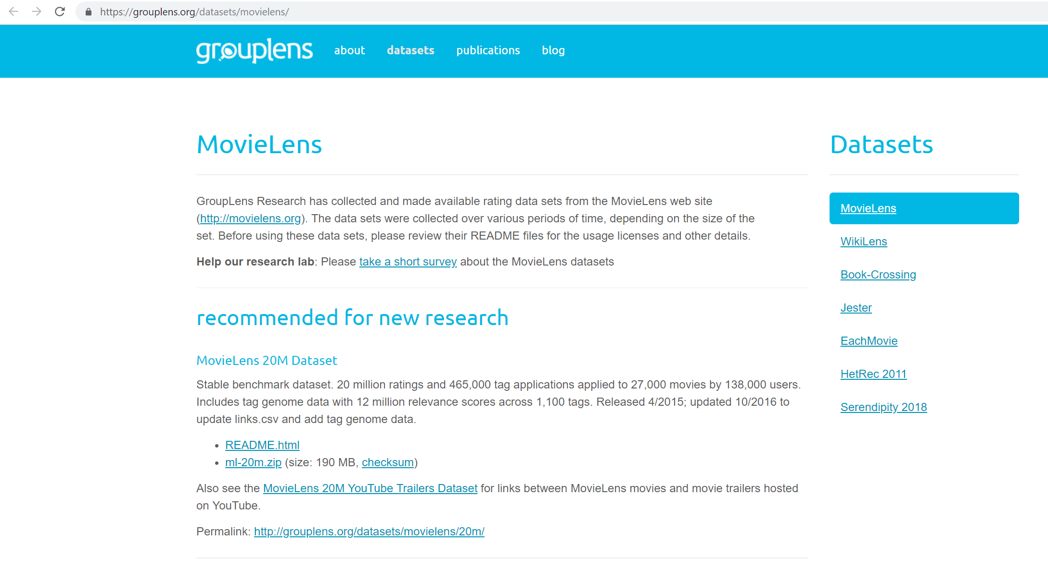
Example data for experiments
https://grouplens.org/datasets/movielens/
Additional reading material: https://hub.packtpub.com/recommending-movies-scale-python/
Recommender Systems

Slide 39
Breakout Sessions 3
Recommender System
Design a systems that suggest educational videos on YouTube that fit your lectures in this term
Recommender Systems

Slide 40
Algorithms for Recommender System
Not core to Intelligent User Interfaces
Efficient implementations in libraries
Important to understand the algorithms to get the parameters right
Many online resources, .e.g.
  https://www.youtube.com/watch?v=Eeg1DEeWUjA
  (introductory video)
  https://www.youtube.com/watch?v=Gf4HZpZAlDA
  https://www.youtube.com/watch?v=b8YyIVulszQ
  (details on Collaborative Filtering Algorithms)
Recommender Systems

Slide 41
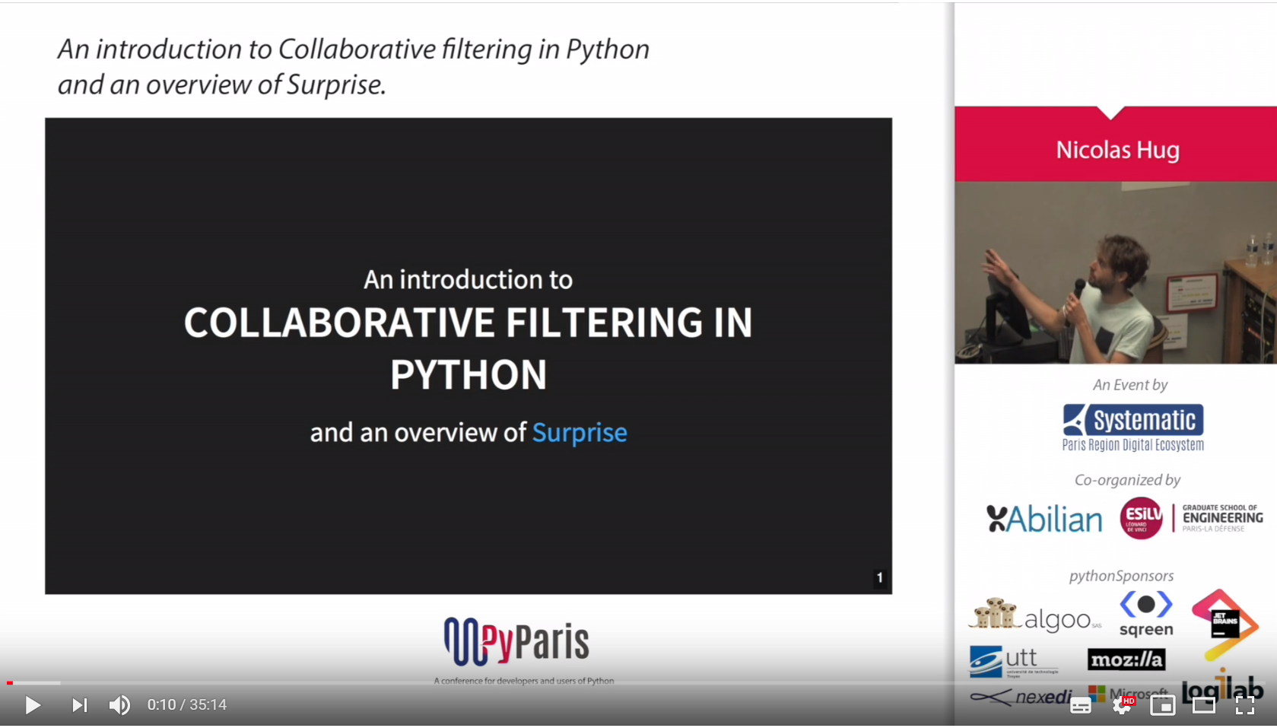
Examples for recommender systems in Python
https://www.youtube.com/watch?v=z0dx-YckFko
https://kerpanic.wordpress.com/2018/03/26/a-gentle-guide-to-recommender-systems-with-surprise/
https://www.analyticsvidhya.com/blog/2016/06/quick-guide-build-recommendation-engine-python/
https://medium.com/@connectwithghosh/recommender-system-on-the-movielens-using-an-autoencoder-using-tensorflow-in-python-f13d3e8d600d
Recommender Systems

Slide 42
Adaptive UIs

Slide 43
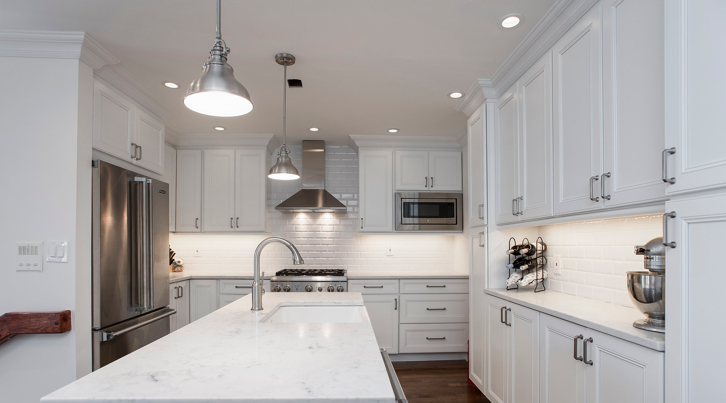
Lights
Fridge
Microwave
Lights
Thermostat
“White Kitchen Interior” by Paintzen Attribution 2.0 Generic (CC BY 2.0)
Users' Context in Smart Environments
Notes:
https://www.flickr.com/photos/147489968@N06/29813588732/

Slide 44
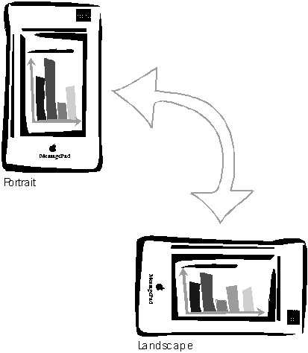
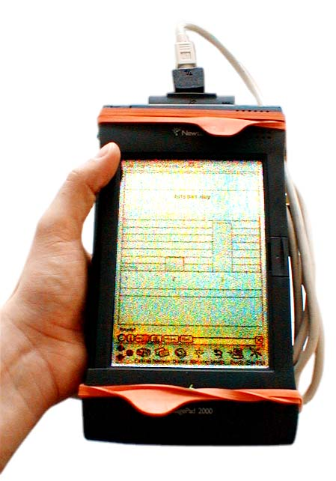
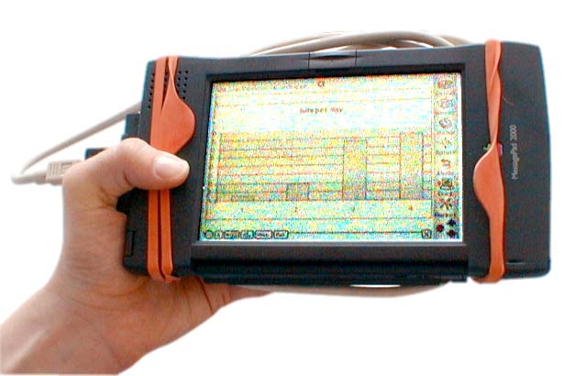
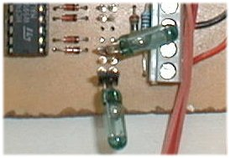
Getting Physical (1) Initial Experience (1998)
Extremely simple, but
still it creates a new experience
2-Bit Input
Not an input device
Very specific function
A. Schmidt, M. Beigl, H. Gellersen. There is more to context than location. Computers and Graphics, 23(6):893--901, 1999.
http://www.comp.lancs.ac.uk/~albrecht/pubs/pdf/schmidt_cug_elsevier_12-1999-context-is-more-than-location.pdf
Users' Context in Smart Environments

Slide 45
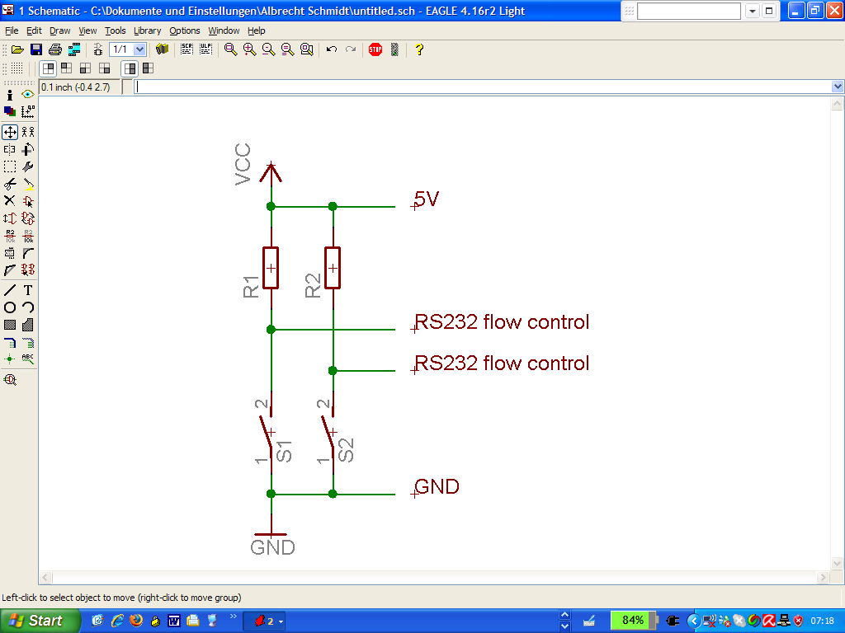
Getting Physical (1) Initial Experience (1998)
Extremely simple, but
still it creates a new experience
2-Bit Input
Not an input device
Very specific function
A. Schmidt, M. Beigl, H. Gellersen. There is more to context than location. Computers and Graphics, 23(6):893--901, 1999.
http://www.comp.lancs.ac.uk/~albrecht/pubs/pdf/schmidt_cug_elsevier_12-1999-context-is-more-than-location.pdf
Users' Context in Smart Environments

Slide 46
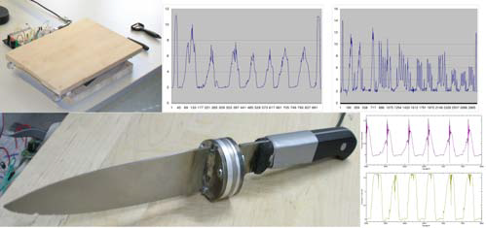
Knife that “knows” what its cuts
Matthias Kranz, Albrecht Schmidt, Alexis Maldonado, Radu Bogdan Rusu, Michael Beetz, Benedikt Hörnler, and Gerhard Rigoll. 2007. Context-aware kitchen utilities. In Proceedings of the 1st international conference on Tangible and embedded interaction (TEI '07). Association for Computing Machinery, New York, NY, USA, 213–214. DOI: https://doi.org/10.1145/1226969.1227013
Users' Context in Smart Environments

Slide 47
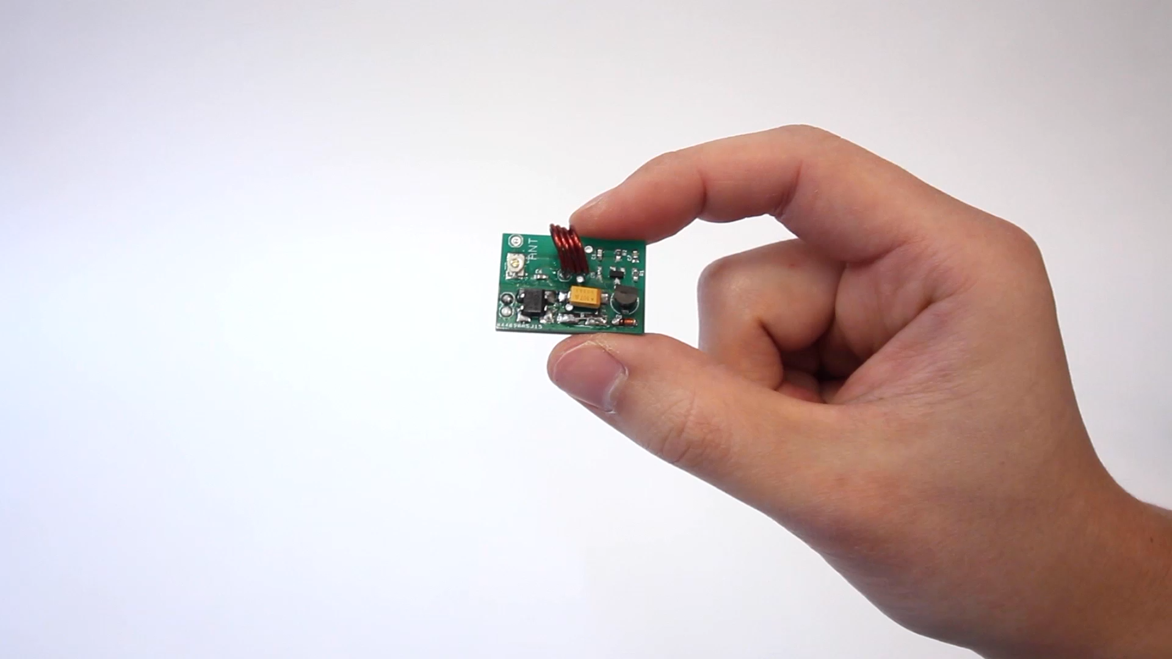
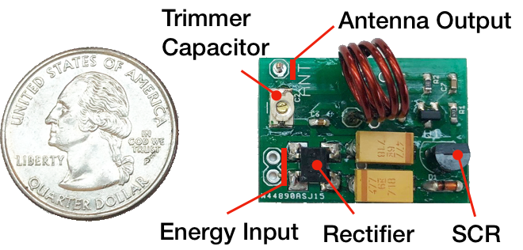
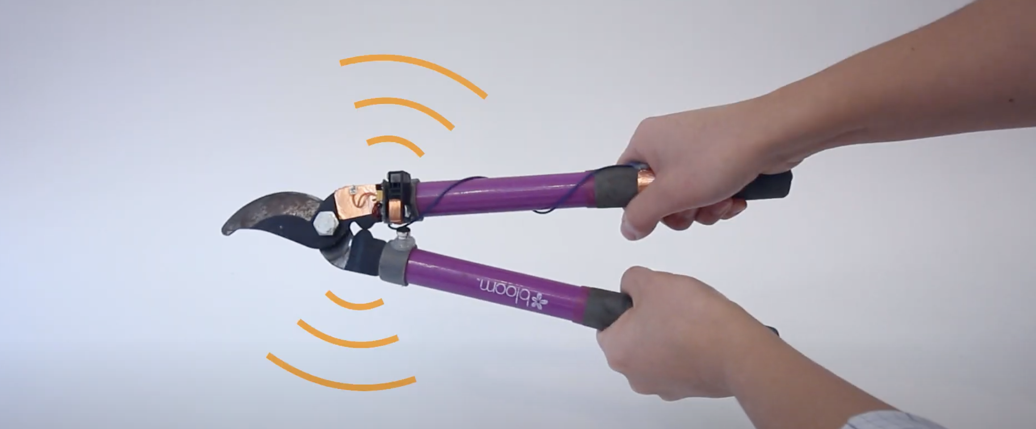
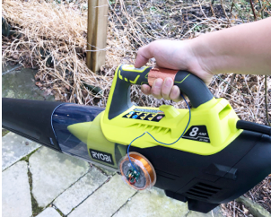
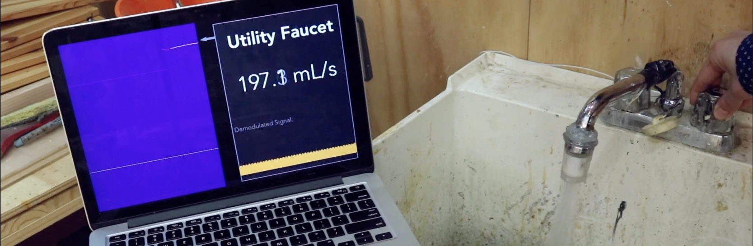
Radio Tags for Activity Sensing
Yang Zhang, Yasha Iravantchi, Haojian Jin, Swarun Kumar, and Chris Harrison. 2019. Sozu: Self-Powered Radio Tags for Building-Scale Activity Sensing. In Proceedings of the 32nd Annual ACM Symposium on User Interface Software and Technology (UIST '19). ACM, New York, NY, USA, 973–985. DOI: https://doi.org/10.1145/3332165.3347952
Video: https://youtu.be/wbq-eOOIPyw
Users' Context in Smart Environments

Slide 48
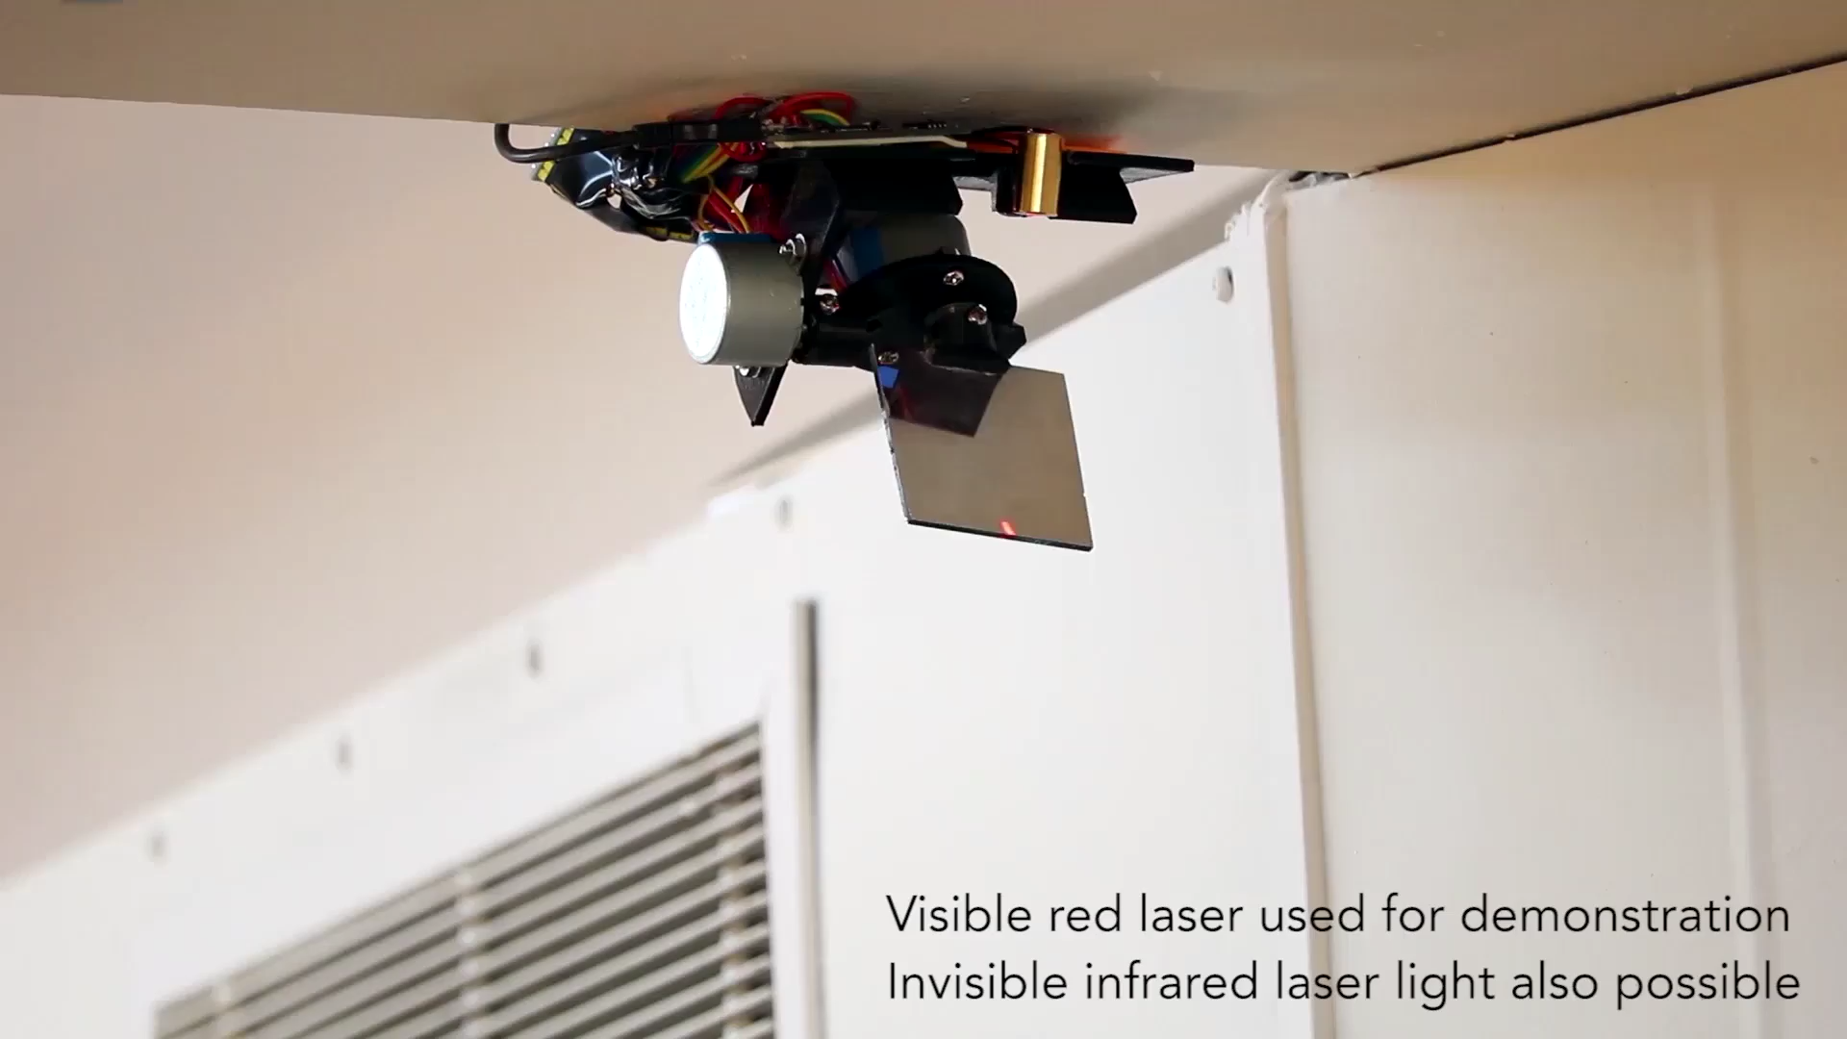
Vibrometry for Environment Sensing
https://youtu.be/51XaZDki6yg
Yang Zhang, Gierad Laput, and Chris Harrison. 2018. Vibrosight: Long-Range Vibrometry for Smart Environment Sensing. In Proceedings of the 31st Annual ACM Symposium on User Interface Software and Technology (UIST '18). ACM, New York, NY, USA, 225–236. DOI: https://doi.org/10.1145/3242587.3242608
Users' Context in Smart Environments

Slide 49
Extracting Contextual Information
Users Location
  GPS
  Direction of Voice
Users Activity
Users Emotion
Users Pose
Objects Surrounding the User
Status of Objects
Users' Context in Smart Environments

Slide 50
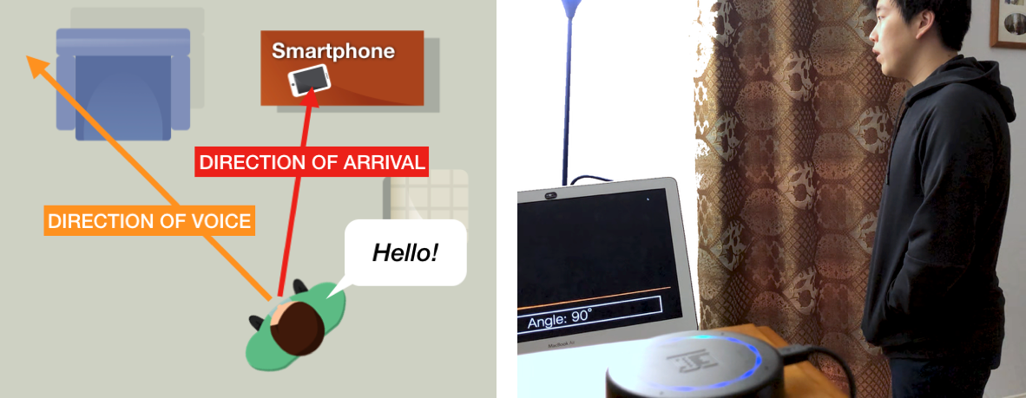
Smart Environments - Direction-of-Voice
Feature Extraction e.g. volume, speech frequency ratio
Machine Learning e.g. ensemble-based decision trees
Karan Ahuja, Andy Kong, Mayank Goel, and Chris Harrison. 2020. Direction-of-Voice (DoV) Estimation for Intuitive Speech Interaction with Smart Devices Ecosystems. In Proceedings of the 33rd Annual ACM Symposium on User Interface Software and Technology (UIST '20). ACM, New York, NY, USA, 1121–1131. DOI: https://doi.org/10.1145/3379337.3415588
Users' Context in Smart Environments

Slide 51
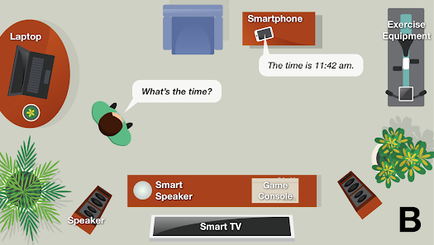
Smart Environments - Direction-of-Voice
Karan Ahuja, Andy Kong, Mayank Goel, and Chris Harrison. 2020. Direction-of-Voice (DoV) Estimation for Intuitive Speech Interaction with Smart Devices Ecosystems. In Proceedings of the 33rd Annual ACM Symposium on User Interface Software and Technology (UIST '20). ACM, New York, NY, USA, 1121–1131. DOI: https://doi.org/10.1145/3379337.3415588
Users' Context in Smart Environments

Slide 52
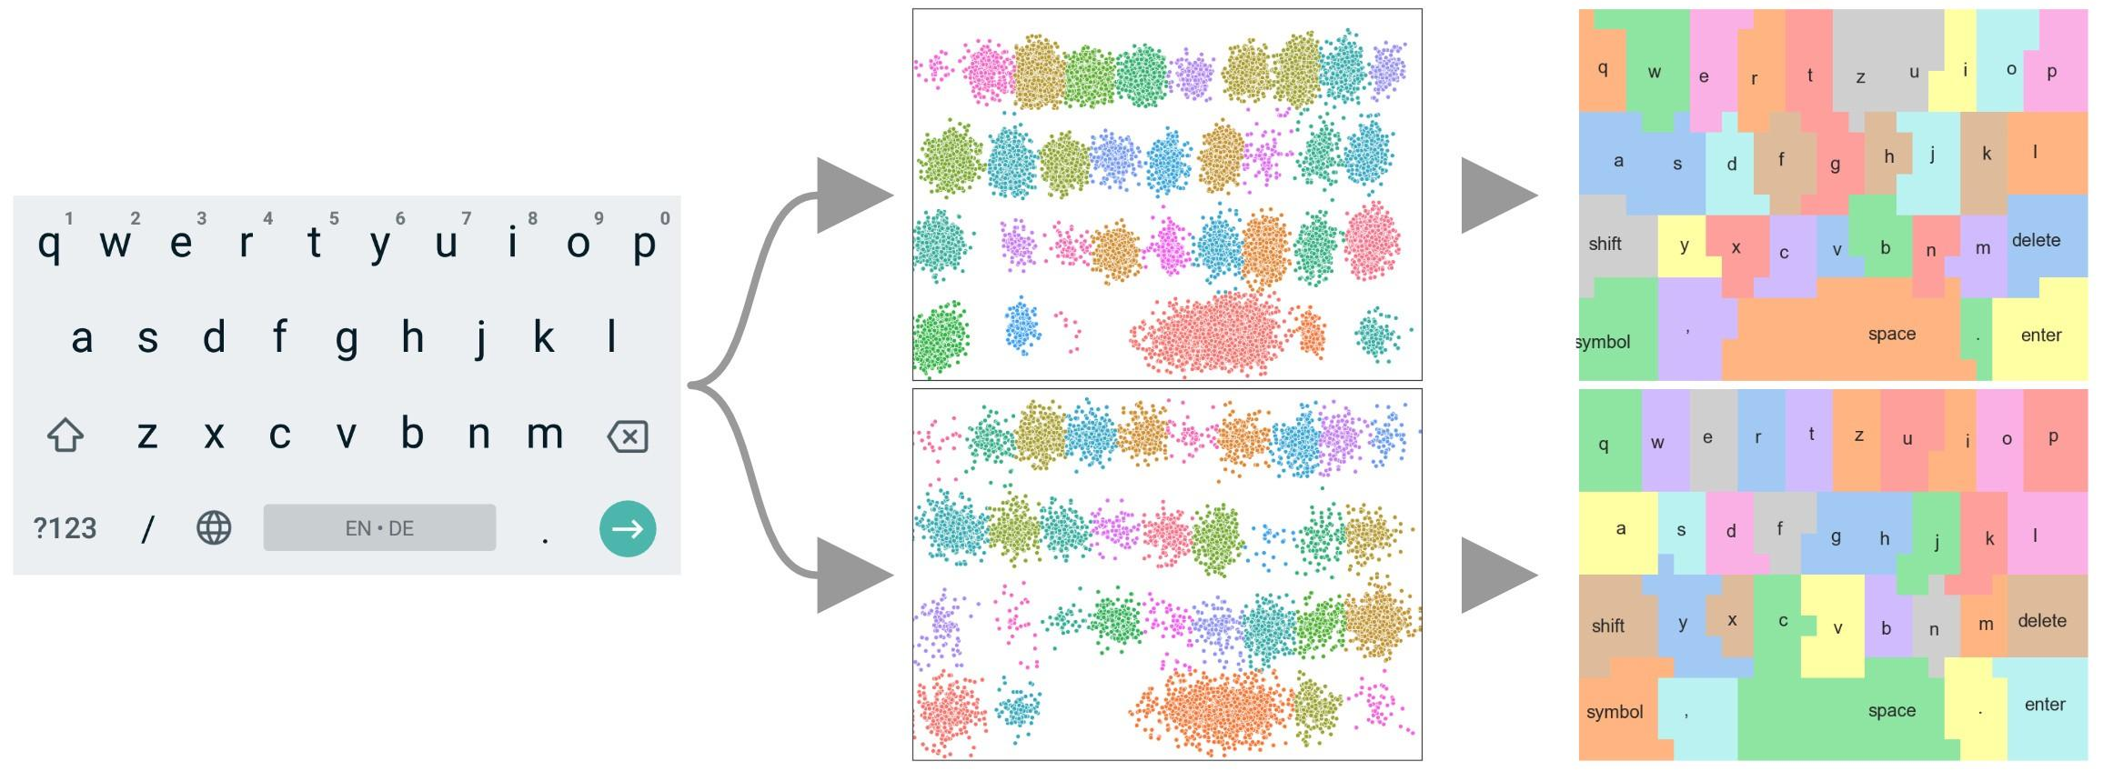
Context-Aware Keyboards
Adapt underlying key regions
Visible keyboard
Collect touches
Palm detection – input rejection
Finger identification, Finger Orientation – model improvement
Grip detection – model selection
Users' Context in Smart Environments

Slide 53
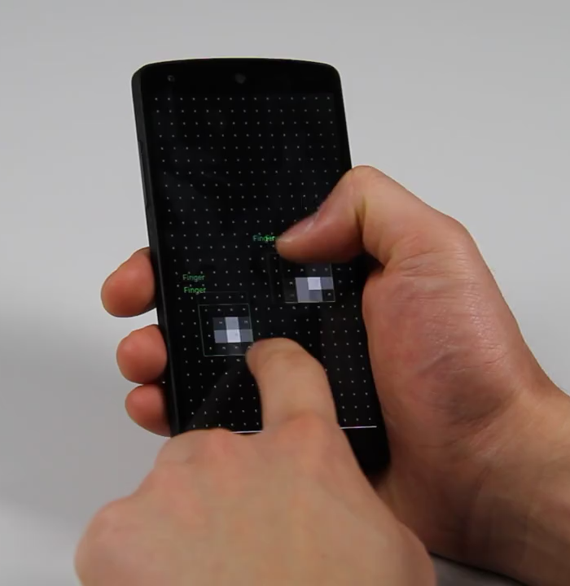
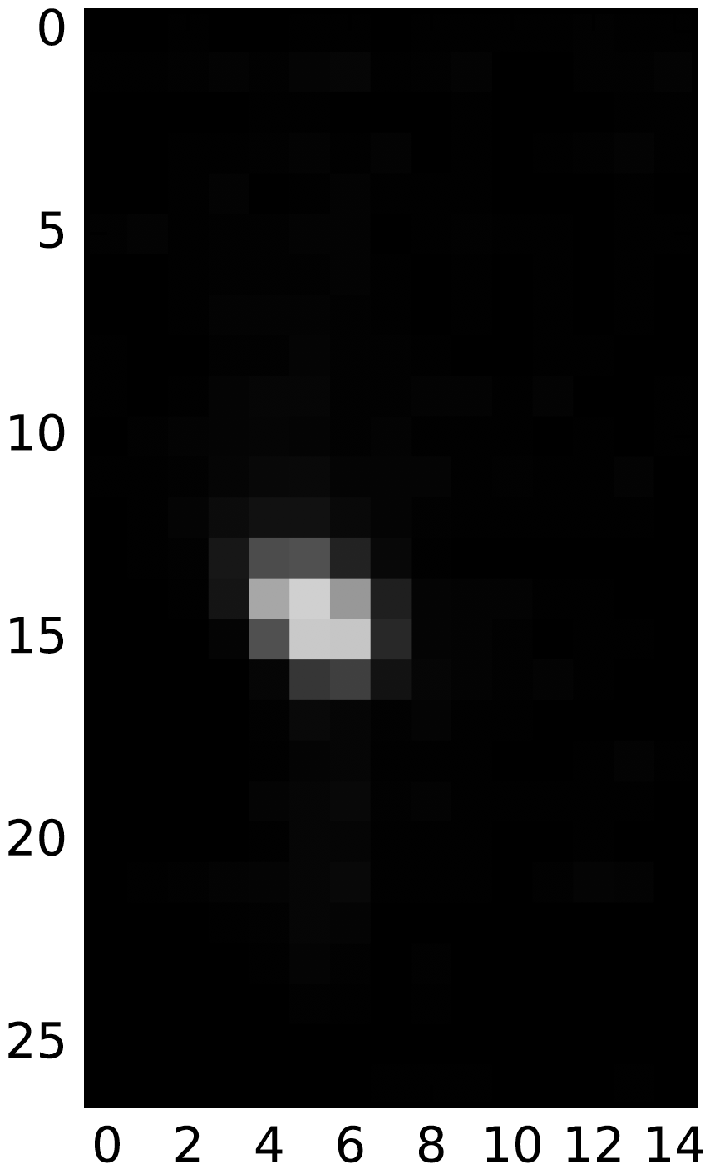
Palm Detection
Convolutional Neural Network
Classification
Representation Learning
Finger
CNN
Palm
Huy Viet Le, Thomas Kosch, Patrick Bader, Sven Mayer, and Niels Henze. 2018. PalmTouch: Using the Palm as an Additional Input Modality on Commodity Smartphones. In Proceedings of the 2018 CHI Conference on Human Factors in Computing Systems (CHI '18). ACM, New York, NY, USA, Paper 360, 1–13. DOI: https://doi.org/10.1145/3173574.3173934
Users' Context in Smart Environments

Slide 54
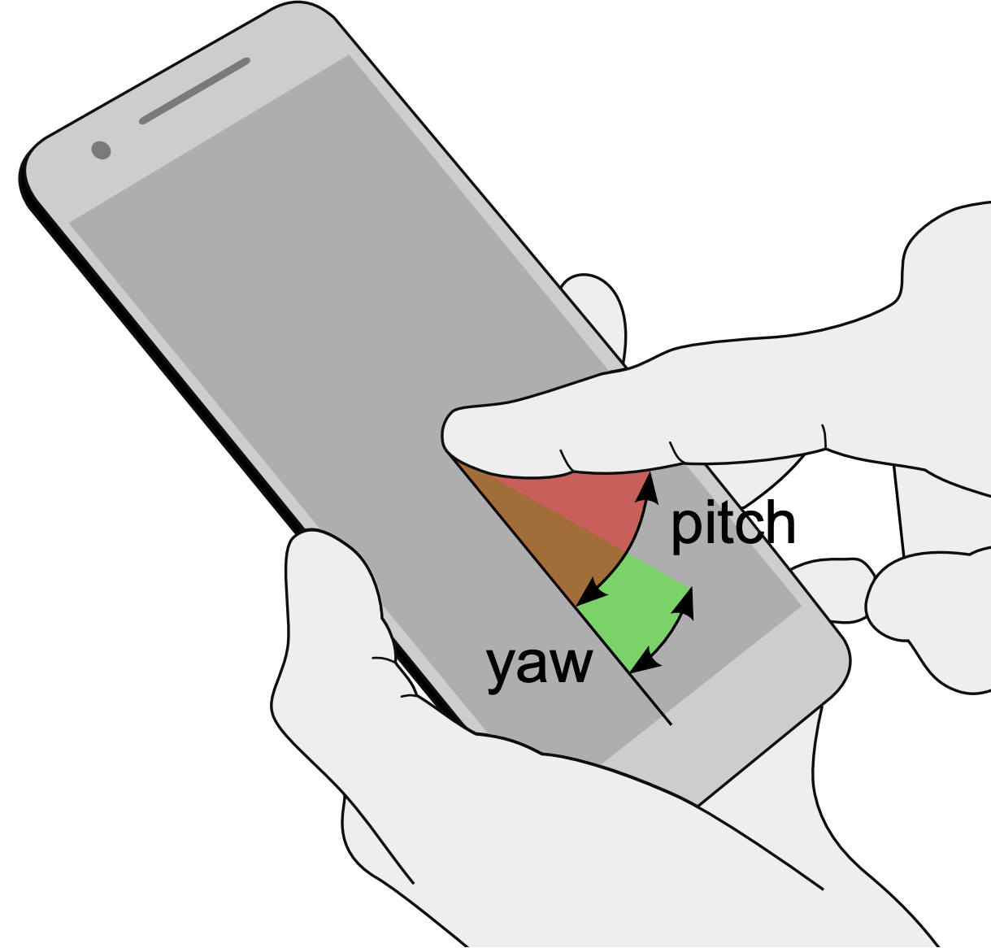
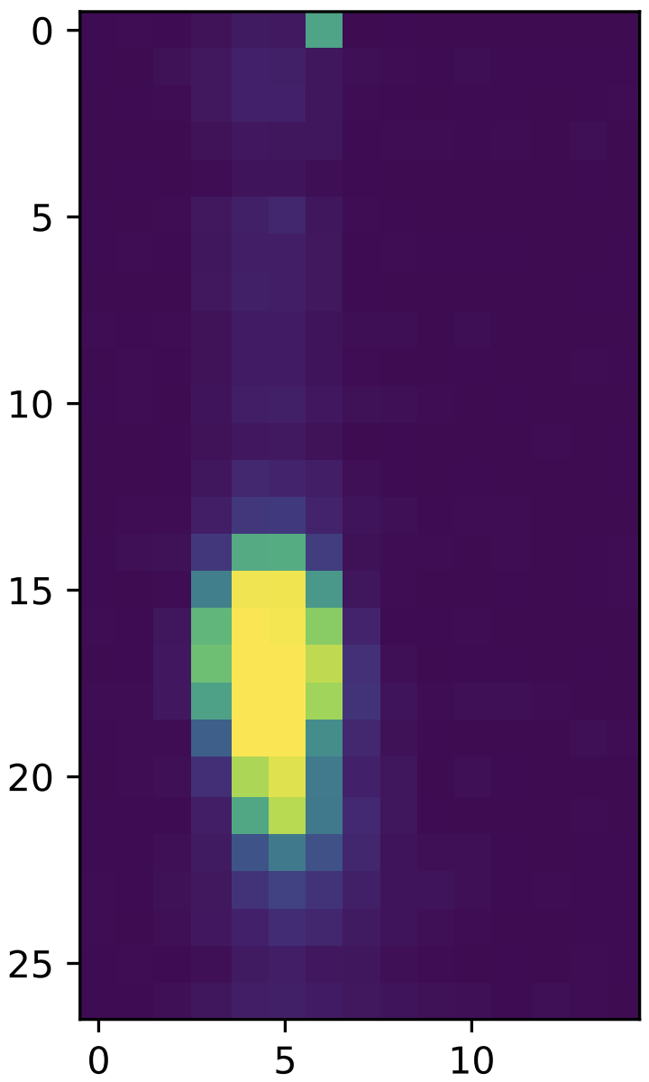
Finger Orientation
Convolutional Neural Network
Regression
Representation Learning
Pitch: 4°
CNN
Yaw: 17°
Sven Mayer, Huy Viet Le, and Niels Henze. 2017. Estimating the Finger Orientation on Capacitive Touchscreens Using Convolutional Neural Networks. In Proceedings of the 2017 ACM International Conference on Interactive Surfaces and Spaces (ISS '17). ACM, New York, NY, USA, 220–229. DOI: https://doi.org/10.1145/3132272.3134130
Users' Context in Smart Environments

Slide 55
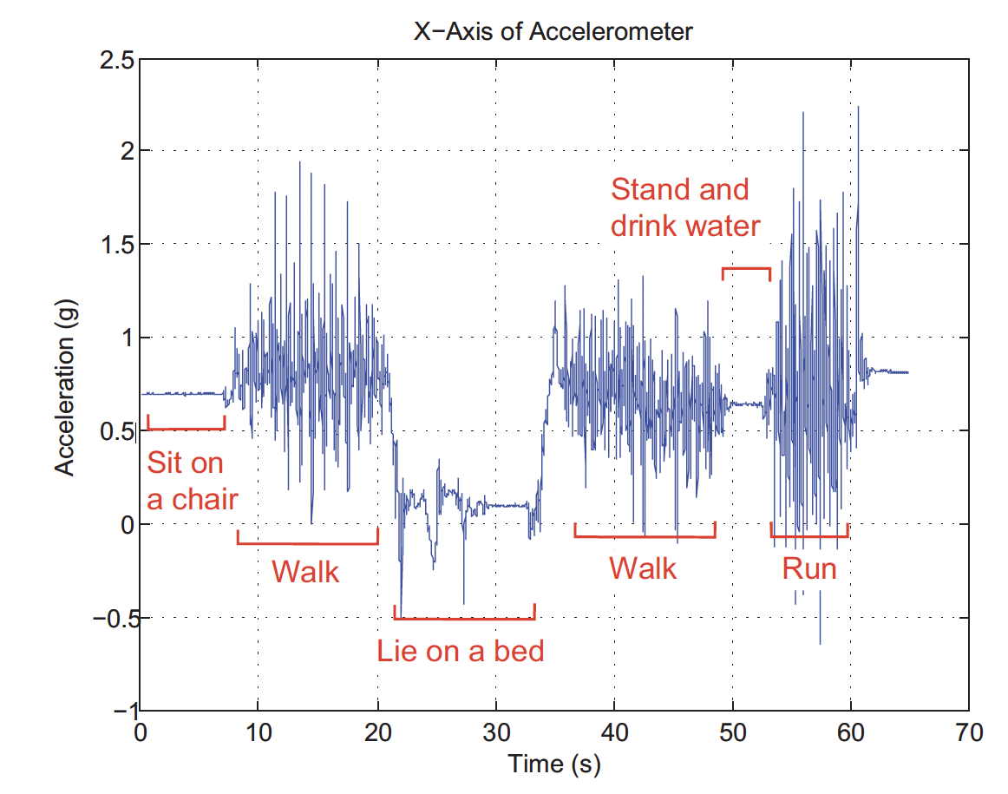
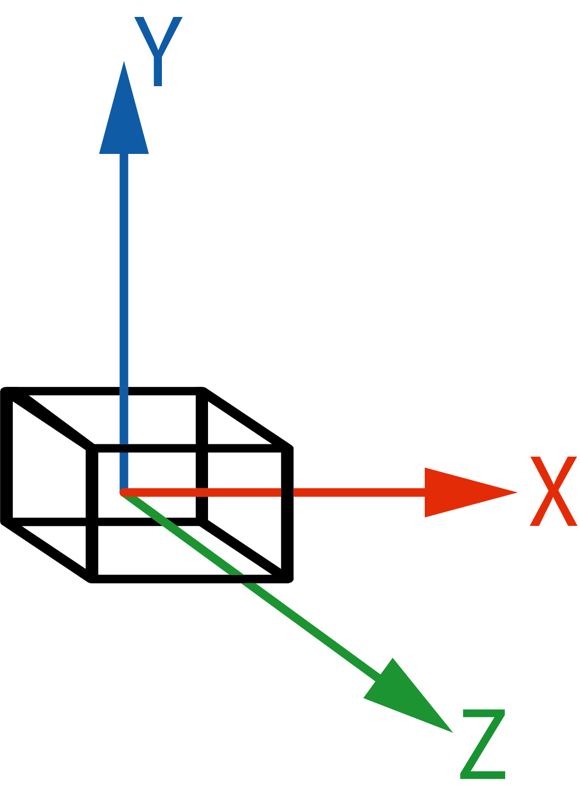
Activity Recognition – Accelerometers
Mi Zhang and Alexander A. Sawchuk. 2012. USC-HAD: a daily activity dataset for ubiquitous activity recognition using wearable sensors. In Proceedings of the 2012 ACM Conference on Ubiquitous Computing (UbiComp '12). Association for Computing Machinery, New York, NY, USA, 1036–1043. DOI: https://doi.org/10.1145/2370216.2370438
Users' Context in Smart Environments

Slide 56
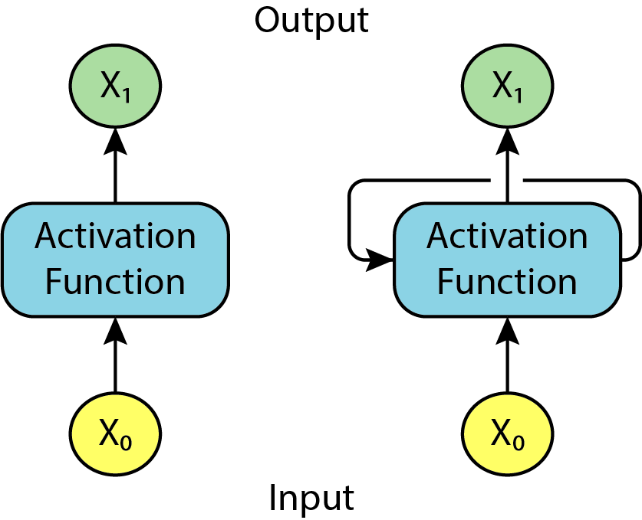
Neuronal Network With Timeseries Data
Recurrent Neural Network
Perceptron
RNN Unit
Side note:
Long short-term memory (LSTM) is an advanced RNN
In depth LSTM tutorial: http://colah.github.io/posts/2015-08-Understanding-LSTMs/
Code Examples: https://github.com/cwi-dis/mobile-har-tutorial
Users' Context in Smart Environments

Slide 57
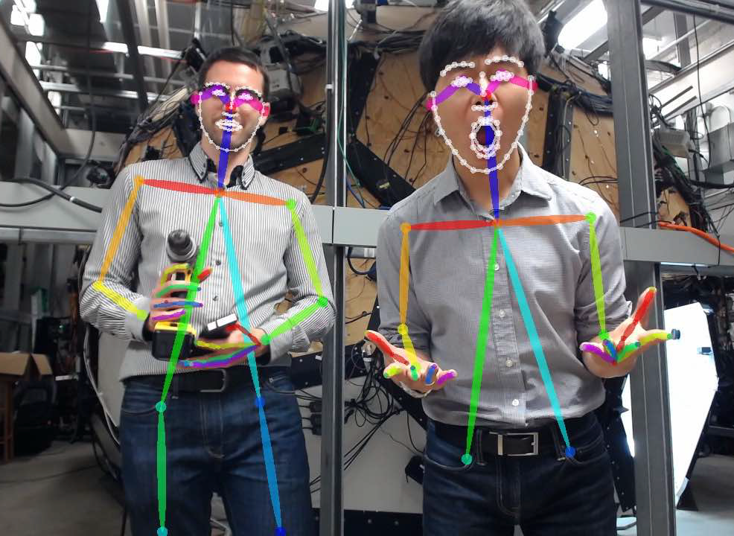
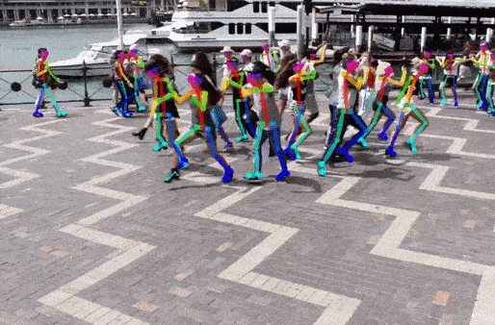
Human Pose Detection
Keypoint Estimation
Multi-stage CNN
Zhe Cao, Gines Hidalgo, Tomas Simon, Shih-En Wei, and Yaser Sheikh. OpenPose: realtime multi-person 2D pose estimation using Part Affinity Fields. IEEE transactions on pattern analysis and machine intelligence 43, no. 1 (2019): 172-186. DOI: https://doi.org/10.1109/TPAMI.2019.2929257
Users' Context in Smart Environments

Slide 58
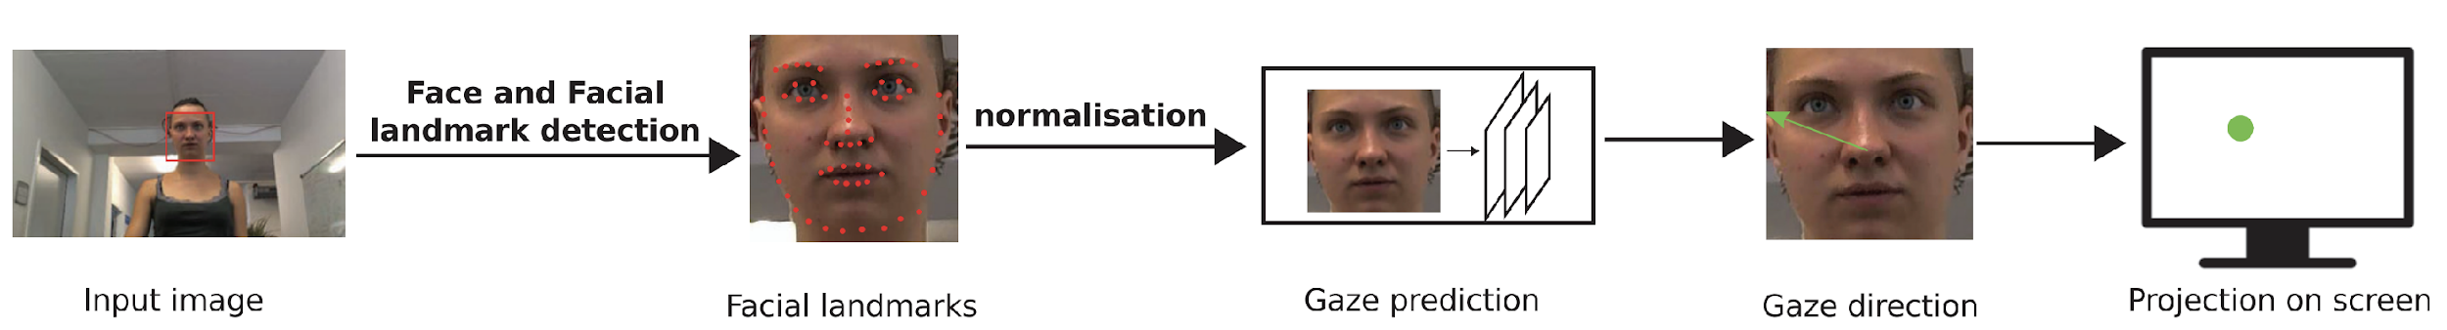
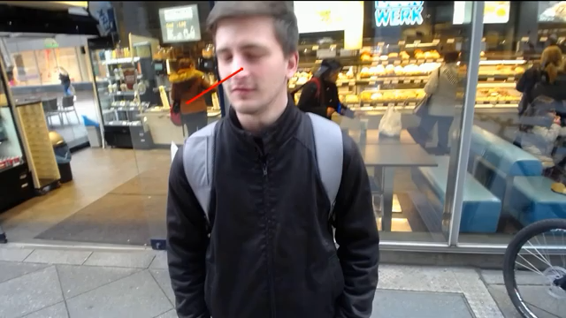
Camera based Gaze Estimation
https://youtu.be/9Lujg3beiYI
Xucong Zhang, Yusuke Sugano, and Andreas Bulling. 2019. Evaluation of Appearance-Based Methods and Implications for Gaze-Based Applications. In Proceedings of the 2019 CHI Conference on Human Factors in Computing Systems (CHI '19). ACM, New York, NY, USA, Paper 416, 1–13. DOI: https://doi.org/10.1145/3290605.3300646 URL: http://www.opengaze.org/
Users' Context in Smart Environments

Slide 59
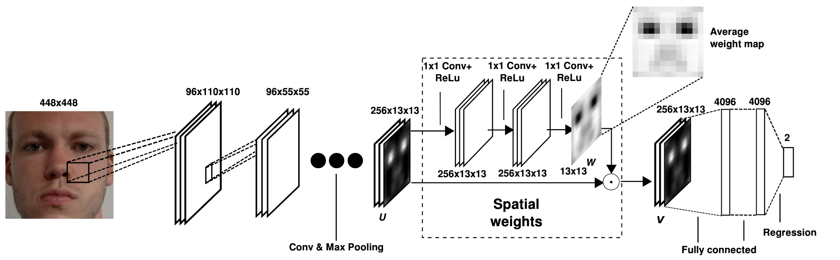
Camera based Gaze Estimation
Convolutional Neural Network
Regression – x/y cornindates
Xucong Zhang, Yusuke Sugano, Mario Fritz, and Andreas Bulling. 2017. It's written all over your face: Full-face appearance-based gaze estimation. In Proceedings of the IEEE Conference on Computer Vision and Pattern Recognition Workshops, pp. 51-60. 2017. DOI: https://doi.org/10.1109/CVPRW.2017.284
Users' Context in Smart Environments

Slide 60


Enhanced Voice Assistants
Sven Mayer, Gierad Laput, and Chris Harrison. 2020. Enhancing Mobile Voice Assistants with WorldGaze. In Proceedings of the 2020 CHI Conference on Human Factors in Computing Systems (CHI '20). Association for Computing Machinery, New York, NY, USA, 1–10. DOI: https://doi.org/10.1145/3313831.3376479
Users' Context in Smart Environments

Slide 61


Object Detection
Sven Mayer, Gierad Laput, and Chris Harrison. 2020. Enhancing Mobile Voice Assistants with WorldGaze. In Proceedings of the 2020 CHI Conference on Human Factors in Computing Systems (CHI '20). Association for Computing Machinery, New York, NY, USA, 1–10. DOI: https://doi.org/10.1145/3313831.3376479
Users' Context in Smart Environments

Slide 62

Object Detection
R-CNN: Regions with CNN feature
Ross Girshick, Jeff Donahue, Trevor Darrell, and Jitendra Malik. Rich feature hierarchies for accurate object detection and semantic segmentation (2014) In Proceedings of the IEEE conference on computer vision and pattern recognition, pp. 580-587. DOI: https://doi.org/10.1109/CVPR.2014.81 Source Code: https://github.com/rbgirshick/rcnn
Users' Context in Smart Environments

Slide 63

Object Detection
YOLO – You Only Look Once
https://youtu.be/MPU2HistivI
Joseph Redmon, and Ali Farhadi. "Yolov3: An incremental improvement." arXiv preprint arXiv:1804.02767 (2018).
URL: https://pjreddie.com/darknet/yolo/
Users' Context in Smart Environments

Slide 64



Machine Learning for HCI
User Centered Design Cycle ISO 9241
Adaptation for Machine Learning
Huy Viet Le, Sven Mayer, and Niels Henze. 2020. Deep learning for human-computer interaction. interactions 28, 1 (January - February 2021), 78–82. DOI: https://doi.org/10.1145/3436958
Users' Context in Smart Environments

Slide 65
Neuronal Network Concepts
Introduced concepts
Classification vs. Regression
Feature Extraction vs. Representation Learning
Model Structures
  Neuronal Network
  Convolutional Neural Network
  RNN
  Long short-term memory (LSTM)
Users' Context in Smart Environments

Slide 66

License
This file is licensed under the Creative Commons Attribution-Share Alike 4.0 (CC BY-SA) license:
https://creativecommons.org/licenses/by-sa/4.0
Attribution: Albrecht Schmidt, Sven Mayer, and Daniel Buschek

