Slide 1


Natural Language Processing and Bots

Slide 2
Natural Language Processing

Slide 3
Overview - NLP
Definition and Motivation
Applications
Terms, basic concepts and algorithms
Milestones in the history of NLP
Text Analytics

Slide 4
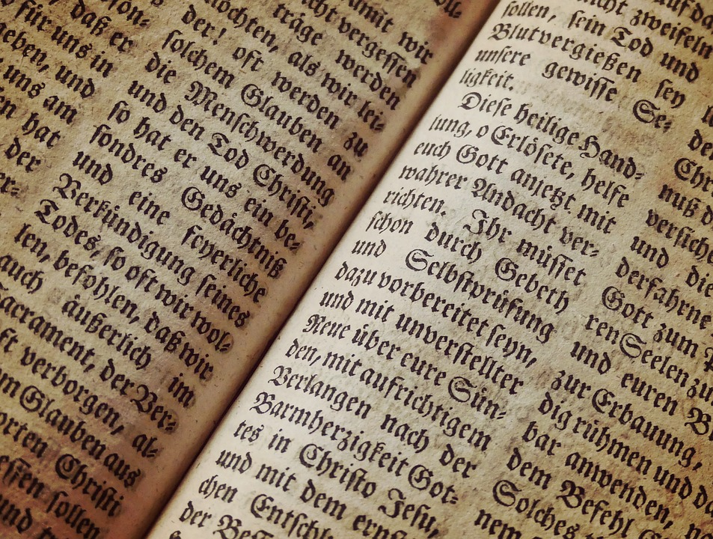
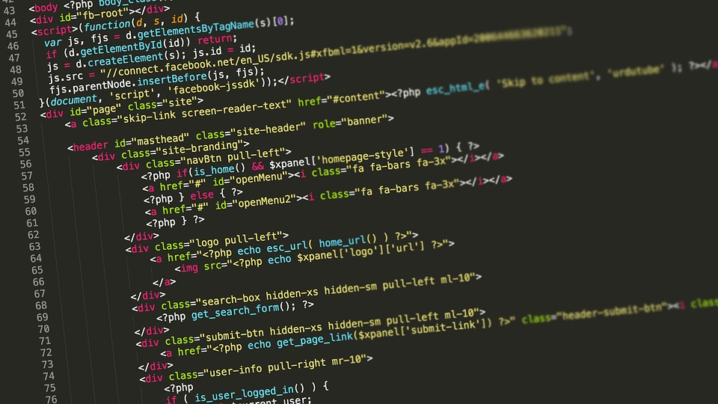
Artificial languages and Natural Languages
Syntax and semantic
Vocabulary as set of words
Text a sequence of words
Language all “valid” texts
Notes:
Die Syntax einer Sprache (eines Zeichensystems) beschreibt die Regeln, nach denen die Sprachkonstrukte (Zeichen des Zeichensystems) gebildet werden. ..
. Die Semantik einer Sprache (eines Zeichensystems) beschreibt die Bedeutung der Sprachkonstrukte (Zeichen des Zeichensystems).
Die Pragmatik einer Sprache (eines Zeichensystems) beschäftigt sich mit der Verwendung und Bedeutung von Sprachkonstrukten in konkreten Situationen.
https://www.inf-schule.de/sprachen/sprachenundautomaten/formalesprachen/einfuehrung_zeichensystem/syntaxsemantikpragmatik
Images are free to use:
https://pixabay.com/photos/code-programming-coding-web-2434271/
https://pxhere.com/en/photo/1201393

Slide 5
Natural Language Processing (NLP) A Definition
“Natural Language Processing is a theoretically motivated range of computational techniques for analyzing and representing naturally occurring texts at one or more levels of linguistic analysis for the purpose of achieving human-like language processing for a range of tasks or applications.”
Liddy, E.D. 2001. Natural Language Processing. In Encyclopedia of Library and Information Science, 2nd Ed. NY. Marcel Decker, Inc.

Slide 6
Natural Language Processing (NLP) A Definition
“Natural Language Processing is a theoretically motivated range of computational techniques for analyzing and representing naturally occurring texts at one or more levels of linguistic analysis for the purpose of achieving human-like language processing for a range of tasks or applications.”
Liddy, E.D. 2001. Natural Language Processing. In Encyclopedia of Library and Information Science, 2nd Ed. NY. Marcel Decker, Inc.
Notes:
https://surface.syr.edu/cgi/viewcontent.cgi?article=1043&context=istpub

Slide 7
Natural Language Processing (NLP) A Definition
“Natural Language Processing is a theoretically motivated range of computational techniques for analyzing and representing naturally occurring texts at one or more levels of linguistic analysis for the purpose of achieving human-like language processing for a range of tasks or applications.”
Liddy, E.D. 2001. Natural Language Processing. In Encyclopedia of Library and Information Science, 2nd Ed. NY. Marcel Decker, Inc.

Slide 8
Natural Language Processing (NLP) A Definition
“Natural Language Processing is a theoretically motivated range of computational techniques for analyzing and representing naturally occurring texts at one or more levels of linguistic analysis for the purpose of achieving human-like language processing for a range of tasks or applications.”
Liddy, E.D. 2001. Natural Language Processing. In Encyclopedia of Library and Information Science, 2nd Ed. NY. Marcel Decker, Inc.

Slide 9
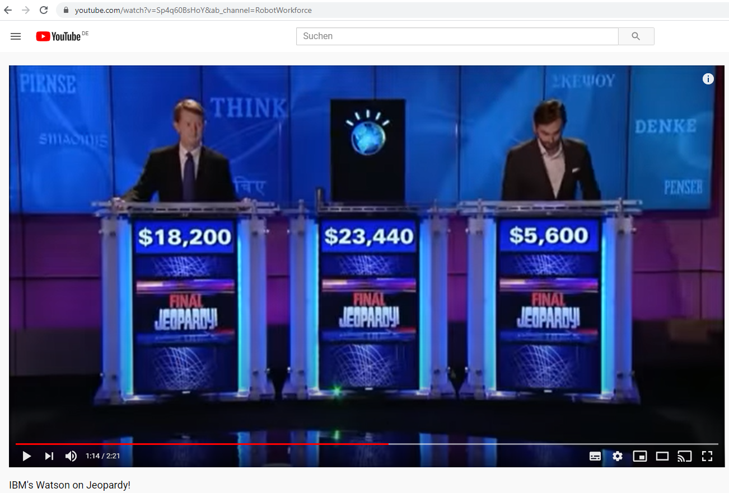
https://www.youtube.com/watch?v=Sp4q60BsHoY

Slide 10
Challenges in NLP Examples
Paraphrase an input text
Translate text from one language into another
Answer questions about the contents of the text (or corpus)
Draw inferences and conclusions from the text (or corpus)
Liddy, E.D. 2001. Natural Language Processing. In Encyclopedia of Library and Information Science, 2nd Ed. NY. Marcel Decker, Inc.

Slide 11
Typical algorithms for
Responding to phrases (e.g. chat bot)
Discover topics and concepts a text describes
Summarizing texts (to different length)
Extracting relevant keywords from texts
Identify the sentiment of a text or phrase
…
…
Break up texts in tokens
Reduce words to the root / stem
https://algorithmia.com/blog/introduction-natural-language-processing-nlp

Slide 12
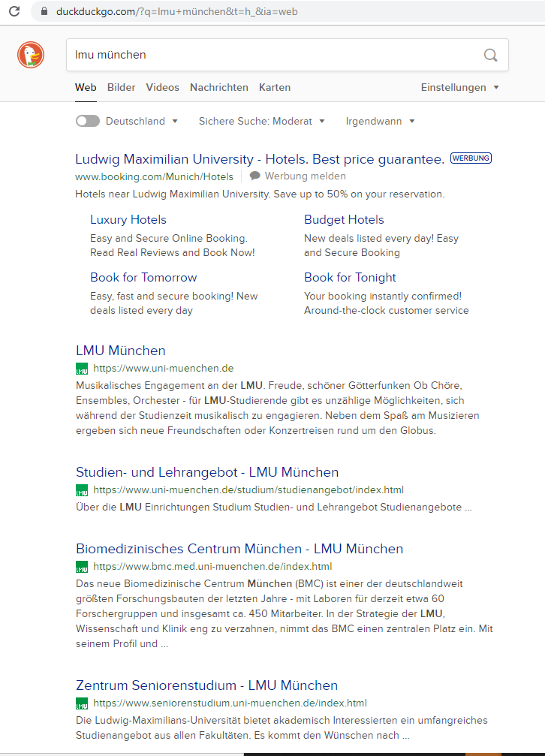
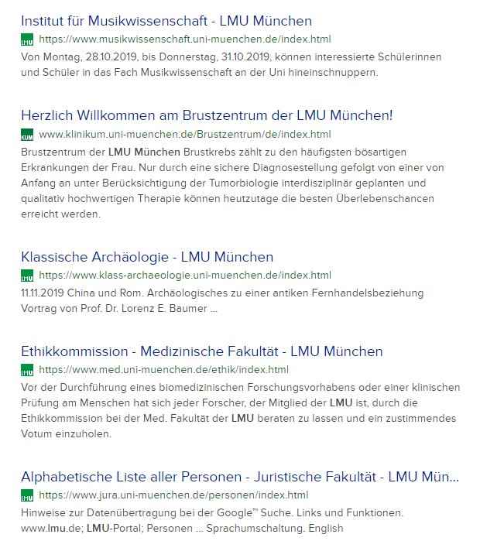

Slide 13
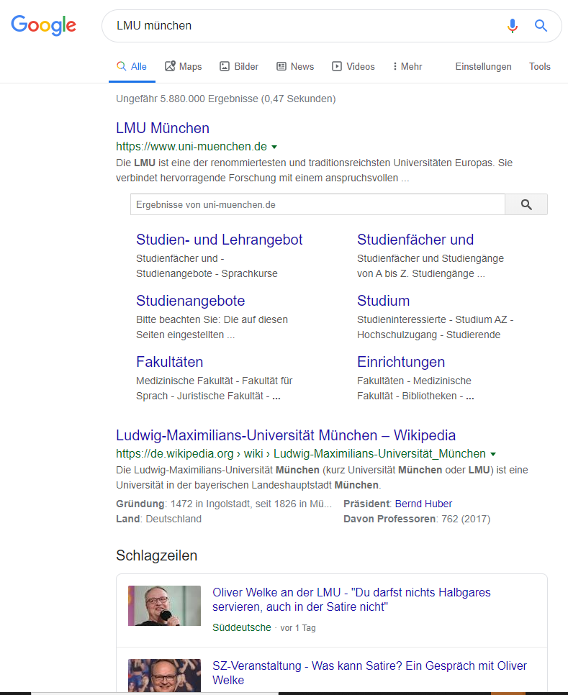
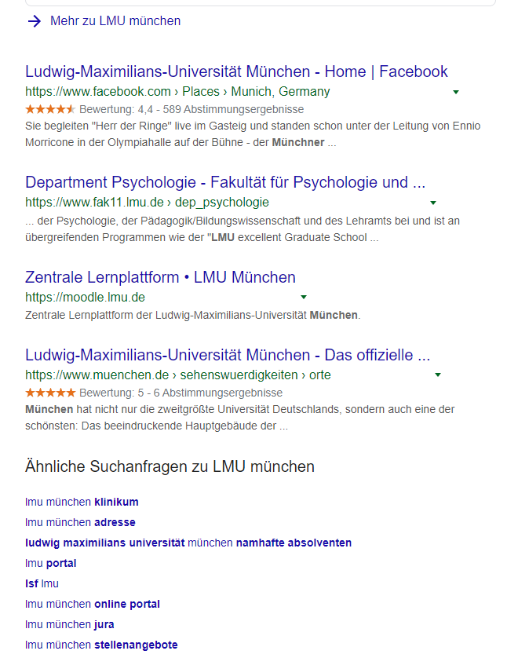

Slide 14
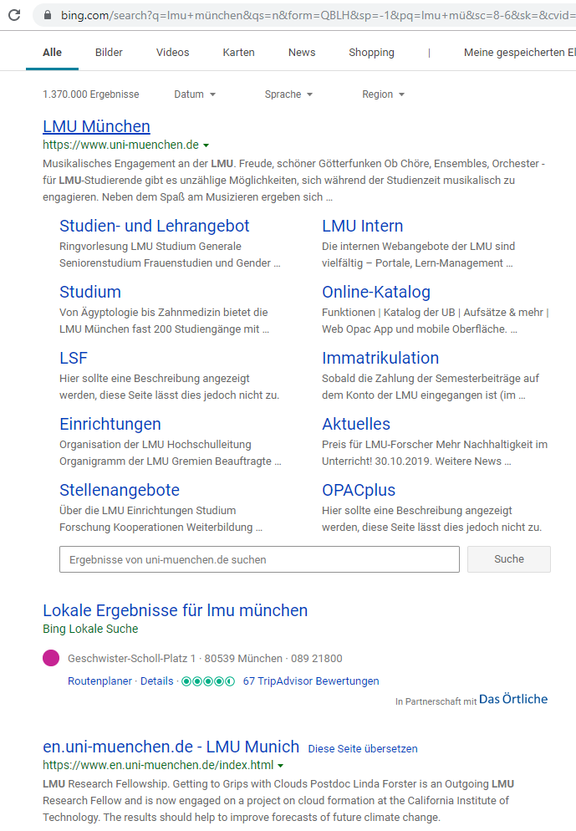
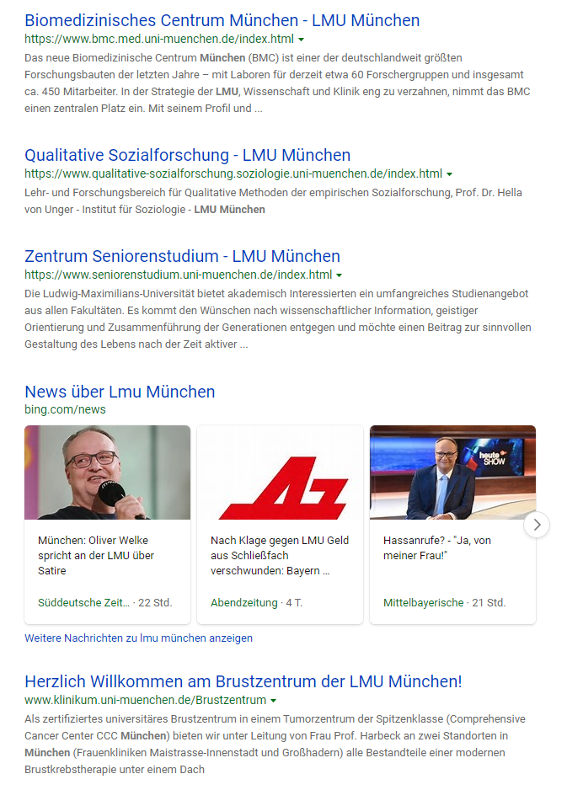

Slide 15
Discussion: Naive implementation of search
Given
10000 text documents with an average length of 1000 words
A search term of up to 4 words
Aim: the 10 text documents that best match the query
Approach?
Where can Machine Learning and AI help?
Scenario:
You have stored all articles of
the New York Times from 2010
to 2020
Someone asks for the article
about “Merkel visiting the US”
Which articles do you give back?

Slide 16
Python Example Counting word occurrences
Query = “media informatics”
Transfering the query into a coordinate
One cell / dimension for each word
Count occurances
informatics
media informatics
4
3
2
1
1
1
0 1 2 3 4
media
Example based on: https://livebook.manning.com/book/essential-natural-language-processing/chapter-1/55

Slide 17
Python Example Counting word occurrences
Query = “media informatics”
Transfering documents into coordinates
D1: media informatics media media media
D2: media informatics media informatics media informatics
Count occurances
media informatics
informatics
D1
4
1
4
3
2
1
D2
D2
3
3
D1
0 1 2 3 4
media
Example based on: https://livebook.manning.com/book/essential-natural-language-processing/chapter-1/55

Slide 18
Python Example Counting word occurrences
Query = “media informatics”
Transfering documents into coordinates
D1: media informatics media media media
D2: media informatics media informatics media informatics
Count occurances
media informatics
informatics
D1
4
1
4
3
2
1
D2
D2
3
3
Q
D1
0 1 2 3 4
media
Example based on: https://livebook.manning.com/book/essential-natural-language-processing/chapter-1/55

Slide 19
Python Example Counting word occurrences
d1 = "media ... informatics media ... media ... media"
d2 = "media informatics ... media ... informatics ... media informatics"
...
vector = [0, 0]
for word in d1.split(" "):
if word=="media":
vector[0] = vector[0] + 1
if word=="informatics":
vector[1] = vector[1] + 1
print (vector)
Example based on: https://livebook.manning.com/book/essential-natural-language-processing/chapter-1/55

Slide 20
Overview - NLP
Definition and Motivation
Applications
Terms, basic concepts and algorithms
Milestones in the history of NLP
Text Analytics

Slide 21
Application of NLP?
Where do you use NLP on a daily basis?
What are typical tasks?

Slide 22
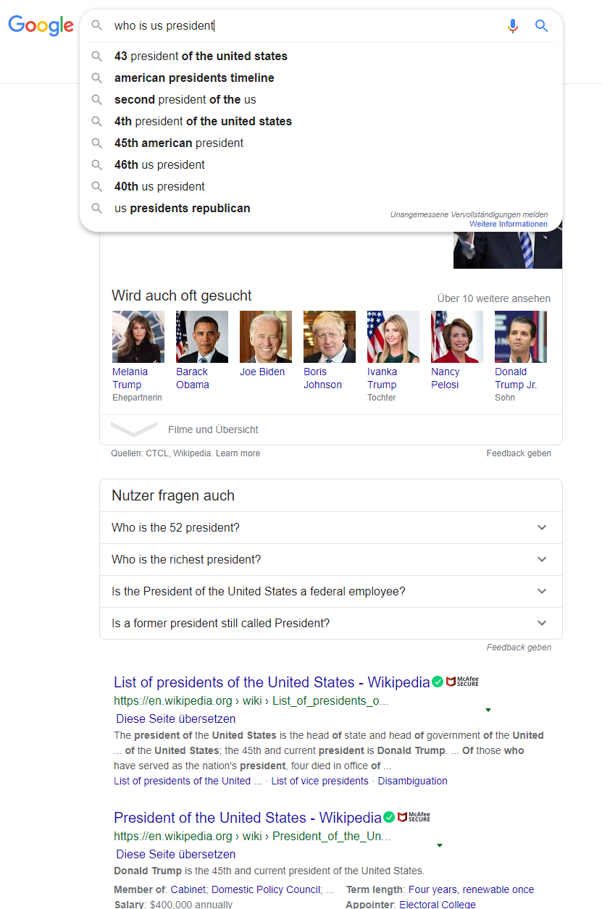
Application of NLP?
Where do you use NLP on a daily basis?
What are typical tasks?

Slide 23
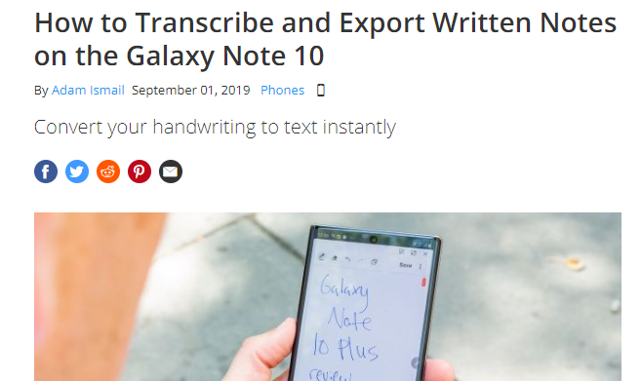
Application of NLP?
Where do you use NLP on a daily basis?
What are typical tasks?
https://www.tomsguide.com/how-to/how-to-transcribe-and-export-written-notes-on-the-galaxy-note-10
Notes:
https://www.tomsguide.com/how-to/how-to-transcribe-and-export-written-notes-on-the-galaxy-note-10

Slide 24
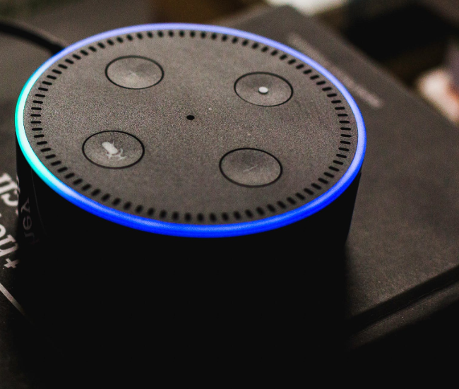
Application of NLP?
Where do you use NLP on a daily basis?
What are typical tasks?
Notes:
https://www.pexels.com/photo/alexa-alexa-talking-amazon-cortana-717235/

Slide 25
Overview - NLP
Definition and Motivation
Applications
Terms, basic concepts and algorithms
Milestones in the history of NLP
Text Analytics

Slide 26
Tokenization
Separating a text into individual words
Words are called tokens
Removing punctuation, (multiple) spaces, separators
Approach:
Search along the text and extract tokens separated by space and punctuation
Store all tokens in a list
Any difficulties?

Slide 27
Tokenization
Separating a text into individual words
Words are called tokens
Removing punctuation, (multiple) spaces, separators
Approach:
Search along the text and extract tokens separated by space and punctuation
Store all tokens in a list
Any difficulties? Dr. Max von Mayer-Hauser is today in New York and we will meet him-hopefully.

Slide 28
Stop Words Removal
Remove „small“ words in the text, such as articles, pronouns, and prepositions
Examples
English: the, and, a, to, …
German: der, die, das, und, es, …
Approaches include stop word lists or stop word learning (based on frequency)
Discussion: Approach based on ML/AI?

Slide 29
Text Normalization
Aim: match the “same” words
Syntactic matching
What is the problem? How to do this?

Slide 30
Text Normalization
Aim: match the “same” words
Upper case / lower case letters (e.g. all lower case)
Tricky if upper case is required to detect names, grammar
Normalizing word forms (stemming, lemmatization)
Acronyms (U.K. 🡪 UK)
Umlauts (für 🡪 fuer or fuer 🡪 für)
Dealing with numbers and symbols in text
Correcting misspelling

Slide 31
Stemming
Reducing the word to its stem
Extract the morphological root
removing affixes and suffixes
Heuristic process (works most of the time)
Approaches and algorithms
Set of rules (language dependent)
E.g. as automaton
Typical algorithms: Porter Stemmer, Snowball Stemmer
Example:
player, playing, playful, plays, played 🡪 play
newer, newest 🡪 new … what happens to news

Slide 32
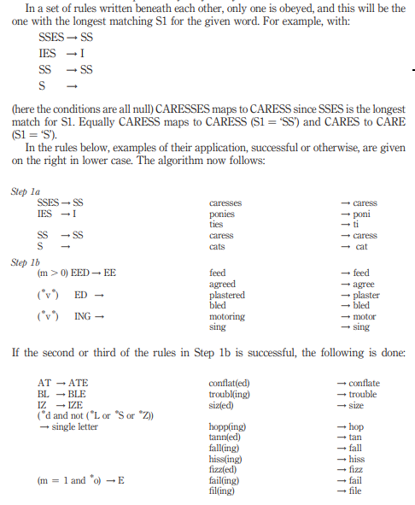
Example Porter Stemmer
Set of rules for removing/changing suffixes
Rules are grouped
Rules for their application of the rules
Porter, Martin F (1980) "An algorithm for suffix stripping." Program, 14(3)
Reprinted 2006: https://cl.lingfil.uu.se/~marie/undervisning/textanalys16/porter.pdf

Slide 33
Lemmatization
Return the base (dictionary) form of a word
Uses linguistic knowledge (vocabulary, grammar, morphological analysis)
“Lemmatization, unlike Stemming, reduces the inflected words properly ensuring that the root word belongs to the language. In Lemmatization root word is called Lemma. A lemma (plural lemmas or lemmata) is the canonical form, dictionary form, or citation form of a set of words.” https://www.datacamp.com/community/tutorials/stemming-lemmatization-python
Examples: was🡪be, running🡪run, has🡪have, swims🡪swim, caring🡪care, …

Slide 34
Stemming/Lemmatization based on ML? How would you do this?

Slide 35
Part-Of-Speech Tagging
Determining the type of a word in the context of a sentence
Identifying words as nouns, verbs, adjectives, adverbs, …

Slide 36
Named-Entity Disambiguation and Entity linking
Determining the meaning of a word, if word have more meanings
Using context and knowledge
Example
I did not use an apple to make these slides.
vs.
I really like to bake apple crumple.

Slide 37
Named-Entity Recognition
Gets entities from unstructured texts
Assigning entities/words to categories
Examples of named entities: people, places, companies, organizations, industries, products, product categories, time, location, brands, etc.
Application and domain specific, e.g. abbreviations for trading stocks, medical conditions, addresses
Library: https://spacy.io/api/annotation#section-named-entities
Example in Python: https://nlpforhackers.io/named-entity-extraction/
Software: Stanford Named Entity Recognizer (NER) https://nlp.stanford.edu/software/CRF-NER.shtml

Slide 38
Bag of Words
Texts are considered a set of words
Simplified representation
Ignores grammar (and generally word order)
Typical calculation:
Frequency of occurrence of words
Frequency of n-grams (preserves some word order)
“My cat likes to sleep. I sleep a lot. Do you have a cat?”
cat 3x, sleep 2x, a 2x, …

Slide 39
Corpus, Corpora
Monolingual corpora
data from one single language
Parallel corpora
original texts in one language
translations in other languages
Examples:
Gutenberg, archive of free electronic books, https://www.gutenberg.org/ or https://www.projekt-gutenberg.org/
https://www.collinsdictionary.com/api/collins-english-dictionary,61,HCA.html

Slide 40
Corpus
“A corpus is a large body of natural language text used for accumulating statistics on natural language text. The plural is corpora. Corpora often include extra information such as a tag for each word indicating its part-of-speech, and perhaps the parse tree for each sentence.” NLP Dictionary http://www.cse.unsw.edu.au/~billw/nlpdict.html
Further Examples:
Swiss SMS Corpus, https://sms.linguistik.uzh.ch/
The National University of Singapore SMS Corpus https://www.kaggle.com/rtatman/the-national-university-of-singapore-sms-corpus

Slide 41
Live-Coding

Slide 42
Overview - NLP
Definition and Motivation
Applications
Terms, basic concepts and algorithms
Milestones in the history of NLP
Text Analytics

Slide 43
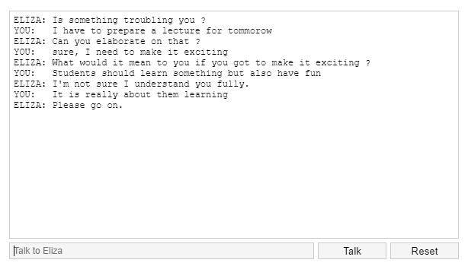
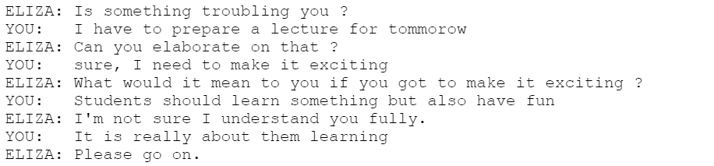
ELIZA by Joseph Weizenbaum
https://katzlberger.ai/2018/08/31/eliza-der-erste-chatbot/
Weizenbaum, Joseph. "ELIZA---a computer program for the study of natural language communication between man and machine." Communications of the ACM 9.1 (1966): 36-45. https://cse.buffalo.edu/~rapaport/572/S02/weizenbaum.eliza.1966.pdf

Slide 44
ELIZA by Joseph Weizenbaum (1966)
“ELIZA is a program […] which makes certain kinds of natural language conversation between man and computer possible. Input sentences are analyzed on the basis of decomposition rules which are triggered by key words appearing in the input text. Responses are generated by reassembly rules associated with selected decomposition rules. The fundamental technical problems with which ELIZA is concerned are:
the identification of key words,
the discovery of minimal context,
the choice of appropriate transformations,
generation of responses in the absence of keywords, and
the provision of an ending capacity for ELIZA "scripts".”
Weizenbaum, Joseph. "ELIZA---a computer program for the study of natural language communication between man and machine." Communications of the ACM 9.1 (1966): 36-45. https://doi.org/10.1145/365153.365168

Slide 45
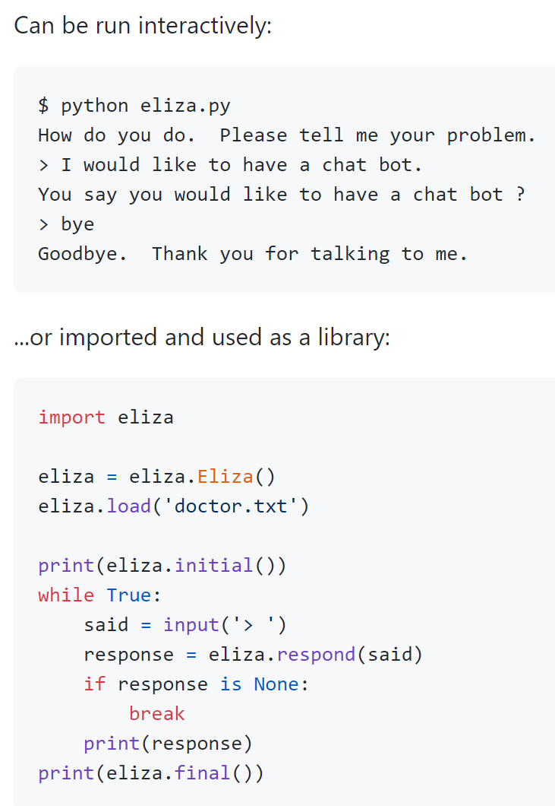
Eliza
Try Eliza out at: http://psych.fullerton.edu/mbirnbaum/psych101/Eliza.htm
Source code in Python: https://github.com/wadetb/eliza

Slide 46
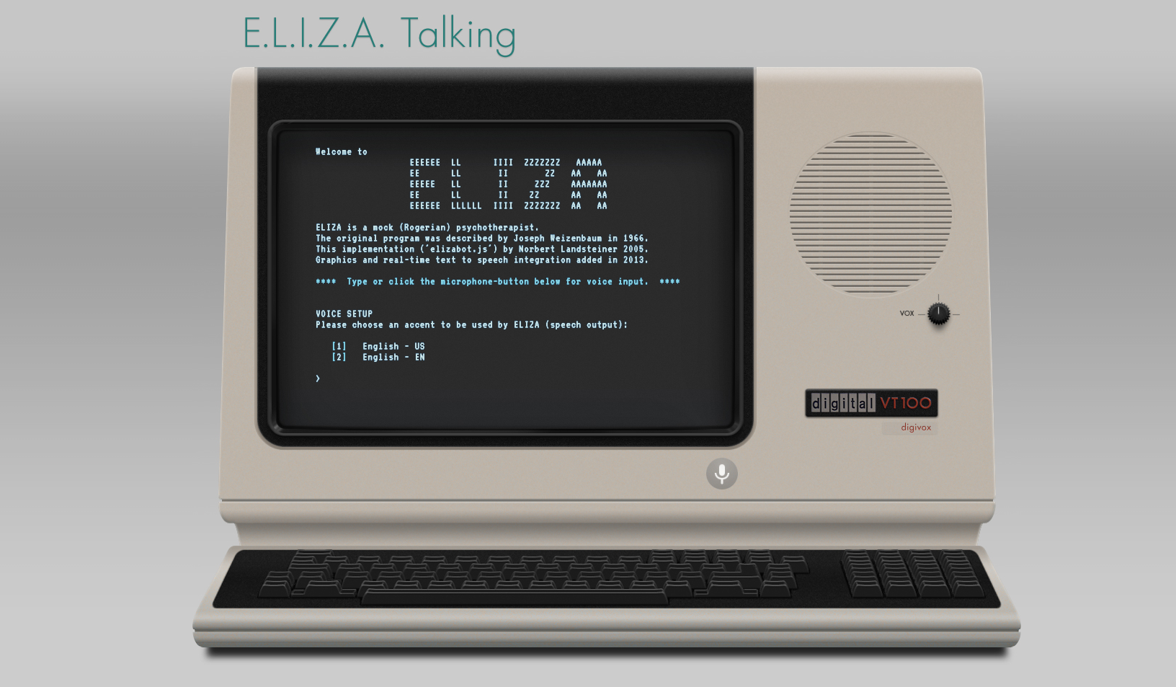
Task: How to implement a chatbot for Alexa?
https://www.masswerk.at/eliza/

Slide 47
NLP timeline three different types of approaches
Since 1950s (early days of NLP):
Rule-based Approaches
Since 1980s (statistical approaches):
Machine Learning Approaches
Since 2010s (advances in neural networks):
Deep Learning Approaches
https://livebook.manning.com/book/essential-natural-language-processing/chapter-1/15

Slide 48
Overview - NLP
Definition and Motivation
Applications
Terms, basic concepts and algorithms
Milestones in the history of NLP
Text Analytics

Slide 49
Text Analytics
Text is a key media:
in personal communication (e.g. texting, email)
in communication media (e.g. news, web pages, social media)
for knowledge sharing and acquisition (e.g. books, reports)
Most user interfaces include texts
Text reception (reading, understanding, or skimming) is often a key factor that defines the require time for a (knowledge work) task
Big individual differences in text reception (e.g. reading speed, understanding)

Slide 50
Definitions of text analytics
Definition of “text data mining”: “as the application of algorithms and methods from the fields machine learning and statistics to texts with the goal of finding useful patterns” [1]
“Text mining is the process of analyzing collections of textual materials in order to capture key concepts and themes and uncover hidden relationships and trends without requiring that you know the precise words or terms that authors have used to express those concepts.” [2]
[1] Hotho, Andreas, Andreas Nürnberger, and Gerhard Paaß. "A brief survey of text mining." Ldv Forum. Vol. 20. No. 1. 2005.
[2] https://www.ibm.com/docs/en/wsd?topic=analytics-about-text-mining

Slide 51
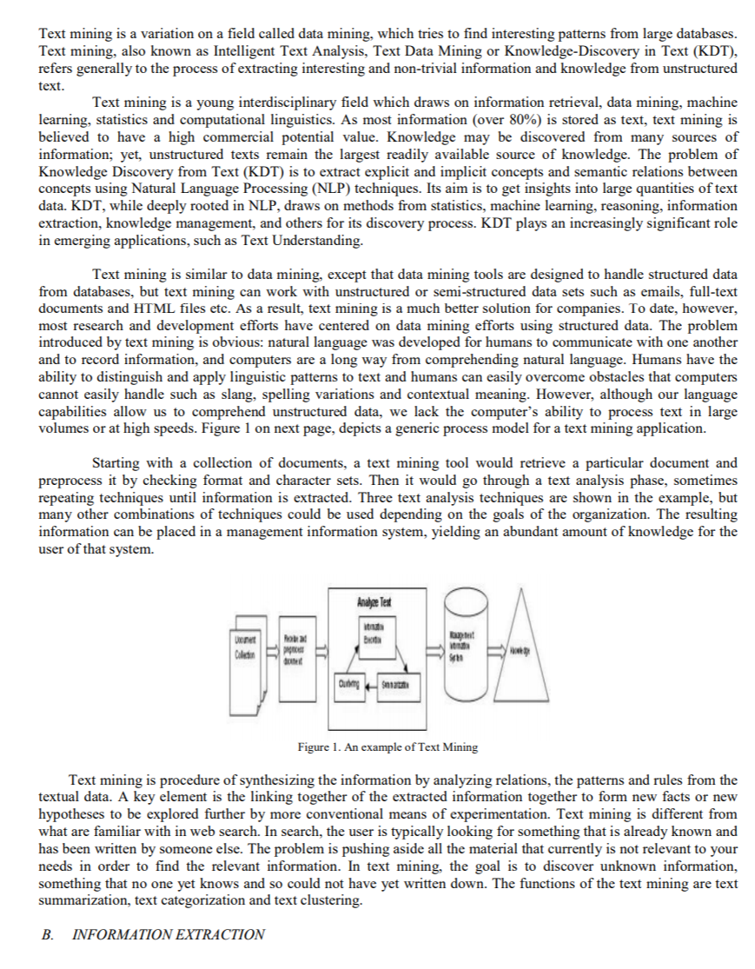
Text analytics – Why and Where?
Answering questions like
What is this text about?
What did the person communicate?
What is the key information in this document?
What feelings are communicated?
Who is saying something?
Is this different from what was said before?
Application areas
Social media analytics, e.g. twitter
Communication and reading interfaces
Customer reviews and feedback
Chat bots
Forensics
http://ijiet.com/wp-content/uploads/2015/04/17.pdf

Slide 52
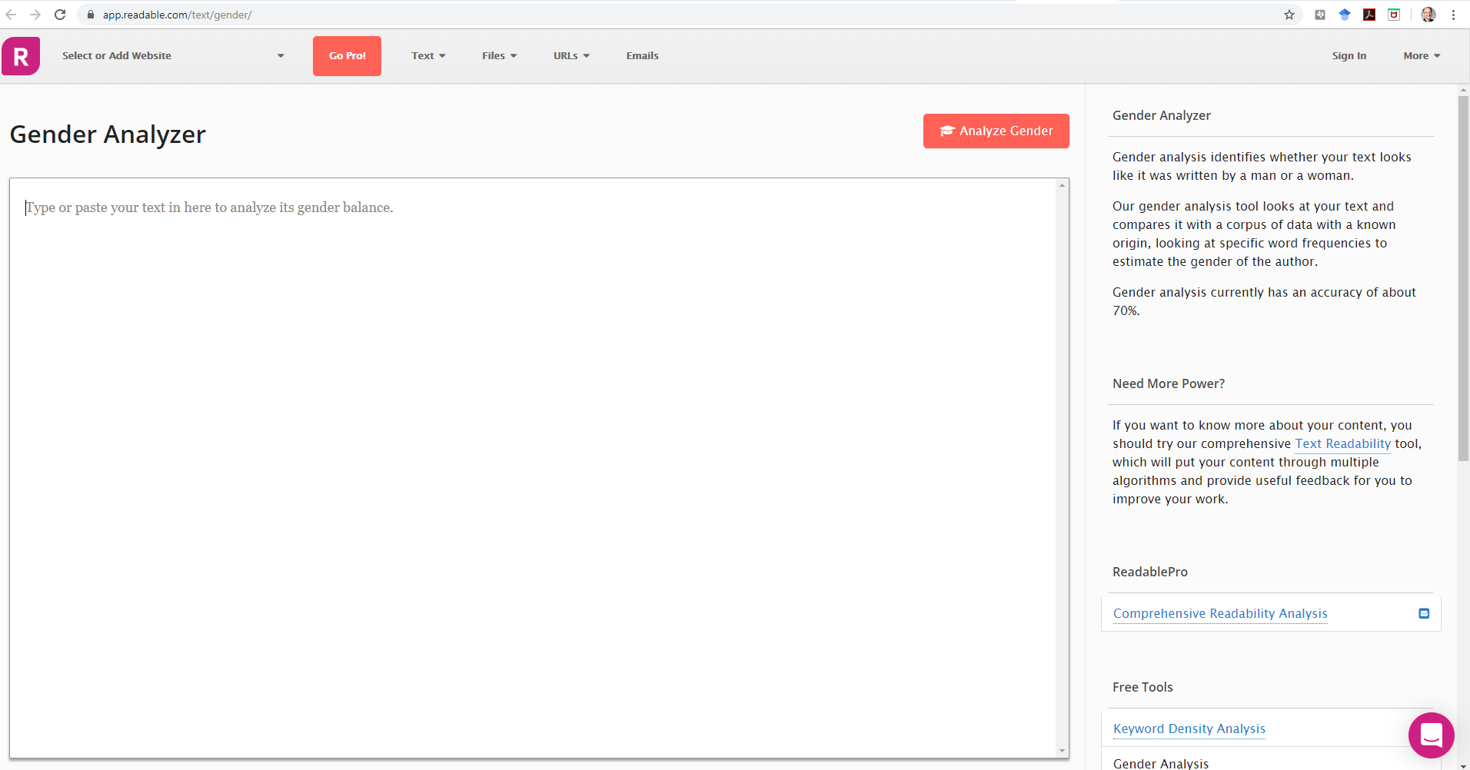
https://app.readable.com/text/gender/

Slide 53
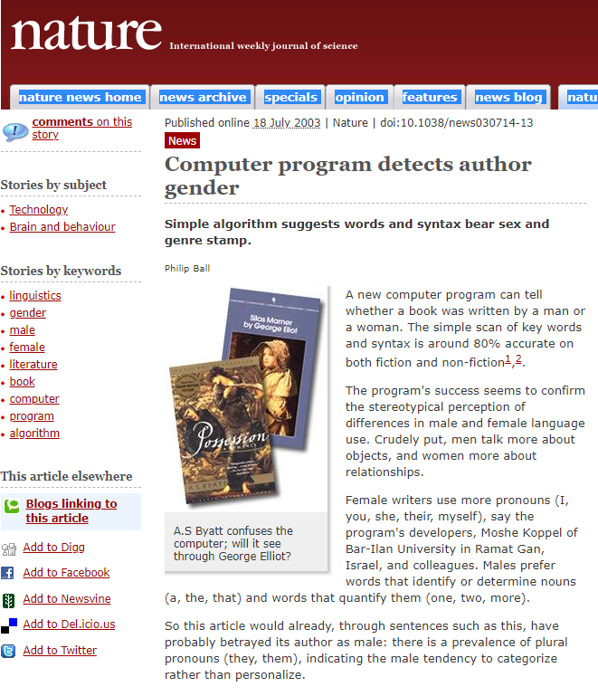
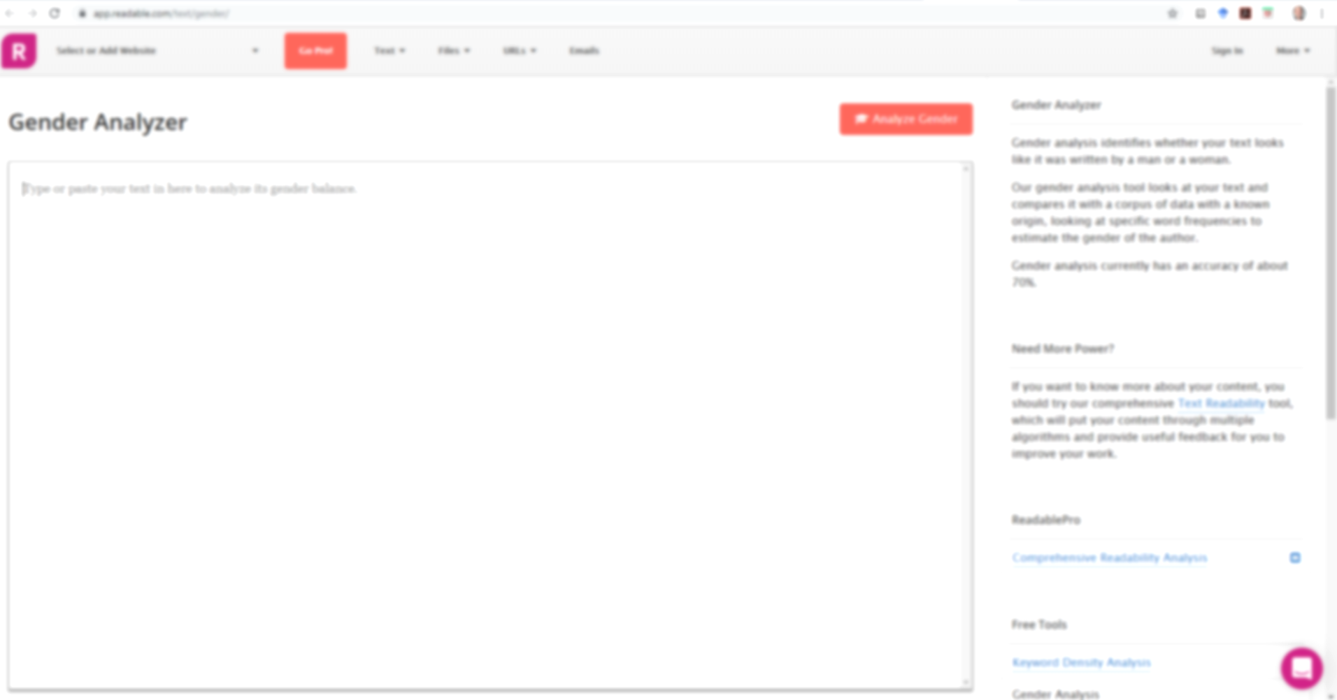
https://www.nature.com/news/2003/030714/full/news030714-13.html
https://app.readable.com/text/gender/

Slide 54
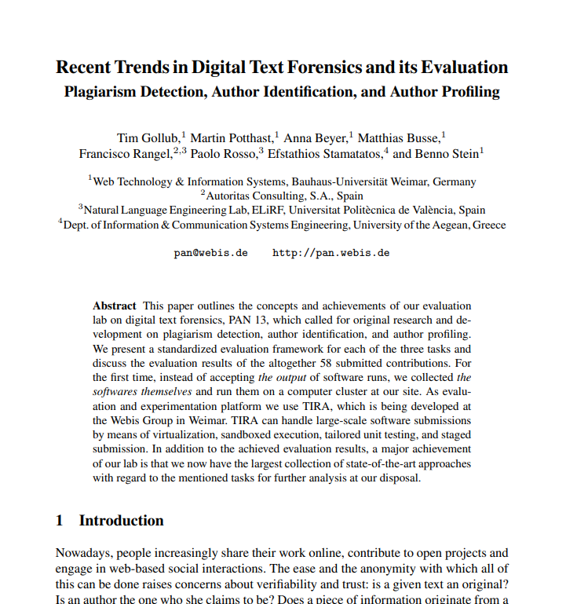
Discussion
Gollub, Tim, et al. "Recent trends in digital text forensics and its evaluation." International Conference of the Cross-Language Evaluation Forum for European Languages. Springer, Berlin, Heidelberg, 2013.
https://webis.de/downloads/publications/papers/stein_2013g.pdf

Slide 55
Text analytics – typical tasks?
Language detection
Named entity extraction
Detecting themes, categories, topics
Detecting intentions
Sentiment analysis
Document summarization
Basis for translation

Slide 56
Text analytics – Identification of the Language
Can tell what language the text is, e.g. English, German, Spanish,…
Relevant for understanding and translation
Example (Online) APIs:
https://console.bluemix.net/apidocs/language-translator
https://docs.microsoft.com/en-us/azure/cognitive-services/translator/
https://cloud.google.com/translate/docs/detecting-language
https://pypi.org/project/langdetect/
Language identification using NLTK, examples
https://avital.ca/notes/language-identification-using-nltk
http://www.algorithm.co.il/blogs/programming/python/cheap-language-detection-nltk/

Slide 57
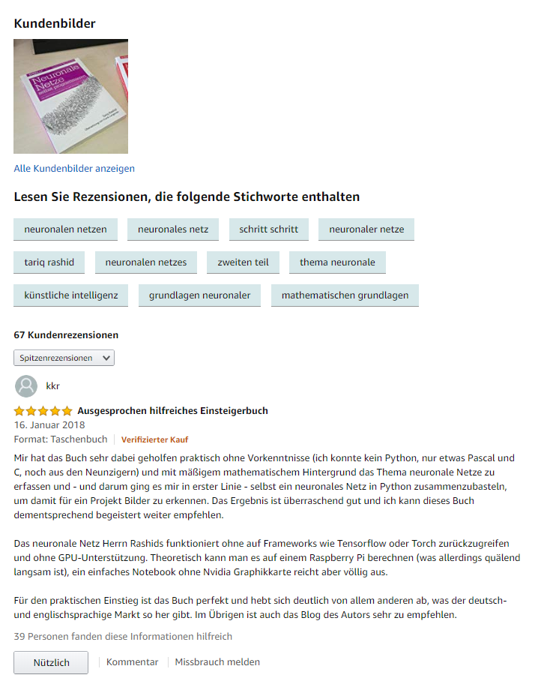

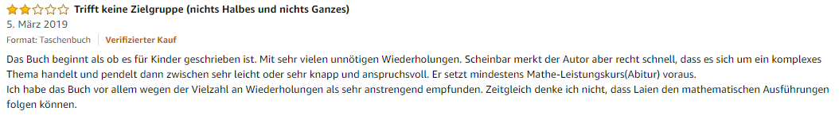
Text analytics – Sentiment analysis Example – how to… classify reviews?

Slide 58
Text analytics – Sentiment analysis
In the sentiment analysis the algorithm determines if text is positive, neutral, or negative
Used to analyze reports, social media posts, customer reviews, forums, news items, communication, etc.
Typically a text is broken up in parts (e.g. sentences or phrases) and for each part the sentiment is estimated. The score for the parts is then combined to get an overall score
Sentiment library and rules
Sentiment library (collection of adjectives and phrases that are either positive or negative, e.g. good, brilliant, great, amazing)
Rules are used to assign a sentiment score based on the library and rules
Typical problems
“Not good”, “the cake wasn’t bad”, …

Slide 59
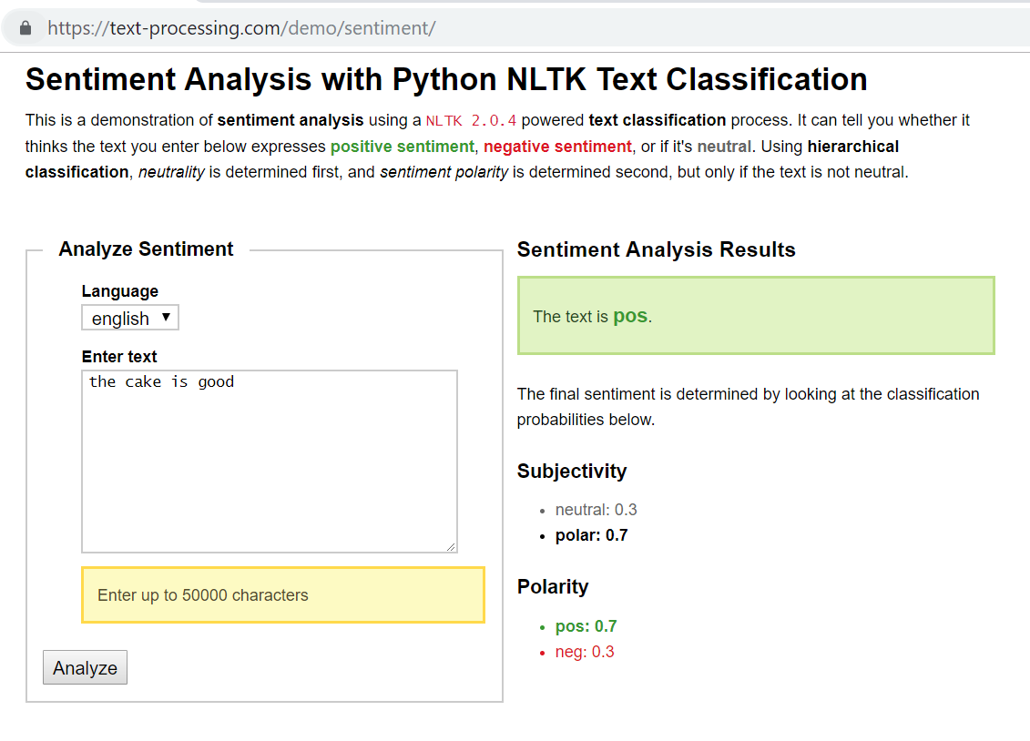

Example: https://text-processing.com/demo/sentiment/
The cake is good The cake is not bad
🡪 pos: 0.7 🡪 pos: 0.2
🡪 neg: 0.3 🡪 neg: 0.8

Slide 60
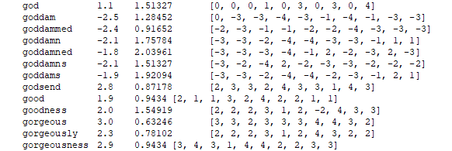
NLTK vader https://www.nltk.org/_modules/nltk/sentiment/vader.html
Sentiment ratings from 10 independent human raters […]. Over 9,000 token features were rated on a scale from "[–4] Extremely Negative" to "[4] Extremely Positive", with allowance for "[0] Neutral (or Neither, N/A)". We kept every lexical feature that had a non-zero mean rating, and whose standard deviation was less than 2.5 as determined by the aggregate of those ten independent raters. This left us with just over 7,500 lexical features […] For example, the word "okay" has a positive valence of 0.9, "good" is 1.9, and "great" is 3.1, whereas "horrible" is –2.5, the frowning emoticon :( is –2.2, and "sucks" and it's slang derivative "sux" are both –1.5.

Slide 61
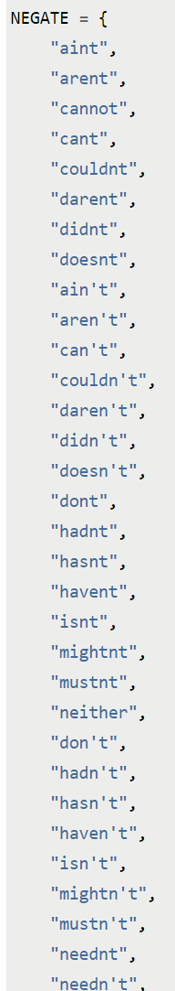
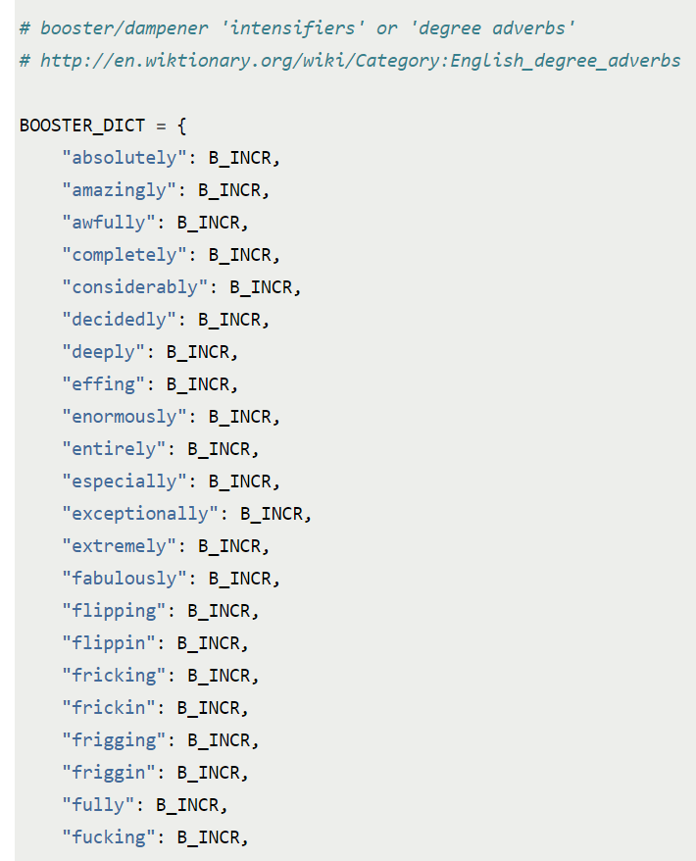
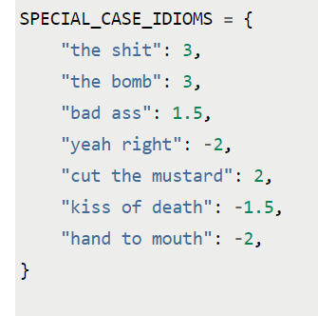
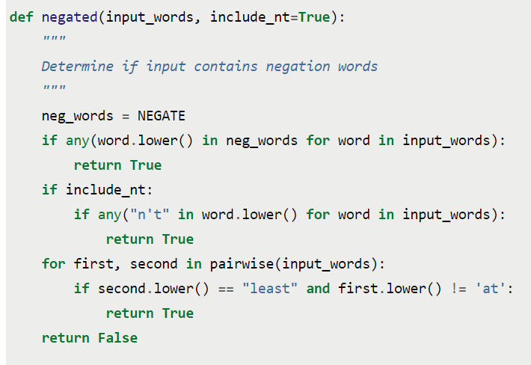
NLTK vader https://www.nltk.org/_modules/nltk/sentiment/vader.html
http://t-redactyl.io/blog/2017/04/using-vader-to-handle-sentiment-analysis-with-social-media-text.html
Hutto, C.J. & Gilbert, E.E. (2014). VADER: A Parsimonious Rule-based Model for Sentiment Analysis of Social Media Text. Eighth International Conference on Weblogs and Social Media (ICWSM-14). Ann Arbor, MI, June 2014.

Slide 62
NLTK vader: https://www.nltk.org/_modules/nltk/sentiment/vader.html
Hutto, C.J. & Gilbert, E.E. (2014). VADER: A Parsimonious Rule-based Model for Sentiment Analysis of Social Media Text. Eighth International Conference on Weblogs and Social Media (ICWSM-14). Ann Arbor, MI, June 2014.
http://t-redactyl.io/blog/2017/04/using-vader-to-handle-sentiment-analysis-with-social-media-text.html

Slide 63
Text analytics – Sentiment analysis
Sentiment Analysis with Python NLTK Text Classification (online example) https://text-processing.com/demo/sentiment/
Twitter Sentiment Analysis using Python https://www.geeksforgeeks.org/twitter-sentiment-analysis-using-python/
nltk.sentiment.sentiment_analyzer module facilitate Sentiment Analysis tasks using NLTK features and classifiers https://www.nltk.org/api/nltk.sentiment.html
https://www.kaggle.com/ngyptr/python-nltk-sentiment-analysis

Slide 64
Text analytics – Summarization
For a given text a short version is created that keep a maximum of the content and should still relay the same message
Important, especially if dealing with a lot of text (reports, social media, communication)
Optimum: Reduce text in a way that only the relevant information remains
Applications:
Reduce reading time for human reader
Improve indexing of documents
Simplify overview of larger texts and collections
Manual text summarization is common
Headings in newspapers, synopses from a book, abstracts in papers, reviews of a film or book
See: https://machinelearningmastery.com/gentle-introduction-text-summarization/

Slide 65
Text analytics – Summarization Example
“So, keep working. Keep striving. Never give up. Fall down seven times, get up eight. Ease is a greater threat to progress than hardship. Ease is a greater threat to progress than hardship. So, keep moving, keep growing, keep learning. See you at work.”
Task: Summarize the above paragraph in 1 sentence. The sentence must not be longer than 10 words.
Example from https://stackabuse.com/text-summarization-with-nltk-in-python/

Slide 66
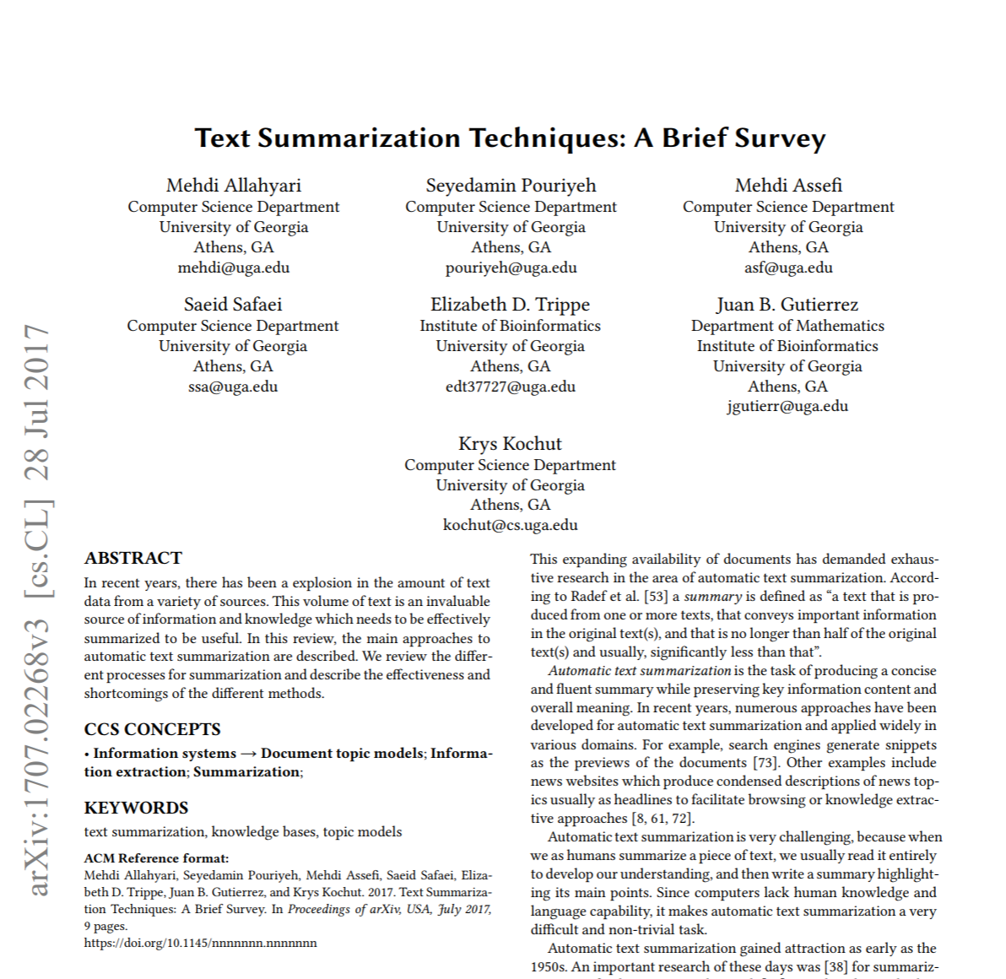
Text analytics – Summarization
Approaches:
Extraction: “identifying important sections of the text and generating them verbatim; thus, they depend only on extraction of sentences from the original text”.
Abstraction: “aim at producing important material in a new way. In other words, they interpret and examine the text using advanced natural language techniques in order to generate a new shorter text that conveys the most critical information from the original text.”
Extraction is easier in typically better than abstraction as it requires less semantic understanding
Mehdi Allahyari et al. Text Summarization Techniques: A Brief Survey. 2017. arXiv:1707.02268 [cs.CL]

Slide 67
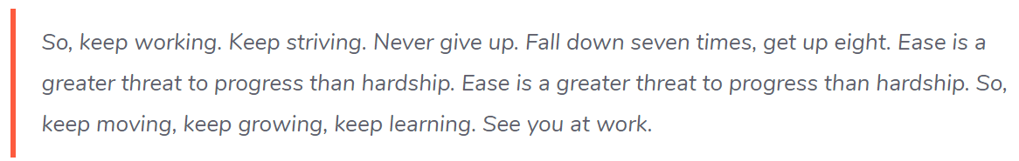
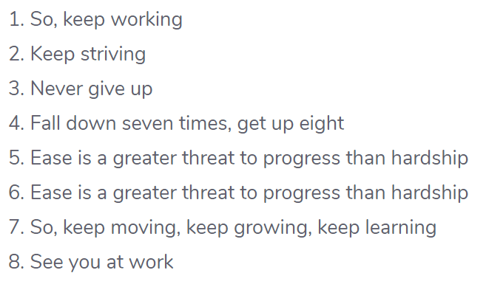
Text analytics – Summarization Example
Step 1: Convert Paragraphs to Sentences
Example from https://stackabuse.com/text-summarization-with-nltk-in-python/

Slide 68
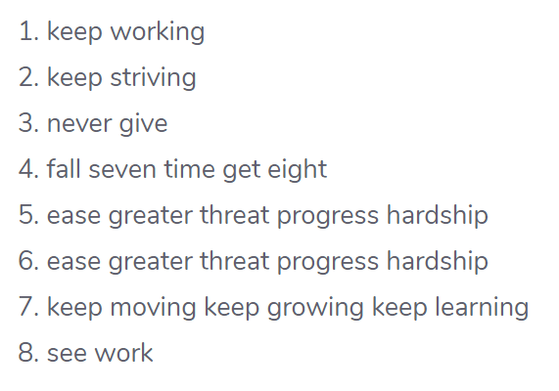
Text analytics – Summarization Example
Step 1: Convert Paragraphs to Sentences
Step 2: Text Preprocessing
Example from https://stackabuse.com/text-summarization-with-nltk-in-python/

Slide 69
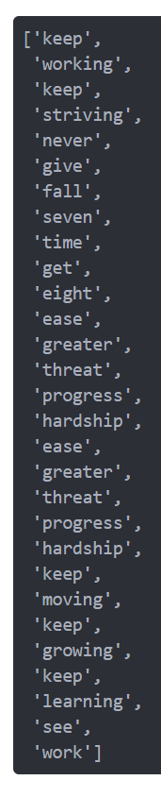
Text analytics – Summarization Example
Step 3. Tokens
Step 1: Convert Paragraphs to Sentences
Step 2: Text Preprocessing
Example from https://stackabuse.com/text-summarization-with-nltk-in-python/

Slide 70
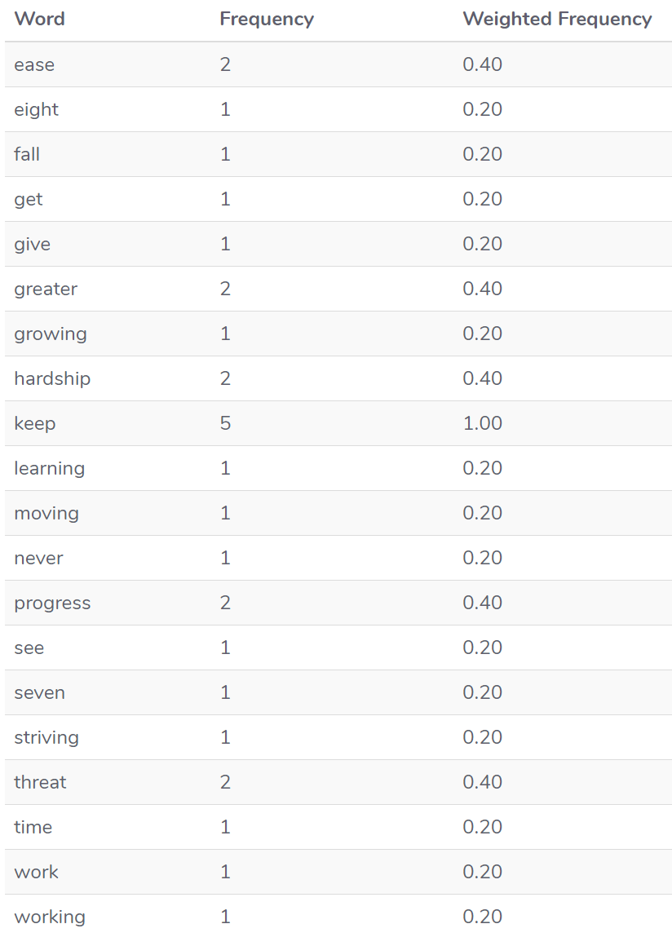
Text analytics – Summarization Example
Step 3. Tokens
Step 4: Find weighted frequency of occurrence
Example from https://stackabuse.com/text-summarization-with-nltk-in-python/

Slide 71
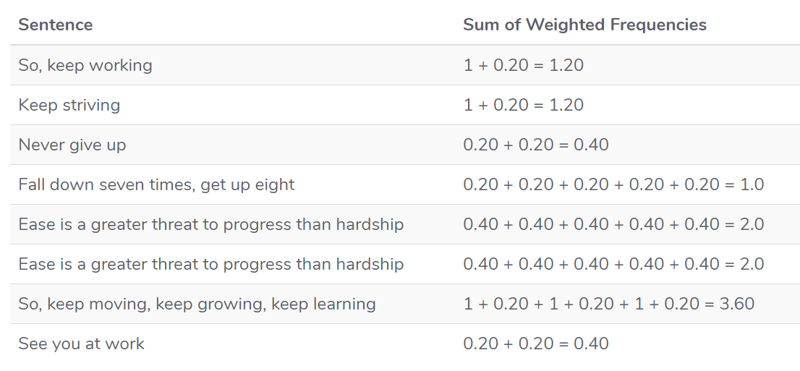
Text analytics – Summarization Example
Step 4: Find weighted frequency of occurrence
5. Replace Words by Weighted Frequency in Original Sentences
Example from https://stackabuse.com/text-summarization-with-nltk-in-python/

Slide 72
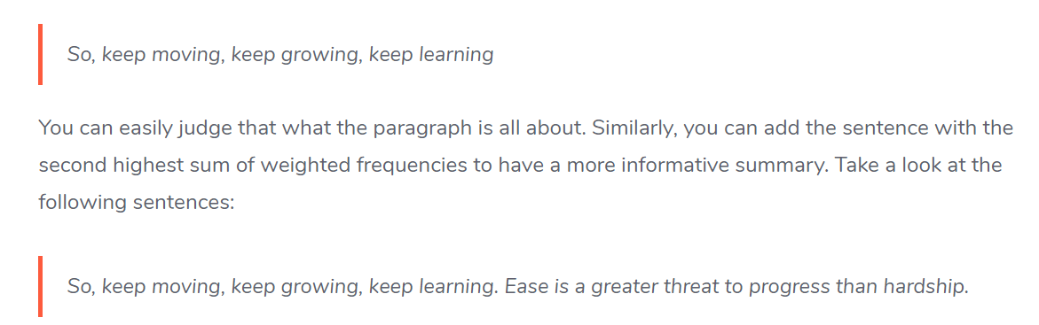
Text analytics – Summarization Example
5. Replace Words by Weighted Frequency in Original Sentences
6. Results
Example from https://stackabuse.com/text-summarization-with-nltk-in-python/

Slide 73
Recap … do you remember what we did last time?
Tokenization
Stop Words Removal
Text normalization
Stemming / Porter Stemmer
Lemmatization
Part-Of-Speech Tagging
Named Entity Disambiguation
Named Entity Extraction
Bag of Words
Corpus, Corpora

Slide 74
Conversational UIs & Bots

Slide 75
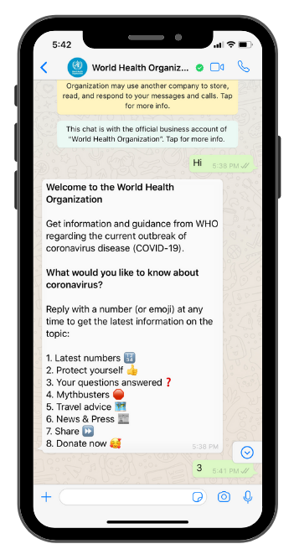
Recent Example
Chatbot by the World Health Organization
Gives covid19 infos via chat (WhatsApp)
What are the benefits of this approach? Why not just a website?
https://www.who.int/news-room/feature-stories/detail/who-health-alert-brings-covid-19-facts-to-billions-via-whatsapp
https://www.whatsapp.com/coronavirus/who

Slide 76
Why use Conversation as a User Interface?
Natural language
Non-graphical UIs (voice)
Hands-free (voice)
Social contexts
Personification / antropomorphism
Personalisation
Integration
…

Slide 77

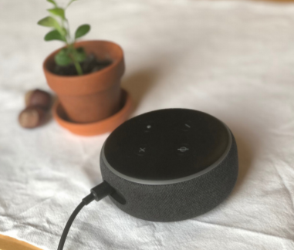

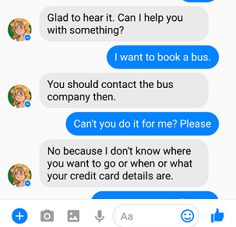
Involved Tasks & Technologies
Voice recognition / natural language understanding
Dialogue model (e.g. contextual references)
Voice synthesis / natural language generation
Photo by Ryutaro Tsukata

Slide 78
CUI Design

Slide 79
Overview & Examples: CUI Design Factors
What is there to design about a conversational UI?
Personification
of the System
Input
Conversation
Output
Photo by Ryutaro Tsukata
Integration

Slide 80
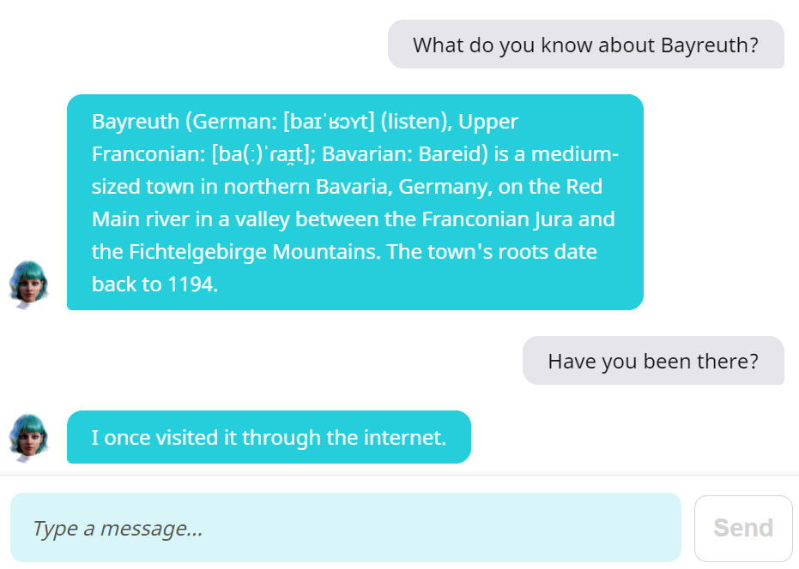
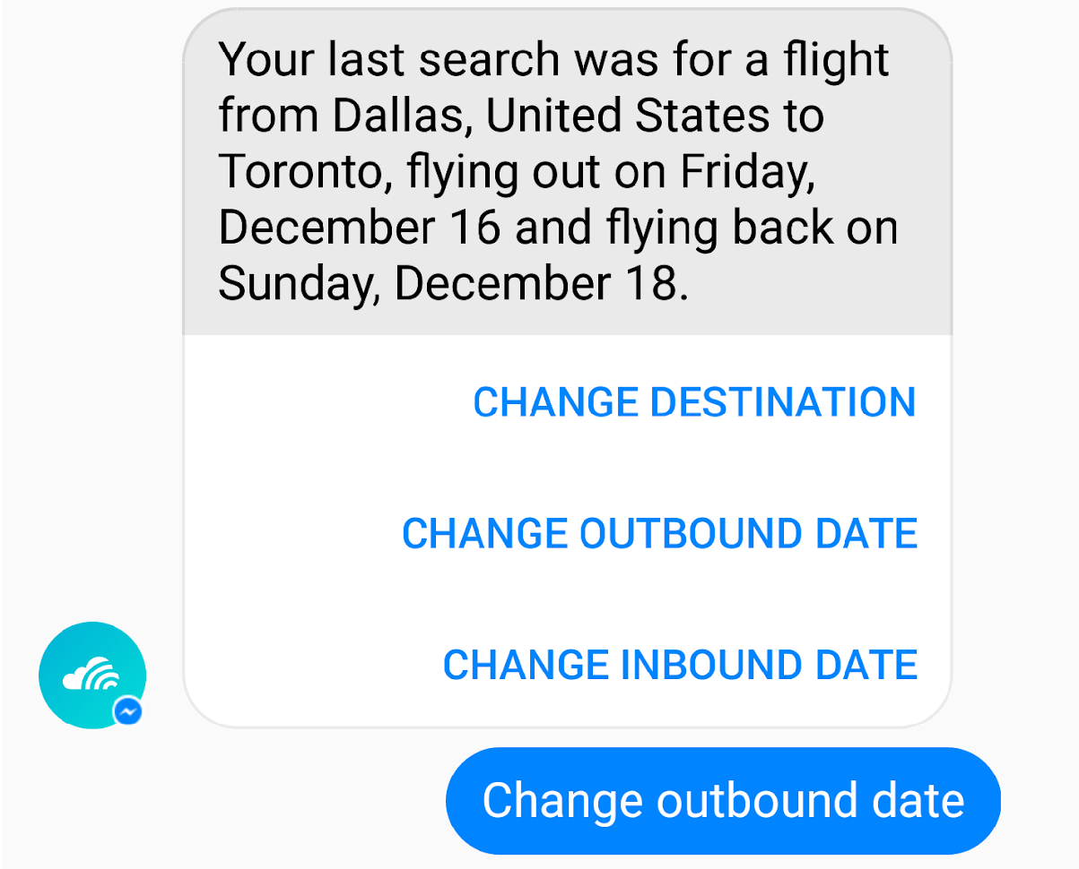
Input Design Factors
Free text vs fixed options
 | Free text | Fixed options
+ | Realistic impression, broad scope, free user expression | Full control (for designer), user guidance, clear capabilities, predictable, less typing
- | Many edge cases or undefined cases, potentially unwanted in/output, annoying if bot can‘t handle input | Limited scope, impersonal, artificial, not useful if user‘s intent not anticipiated
https://chatbotsmagazine.com/19-best-practices-for-building-chatbots-3c46274501b2

Slide 81
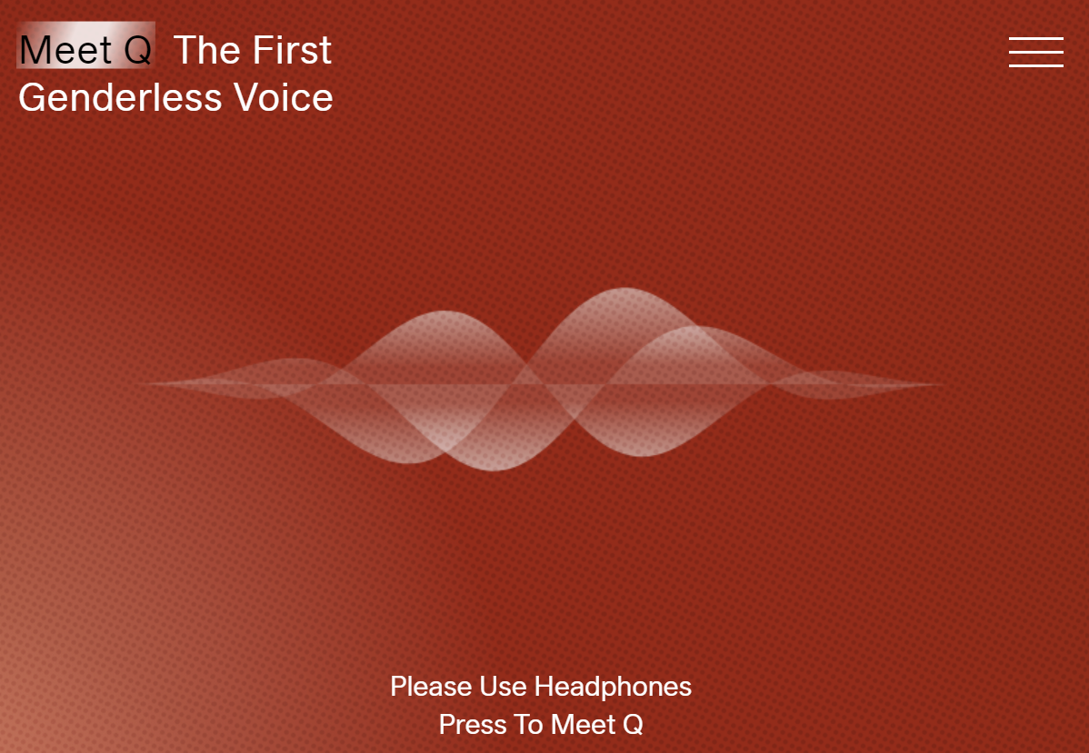
Output Design Factors
Conversational elements
Linguistic features: e.g. word choice, sentence length, level of formality, slang, puns, irony, cultural proverbs, …
Paraverbal features: e.g. prosody, tone of voice, dialect, intonation, gender, …
https://www.genderlessvoice.com/

Slide 82
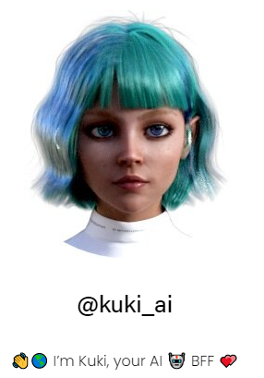
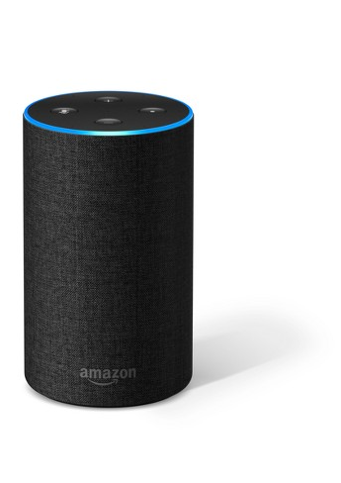
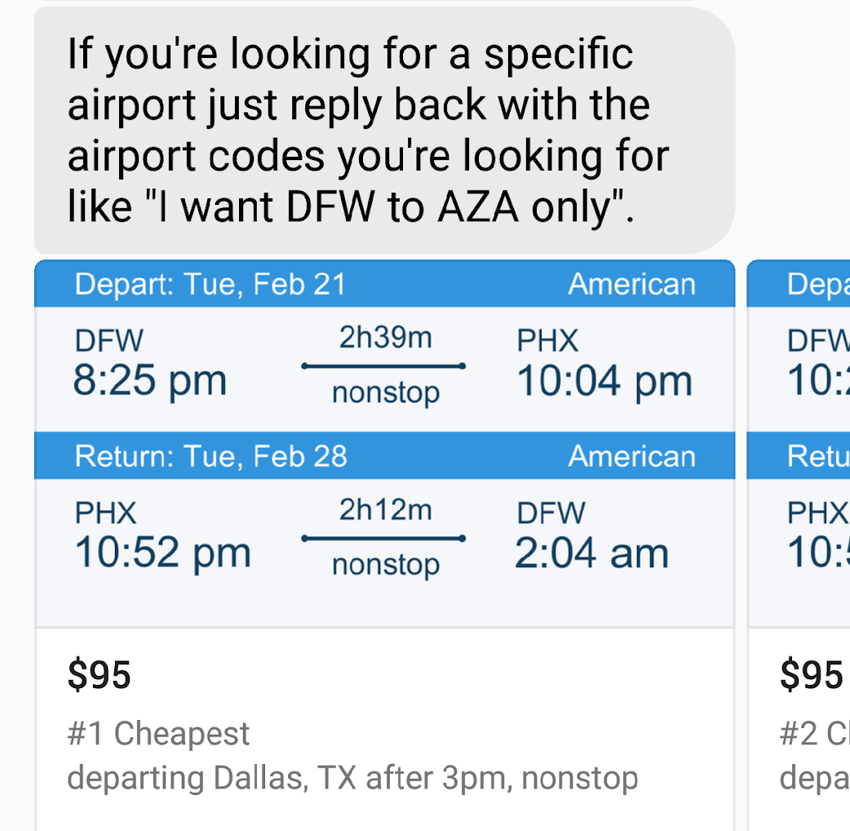
Output Design Factors
Additional (visual) elements
Non-conversational UI: e.g. status, progress, shortcuts, tables, images
Surrounding presentation: e.g. avatar, device design

Slide 83
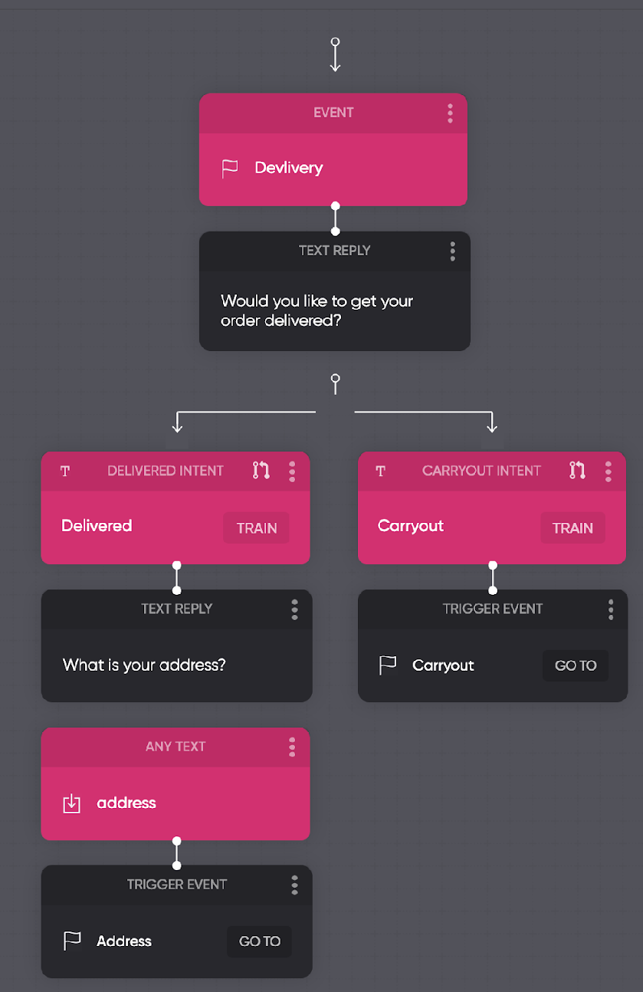
Conversation Design
Conversation flow
Graphical representation of conversation, branches, start and end points, e.g.:
https://flow.ai

Slide 84
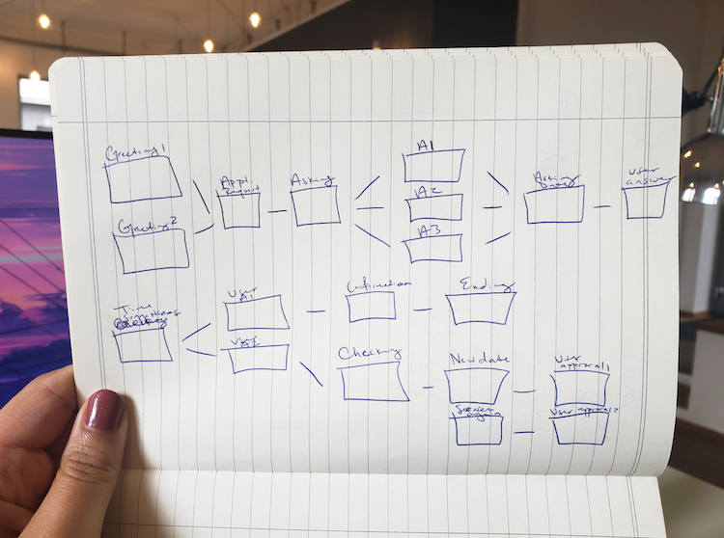
Breakout Activity
Conversation Design
Scenario: You develop a chatbot for scheduling appointments at a local business (e.g. hair stylist, bookshop, doctor).
Task: Create a conversation flow diagram for this. Can you identify conversation elements that could be generally useful, beyond your specific scenario?
https://www.userlike.com/en/blog/chatbot-conversation-flow

Slide 85
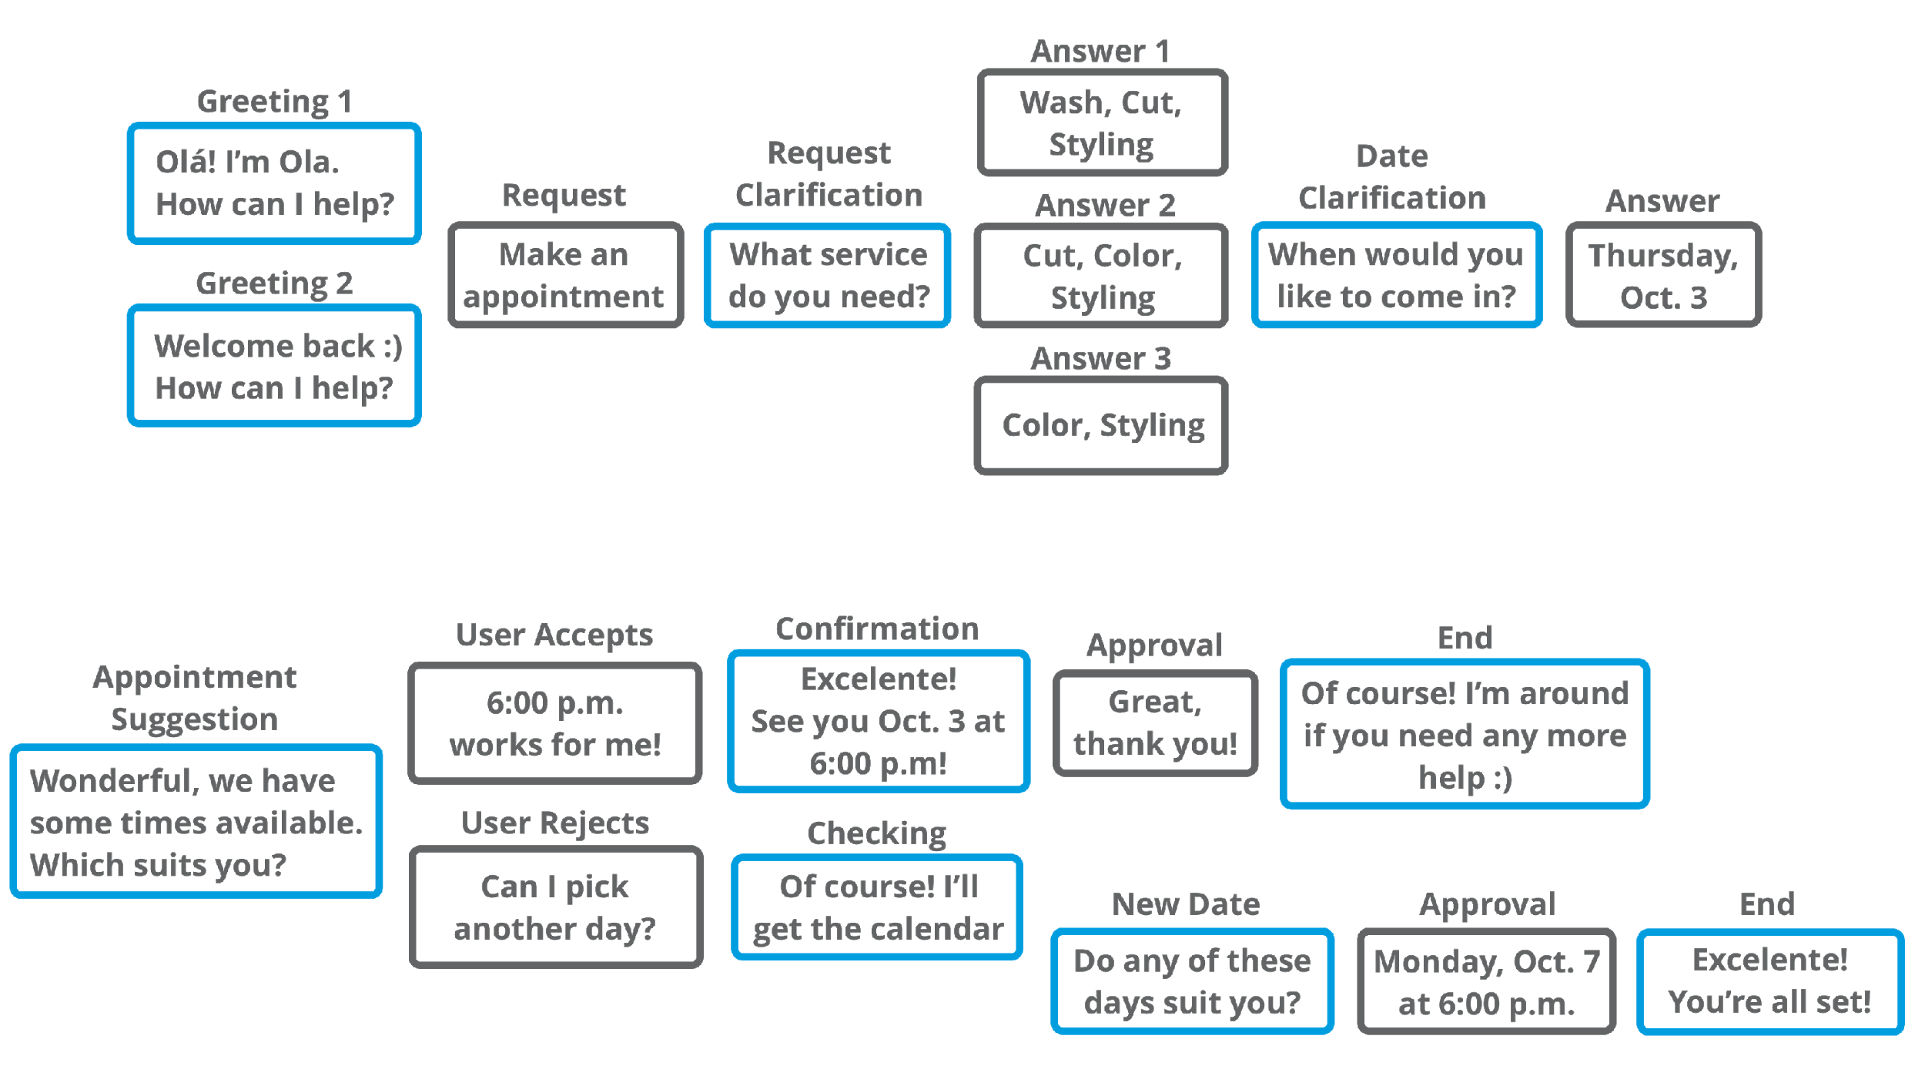
Conversation Design
Conversation flow
https://www.userlike.com/en/blog/chatbot-conversation-flow

Slide 86
Conversation Design
Typical elements of a conversation
Start
Establish relationship, provide information
E.g. a greeting
Suggestions / prompts
Present the user with possible / relevant actions or options.
E.g. “I can help you to create a new order or check on an existing one.”
Progress indicators
Reveal progress through a conversation towards a goal
E.g. “Almost there! To complete this I also need…”
Confirmation
Confirm actions, restate information
E.g. „Ok, I will update your address to: …“,
Error handling
Acknowledge limitations or breakdowns
„Sorry, I do not understand this.“
End: provide a clear end to the conversation
https://www.userlike.com/en/blog/chatbot-conversation-flow

Slide 87





Conversation Design
Handling conversation breakdowns
[Ashktorab et al., 2019]
Example: Bot doesn‘t understand this.
Repair strategies:
Repeat
Give options
Confirm
Defer
Explain e.g. highlight words
🡪 Acknowledge breakdowns, assist user repair, proactively suggest solutions

Slide 88
Personification of a CUI
In the conversation: E.g. should the voice assistant / chatbot portrait a person with specific characteristics?
Beyond conversation: E.g. visual avatar?
Conceptual framework: Analogy to human personality?

Slide 89
Summary: CUI Design Factors
Input
Modality: Voice vs text
Options: Free vs fixed choices
Conversation
Personification of the System
Dialogue characteristics: e.g. short vs long replies/chunks
Conversation flow: e.g. branching, boundaries
Error handling: e.g. repair strategies
In the conversation: e.g. should the assistant / chatbot portrait a specific personality
Beyond conversation: e.g. visual avatar, physical device design
Output
Integration
Modality: Voice vs text
Content & style: e.g. prosody, level of formality, slang, …
Non-conversation UI elements: e.g. status, progress, images, shortcuts
E.g. of a chatbot in the surrounding GUI
In context…

Slide 90
Design Principles
Comparison of graphical UIs and voice UIs
Some design principles from GUIs are applicable with voice
Consistency (especially lexical)
Feedback (visual, acoustic or spoken)
Metaphors (when expressed in language)
Other principles are different with voice
Constraints (only logical and cultural, no physical)
Error tolerance (homophones, ambiguities, …)
Some are not available with voice
Spatial mappings
Visual affordances

Slide 91
Some Guidelines
For voice UIs
Tell users what they can do e.g. „You can ask for today’s weather or a weekly forecast.”
Tell users where they are e.g. „Today’s weather forecast is mostly sunny and dry” (rather than just „sunny and dry.”)
Give examples rather than instructions e.g. in the help function or in the greeting
Limit the amount of information
e.g. not more than three different options for an interaction
tradeoff between efficiency and short term memory!
Use visual feedback (if possible)

Slide 92

CUI Design Process
Special challenge with CUIs: Handling UI, conversation, technical aspects with mutual influences
Think of possible ways a conversation could go for your use case
Try it out! 🡪 User-centred approach
Example
https://uxknowledgebase.com/conversational-ui-designing-part-2-52bad56f005c

Slide 93
Challenges & Limitations of CUIs

Slide 94


Challenges
Semantics and pragmatics of natural language
Semantics: The meaning of the words
Pragmatics: How we actually use language
A: „Have you got coffee to go?“
B: „Milk and sugar?“
A: „Black as my soul…“
or
„time flies“
Try to teach this to a computer…

Slide 95


Limitations of CUIs
Questioning assumptions around CUIs
Is it really a conversation? Is it natural?
“Conversational interaction […] confuses interaction with a device within conversation with an actual conversation.“
People use voice in daily life - but the system is not a conversation partner like a human
Incorrect expectations about capabilities, i.e. what the system can or cannot do
Voice promises hands-free use but often shifts focus away from main task
E.g. due to bad error-handling
Splits attention (e.g. driving, in the kitchen, …)
Photo by Daria Shevtsova
[Porcheron et al., 2018]
[Luger and Sellen, 2016]
Photo by C Technical

Slide 96
Limitations of CUIs
Managing user expectations
Users tend to overestimate machine capabilities
Normally we use voice to communicate with humans
Humans are intelligent
…hence, the thing we talk to must be intelligent
Some guidelines for managing limitations:
Don’t assume your CUI can fully understand the user’s context
If in doubt, go for limited scenarios
Make options and suggestions easily available to users
…but never interrupt to provide them

Slide 97
Conversational UIs in HCI Research
Selected examples

Slide 98

Conversation Design Methods & Tools
Example: „ProtoChat“
Idea: Crowdsourcing conversation design
Crowdworkers test a conversation
They can add missing but desired responses for the bot
They can add missing but desired branches for the user
1.
2.
3.
[Choi et al., 2021]

Slide 99

Exploring new Use-Cases for CUIs
Example: CUIs for text documents
Idea: Use a chatbot to query a text document
What‘s the benefit over simple text-based search?
E.g. Context: usable in the car
Bridge the „Semantic gap“: User has an idea what they want but does not know how to formulate a query 🡪 use natural language
[ter Hoeve et al., 2019]

Slide 100

CUIs as a Research Tool
Example: A chatbot as an interviewer
Idea: Use a chatbot instead of a questionnaire
E.g. for user research on smartphones
Potential benefits?
“We found that the participants in the chatbot survey, as compared to those in the web survey, were more likely to produce differentiated responses and were less likely to satisfice*; the chatbot survey thus resulted in higher-quality data.”
[Kim et al., 2019]
*satisfice - here: just answering to complete the questionnaire, not necessarily giving a „true“ response
https://www.youtube.com/watch?v=A2AzbKFozc8

Slide 101
References
Ammari, T., Kaye, J., Tsai, J. Y., & Bentley, F. (2019). Music, Search, and IoT: How People (Really) Use Voice Assistants. ACM Transactions on Computer-Human Interaction, 26(3), 17:1-17:28. https://doi.org/10.1145/3311956
Ashktorab, Z., Jain, M., Liao, Q. V., & Weisz, J. D. (2019). Resilient Chatbots: Repair Strategy Preferences for Conversational Breakdowns. Proceedings of the 2019 CHI Conference on Human Factors in Computing Systems, 1–12. https://doi.org/10.1145/3290605.3300484
Choi, Y., Monserrat, T.-J. K. P., Park, J., Shin, H., Lee, N., & Kim, J. (2021). ProtoChat: Supporting the Conversation Design Process with Crowd Feedback. Proceedings of the ACM on Human-Computer Interaction, 4(CSCW3), 225:1-225:27. https://doi.org/10.1145/3432924
Kim, S., Lee, J., & Gweon, G. (2019). Comparing Data from Chatbot and Web Surveys: Effects of Platform and Conversational Style on Survey Response Quality. Proceedings of the 2019 CHI Conference on Human Factors in Computing Systems, 1–12. https://doi.org/10.1145/3290605.3300316
Luger, E., & Sellen, A. (2016). „Like Having a Really Bad PA“: The Gulf between User Expectation and Experience of Conversational Agents. Proceedings of the 2016 CHI Conference on Human Factors in Computing Systems, 5286–5297. https://doi.org/10.1145/2858036.2858288
Porcheron, M., Fischer, J. E., Reeves, S., & Sharples, S. (2018). Voice Interfaces in Everyday Life. Proceedings of the 2018 CHI Conference on Human Factors in Computing Systems, 1–12. https://doi.org/10.1145/3173574.3174214
Ter Hoeve, M., Sim, R., Nouri, E., Fourney, A., Rijke, M. de, & White, R. W. (2020). Conversations with Documents: An Exploration of Document-Centered Assistance. The 5th ACM SIGIR Conference on Human Information Interaction and Retrieval. CHIIR. https://doi.org/10.1145/3343413.3377971

Slide 102

License
This file is licensed under the Creative Commons Attribution-Share Alike 4.0 (CC BY-SA) license:
https://creativecommons.org/licenses/by-sa/4.0
Attribution: Albrecht Schmidt, Sven Mayer, and Daniel Buschek

