Slide 1
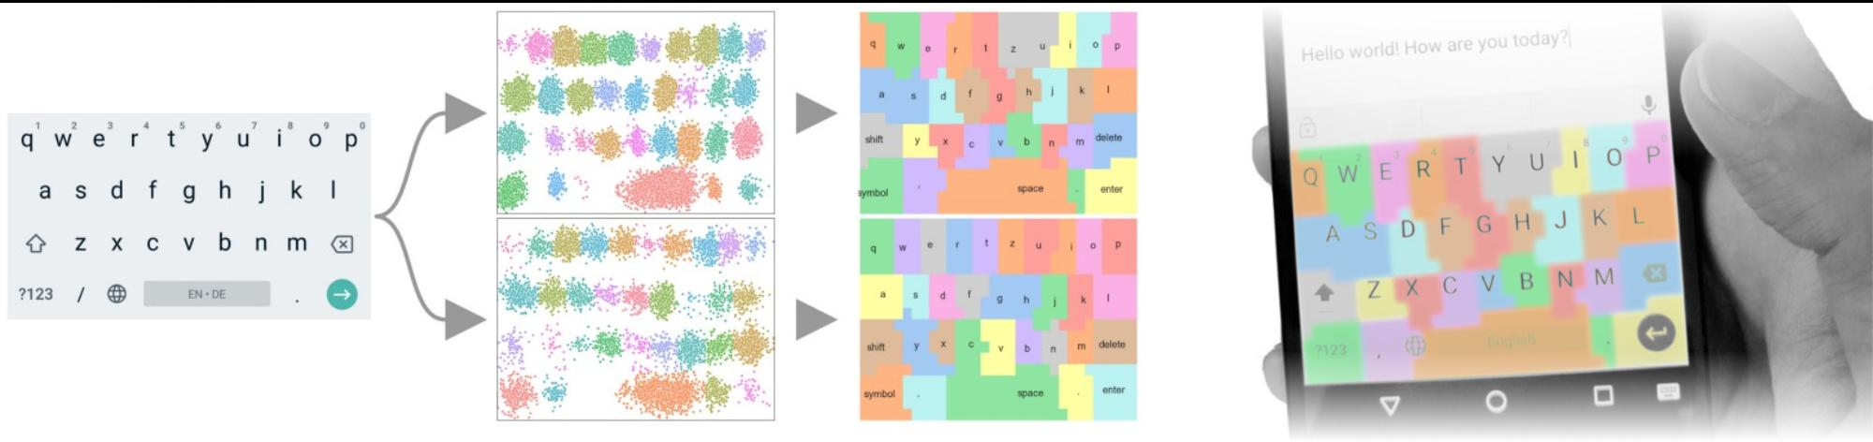

Intelligent Text Input and Optimization

Slide 2
Learning Goals
Combinatorial optimization as a UI design approach
Probabilistic methods for handling input
Application example: keyboards
Intelligent Text Entry

Slide 3
Optimizing User Interfaces
Example: keyboard layout optimization
Intelligent Text Entry

Slide 4
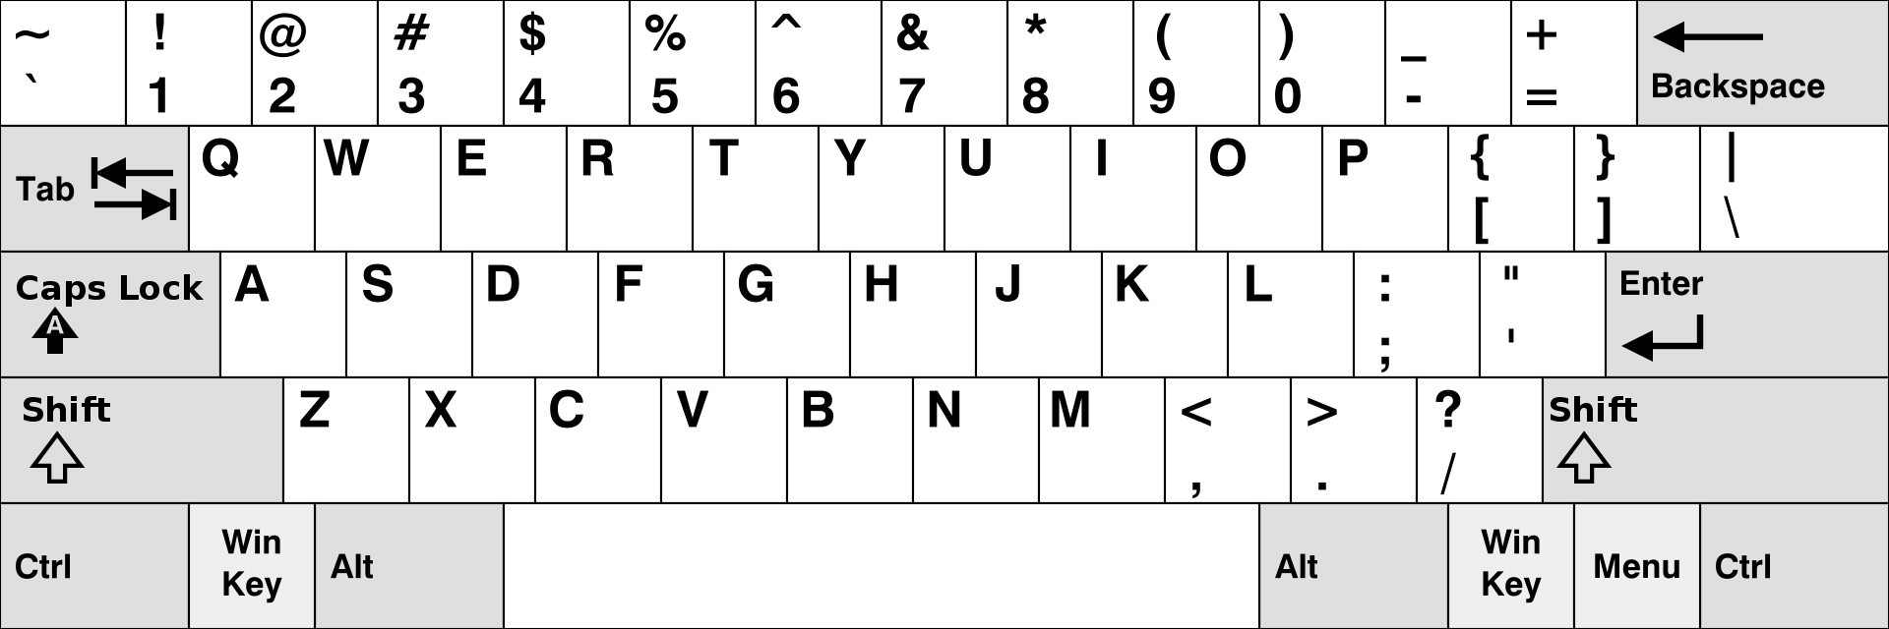
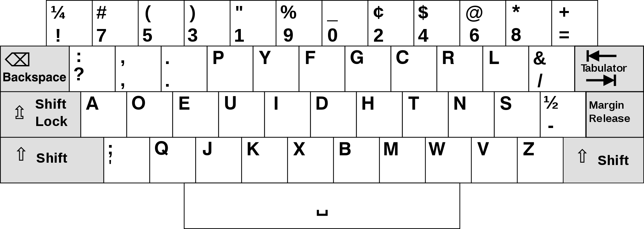
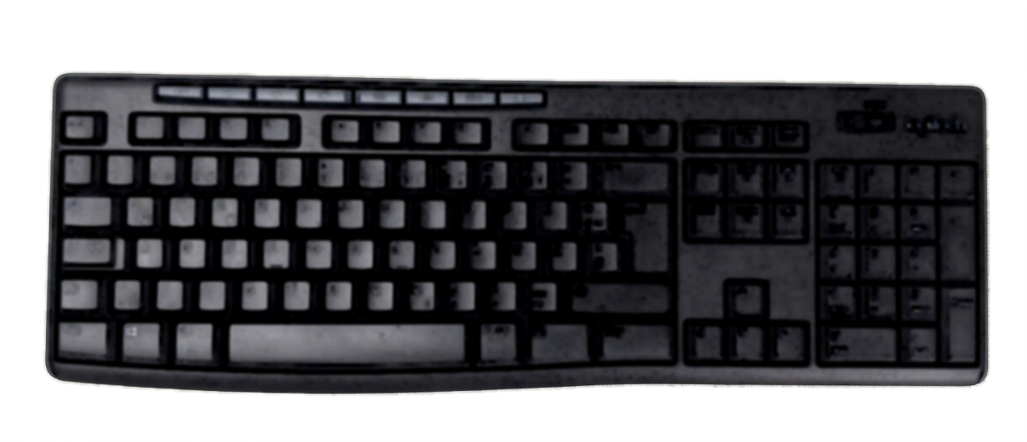
Motivation: Fast typing without errors
Are some layouts better than others?
If so, how do we find the best one?
QWERTY, by Christopher Sholes, 1873
Dvorak, by August Dvorak, 1936
By: https://commons.wikimedia.org/wiki/File:KB_United_States.svg, https://commons.wikimedia.org/wiki/File:KB_United_States_Dvorak.svg
Intelligent Text Entry

Slide 5
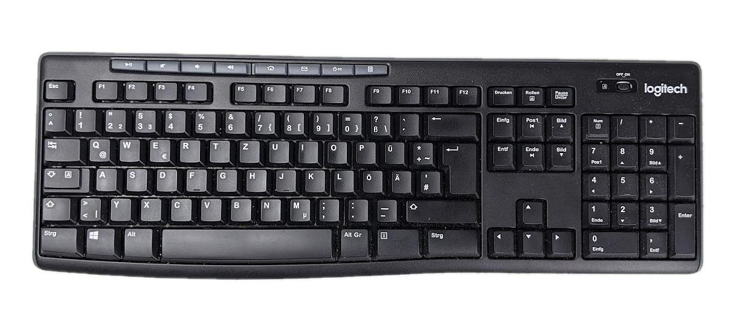
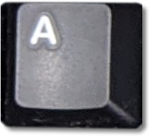
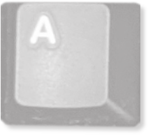
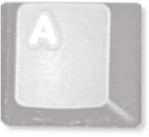
Key Assignment Problem
?
…
How many layouts are there?
26! = 4 * 10²⁶
For comparison - stars in the universe: https://www.esa.int/Science_Exploration/Space_Science/Herschel/How_many_stars_are_there_in_the_Universe
Intelligent Text Entry

Slide 6
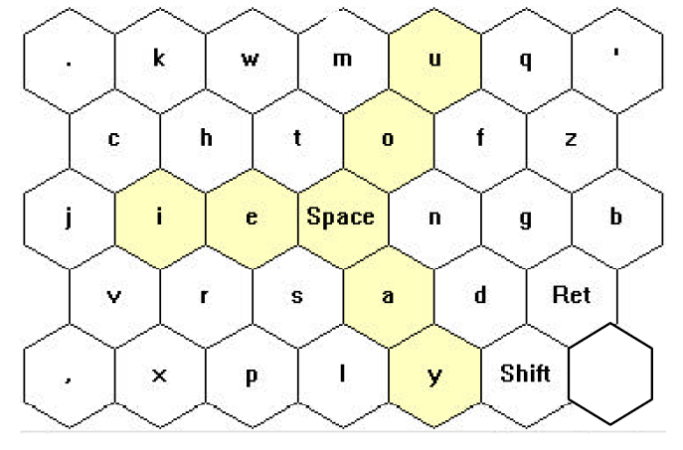
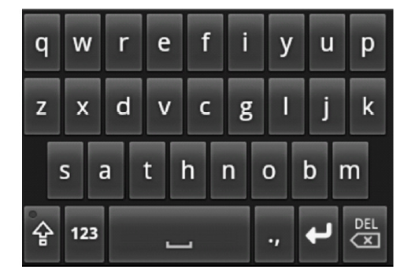
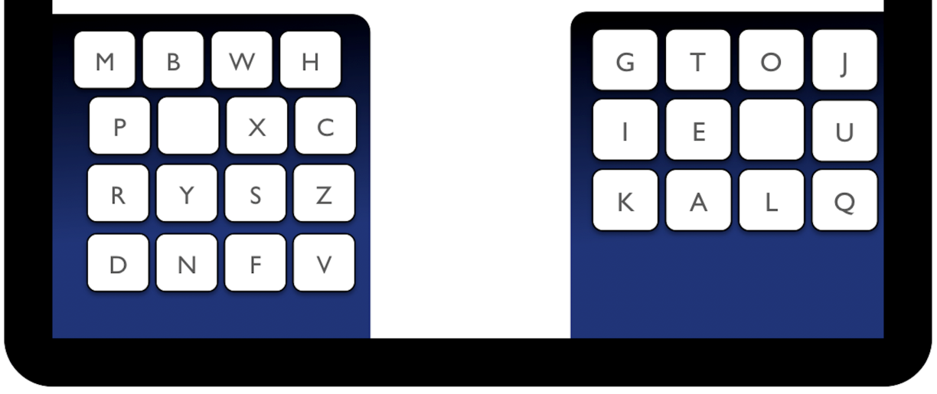
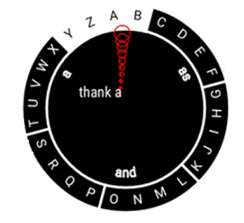
Examples of Optimised Designs
Zhai et al. 2000, Dunlop and Levine 2012, Oulasvirta et al. 2013, Gong et al. 2018
Intelligent Text Entry

Slide 7

What is „optimal“?
Design space:
Best among which options?
Design objective:
Best for what?
Optimizer:
How to find the best design?
Best with which guarantees?
Intelligent Text Entry

Slide 8
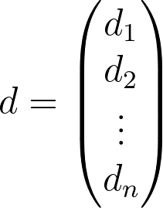
Design Space, formalised
Design space D
with n design variables
Intelligent Text Entry

Slide 9
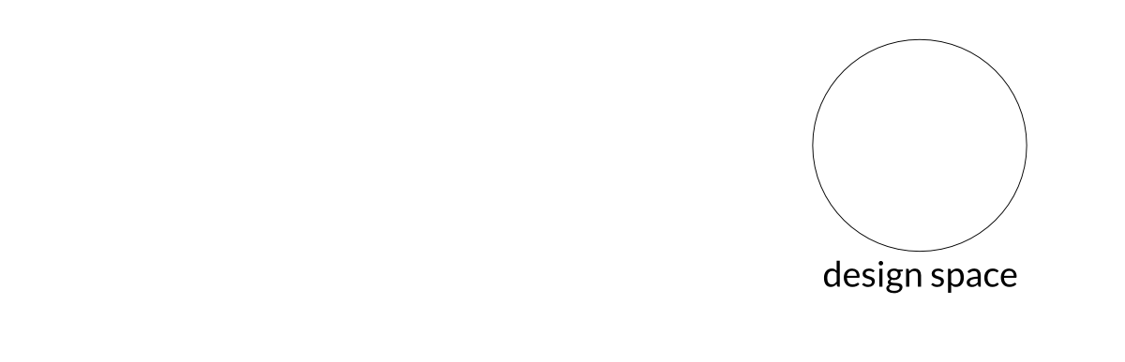
Design Space: Set of possible layouts
?
26! = 4 * 10²⁶
Intelligent Text Entry

Slide 10
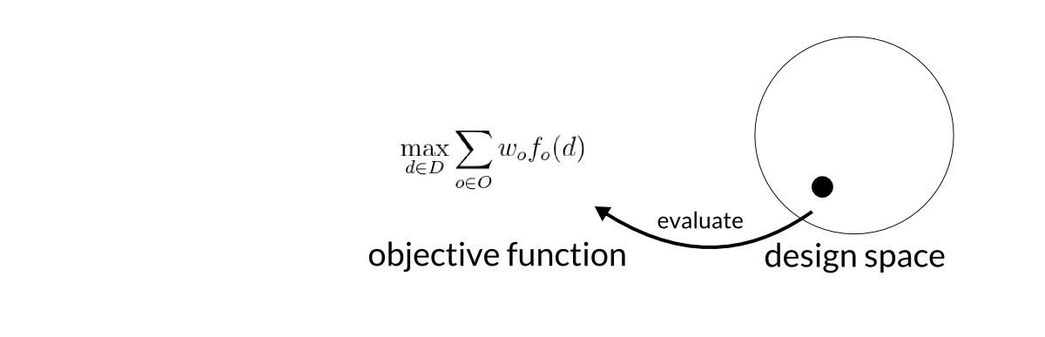
Objective Function: How to judge a layout?
Intelligent Text Entry

Slide 11
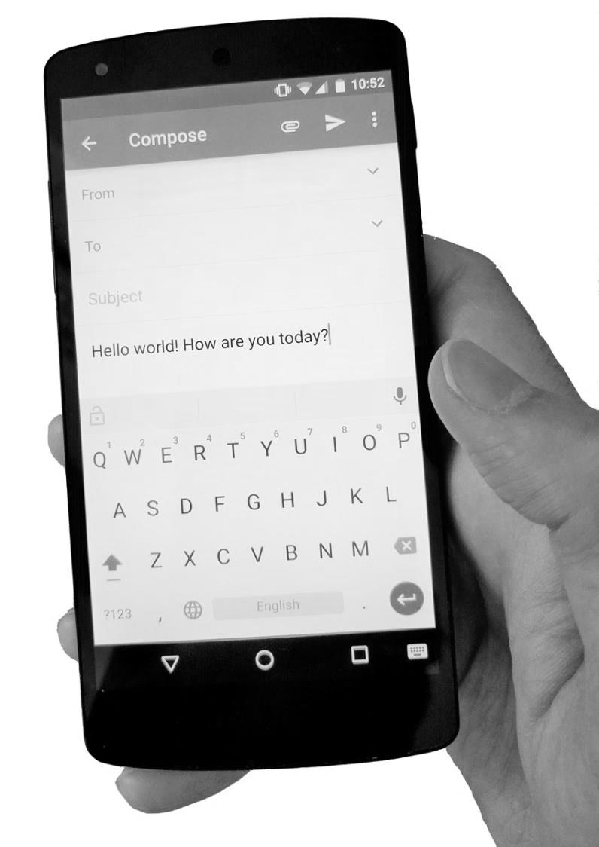
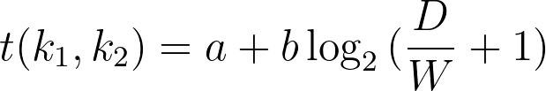

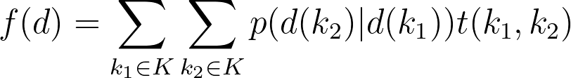
Objective Function: How to judge a layout?
Finger movement time (e.g. Fitts‘ law)
Language properties
(e.g. bigram frequencies)
k₁
k₂
e.g.
Combined: mean time between two key presses
Intelligent Text Entry

Slide 12
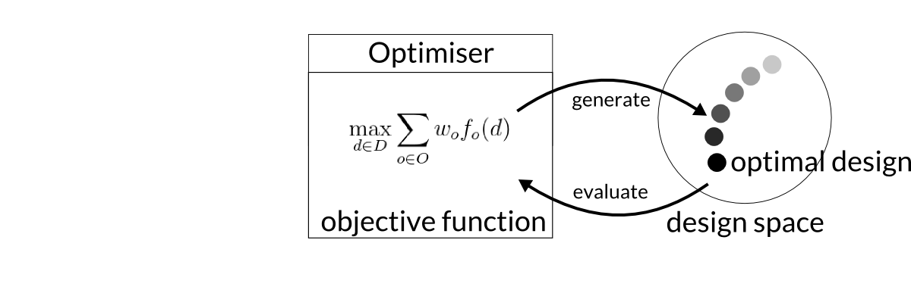
Optimizer: How to pick layouts?
Intelligent Text Entry

Slide 13
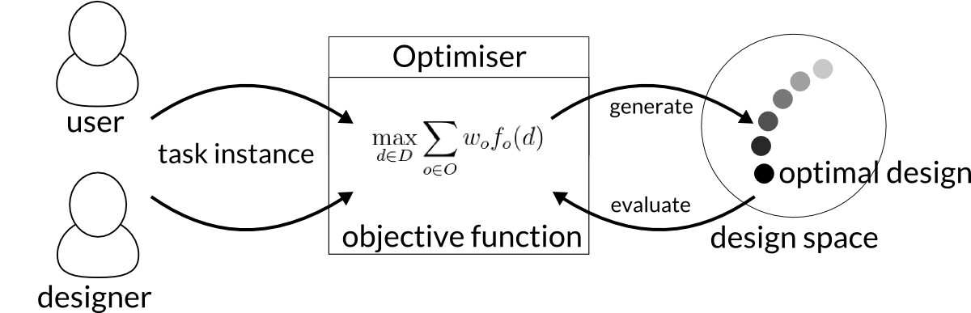
Design Task
e.g. keyboard layout optimization
Intelligent Text Entry

Slide 14
A Simple Optimizer
Can you think of a trivial optimizer?
Random Search:
  Generate random design
  Keep if better than current best design
  Repeat
Intelligent Text Entry

Slide 15
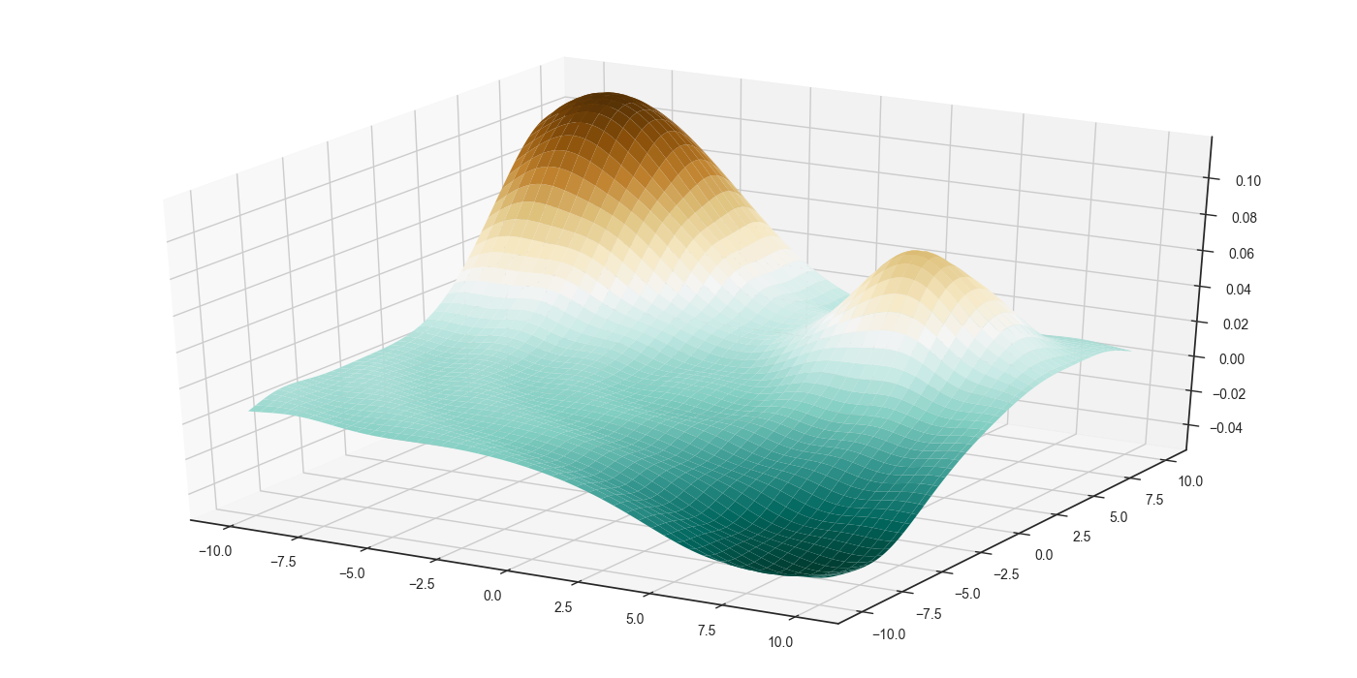
Optimization Landscape
Here: objective function (y) across two design parameters (x, z)
global maximum
local maximum
y
z
x
global minimum
Intelligent Text Entry

Slide 16
Random Guessing
Intelligent Text Entry

Slide 17
Optimizers
Heuristic methods (e.g. Simulated Annealing)
  + Flexible
  - Not guaranteed to find global optimum
Exact methods (e.g. Integer Programming)
  + Guarantees
  - Less flexible objectives
Intelligent Text Entry

Slide 18

Example: Simulated Annealing
Metaphor: shaping hot metal
Flexible at beginning (exploration)
Gradually more rigid as it “cools down” (exploitation)
Photo by Kateryna Babaieva
For i=0 to N:
reduce temperature T
generate neighbor design
if better: go to neighbor
else: still go with chance relative to T
Intelligent Text Entry

Slide 19
Simulated Annealing
Intelligent Text Entry

Slide 20
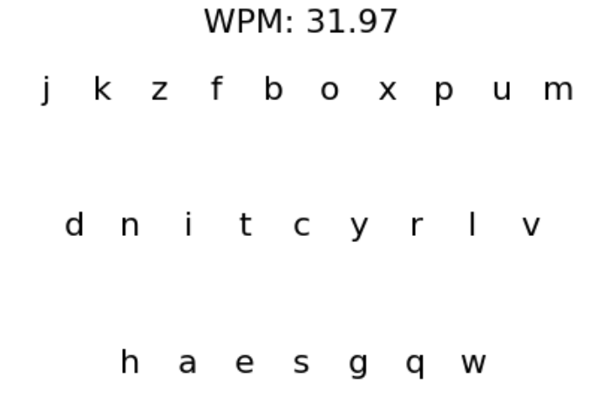
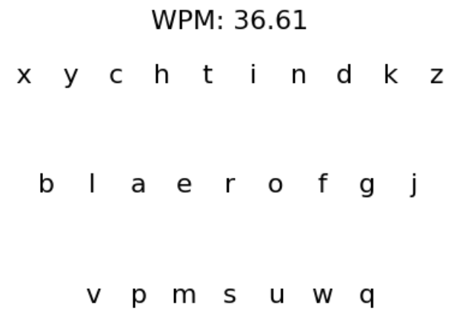
Example Results
“boxpum”
found with random search
“aero”
found with Simulated Annealing
Challenge – can you find a better layout than “aero”?
Use the provided python notebook as a starting point.
Intelligent Text Entry

Slide 21
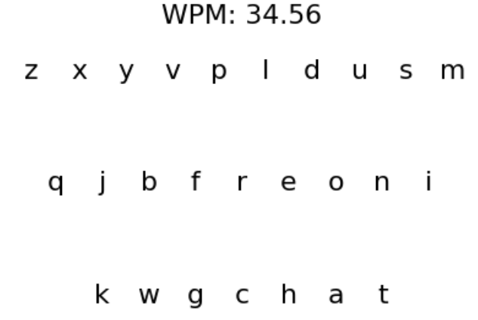
Example Results
With a modified objective function
“chat”
found with Simulated Annealing
What was this layout optimized for?
→ Typing with right thumb, reduce thumb stretching
Intelligent Text Entry

Slide 22
Potential of Optimization-based Design
Obtaining information on the design problem and a formal specification
Exploring a large design space comprehensively
Improving quality and robustness of designs
Estimating possible improvements
Supporting human designers
Optimization during use, personalised UIs
Requires: Models of user behaviour, formal problem definition / objective function, computational capacity, …
Intelligent Text Entry

Slide 23
Adaptive and Predictive Keyboards

Slide 24
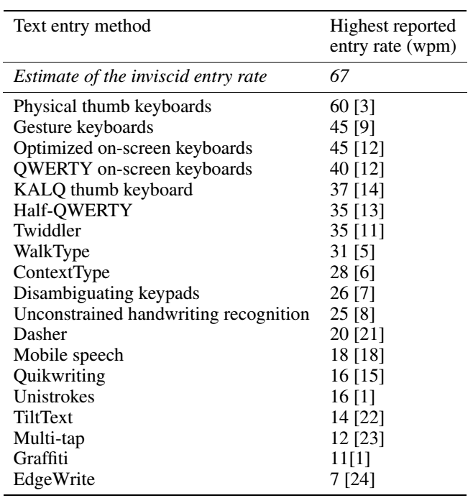
Motivation: Fast typing without errors
Here: mobile devices
„Inviscid entry rate“:
Bottleneck is not the text entry UI but coming up with the text
Estimated as 67 WPM
→ Try to reach this on your phone without errors,
e.g. in an online typing speed test.
[Kristensson and Vertanen 2014]
Intelligent Text Entry

Slide 25

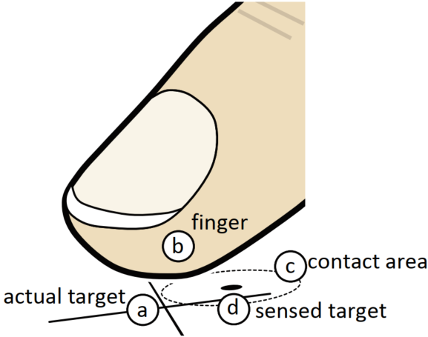
Challenges for Mobile Typing
Why is it inaccurate?
Parallax
eye – finger - screen
Mobile use
1-2 fingers, small keys, body movement
[Holz and Baudisch 2011]
Photo by Ketut Subiyanto
Intelligent Text Entry

Slide 26
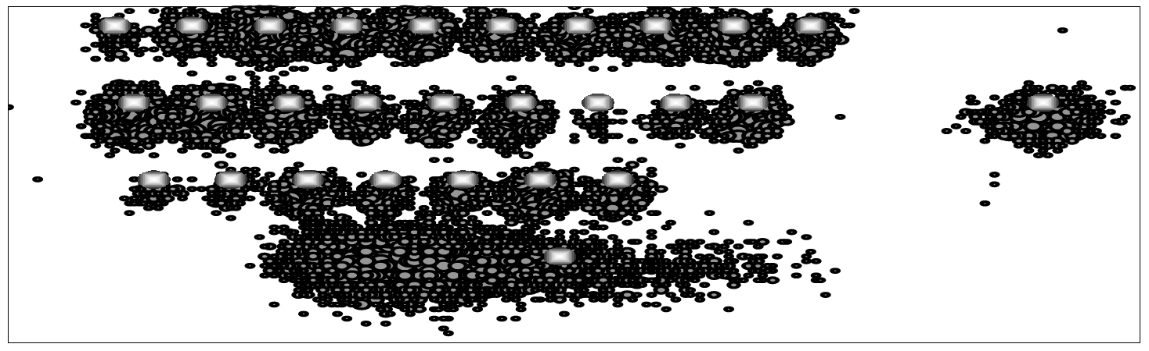
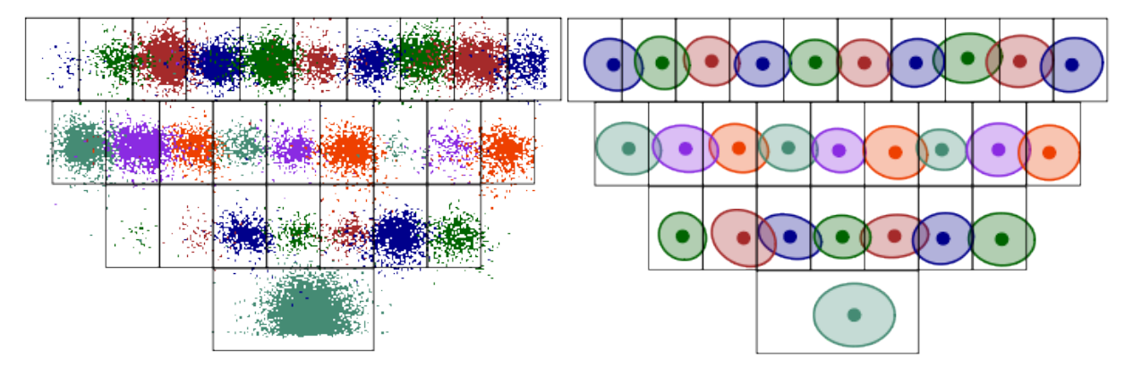
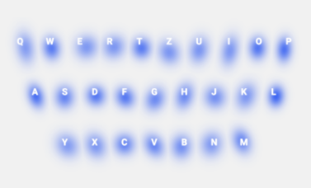
Variance in Touchscreen Keypresses
Spread of x,y touch locations around key centres
PDA
[Goodman et al. 2002]
Smartphone
https://www.microsoft.com/en-us/swiftkey
[Azenkot and Zhai 2012]
Intelligent Text Entry

Slide 27
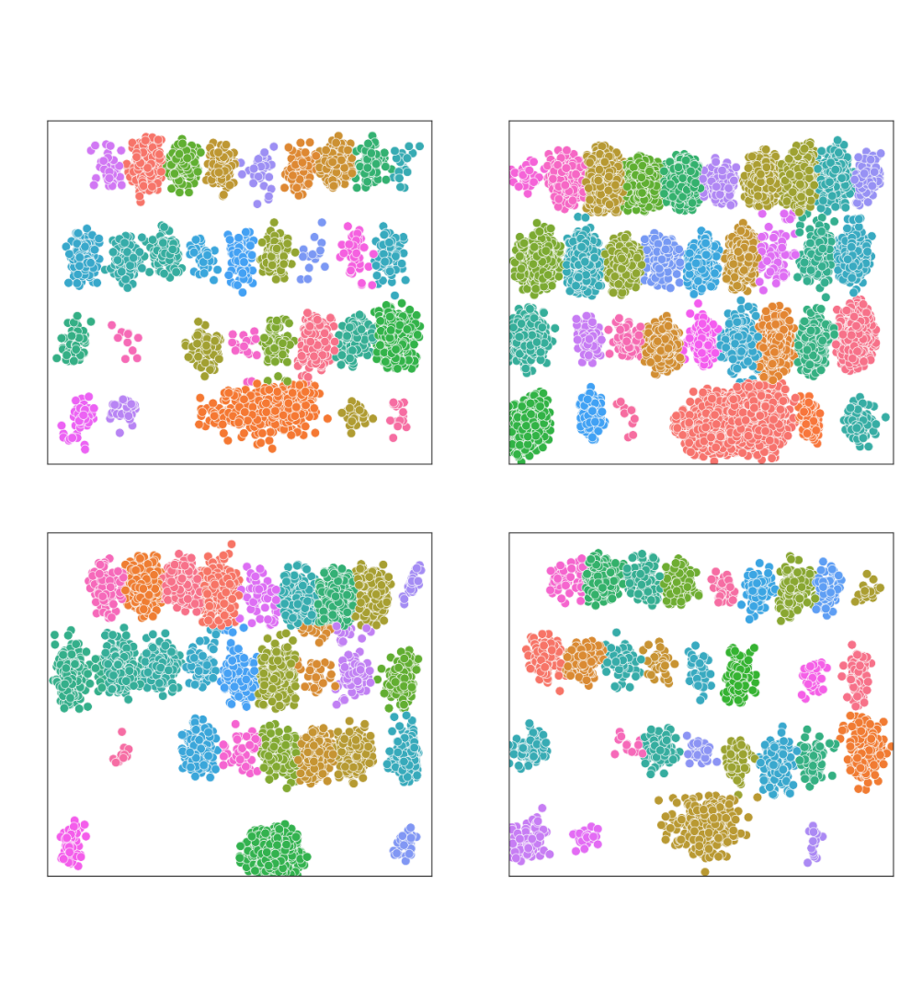
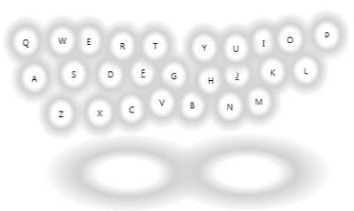
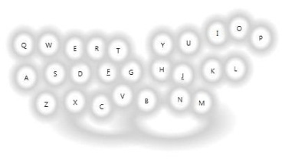
Individual Typing Behaviour
Tabletop
Smartphone
[Findlater and Wobbrock 2012]
[Buschek et al. 2018]
Intelligent Text Entry

Slide 28
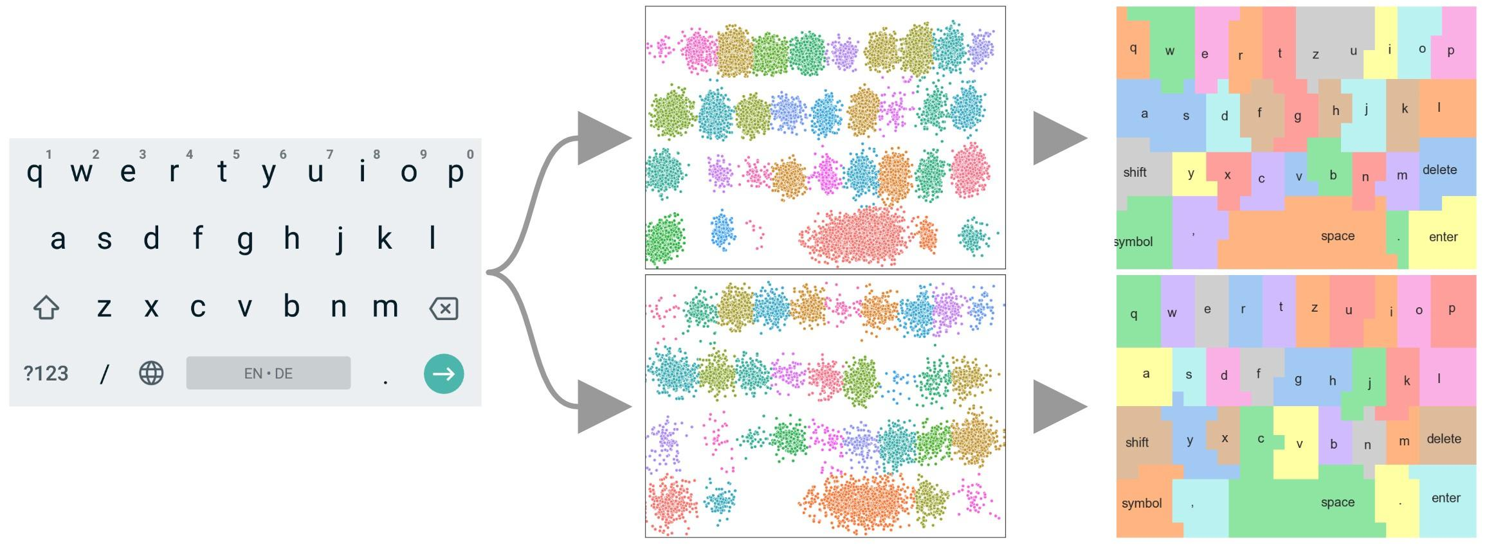
Adapting Keyboards to Typists
Overview
Visible keyboard
Collect touches
Adapt underlying key regions
User A
User B
Intelligent Text Entry

Slide 29
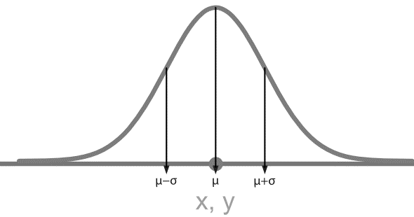

Modelling Touchscreen Keypresses
From x,y touch points to one Gaussian per key
[Azenkot and Zhai 2012]
Gaussian key model:
(shown in 1D here)
likelihood
touch location t
Intelligent Text Entry

Slide 30

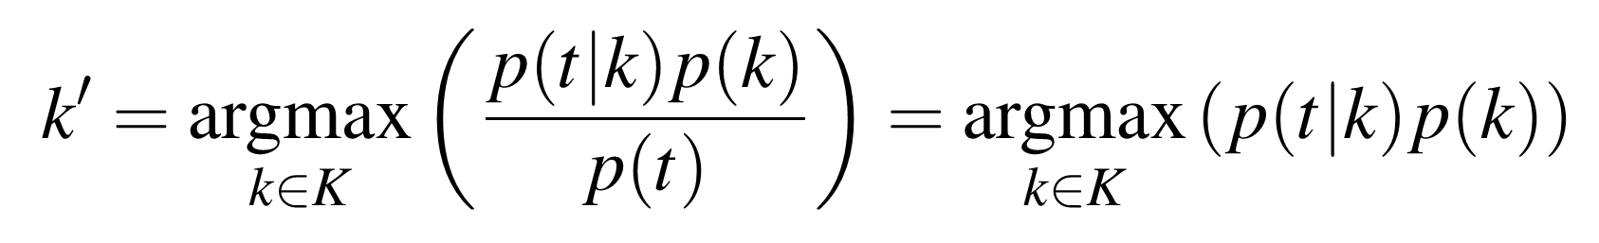
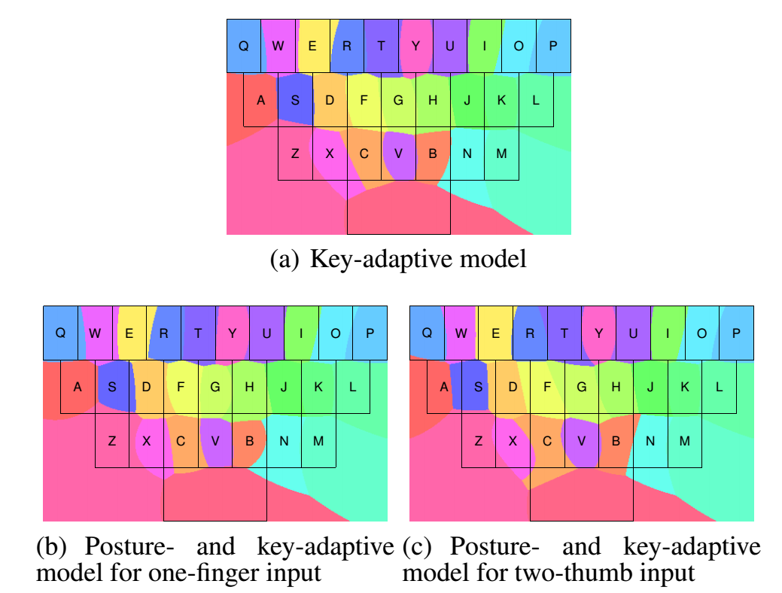

Probabilistic Keyboard Model
Which key does the user intend to press? i.e. „input decoding“
Gaussian key model
Language model
e.g. based on
last five characters:
}
predicted
keypress
Bayes‘ rule
=
Evaluate and colour k‘ for each pixel
[Yin et al. 2013]
Intelligent Text Entry

Slide 31
DIY: Probabilistic Keyboard Model
touchX = ... // touch X coordinate
touchY = ... // touch Y coordinate
num_keys = ... // number of keys on keyboard
means = [...] // list of all key means (2D key locations)
variances = [...] // list of key variances (real values) or covariances (2x2 matrices)
probs = [] // list to store the likelihoods of each key being pressed
sum = 0 // variable to store sum of likelihoods for normalisation (see below)
for k = 0 to num_keys: // iterate over all keys
// evaluate touch location under distribution of the key*:
prob_t_given_k = multinormal_pdf(touchX, touchY, means[k], variances[k])
// likelihood of key without touch info; uniform (here), or based on language*:
prob_k = 1/num_keys
// store product and add it to the sum of all likelihoods*:
probs[k] = prob_t_given_k * prob_k
sum = sum + probs[k]
// normalise, so that the likelihoods add up to 1*:
probs = probs / sum //note: “/” is element-wise division
// find most likely key:
pressed_key_index = argmax(probs)
// TODO for adaptation: update means and variances with new touchX and touchY
* in real implementation use logarithm and corresponding operations for numerical stability
Intelligent Text Entry

Slide 32
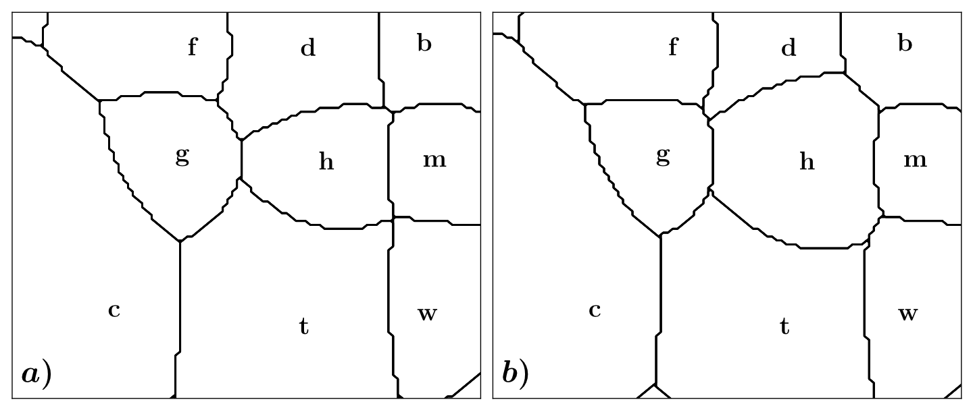
Language Model Influence
Example: bigram model for English
After „n“:
After „t“:
Intelligent Text Entry

Slide 33
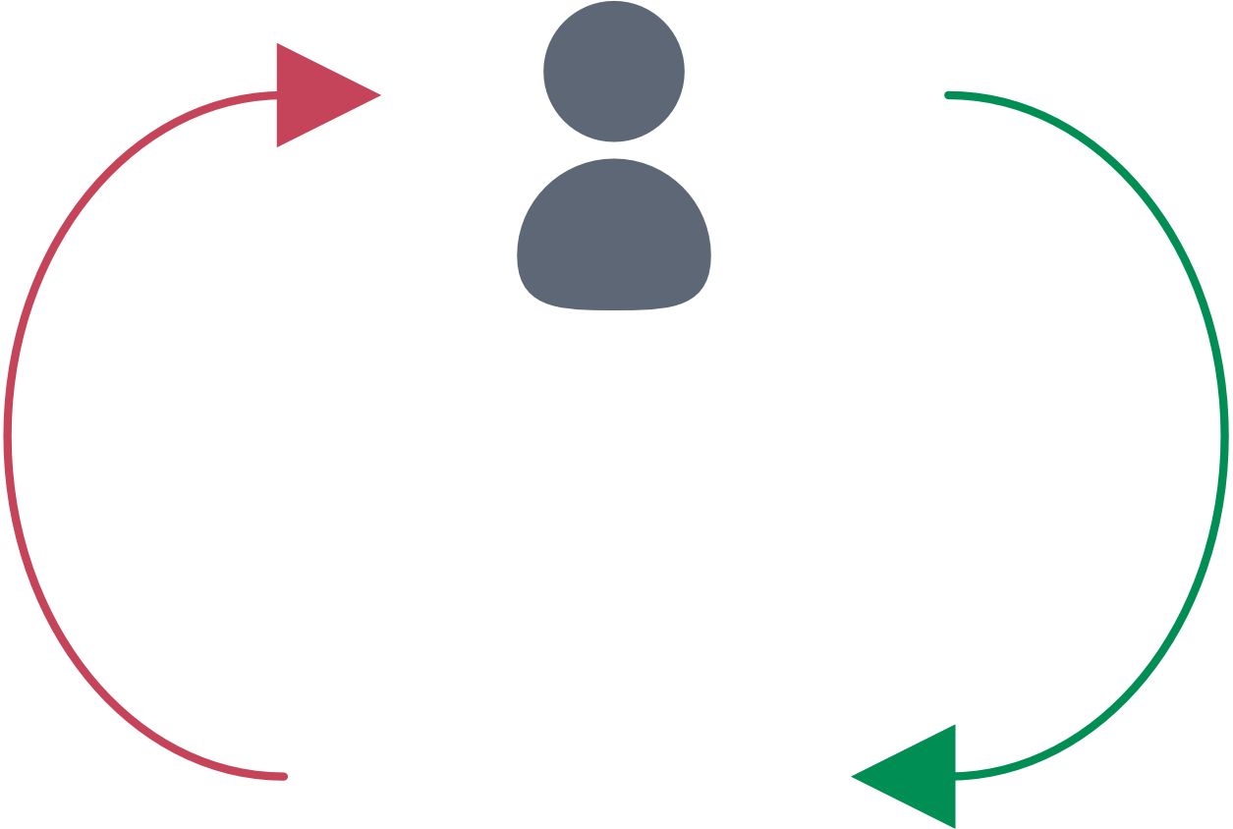
Adaptation in the Background
Why do our keyboards
not look like this?
→ Avoid co-adaptation
of user and system
Keyboard visuals
change touch behaviour
Touch behaviour
changes keyboard
[Yin et al. 2013]
Intelligent Text Entry

Slide 34
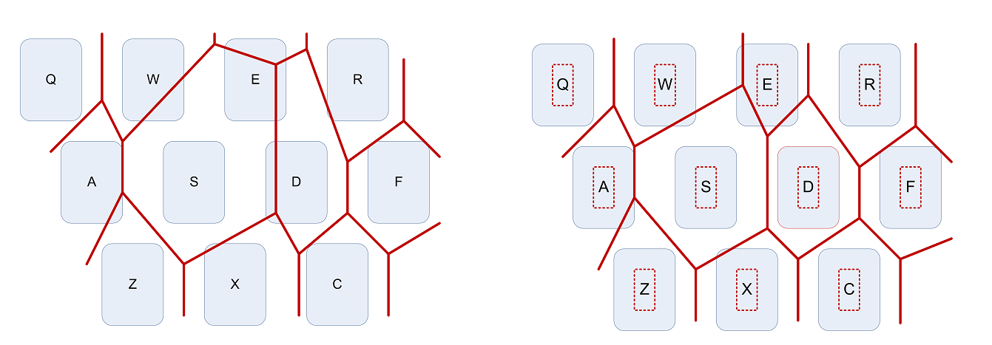
Adaptation vs Distortion
Unlimited adaptation
With protected key region
Here: (almost) impossible to type „e“!
[Gunawardana et al. 2010]
Intelligent Text Entry

Slide 35
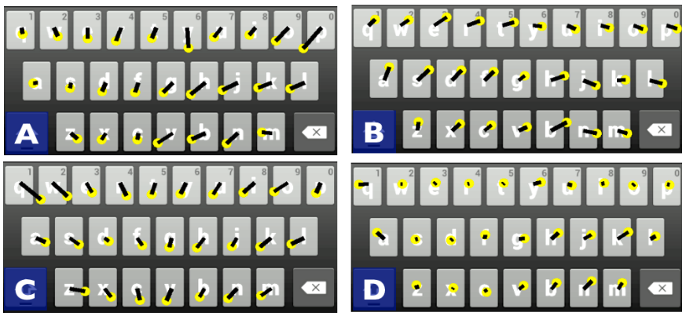
Context Adaptations
e.g. hand posture – „ContextType“, Goel et al. 2013
Left thumb
Right thumb
Index finger
Two thumbs
[Goel et al. 2013]
Intelligent Text Entry

Slide 36
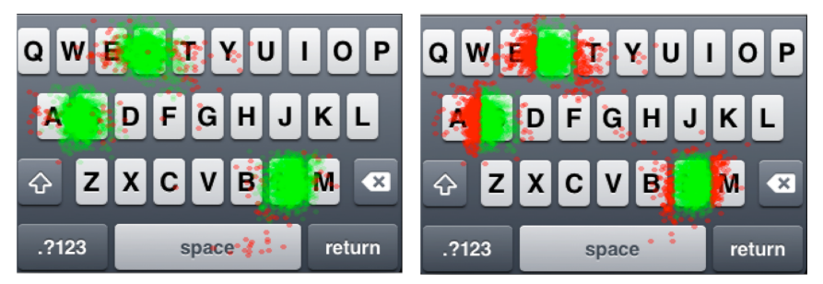
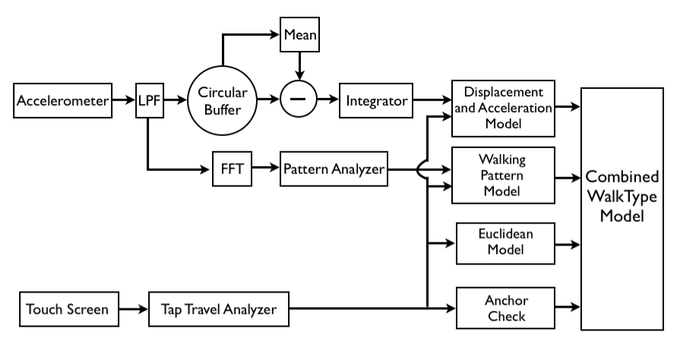
Context Adaptations
e.g. walking – „WalkType“, Goel et al. 2012
[Goel et al. 2012]
Intelligent Text Entry

Slide 37
Notebook Example
Visualising adaptive keyboards

Slide 38

Decoding Typing Sequences
Infer intended input after entering whole word or sentence
  + More evidence for inference
  + No need for user to pay attention to intermediate output
  - No intermediate feedback
Example (sentence-based decoding):
„pleaseforwarxmetheatachement“
Hit enter
„Please forward me the attachement.“
[Vertanen et al. 2015]
Intelligent Text Entry

Slide 39



Sequence Decoding, formally
Sequence of user‘s intended keys/letters
(i.e. unknown to system)
Sequence of user‘s touches (i.e. system‘s observations)
Can we infer s from o ?
Note: Same approach as for a single touch but now we have sequences of touches and keys
Intelligent Text Entry

Slide 40


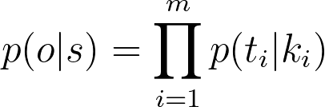

Probabilistic Model for Sequences
See notebook for an example implementation
Prior over letter sequences,
i.e. probability of s in a language,
i.e. a language model
…
Gaussian key model, now for a touch sequence
(i.e. likelihood of observing the touch sequence o under the assumption that the user intended to write s)
Intelligent Text Entry

Slide 41


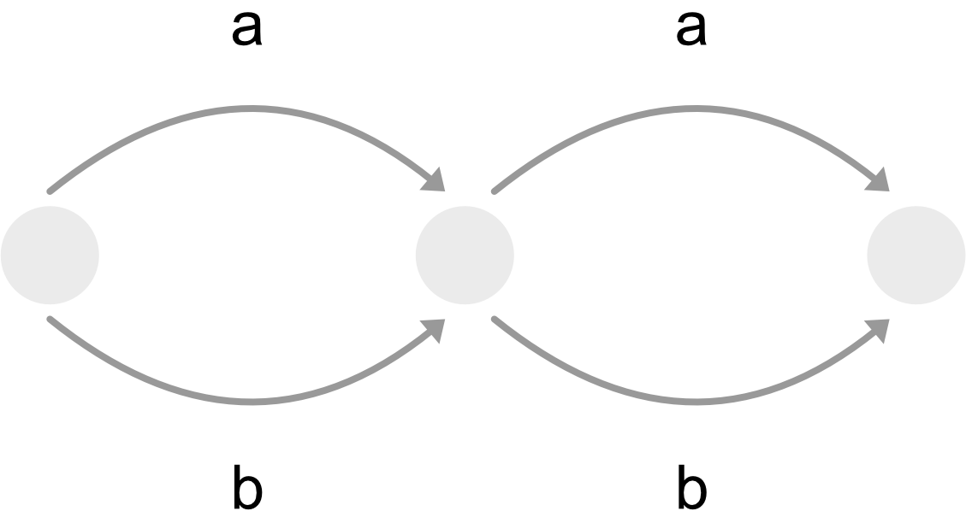






Decoding Typing Sequences
Token passing algorithm
Keyboard,
typing touches
Token
Hyp: „ab“
p: 0.009
Index: 2
Token
Hyp: „bb“
p: 0.004
Index: 2
Token
Hyp: „a“
p: 0.082
Index: 1
Token
Hyp: „aa“
p: 0.002
Index: 2
Token
Hyp: „ba“
p: 0.0001
Index: 2
Token
Hyp: „a“
p: 0.082
Index: 1
Token
Hyp: „“
p: 1.0
Index: 0
Token
Hyp: „aa“
p: 0.002
Index: 2
Token
Hyp: „b“
p: 0.015
Index: 1
Token
Hyp: „b“
p: 0.015
Index: 1
Token
Hyp: „ab“
p: 0.009
Index: 2
Token
Hyp: „bb“
p: 0.004
Index: 2
Token
Hyp: „ba“
p: 0.0001
Index: 2
Intelligent Text Entry

Slide 42
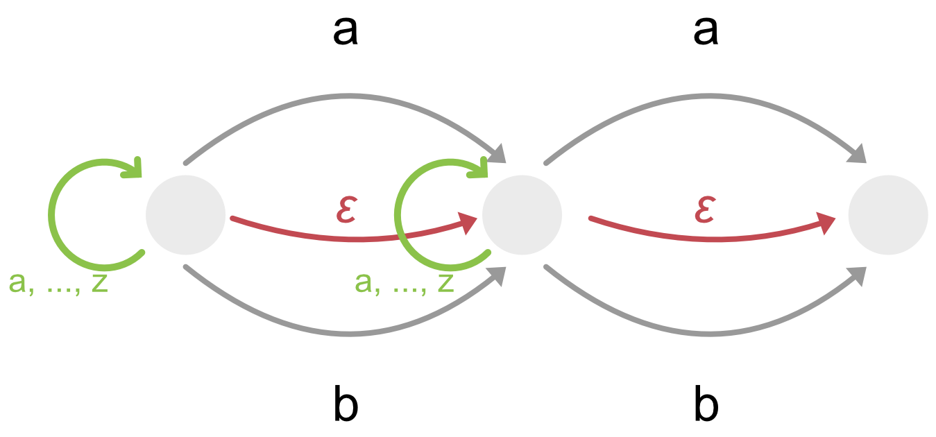
Decoding Typing Sequences
With insertion and deletion
Previous slide: Substitution-only decoder
Extensions: insertion and deletion transitions,
with „penalty“
Intelligent Text Entry

Slide 43
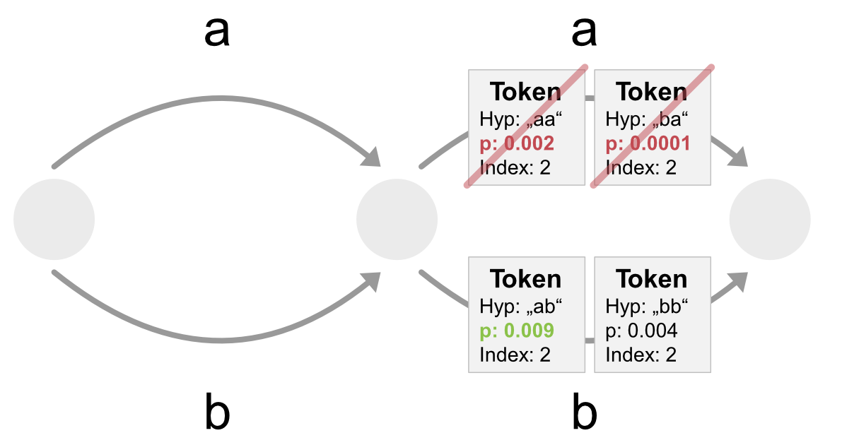
Decoding Typing Sequences
With beam search / pruning
Problem: Large search space
Substitution-only → exponential, Insertion → infinite
Solution: Beam search / pruning
Per index, only propagate tokens that are within a certain range
(=„beam width“) of the probability of the most likely token.
e.g. beam width = 0.005,
i.e. here exclude p < 0.009-0.005=0.004
Intelligent Text Entry

Slide 44
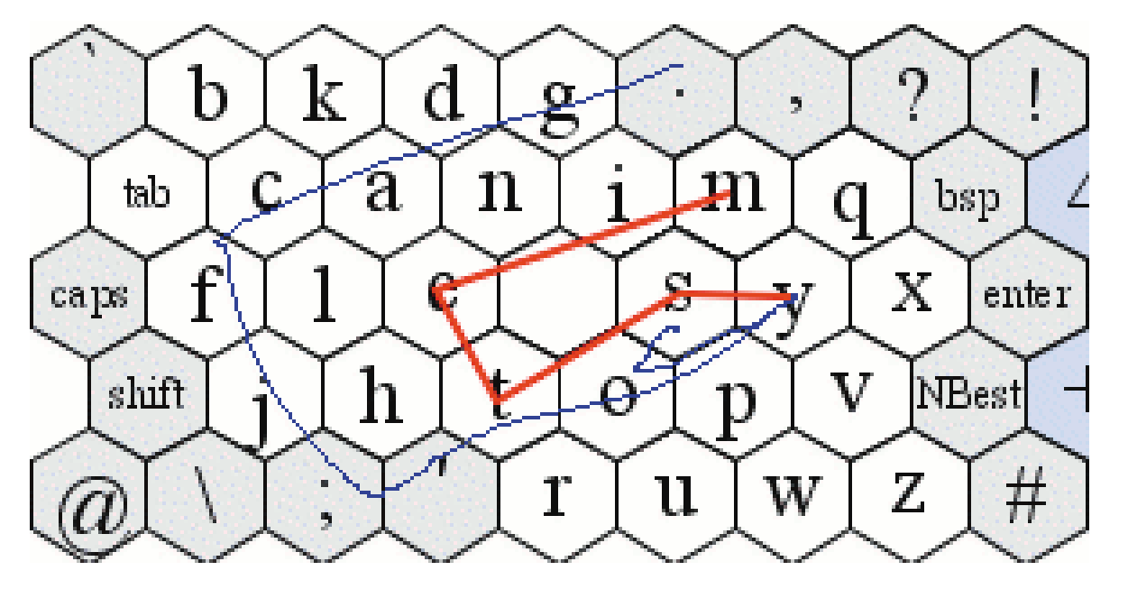
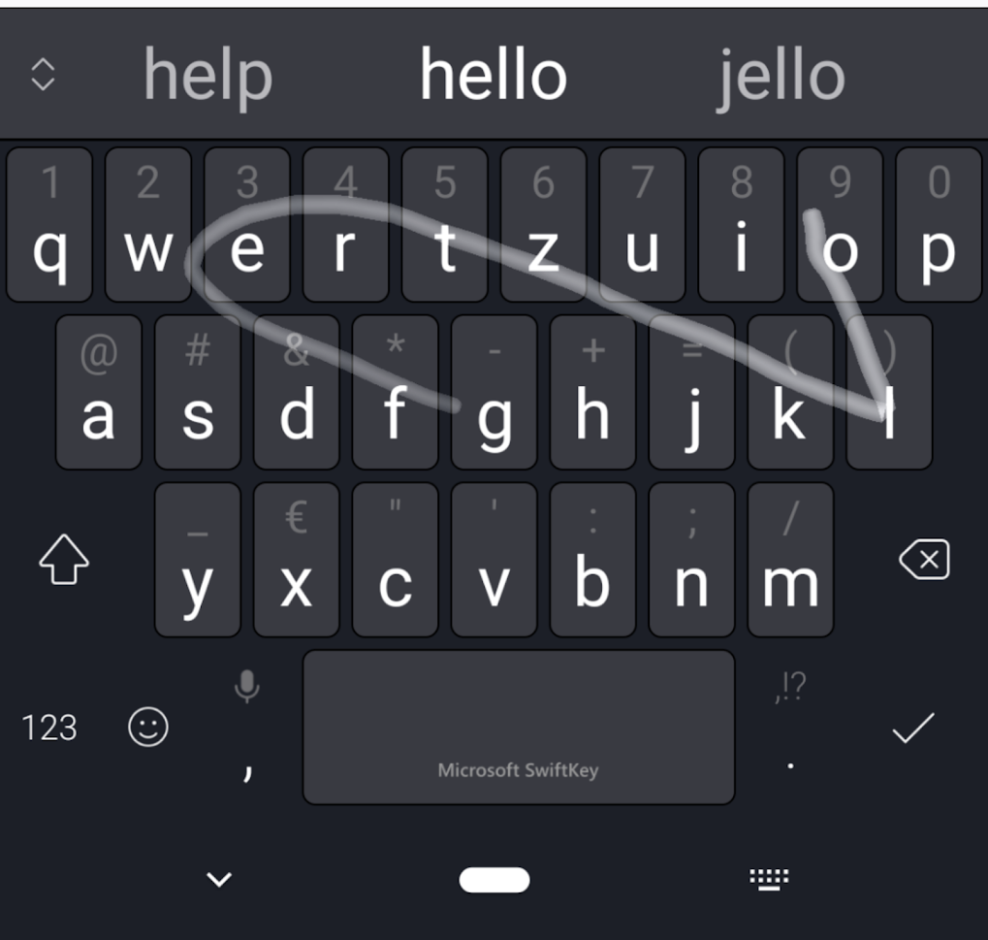
Gesture-based Decoding
Infer intended word from shape of finger trace on the keyboard
„SHARK²“ [Kristensson and Zhai 2004]
Microsoft SwiftKey (screenshot Nov 2020)
Intelligent Text Entry

Slide 45
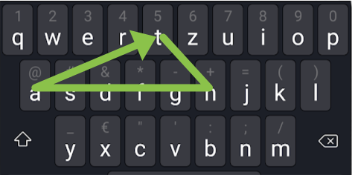
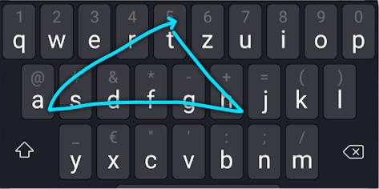


Gesture-based Decoding
Shape model
Language model
Stored template (ideal) shapes
for all words in dictionary W
User‘s touch trace
Distance
metric
e.g. see
Kristensson and Zhai,
2004
…
Intelligent Text Entry

Slide 46


Word Prediction
So far: Inference used touch input
Now: Predict next word that user has not yet started to type,
only using language context
E.g. n-gram word models, i.e. context of last n-1 words
More recently: Deep Learning
to include larger context
Intelligent Text Entry

Slide 47
Summary
Improving keyboards by probabilistically combining
input information with language information
Adaptation:
  Individual input behaviour → adaptation to typist
  Further sensors → adaptation to context
Prediction/Decoding:
  Single touch + language context → current key
  Touch sequences + language context → current word/sentence
  Language only → next word(s)
Intelligent Text Entry

Slide 48
Notebook Example 2
Sequence decoding

Slide 49
References (Part 1)
Kristensson, P. O., & Vertanen, K. (2014). The inviscid text entry rate and its application as a grand goal for mobile text entry. Proceedings of the 16th international conference on Human-computer interaction with mobile devices & services, 335–338. https://doi.org/10.1145/2628363.2628405
Kristensson, P.-O., & Zhai, S. (2004). SHARK2: A large vocabulary shorthand writing system for pen-based computers. Proceedings of the 17th Annual ACM Symposium on User Interface Software and Technology - UIST ’04, 43. https://doi.org/10.1145/1029632.1029640
Vertanen, K., Memmi, H., Emge, J., Reyal, S., & Kristensson, P. O. (2015). VelociTap: Investigating Fast Mobile Text Entry using Sentence-Based Decoding of Touchscreen Keyboard Input. Proceedings of the 33rd Annual ACM Conference on Human Factors in Computing Systems, 659–668. https://doi.org/10.1145/2702123.2702135
Yin, Y., Ouyang, T. Y., Partridge, K., & Zhai, S. (2013). Making touchscreen keyboards adaptive to keys, hand postures, and individuals: A hierarchical spatial backoff model approach. Proceedings of the SIGCHI Conference on Human Factors in Computing Systems, 2775–2784. https://doi.org/10.1145/2470654.2481384
Further Reading:
Bi, X., Li, Y., & Zhai, S. (2013). FFitts law: Modeling finger touch with fitts’ law. Proceedings of the SIGCHI Conference on Human Factors in Computing Systems, 1363–1372. https://doi.org/10.1145/2470654.2466180
Oulasvirta, A., Kristensson, P. O., Bi, X., & Howes, A. (Hrsg.). (2018). Computational Interaction. Oxford University Press.
Intelligent Text Entry

Slide 50
References (Part 2)
Azenkot, S., & Zhai, S. (2012). Touch behavior with different postures on soft smartphone keyboards. Proceedings of the 14th international conference on Human-computer interaction with mobile devices and services, 251–260. https://doi.org/10.1145/2371574.2371612
Buschek, D., Bisinger, B., & Alt, F. (2018). ResearchIME: A Mobile Keyboard Application for Studying Free Typing Behaviour in the Wild. Proceedings of the 2018 CHI Conference on Human Factors in Computing Systems, 1–14. https://doi.org/10.1145/3173574.3173829
Findlater, L., & Wobbrock, J. (2012). Personalized input: Improving ten-finger touchscreen typing through automatic adaptation. Proceedings of the SIGCHI Conference on Human Factors in Computing Systems, 815–824. https://doi.org/10.1145/2207676.2208520
Goel, M., Findlater, L., & Wobbrock, J. (2012). WalkType: Using accelerometer data to accomodate situational impairments in mobile touch screen text entry. Proceedings of the 2012 ACM Annual Conference on Human Factors in Computing Systems - CHI ’12, 2687. https://doi.org/10.1145/2207676.2208662
Goel, M., Jansen, A., Mandel, T., Patel, S. N., & Wobbrock, J. O. (2013). ContextType: Using Hand Posture Information to Improve Mobile Touch Screen Text Entry. Proceedings of the SIGCHI Conference on Human Factors in Computing Systems, 2795–2798. https://doi.org/10.1145/2470654.2481386
Goodman, J., Venolia, G., Steury, K., & Parker, C. (2002). Language modeling for soft keyboards. Proceedings of the 7th international conference on Intelligent user interfaces, 194–195. https://doi.org/10.1145/502716.502753
Gunawardana, A., Paek, T., & Meek, C. (2010). Usability guided key-target resizing for soft keyboards. Proceedings of the 15th international conference on Intelligent user interfaces - IUI ’10, 111. https://doi.org/10.1145/1719970.1719986
Holz, C., & Baudisch, P. (2011). Understanding touch. Proceedings of the SIGCHI Conference on Human Factors in Computing Systems, 2501–2510. https://doi.org/10.1145/1978942.1979308
Intelligent Text Entry

Slide 51
References (Part 2, cont.)
Dunlop, M., & Levine, J. (2012). Multidimensional pareto optimization of touchscreen keyboards for speed, familiarity and improved spell checking. Proceedings of the SIGCHI Conference on Human Factors in Computing Systems, 2669–2678. https://doi.org/10.1145/2207676.2208659
Gong, J., Xu, Z., Guo, Q., Seyed, T., Chen, X. „Anthony“, Bi, X., & Yang, X.-D. (2018). WrisText: One-handed Text Entry on Smartwatch using Wrist Gestures. Proceedings of the 2018 CHI Conference on Human Factors in Computing Systems - CHI ’18, 1–14. https://doi.org/10.1145/3173574.3173755
Oulasvirta, A., Reichel, A., Li, W., Zhang, Y., Bachynskyi, M., Vertanen, K., & Kristensson, P. O. (2013). Improving two-thumb text entry on touchscreen devices. Proceedings of the SIGCHI Conference on Human Factors in Computing Systems, 2765–2774. https://doi.org/10.1145/2470654.2481383
Zhai, S., Hunter, M., & Smith, B. A. (2000). The metropolis keyboard—An exploration of quantitative techniques for virtual keyboard design. Proceedings of the 13th Annual ACM Symposium on User Interface Software and Technology - UIST ’00, 119–128. https://doi.org/10.1145/354401.354424
Further Reading:
Oulasvirta, A., Dayama, N. R., Shiripour, M., John, M., & Karrenbauer, A. (2020). Combinatorial Optimization of Graphical User Interface Designs. Proceedings of the IEEE, 108(3), 434–464. https://doi.org/10.1109/JPROC.2020.2969687
Simon, H. A. (1969). The sciences of the artificial. The MIT Press.
Intelligent Text Entry

Slide 52

License
This file is licensed under the Creative Commons Attribution-Share Alike 4.0 (CC BY-SA) license:
https://creativecommons.org/licenses/by-sa/4.0
Attribution: Daniel Buschek
For more content see: https://iui-lecture.org

