Slide 1


Introduction to Intelligent User Interfaces
Artificial Intelligence: An Overview for HCI
Image Source

Slide 2
What is considered Artificial Intelligence?
What is AI?

Slide 3
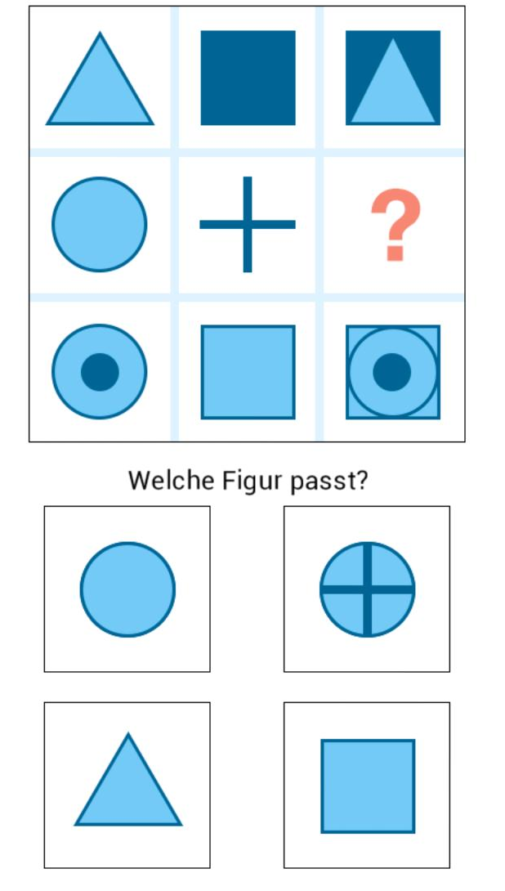
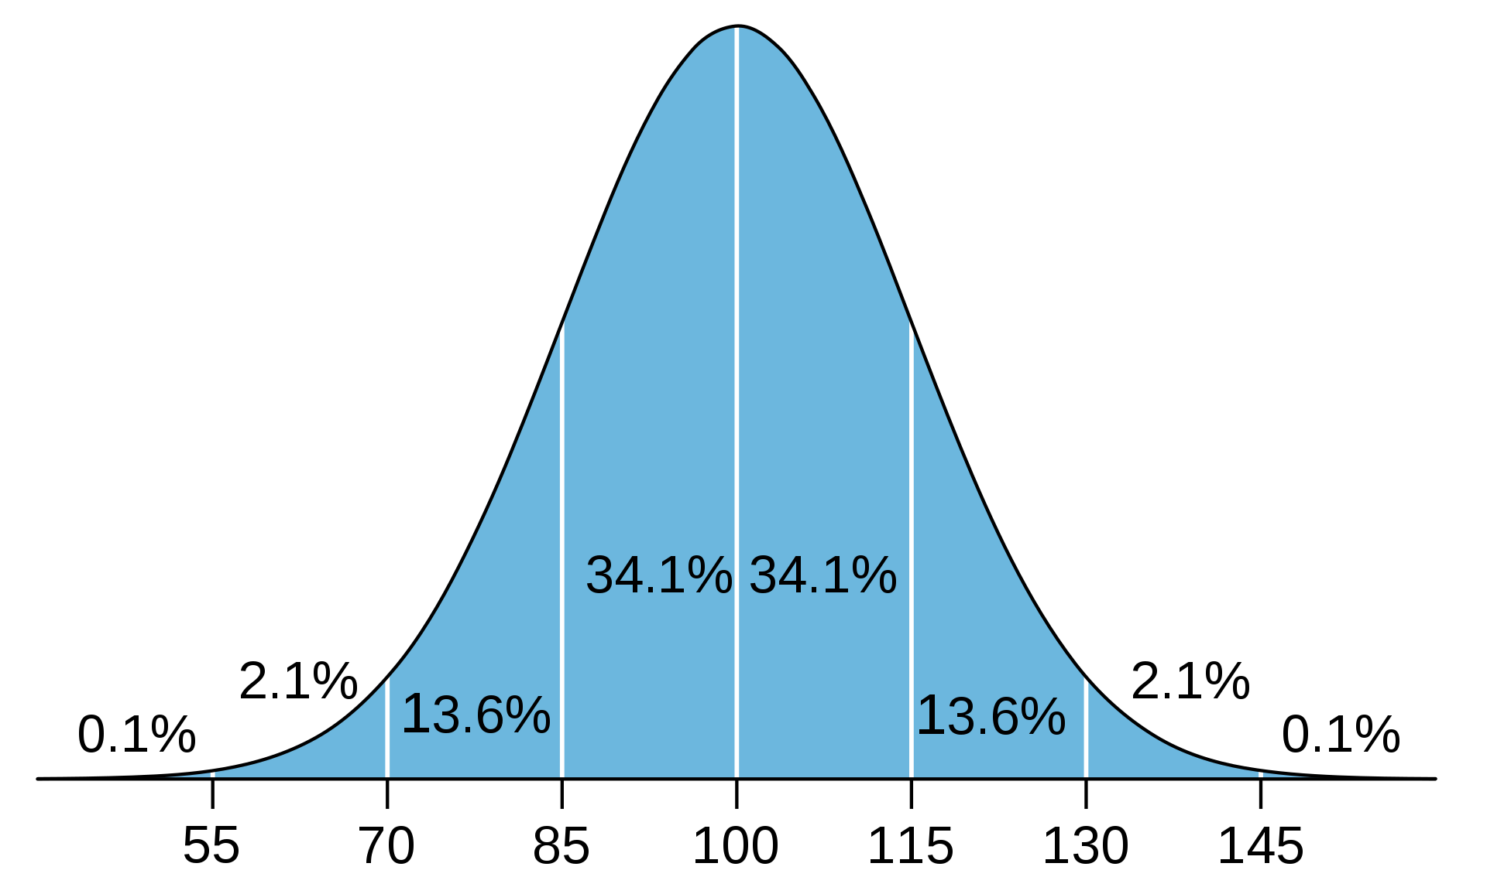
What is considered Artifical Intelligence?
What is Human Intelligence?
Which figure fits?
What is AI?
Notes:
What tasks are in an IQ test?
Why are the solution requiring an intelligent person/actor?
Predict the future from know examples → regresion, prediction
Classify based on previous examples → NN, SVM
The odd

Slide 4
What is in an IQ test?
Many different types… typical questions include:
Finding Analogies (math and verbal)
  Pen and writing, cup and ???
Finding / extending Pattern (graphical and math)
  45 … 40 … 60 … 55 … 75 … 70 … ???
Classification tasks
  Make two groups: apple, plate, grape, cake, spoon, knife
Making sense spatial and visual representations
Reasoning and logical
General knowedge

Slide 5
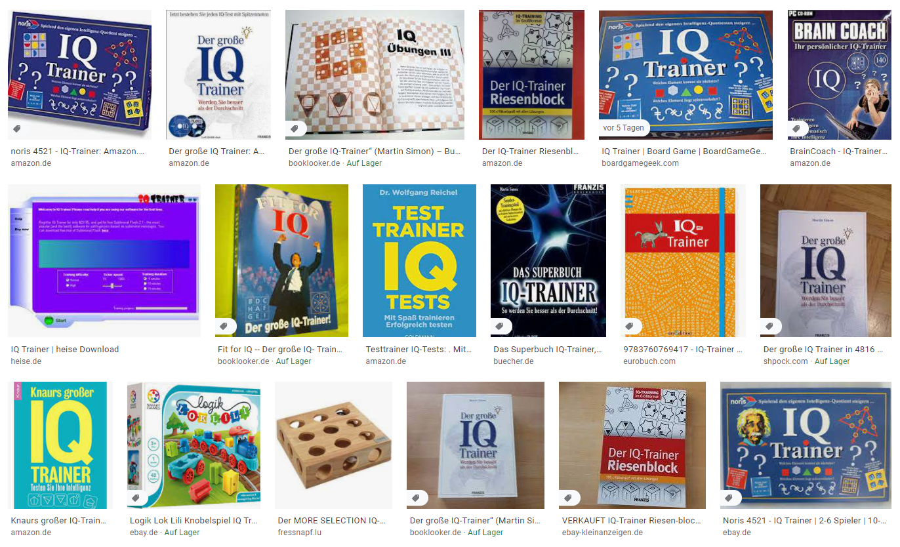
Is the IQ static or can it be learned?
Google Search for IQ trainer…

Slide 6
What is…
Mini In-Class Exercise
Artificial intelligence
Machine Learning
Write a definition for one of the term
  Time limit is 3 minutes
  No more than 20 words
What is AI?

Slide 7

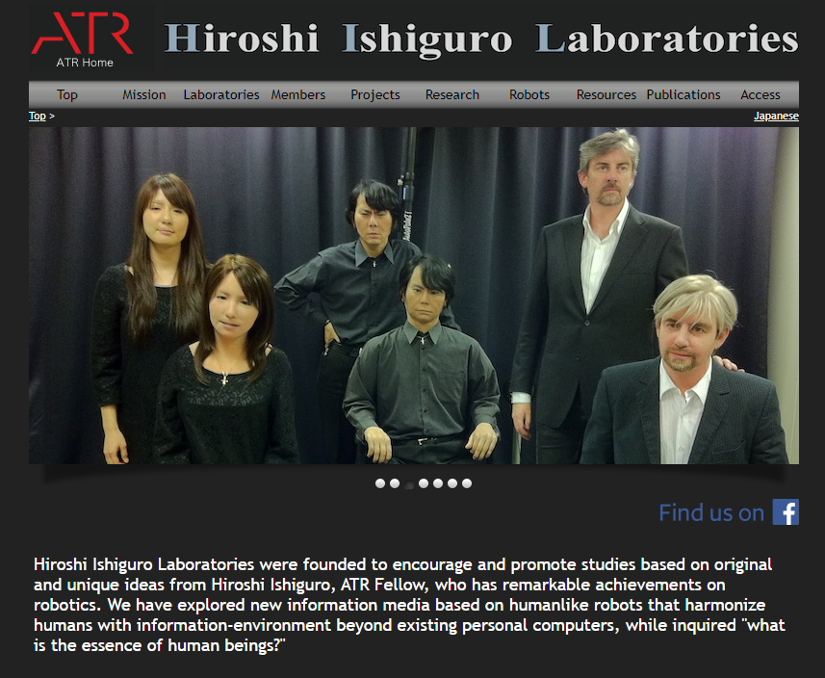
Artificial Intelligence?
Artificial Narrow Intelligence (also Weak AI)
  Solves very specific and well described problems in a specific domain
Artificial General Intelligence (also Strong AI)
  An artificial intelligence that has the ability to mimic human intelligence
  Its behavior cannot be distinguished by observation from a human
Artificial Super Intelligence
  An artificial intelligence that surpasses human intelligence
http://www.geminoid.jp/en
What is AI?

Slide 8
AI Knowledge Map: how to classify AI technologies
A sketch of a new AI technology landscape by Francesco Corea
Technologies
  Logic-based
  Knowledge-based
  Probabilistic methods
  Machine learning
  Embodied intelligence
  Search and optimization
Domains
  Reasoning
  Knowledge
  Planning
  Communication
  Perception
https://medium.com/@Francesco_AI/ai-knowledge-map-how-to-classify-ai-technologies-6c073b969020
What is AI?

Slide 9
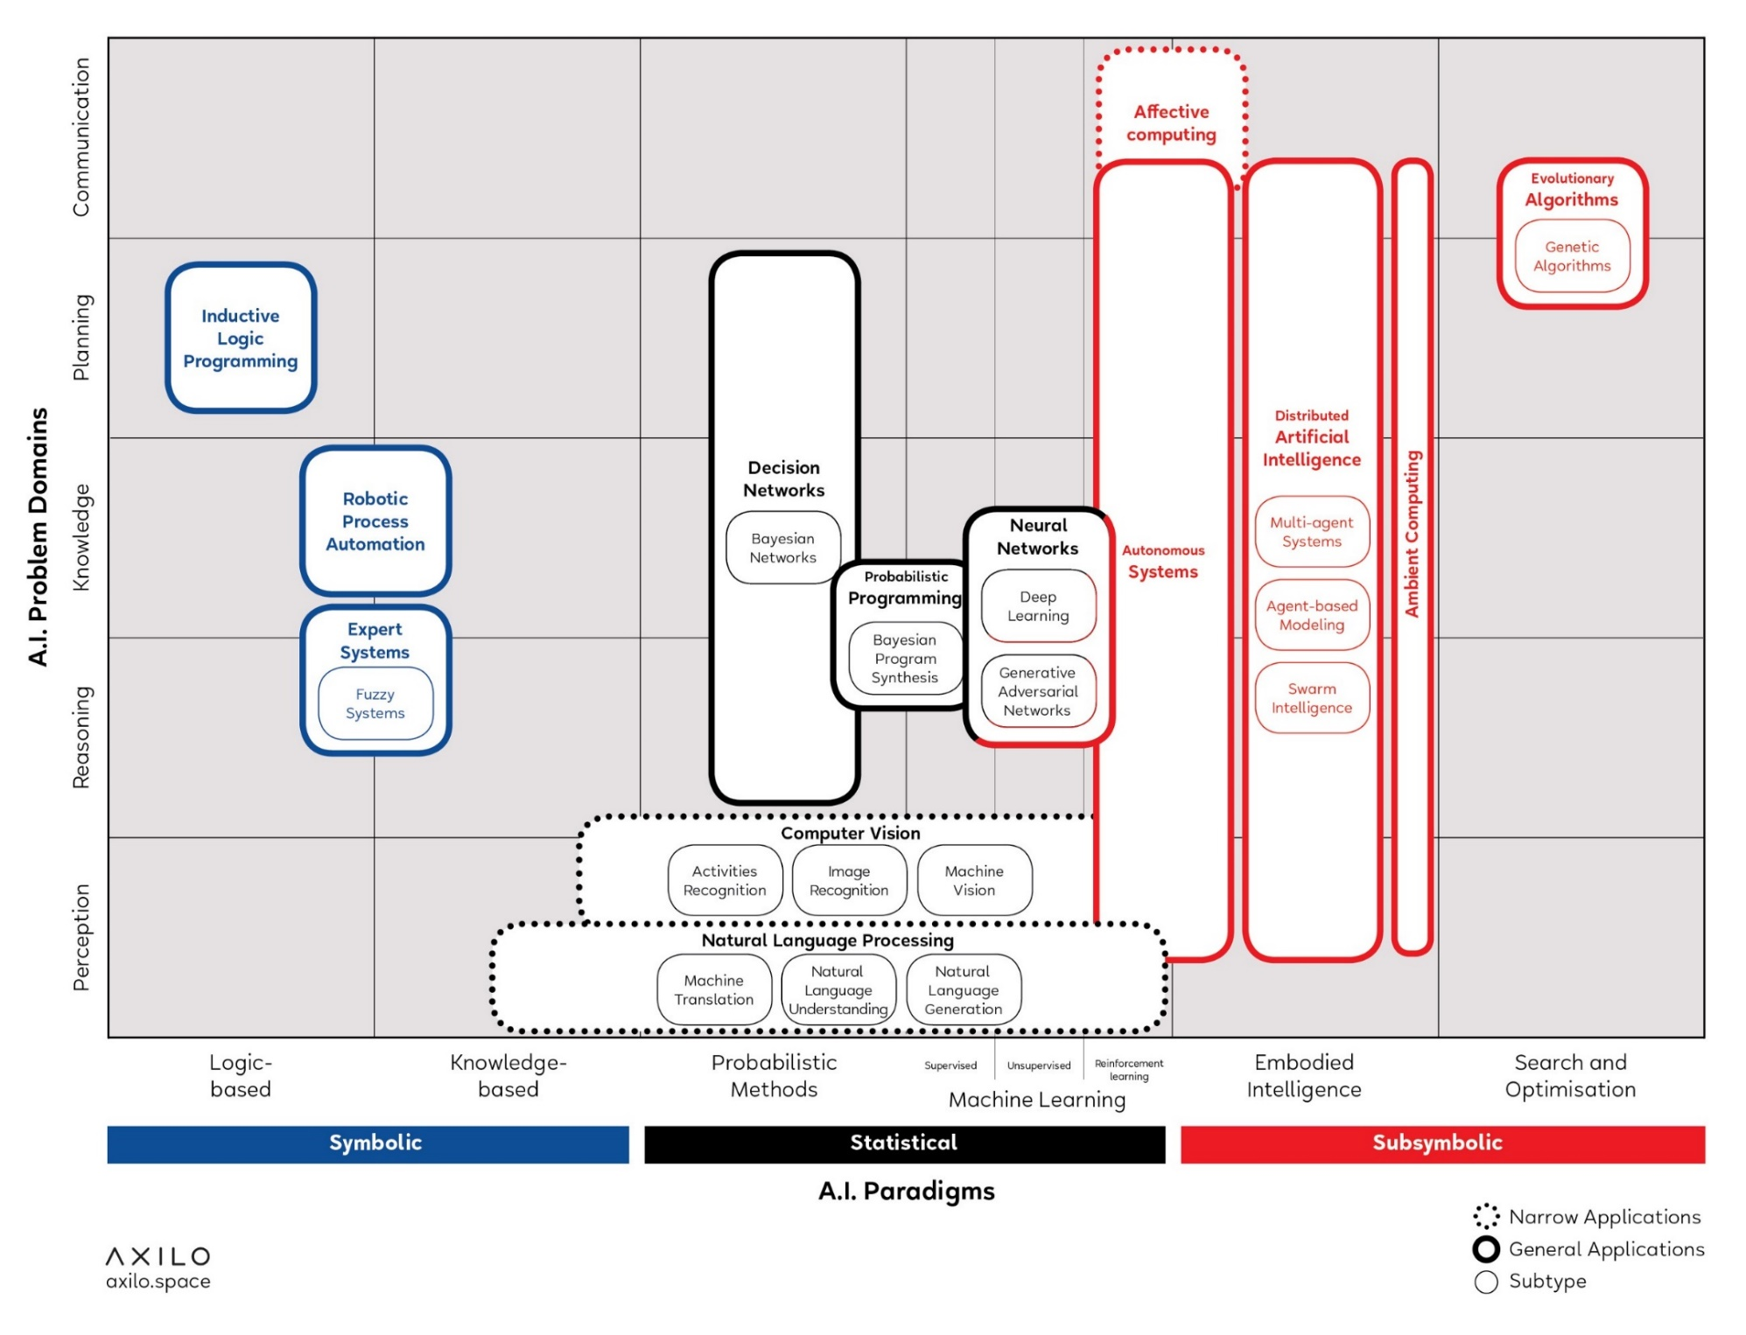
AI Knowledge Map: how to classify AI technologies
A sketch of a new AI technology landscape by Francesco Corea
https://medium.com/@Francesco_AI/ai-knowledge-map-how-to-classify-ai-technologies-6c073b969020
AI Knowledge Map: how to classify AI technologies. A sketch of a new AI technology landscape Francesco Corea
What is AI?

Slide 10
AI Knowledge Map: how to classify AI technologies
A sketch of a new AI technology landscape by Francesco Corea
Technologies
Logic-based tools: tools that are used for knowledge representation and problem-solving
Knowledge-based tools: tools based on ontologies and huge databases of notions, information, and rules
Probabilistic methods: tools that allow agents to act in incomplete information scenarios
Machine learning: tools that allow computers to learn from data
Embodied intelligence: engineering toolbox, which assumes that a body (or at least a partial set of functions such as movement, perception, interaction, and visualization) is required for higher intelligence
Search and optimization: tools that allow intelligently searching through many possible solutions
https://medium.com/@Francesco_AI/ai-knowledge-map-how-to-classify-ai-technologies-6c073b969020
What is AI?

Slide 11
AI Knowledge Map: how to classify AI technologies
A sketch of a new AI technology landscape by Francesco Corea
Domains
Reasoning: the capability to solve problems
Knowledge: the ability to represent and understand the world
Planning: the capability of setting and achieving goals
Communication: the ability to understand language and communicate
Perception: the ability to transform raw sensorial inputs (e.g., images, sounds, etc.) into usable information
https://medium.com/@Francesco_AI/ai-knowledge-map-how-to-classify-ai-technologies-6c073b969020
What is AI?

Slide 12
Classification
e.g. is an Email spam or not?
These are your examples…
How can we find a “line” that separates the two groups?
What is AI?

Slide 13
Classification
e.g. is an Email spam or not?
These are your examples…
How can we find a “line” that separates the two groups?
What is AI?

Slide 14
Classification
e.g. is an Email spam or not?
These are your examples…
How can we find a “line” that separates the two groups?
What is AI?

Slide 15
Classification
e.g. is an Email spam or not?
These are your examples…
How can we find a “line” that separates the two groups?
What is AI?

Slide 16
Classification
How will you classify the new data points?
e.g. is an Email spam or not?
1
3
2
These are your examples…
How can we find a “line” that separates the two groups?
What is AI?

Slide 17
Classification
How will you classify the new data points?
  … it depends on your “line”
e.g. is an Email spam or not?
1
3
2
These are your examples…
How can we find a “line” that separates the two groups?
What is AI?

Slide 18
Classification
How will you classify the new data points?
  … it depends on your “line”
e.g. is an Email spam or not?
1
3
2
These are your examples…
How can we find a “line” that separates the two groups?
What is AI?

Slide 19
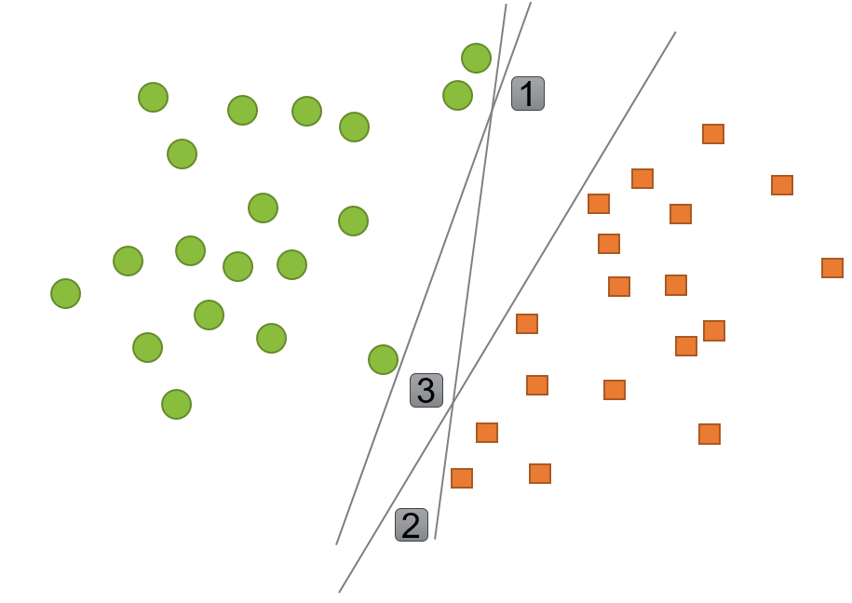
Classification
Example: Support Vector Machines (SVM)
Determine whether a given data point belongs to a certain class or not
Supervised method:
  First training a classifier model on data points for which the class is known (e.g. a set of emails that are labeled as spam or not spam)
  Then use the model to determine
  the class of new, unseen data-points
Find the boundary line that
separates two classes
The boundary line should create
a maximum separation between
the classes
https://www2.deloitte.com/nl/nl/pages/data-analytics/articles/part-2-artificial-intelligence-techniques-explained.html#
What is AI?

Slide 20
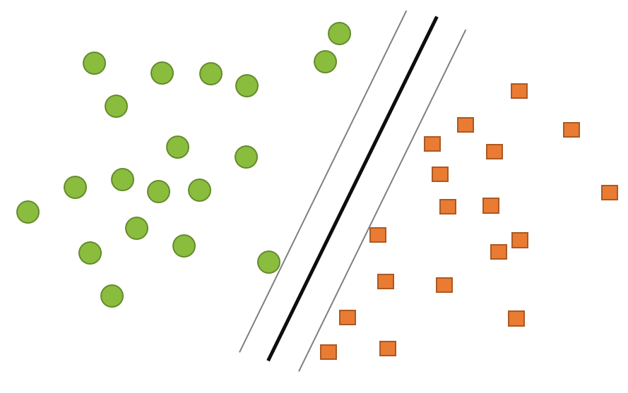
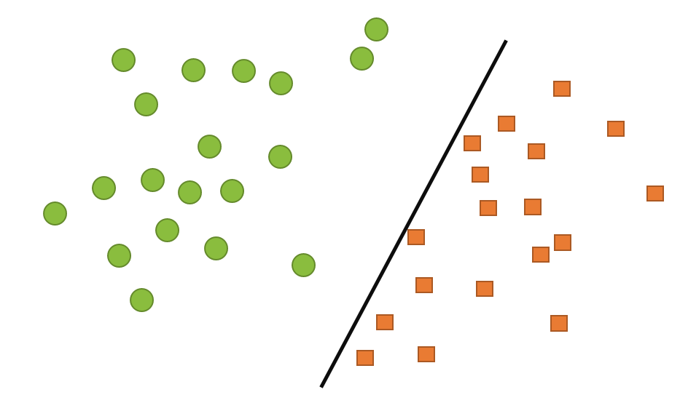
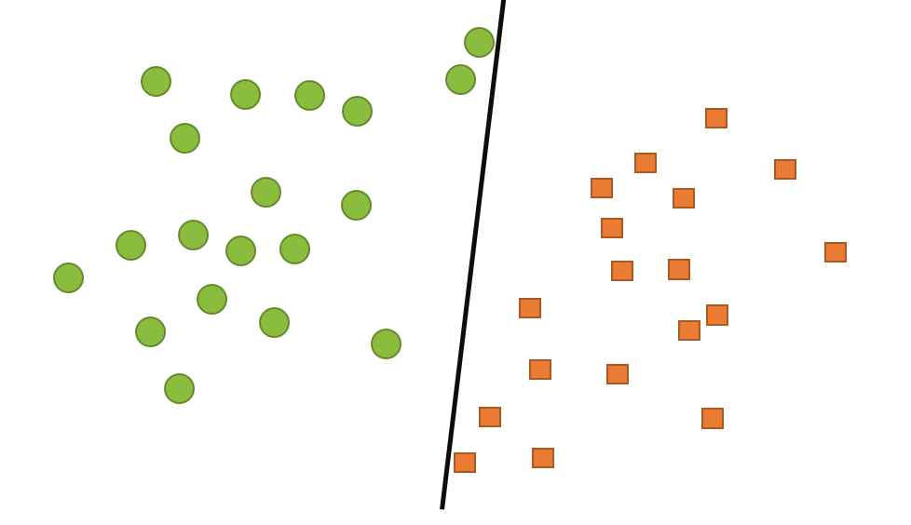
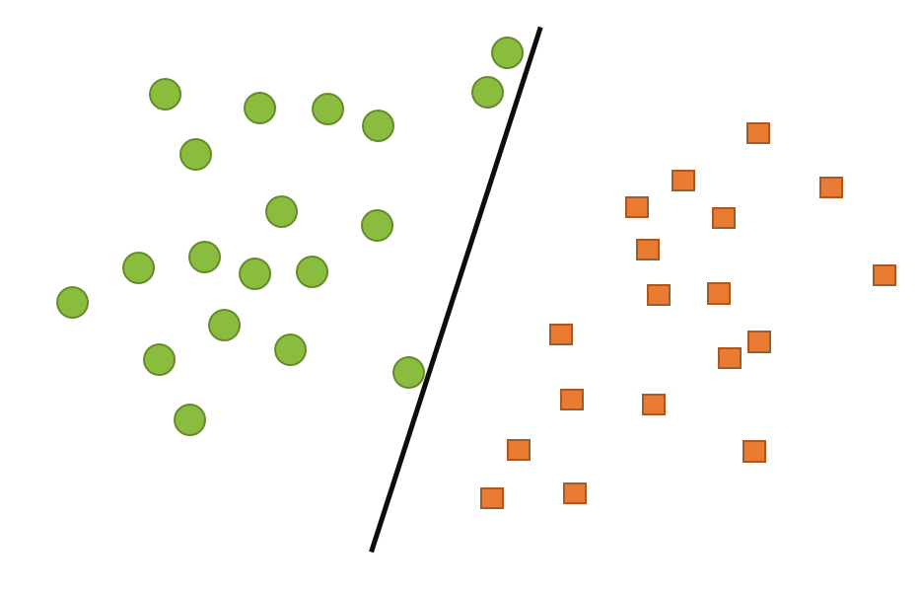
Classification
Example: Support Vector Machines (SVM)
Find the boundary line that separates two classes
The boundary line should create a maximum separation between the classes
What is AI?

Slide 21
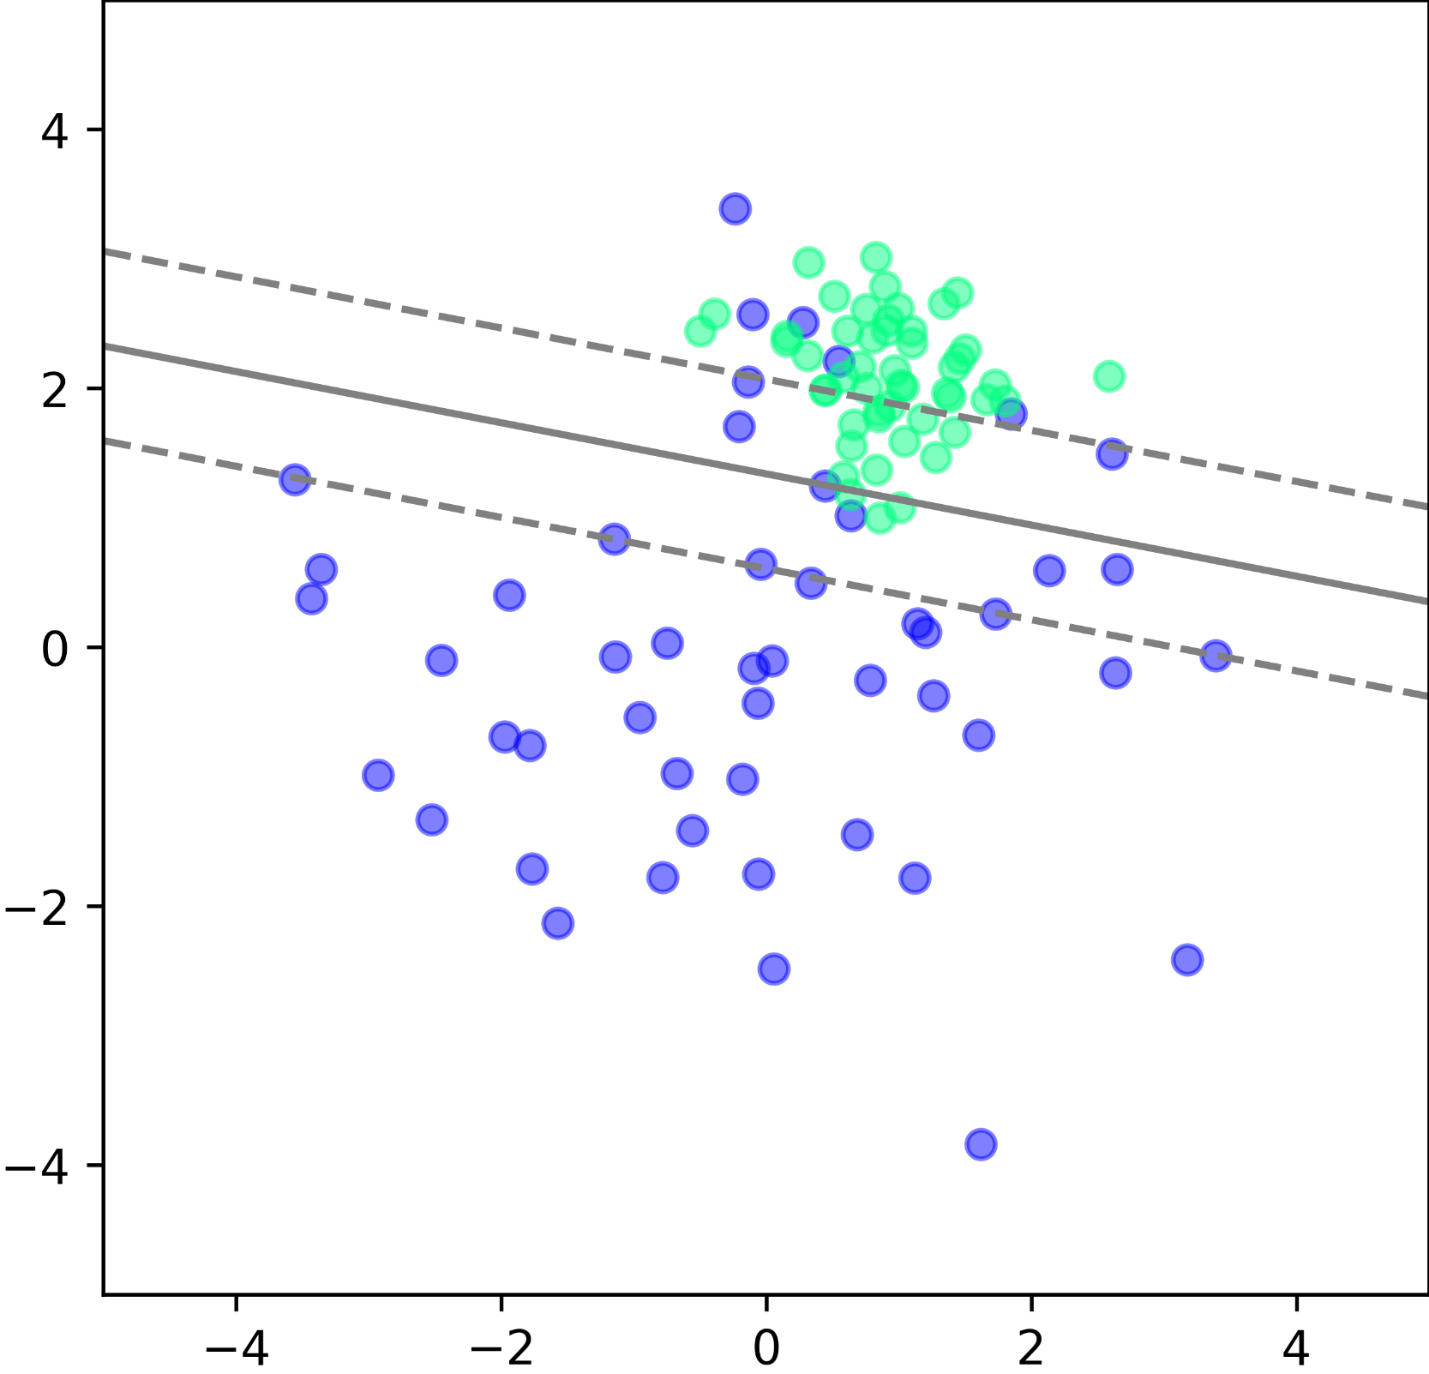
Live Coding Example 1
SVM in Python
SVM with scikit-learn
https://scikit-learn.org

Slide 22
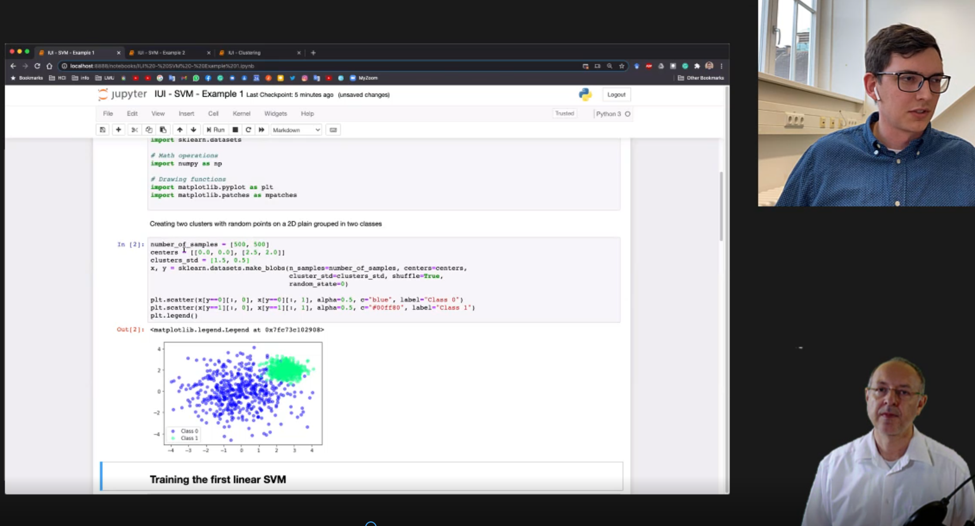

Slide 23
Supervised Learning vs.
Unsupervised Learning
Supervised Learning
  We have a set of examples (data point) for which we know the ground truth (knowledge about the group the data point belongs to)
  Typically a data set with labels exists (or is created)
  During learning the algorithm look at the data AND the desired outcome and learns to associated them
  Learning / preparation is done with a learning set
  It is tested with a set that has not been used for learning
Unsupervised learning
  We may not know what class or group a data point belongs to
  It may not be clear how many classes exist
  The goal is to infer the natural structure present within a set of data points
https://towardsdatascience.com/supervised-vs-unsupervised-learning-14f68e32ea8d
What is AI?

Slide 24
Supervised Learning
“Supervised learning is typically done in the context of classification, when we want to map input to output labels, or regression, when we want to map input to a continuous output. Common algorithms in supervised learning include logistic regression, naive bayes, support vector machines, artificial neural networks, and random forests. In both regression and classification, the goal is to find specific relationships or structure in the input data that allow us to effectively produce correct output data. Note that “correct” output is determined entirely from the training data, so while we do have a ground truth that our model will assume is true, it is not to say that data labels are always correct in real-world situations. Noisy, or incorrect, data labels will clearly reduce the effectiveness of your model.”
Regression
Classification
https://towardsdatascience.com/supervised-vs-unsupervised-learning-14f68e32ea8d
What is AI?

Slide 25
Live Coding Example 2
H or L

Slide 26


Slide 27

Unsupervised Learning
Exercise: make reasonable groups!
“The most common tasks within unsupervised learning are clustering, representation learning, and density estimation. In all of these cases, we wish to learn the inherent structure of our data without using explicitly-provided labels. Some common algorithms include k-means clustering, principal component analysis, and autoencoders. Since no labels are provided, there is no specific way to compare model performance in most unsupervised learning methods.
Two common use-cases for unsupervised learning are exploratory analysis and dimensionality reduction.”
https://towardsdatascience.com/supervised-vs-unsupervised-learning-14f68e32ea8d
What is AI?

Slide 28

Unsupervised Learning
Unsupervised learning
Make reasonable groups!
https://towardsdatascience.com/supervised-vs-unsupervised-learning-14f68e32ea8d
What is AI?

Slide 29
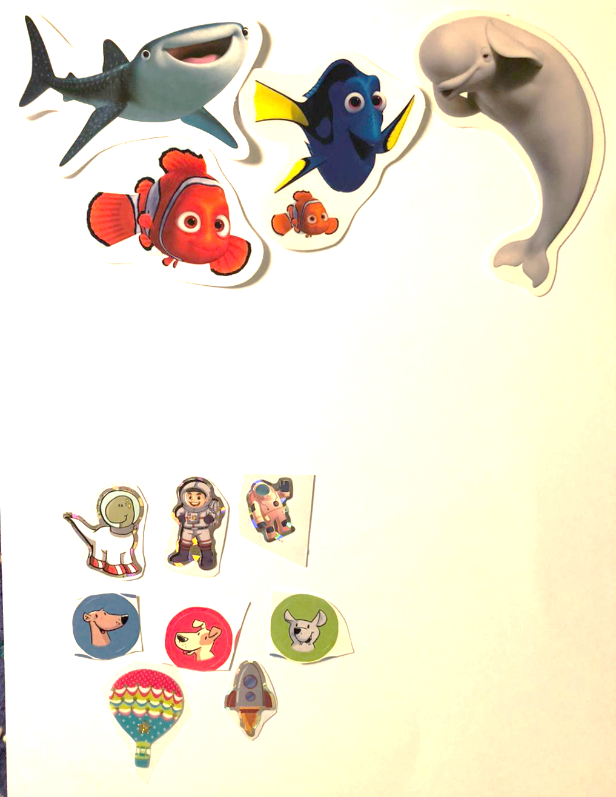
Unsupervised Learning
Unsupervised learning
Make reasonable groups!
https://towardsdatascience.com/supervised-vs-unsupervised-learning-14f68e32ea8d
What is AI?

Slide 30
Supervised Learning vs.
Unsupervised Learning
 | Supervised Learning | Unsupervised Learning
Discrete | Classification or Categorization | Clustering
Continuous | Regression | Dimensionality reduction
https://towardsdatascience.com/supervised-vs-unsupervised-learning-14f68e32ea8d
What is AI?

Slide 31


Slide 32
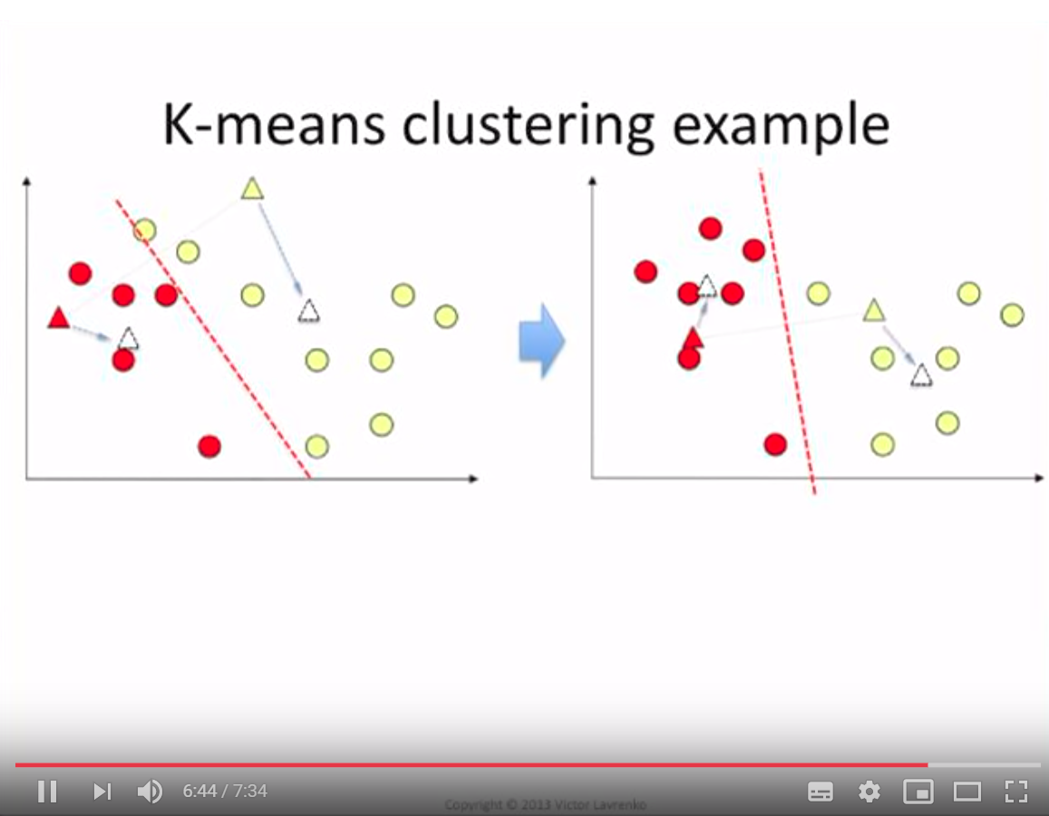
Example: Clustering
https://www.youtube.com/watch?v=_aWzGGNrcic
What is AI?

Slide 33
Discussion: Usable Security
Detecting “the wrong user” trying to log in?
Detecting a denial of service vs. a user who forgot her password?
How can you do use machine learning to do this?
How to use a cluster algorithm?
 | Supervised Learning | Unsupervised Learning
Discrete | Classification or Categorization | Clustering
Continuous | Regression | Dimensionality reduction
https://towardsdatascience.com/supervised-vs-unsupervised-learning-14f68e32ea8d
What is AI?

Slide 34
Implementing AI
Libraries
Frameworks
Web Services
See Exercises and Tutorials…
Implementing AI

Slide 35
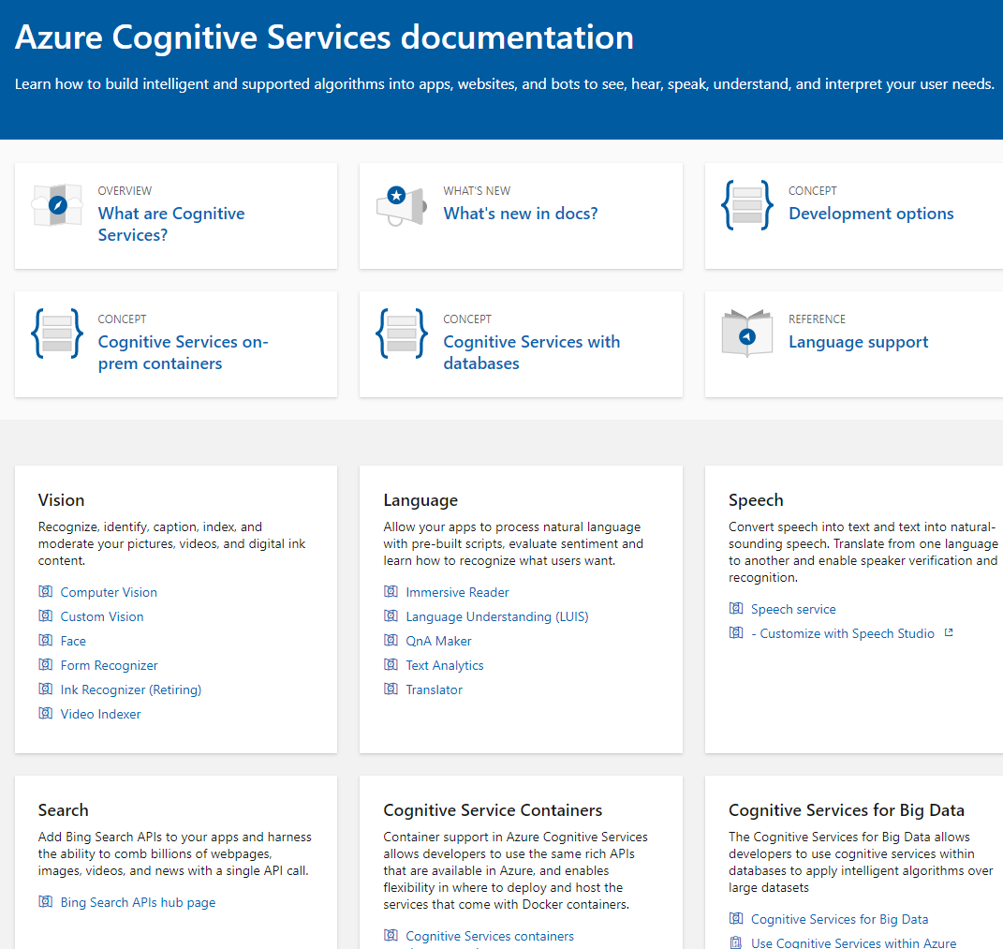
Cloud Services
Example: Microsoft Cognitive Services
Cloud Services from:
IBM
Google
Amazon
Microsoft
… and many others
Why do people use them?
What is the risk?
https://docs.microsoft.com/en-us/azure/cognitive-services/
Implementing AI

Slide 36
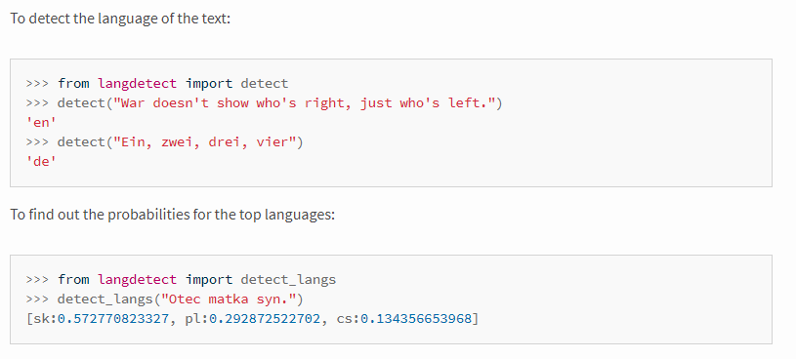
Examples Text Analytics
Identification of the Language
Can tell what language the text is, e.g. English, German, Spanish,…
Relevant for understanding and translation
Example (Online) APIs:
  https://console.bluemix.net/apidocs/language-translator
  https://docs.microsoft.com/en-us/azure/cognitive-services/translator/
  https://cloud.google.com/translate/docs/basic/detecting-language
  https://pypi.org/project/langdetect/
Implementing AI

Slide 37
Discussion
Pros and Cons of Online APIs for AI/Machine learning?
Implementing AI

Slide 38
How to Install Python
Python with pip https://www.python.org/downloads/
Python in the web via Google Colab https://colab.research.google.com
Python via Anaconda www.anaconda.com

