Slide 1

Introduction to Intelligent User Interfaces
Users' Context in Smart Environments
"'A SONY 4K TV' NORMAN HARVEY CONNECTED HOME SHOWHOUSE [IDEAL HOME SHOW 17th - 19th April 2015] -103590" by infomatique is licensed with CC BY-SA 2.0
Notes:
https://www.flickr.com/photos/infomatique/16556890624/in/photostream/

Slide 2
Objects and Artifacts in our Life
Users' Context in Smart Environments

Slide 3
How many things do you own? 72?
Green tshirt
Dark blue v-neck tshirt
Green/grey long sleeve tshirt
Tan tshirt
White v-neck tshirt (with Google Homepage drawn on it…ah, Halloween)
Light blue polo
Yellow polo
Grey polo
Light blue military-style shirt
Light blue shirt
Torn up jeans
Rock star jeans
Fashiony jeans
Green casual jacket
Dark blue fancier jacket
5 pairs of boxer briefs
6 pairs of socks (solid colors and argyle)
Brown leather belt
Brown leather watch
Slim Slimmy Wallet, Passport, ID, Debit cards, Credit card, Pesos, Business card with notes scribbled all over it
Cheap sunglasses
Newsie-style hat
Brown leather flip flops
Brown leather sexy shoes
Vibram Five Finger workout shoes
Umbrella
Nike+ workout watch and sensor
Workout shorts
2 sleeveless workout shirts
Travel journal
Medium and small Moleskine notebooks
Array of pens, pencils and markers
iPod Touch and armband
iPhone headphones
Unlocked RAZR
Brown leather satchel
EEE PC 1005HA netbook with sleeve
15″ Macbook Pro
15″ Mabook Pro sleeve
Wireless Mighty Mouse
USB-splitter
3 USB-powered hard drives
Mini DisplayPort to DVi adapter
Mac Software install discs
Lumix LX3 digital camera with case
HF100 Digital HD camcorder with remote
Gorillapod tripod
Spare 512 MB SD card and microfiber screen-cleaning cloth
Rechargeable batteries
Toothbrush, toothpaste, floss
Nose and facial hair trimmers
Hair product
Prescription glasses and case
Spare contact lenses, case and solution
Carry-on bag
Wine aerator
http://exilelifestyle.com/all-72-things-own/
Users' Context in Smart Environments

Slide 4
How many things do you own? 288?
Life Tools & Accessories. 33 items, including my car, guitar, books, hairbrush, toothbrush, etc.
Consumables. 5 groups of items, including food, cleaning supplies, hygiene supplies, office supplies, and paper goods.
Kitchen Items. 19 items, including pots, pans, utensils, coffeemaker, toaster, oven mitt, etc.
Bathroom Items. 6 items, including my bathroom scale, rugs, trash can, shower caddy, etc.
Electronics. 10 items, including my BlackBerry, MacBook, Printer, iPod, etc.
Furniture. 18 items, including my bed, couch, coffee table, desk, chairs, etc.
Decorations. 14 items, including decorative plants, artwork, digital picture frames, wall clock, etc.
Casual Clothes. 79 items, including jeans, hoodies, T-shirts, button-down shirts, etc.
Dress Clothes. 50 items, including suits, ties, dress shirts, etc.
Clothes (Miscellaneous). 58 items, including shoes, socks, underwear, belts, gym shorts, coats, etc.
http://www.theminimalists.com/288/
Users' Context in Smart Environments

Slide 5
Breakout Sessions
How many things do you own?
How many things do you own that cost more than 50€?
List things you own that are electrically powered?
3 min
Users' Context in Smart Environments

Slide 6
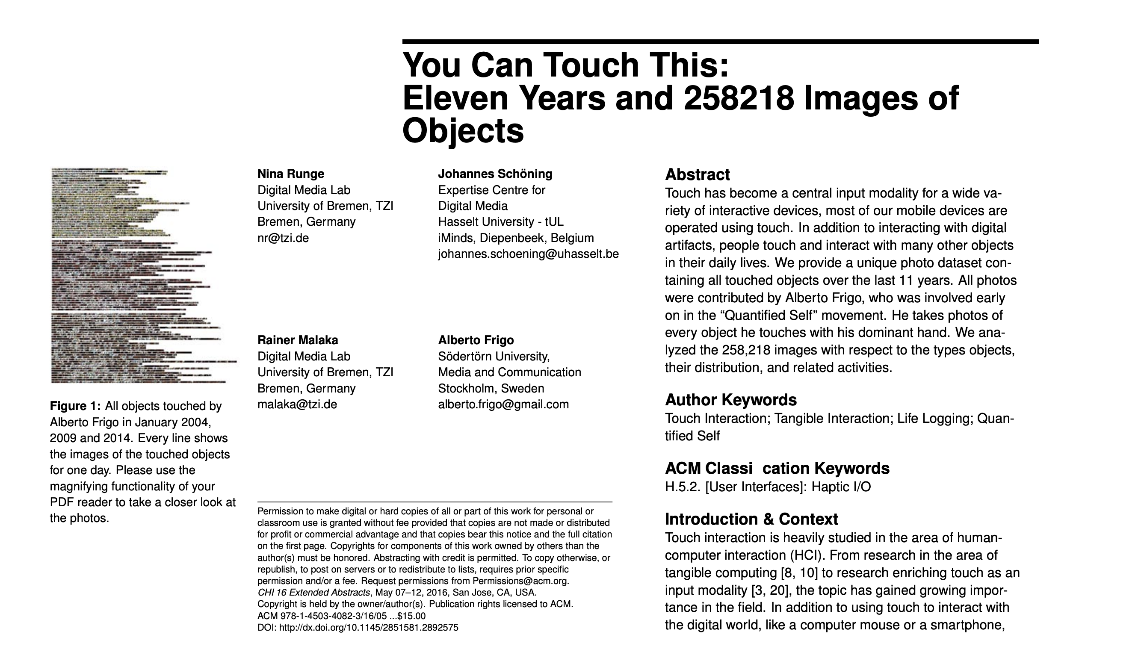
How many things do you touch?
Alberto Frigo
https://en.wikipedia.org/wiki/Alberto_Frigo
Nina Runge, Johannes Schöning, Rainer Malaka, and Alberto Frigo. 2016. You Can Touch This: Eleven Years and 258218 Images of Objects. In Proceedings of the 2016 CHI Conference Extended Abstracts on Human Factors in Computing Systems (CHI EA '16). Association for Computing Machinery, New York, NY, USA, 541–552. DOI: https://doi.org/10.1145/2851581.2892575
Users' Context in Smart Environments

Slide 7
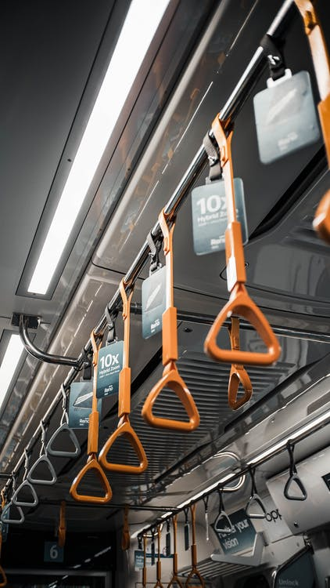
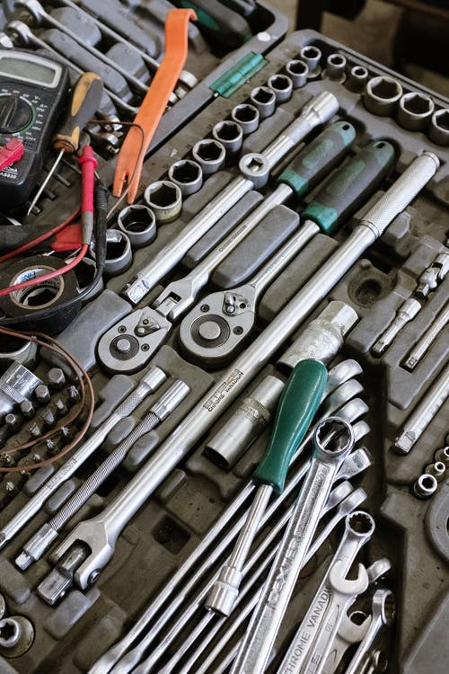

Users' Context in Smart Environments
Notes:
https://www.pexels.com/photo/hanging-orange-handles-in-public-transport-3766617/
https://www.pexels.com/photo/fashion-art-camera-office-57750/
https://www.pexels.com/photo/silver-and-green-screw-driver-4480453/

Slide 8
Ubiquitous Computing
Users' Context in Smart Environments

Slide 9
Ubiquitous Computing
Mark Weiser, 1991
“The most profound technologies are those that disappear. They weave themselves into the fabric of everyday life until they are indistinguishable from it”
“…Hundreds of computers in a room could seem intimidating at first, […] these hundreds of computers will come to be invisible to common awareness. People will simply use them unconsciously to accomplish everyday tasks.”
Mark Weiser. 1991. The Computer for the 21 st Century. Scientific american, 265(3). https://www.jstor.org/stable/24938718
Users' Context in Smart Environments

Slide 10
Ubiquitous Computing
Surfaces of different sizes and scales are used in information processing: Prototypes of Tabs, Pads, and Boards (inch-, foot-, yard-sized computers).
Mark Weiser. 1991. The Computer for the 21 st Century. Scientific american, 265(3). https://www.jstor.org/stable/24938718
Users' Context in Smart Environments

Slide 11
Ubiquitous Computing
“Most of the computers that participate in embodied virtuality will be invisible in fact as well as in metaphor. Already computers in light switches, thermostats, stereos and ovens help to activate the world. These machines and more will be interconnected in a ubiquitous network.”
“In our experimental embodied virtuality, doors open only to the right badge wearer, rooms greet people by name, telephone calls can be automatically forwarded to wherever the recipient may be, receptionists actually know where people are, computer terminals retrieve the preferences of whoever is sitting at them, and appointment diaries write themselves. No revolution in artificial intelligence is needed--just the proper imbedding of computers into the everyday world.”
Mark Weiser. 1991. The Computer for the 21 st Century. Scientific american, 265(3). https://www.jstor.org/stable/24938718
Users' Context in Smart Environments

Slide 12
Ubiquitous Computing
Mark Weiser, 1993
“The computer today is isolated from the overall situation, however, and fails to get out of the way of the work. In other words, rather than being a tool through which we work, and thus disappearing from our awareness, the computer too often remains the focus of attention.”
“The challenge is to create a new kind of relationship of people to computers, one in which the computer would have to take the lead in becoming vastly better at getting out of the way, allowing people to just go about their live.”
Mark Weiser. 1993. Some computer science issues in ubiquitous computing. Commun. ACM (July 1993). DOI: http://dx.doi.org/10.1145/159544.159617
Users' Context in Smart Environments

Slide 13
Breakout Sessions
List as many electrical/digital tools/appliances as you can and use, which are ubiquitous in your environment?
2 min
Users' Context in Smart Environments

Slide 14
Lights
Fridge
Microwave
Lights
Thermostat
“White Kitchen Interior” by Paintzen Attribution 2.0 Generic (CC BY 2.0)
Users' Context in Smart Environments
Notes:
https://www.flickr.com/photos/147489968@N06/29813588732/

Slide 15
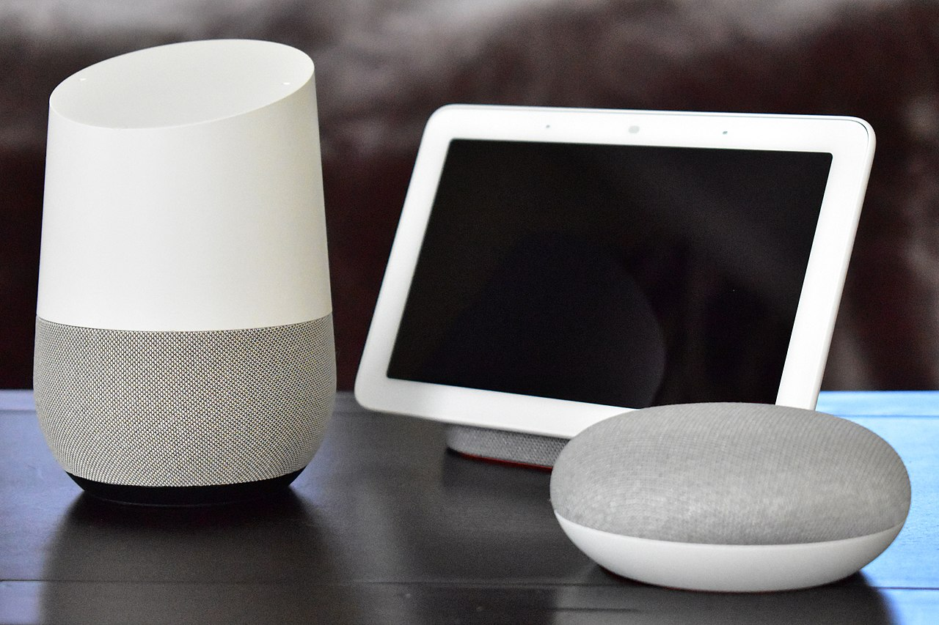
Voice Assistants
Powerful tool
Cumbersome to use as they leg contextual information
"Apple HomePod - June 2018 (1923)" by varnent is licensed with CC BY-SA 4.0.
"Google Home with Home Hub and Home Mini on table" by Y2kcrazyjoker4 is licensed with CC BY-SA 4.0.
Users' Context in Smart Environments
Notes:
https://commons.wikimedia.org/w/index.php?curid=84394292
https://commons.wikimedia.org/w/index.php?curid=69690697

Slide 16
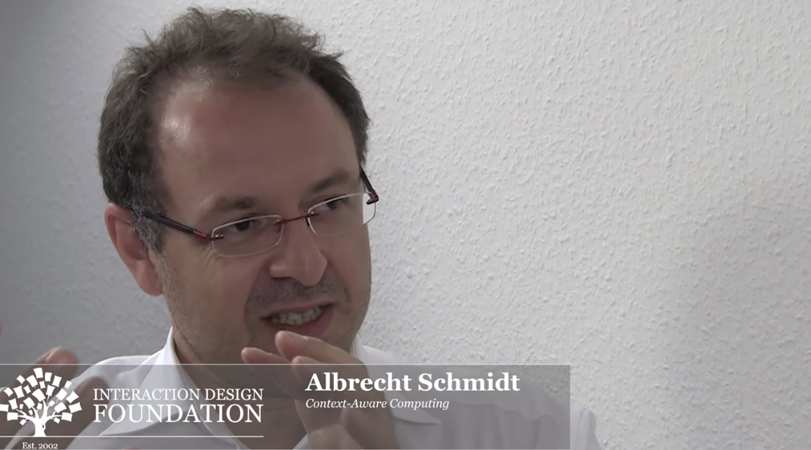
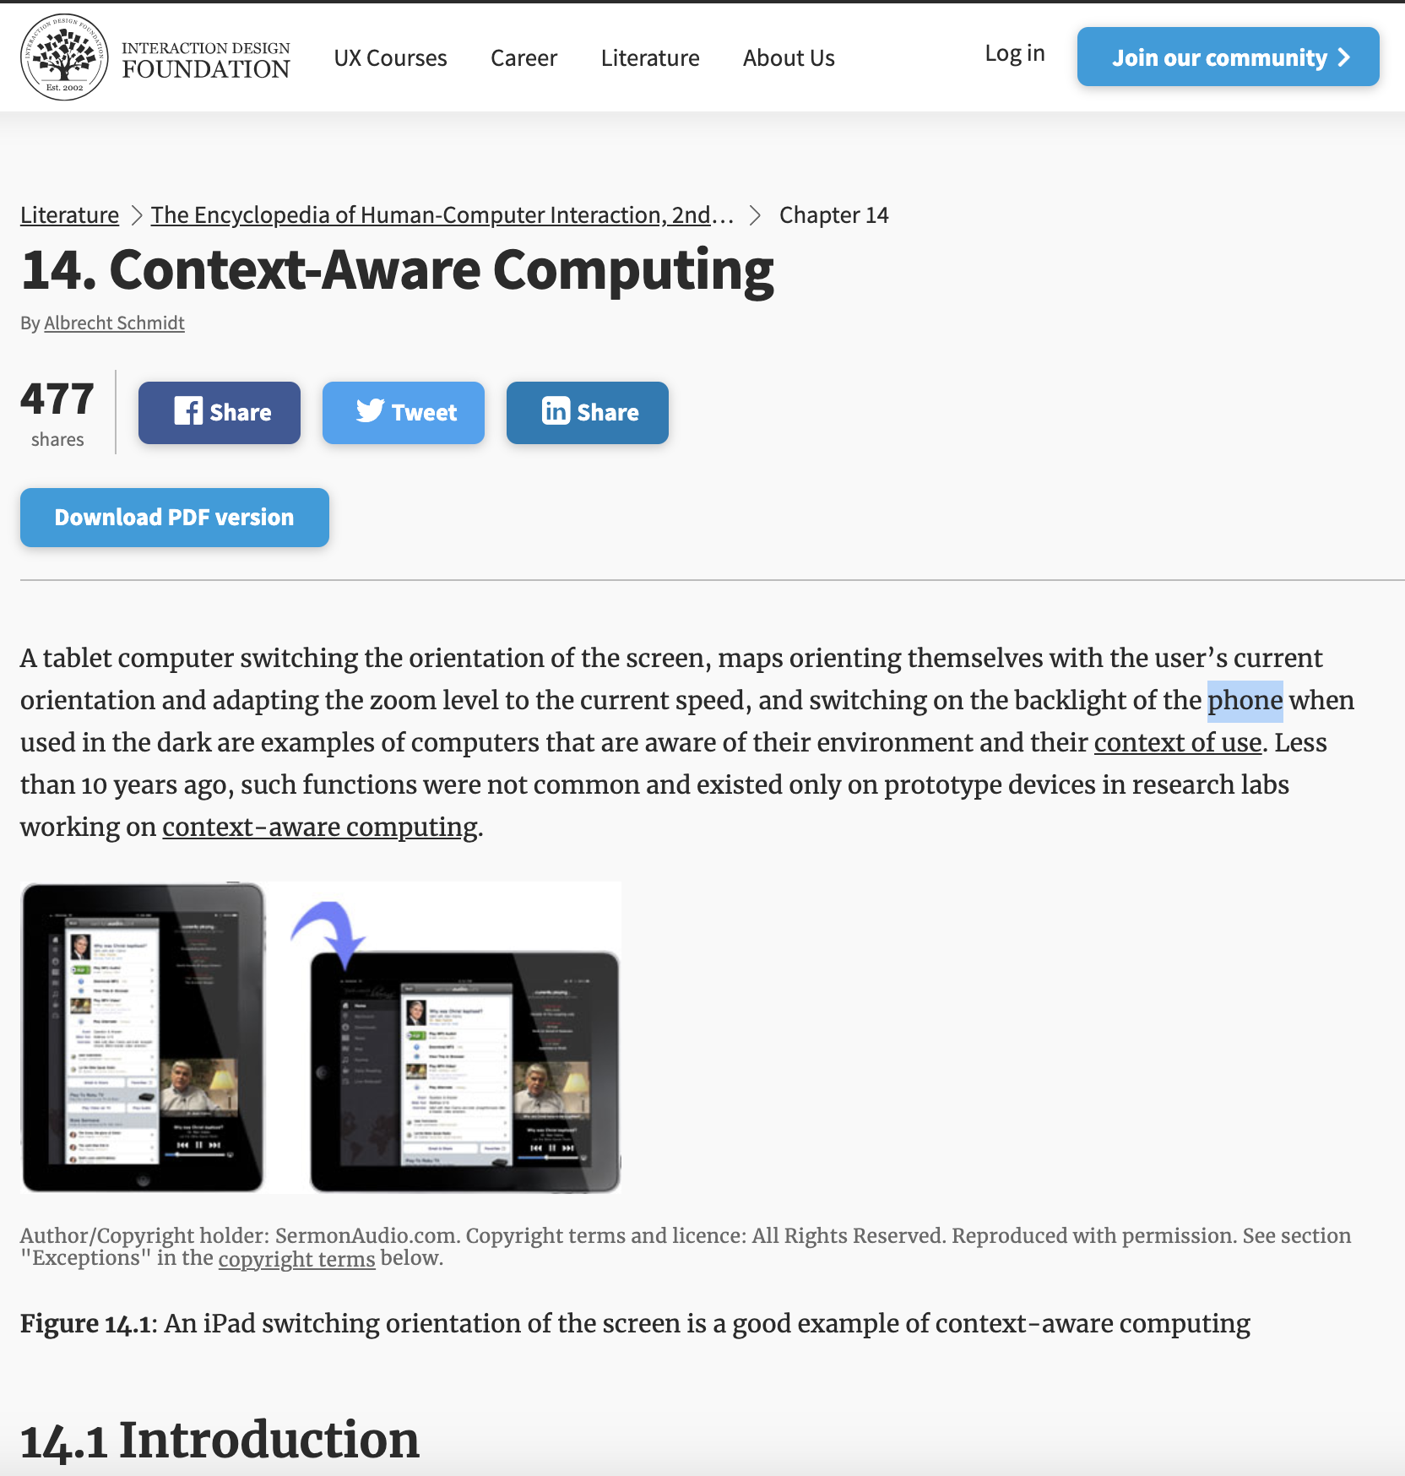
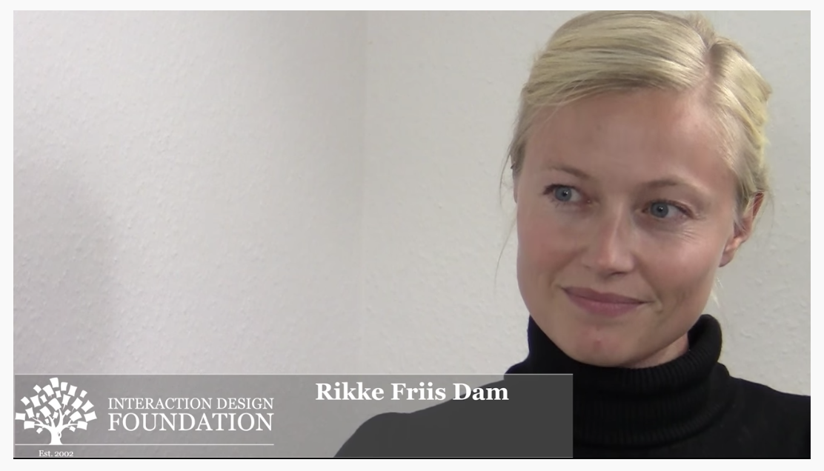
Sensing and Context-Aware Objects
https://www.interaction-design.org/literature/book/the-encyclopedia-of-human-computer-interaction-2nd-ed/context-aware-computing-context-awareness-context-aware-user-interfaces-and-implicit-interaction
Users' Context in Smart Environments

Slide 17
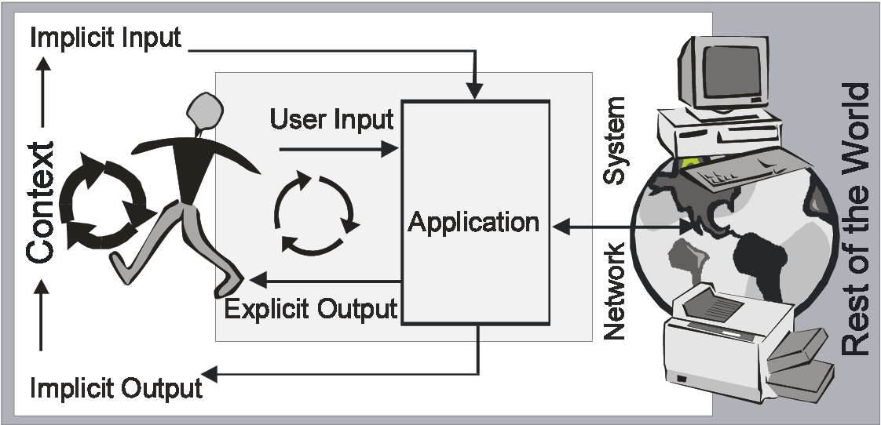
Design for explicit and implicit Interaction
Albrecht
Albrecht Schmidt. "Implicit human computer interaction through context." Personal technologies 4, no. 2 (2000): 191-199.
Albrecht Schmidt. Ubiquitous computing-computing in context (Doctoral dissertation) (2003).
Users' Context in Smart Environments

Slide 18
Embedding Information and Interaction
“Potentially everyone has access to enormous amounts of information nowadays. […] We suggest a different approach for contextual information delivery. Instead of detecting the context we place the information – by the choice of the information display - in context. The assumption is that in future we can afford environments where there is a massive over-provision of displays. […] Our first step is to provide additional information at decision points (e.g. what should I wear, do I go by bike or by car, should I take the umbrella or not) that help to make a more informed decision.”
Schmidt, Albrecht, Matthias Kranz, and Paul Holleis. "Embedded information." In Proc. Workshop Ubiquitous Display Environments in conjunction with UbiComp. 2004.
Kranz, Matthias, Paul Holleis, and Albrecht Schmidt. "Embedded interaction: Interacting with the internet of things." IEEE internet computing 14, no. 2 (2010): 46-53.

Slide 19
Design Criteria for Embedding Information
Basic principle: over-provision of information displays
Embedding information where and when it is useful
It is central to provide the information so that the user can benefit from it. Information is embedded at points where decisions are made. The information provided should increase the user’s ability to make an informed choice.
Embedding information in a most unobtrusive way
The information provided should not be forced onto the user. It should be embedded in such a way giving the user the right clue but in a way not to become an annoyance.
Providing information in a way that there is no interaction required
It is essential that there is no action required from the user when information is provided. This requires dedicated information displays that are only used for providing a specific type of information.
Schmidt, Albrecht, Matthias Kranz, and Paul Holleis. "Embedded information." In Proc. Workshop Ubiquitous Display Environments in conjunction with UbiComp. 2004.
Kranz, Matthias, Paul Holleis, and Albrecht Schmidt. "Embedded interaction: Interacting with the internet of things." IEEE internet computing 14, no. 2 (2010): 46-53.

Slide 20

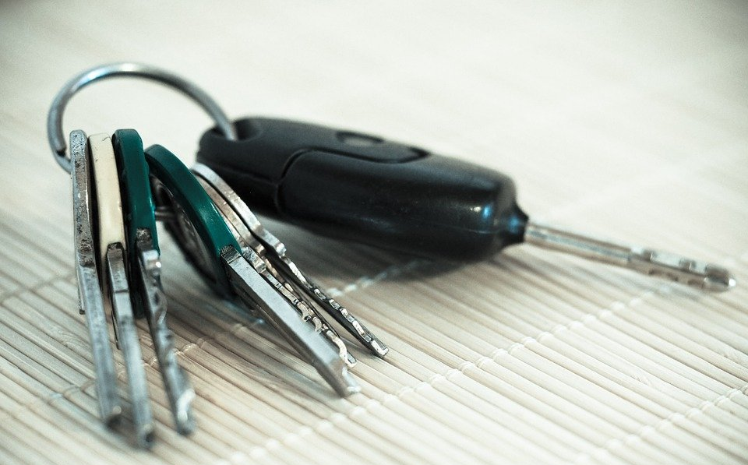
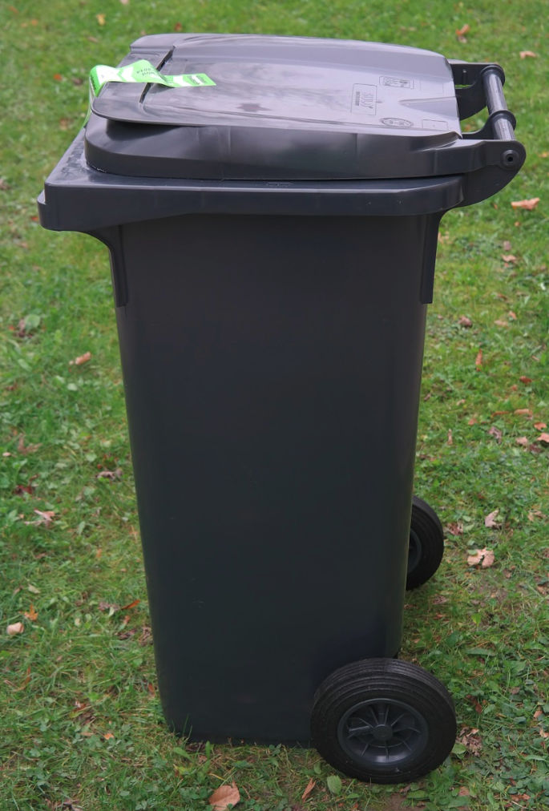
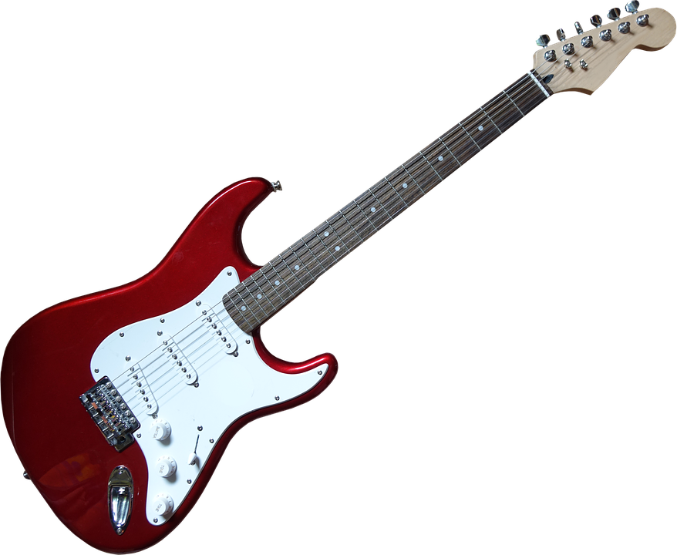

Breakout Sessions
2 min
What information would you embed into the following objects?
Users' Context in Smart Environments

Slide 21
Context in Interactive Systems
Use context for adaptation of
  Application
  Content
  Presentation
  Interaction modality
  Time of interruption
Context as content
  Tagging of media (e.g. location and time in photos)
  Creating meta information
  Context as the content (e.g. recording a walking track)
  Real-time sharing of context (e.g. presence)
Rethink user interface options
  Output
  Input
  Communication
Users' Context in Smart Environments

Slide 22
Rethink Output
Make use of context
Adjusting media quality
Adapt media usages
Choose the modality
Adapt content and visual representation
Timing of output / notification
  Interrupt at “appropriate” times
Users' Context in Smart Environments

Slide 23
Rethink Input
Easing input by using context knowledge
Automate input
  current time
  who is in a meeting
  tracking documents used
  places visited…
Provide context-dependent defaults
Optimize input space to fit to current context
  recognizer for handwriting/speech,
  context-sensitive menus
Users' Context in Smart Environments

Slide 24
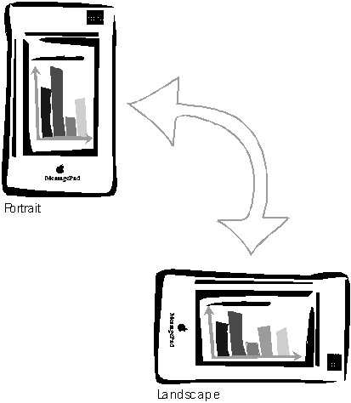
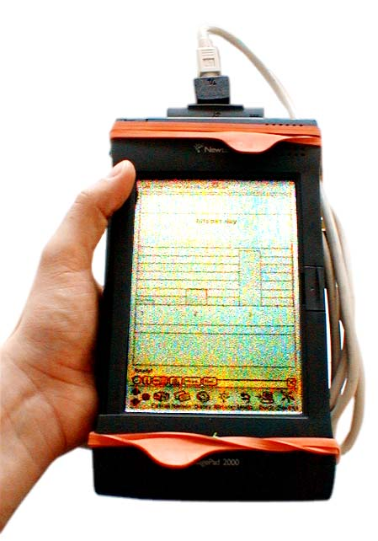
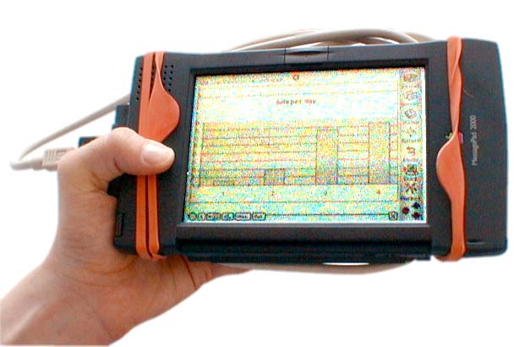
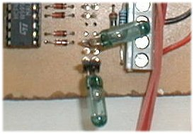
Getting Physical (1) Initial Experience (1998)
Extremely simple, but
still it creates a new experience
2-Bit Input
Not an input device
Very specific function
A. Schmidt, M. Beigl, H. Gellersen. There is more to context than location.
Computers and Graphics, 23(6):893--901, 1999.
http://www.comp.lancs.ac.uk/~albrecht/pubs/pdf/schmidt_cug_elsevier_12-1999-context-is-more-than-location.pdf

Slide 25
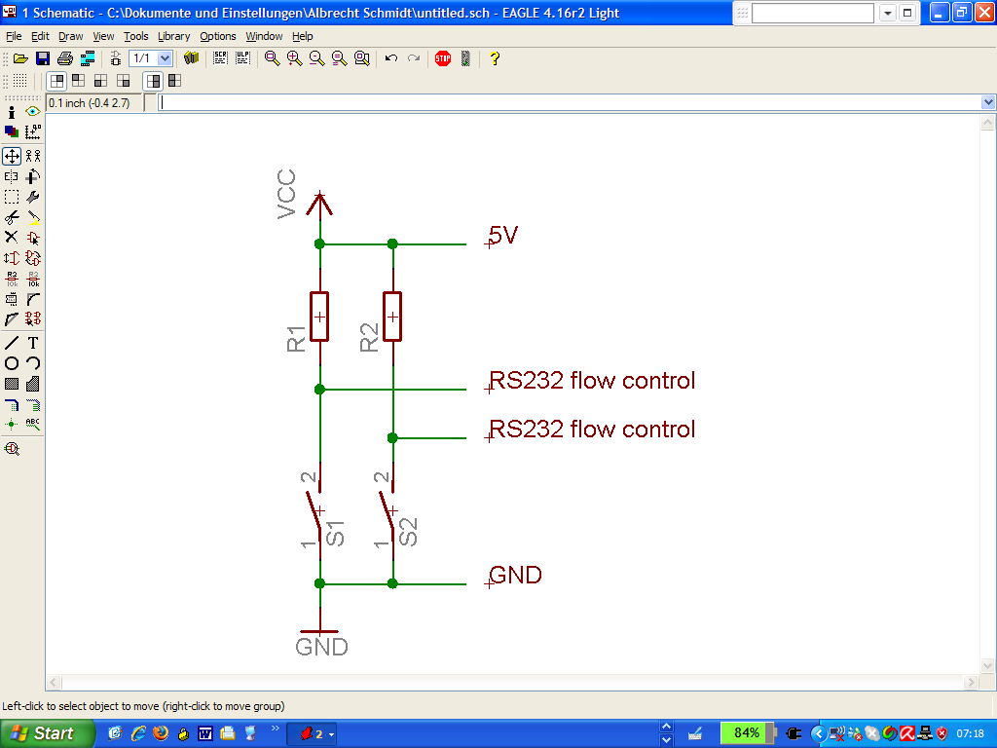
Getting Physical (1) Initial Experience (1998)
Extremely simple, but
still it creates a new experience
2-Bit Input
Not an input device
Very specific function
A. Schmidt, M. Beigl, H. Gellersen. There is more to context than location.
Computers and Graphics, 23(6):893--901, 1999.
http://www.comp.lancs.ac.uk/~albrecht/pubs/pdf/schmidt_cug_elsevier_12-1999-context-is-more-than-location.pdf

Slide 26
Knife that “knows” what its cuts
Matthias Kranz, Albrecht Schmidt, Alexis Maldonado, Radu Bogdan Rusu, Michael Beetz, Benedikt Hörnler, and Gerhard Rigoll. 2007. Context-aware kitchen utilities. In Proceedings of the 1st international conference on Tangible and embedded interaction (TEI '07). Association for Computing Machinery, New York, NY, USA, 213–214. DOI: https://doi.org/10.1145/1226969.1227013
Users' Context in Smart Environments

Slide 27
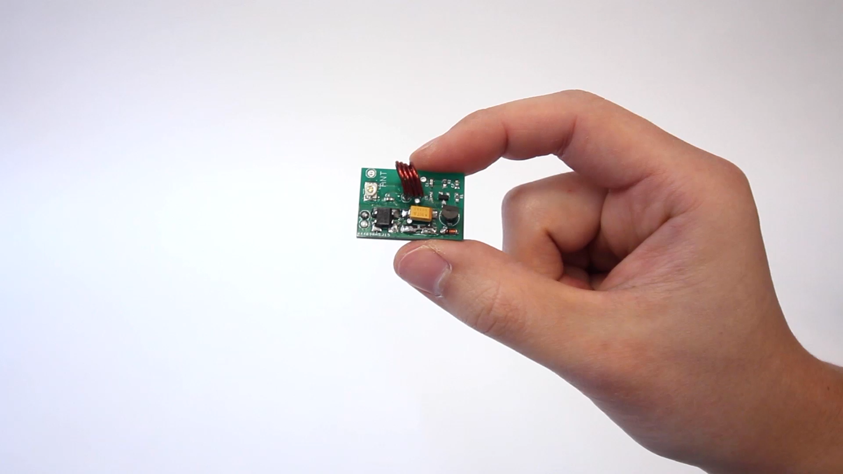
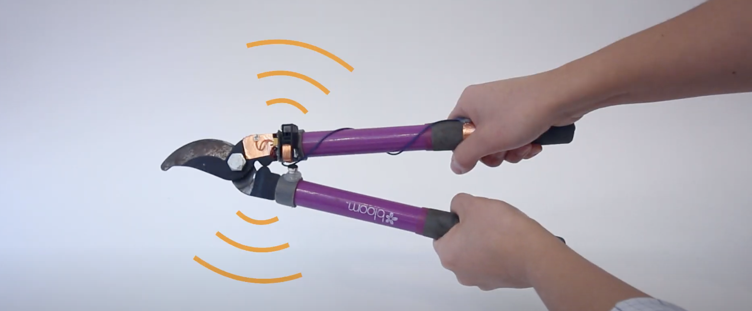
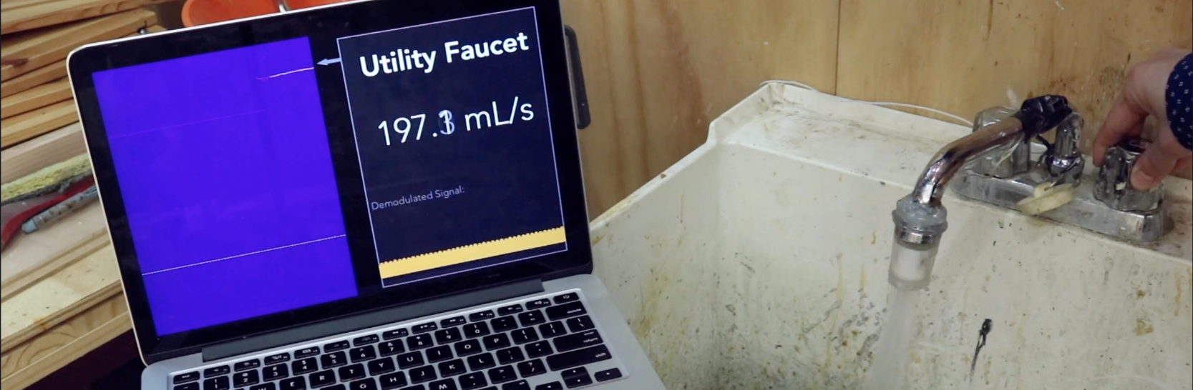
Radio Tags for Activity Sensing
Yang Zhang, Yasha Iravantchi, Haojian Jin, Swarun Kumar, and Chris Harrison. 2019. Sozu: Self-Powered Radio Tags for Building-Scale Activity Sensing. In Proceedings of the 32nd Annual ACM Symposium on User Interface Software and Technology (UIST '19). ACM, New York, NY, USA, 973–985. DOI: https://doi.org/10.1145/3332165.3347952
Video: https://youtu.be/wbq-eOOIPyw
Users' Context in Smart Environments

Slide 28
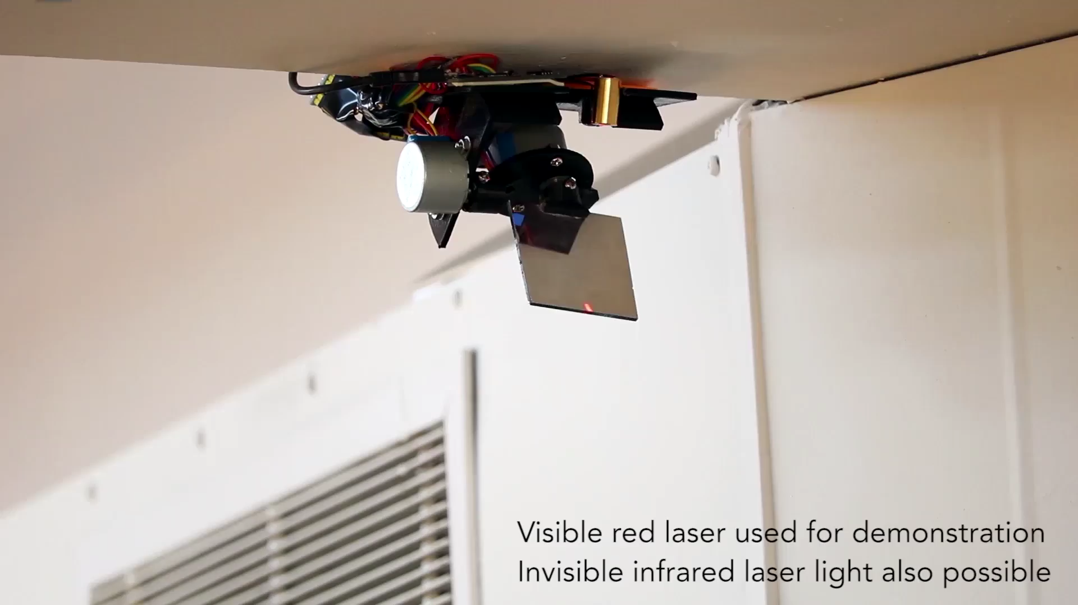
Vibrometry for Environment Sensing
https://youtu.be/51XaZDki6yg
Yang Zhang, Gierad Laput, and Chris Harrison. 2018. Vibrosight: Long-Range Vibrometry for Smart Environment Sensing. In Proceedings of the 31st Annual ACM Symposium on User Interface Software and Technology (UIST '18). ACM, New York, NY, USA, 225–236. DOI: https://doi.org/10.1145/3242587.3242608
Users' Context in Smart Environments

Slide 29
Visions and Terms (Embodiment)
Users' Context in Smart Environments

Slide 30
What does make an object into a smart object?
How is the physical shape and the way an object is constructed impacting how „intelligent“ an object is?
Where is embodiment required for intelligent behavior in the real world?
2 min
Users' Context in Smart Environments

Slide 31
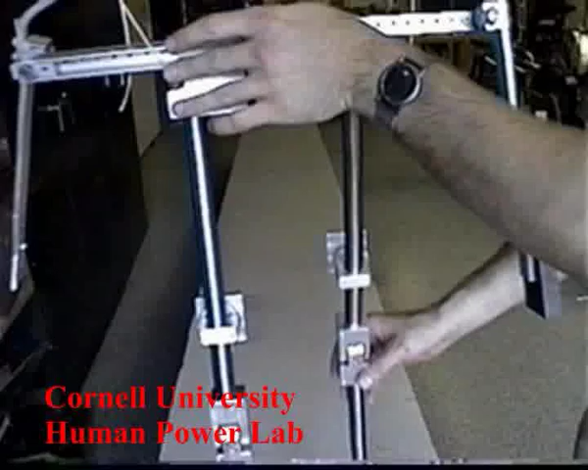
Passive Dynamic Walker
https://youtu.be/uU0baFifDKE
Steven H. Collins, Martijn Wisse, and Andy Ruina. A three-dimensional passive-dynamic walking robot with two legs and knees. The International Journal of Robotics Research 20.7 (2001). DOI: https://doi.org/10.1177/02783640122067561
Users' Context in Smart Environments
Notes:
Also nice: https://www.youtube.com/watch?v=v2qILGYl-BM Steve Collins, Andy Ruina, Russ Tedrake, and Martijn Wisse. "Efficient bipedal robots based on passive-dynamic walkers." Science 307, no. 5712 (2005): 1082-1085.

Slide 32
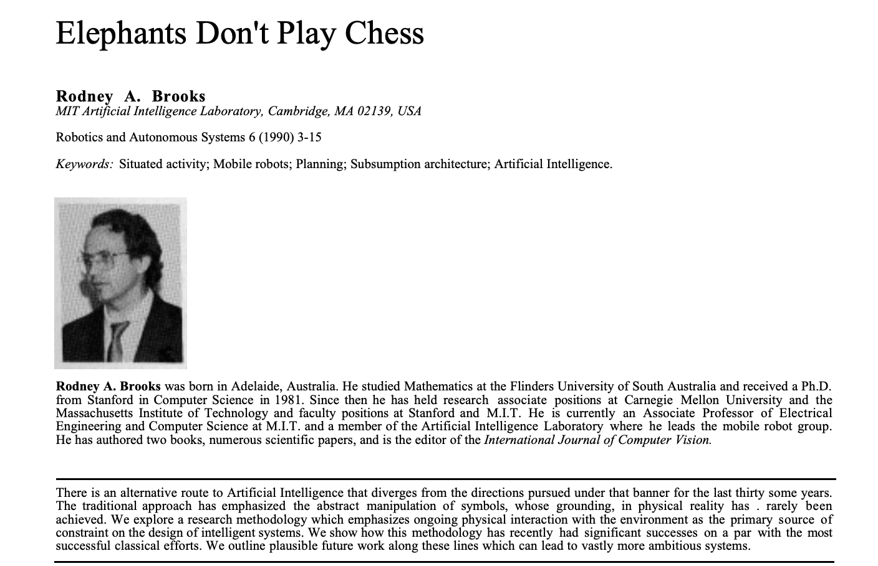
Rodney A. Brooks. Elephants don't play chess. Robotics and autonomous systems 6, no. 1-2 (1990): 3-15.
Users' Context in Smart Environments

Slide 33
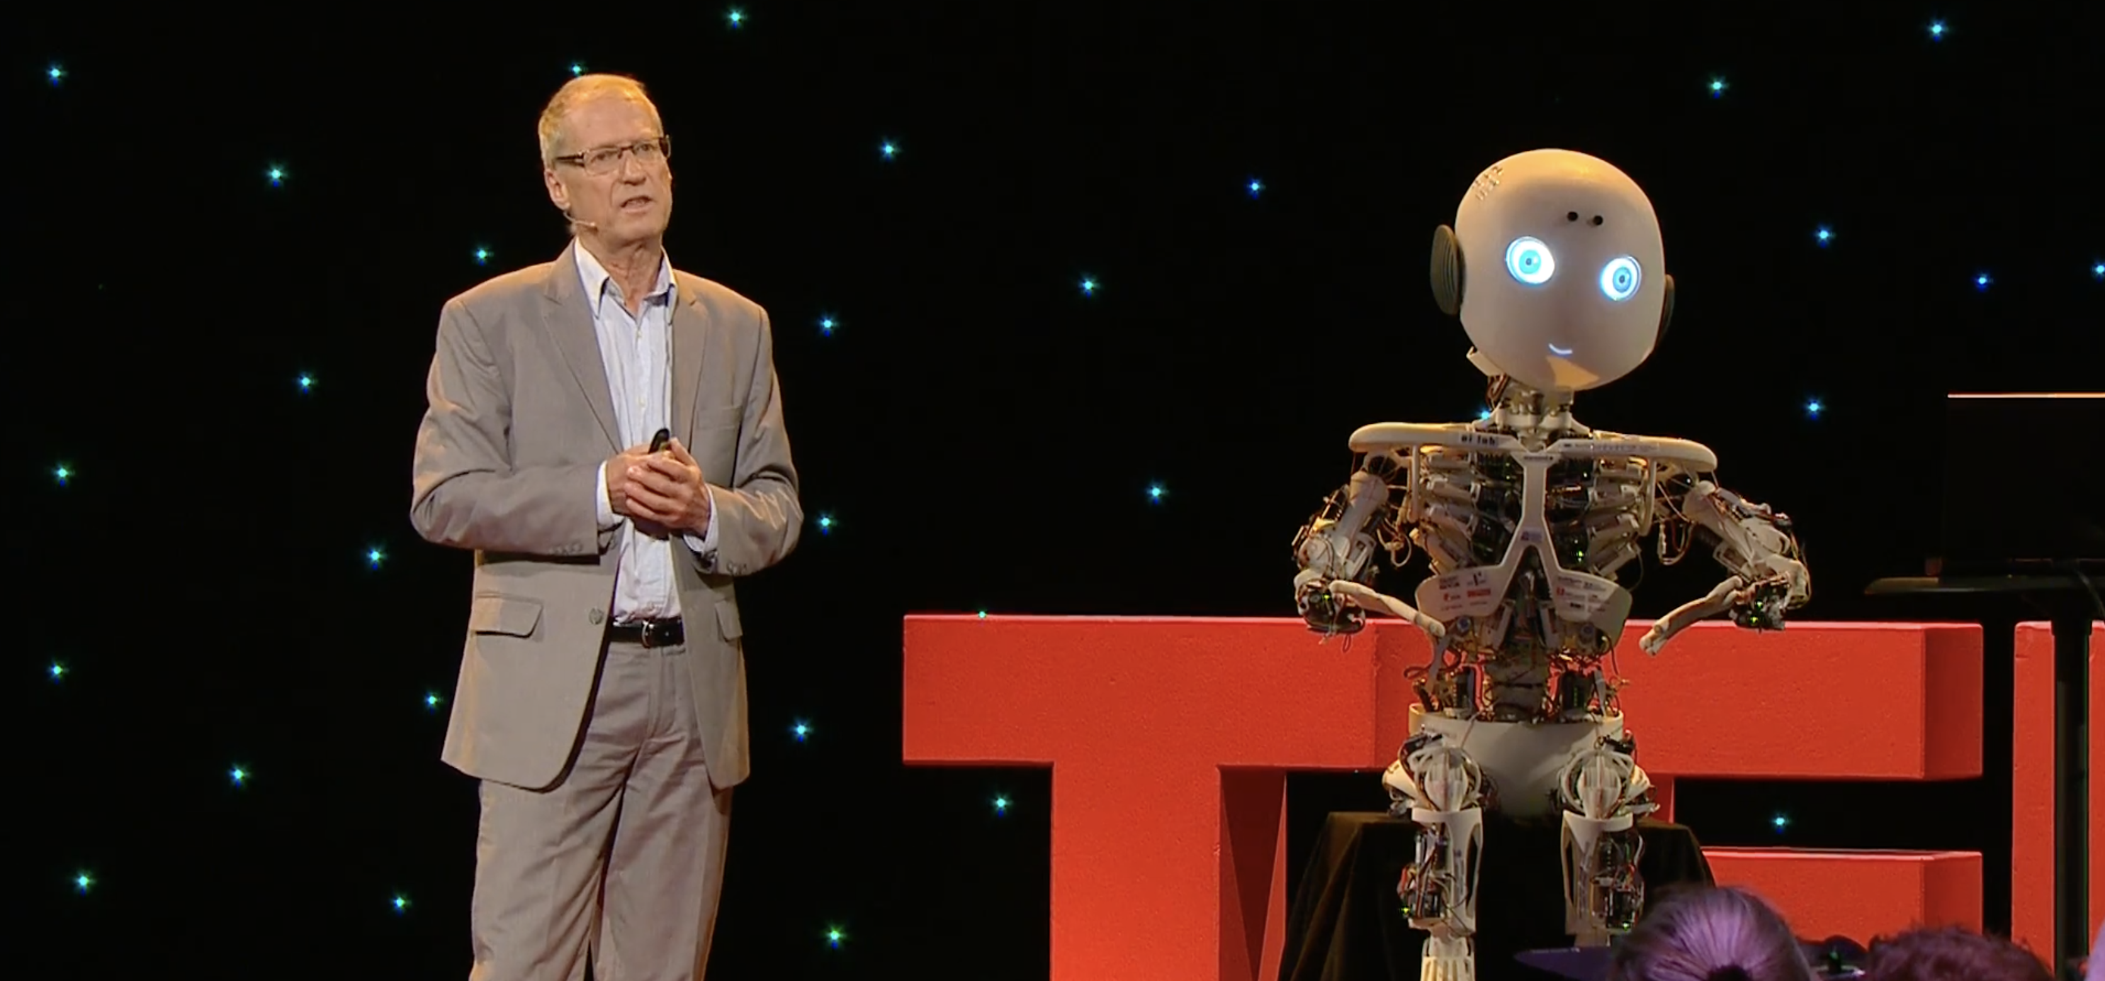
“How the body shapes the way we think”
https://youtu.be/mhWwoaoxIyc
Rolf Pfeifer at TEDxZurich 2013. He professor of computer science at the Department of Informatics University of Zurich.
Users' Context in Smart Environments

Slide 34
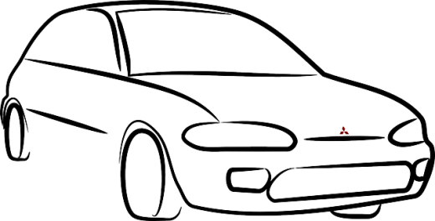



How to create the IoT and
Cyber-Physical-Systems?
Revolution or Evolution – two views
  adding computing as required and extending the traditional systems with computing
  adding physicality (through sensors, actuators) to software
Evolution
  Cyber-physical system as an electro-mechanical system with computers added
Revolution
  As a computer with the electro-mechanical system attached to

Slide 35
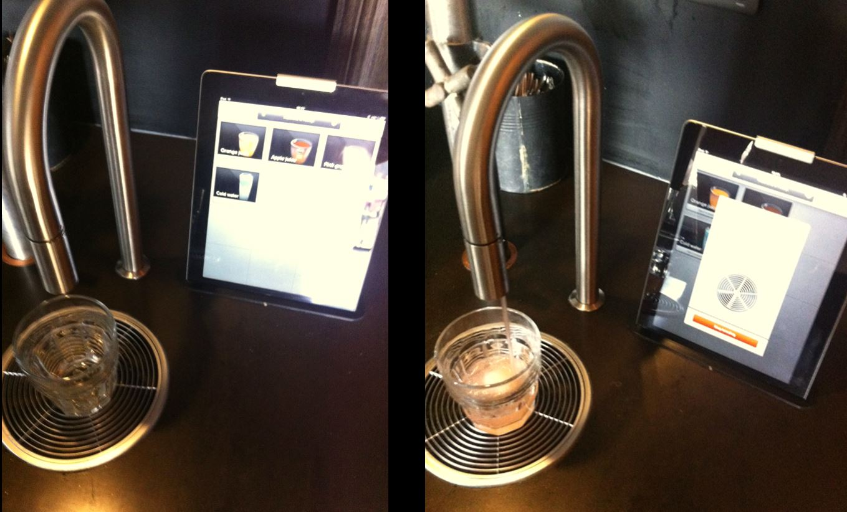
Revolution or Evolution – two approaches
Established (engineering) companies and industries are usually on the “evolution path”
Newcomers and it-driven enterprises are on the
“revolution path”
Notes:
Mobile Phones: Siemens, Nokia, Apple – A question?
Great knowledge and skill in RF, electronics manufacturing, and distribution channels did not help to stay in front
Daimler, Audi, VW, …, Google – what will be the key skills for the next generation cars?
Things that are considered difficult now, may be really easy in the future

Slide 36
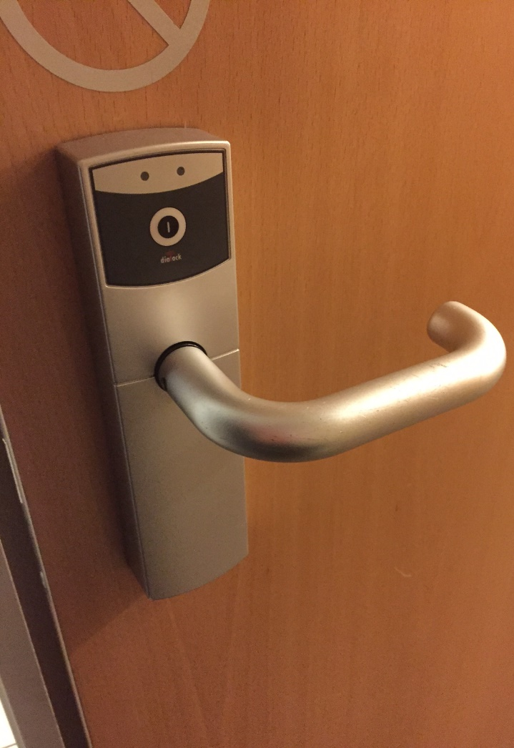
How to use a door…

Slide 37
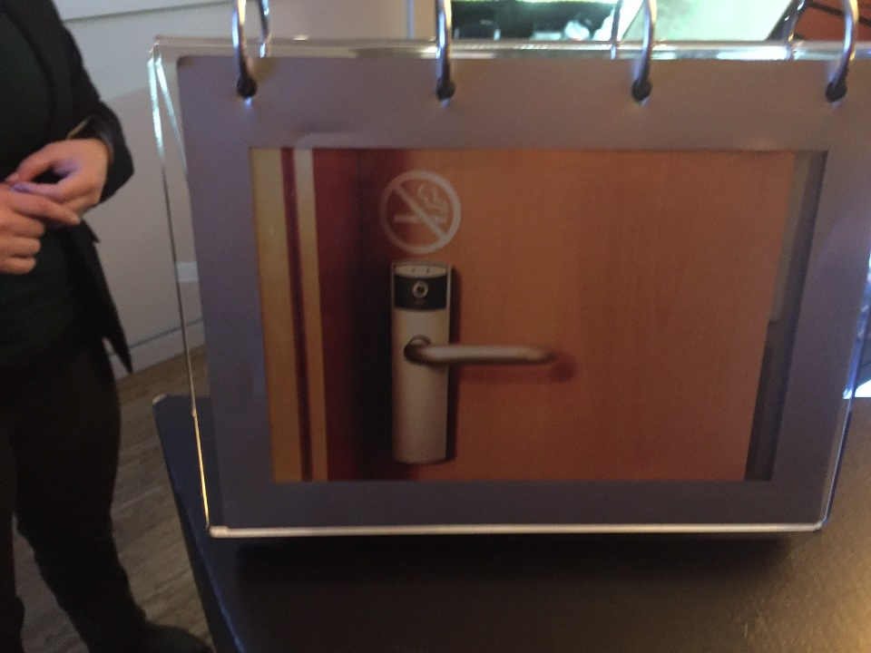
How to use a door…

Slide 38
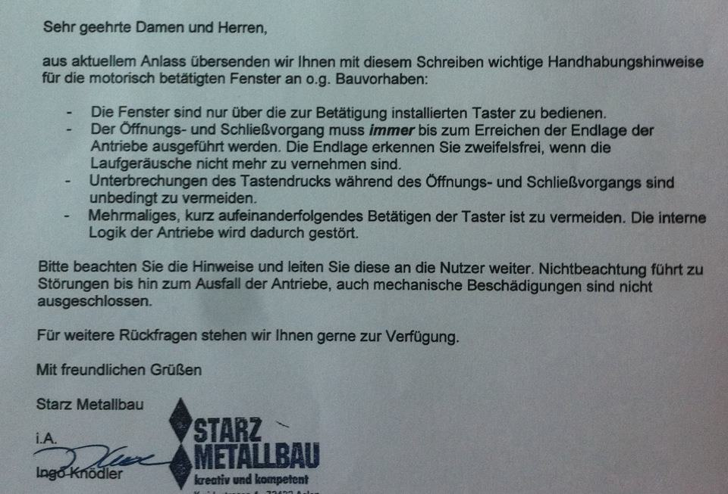
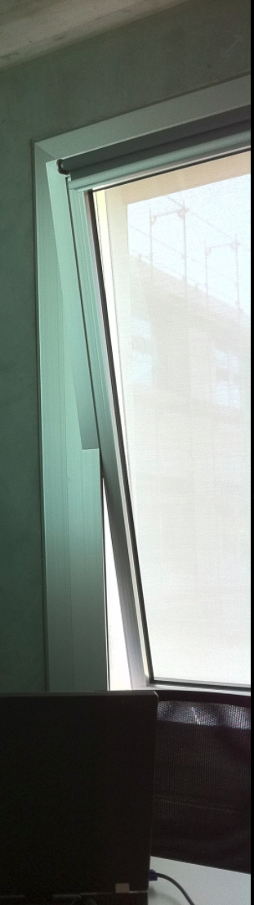
The windows are only to be operated by using the buttons [next to the door].
Windows must always be opened to the maximum or close fully. You recognize this end position without any doubt when the motor noise is not audible anymore.
Interruptions in the button presses have to be absolutely avoided while operating the window.
Avoid pressing the buttons several times. This will confuse the internal logic of the motor drive.
Do follow these rules and hand them on. If you do not obey these rules you will damage the windows.

Slide 39
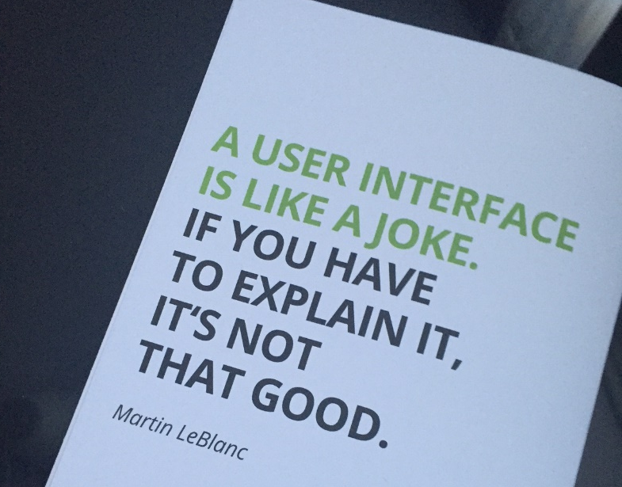

Slide 40
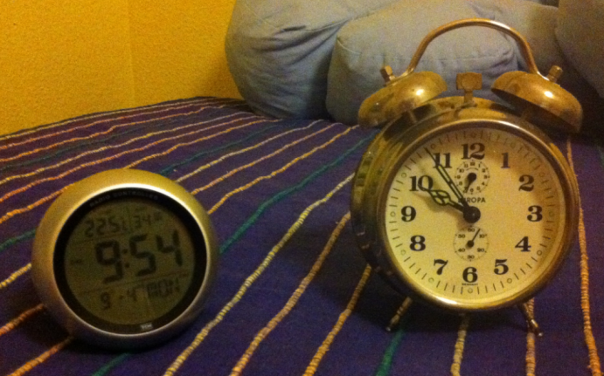
Digital vs. Mechanical

Slide 41
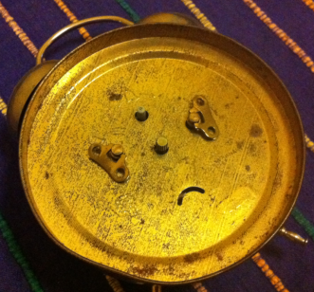
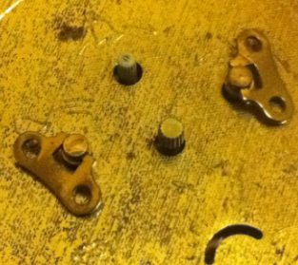
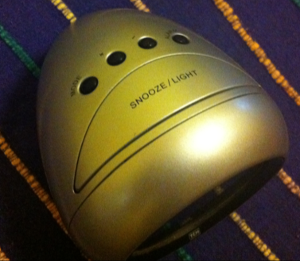
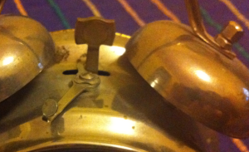
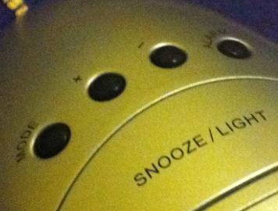
Digital vs. Mechanical

