Slide 1

Introduction to Intelligent User Interfaces
Context Awareness Interaction in Smart Environments
"'A SONY 4K TV' NORMAN HARVEY CONNECTED HOME SHOWHOUSE [IDEAL HOME SHOW 17th - 19th April 2015] -103590" by infomatique is licensed with CC BY-SA 2.0
Notes:
https://www.flickr.com/photos/infomatique/16556890624/in/photostream/

Slide 2
Context Awareness Interaction
Karan Ahuja, Andy Kong, Mayank Goel, and Chris Harrison. 2020. Direction-of-Voice (DoV) Estimation for Intuitive Speech Interaction with Smart Devices Ecosystems. In Proceedings of the 33rd Annual ACM Symposium on User Interface Software and Technology (UIST '20). ACM, New York, NY, USA, 1121–1131. DOI: https://doi.org/10.1145/3379337.3415588

Slide 3
Breakout Sessions
List as many addition information which would support am intelligent user interface?
Scenario 1: Touch Screen Interaction
Scenario 2: Navigation
Scenario 3: Movie
Scenario 4: Voice activated lights in a living room
5 min
Users' Context in Smart Environments

Slide 4
Extracting Contextual Information
Users Location
  GPS
  Direction of Voice
Users Activity
Users Emotion
Users Pose
Objects Surrounding the User
Status of Objects
Users' Context in Smart Environments

Slide 5
Smart Environments - Direction-of-Voice
Feature Extraction e.g. volume, speech frequency ratio
Machine Learning e.g. ensemble-based decision trees
Karan Ahuja, Andy Kong, Mayank Goel, and Chris Harrison. 2020. Direction-of-Voice (DoV) Estimation for Intuitive Speech Interaction with Smart Devices Ecosystems. In Proceedings of the 33rd Annual ACM Symposium on User Interface Software and Technology (UIST '20). ACM, New York, NY, USA, 1121–1131. DOI: https://doi.org/10.1145/3379337.3415588
Users' Context in Smart Environments

Slide 6
Smart Environments - Direction-of-Voice
Karan Ahuja, Andy Kong, Mayank Goel, and Chris Harrison. 2020. Direction-of-Voice (DoV) Estimation for Intuitive Speech Interaction with Smart Devices Ecosystems. In Proceedings of the 33rd Annual ACM Symposium on User Interface Software and Technology (UIST '20). ACM, New York, NY, USA, 1121–1131. DOI: https://doi.org/10.1145/3379337.3415588
Users' Context in Smart Environments

Slide 7
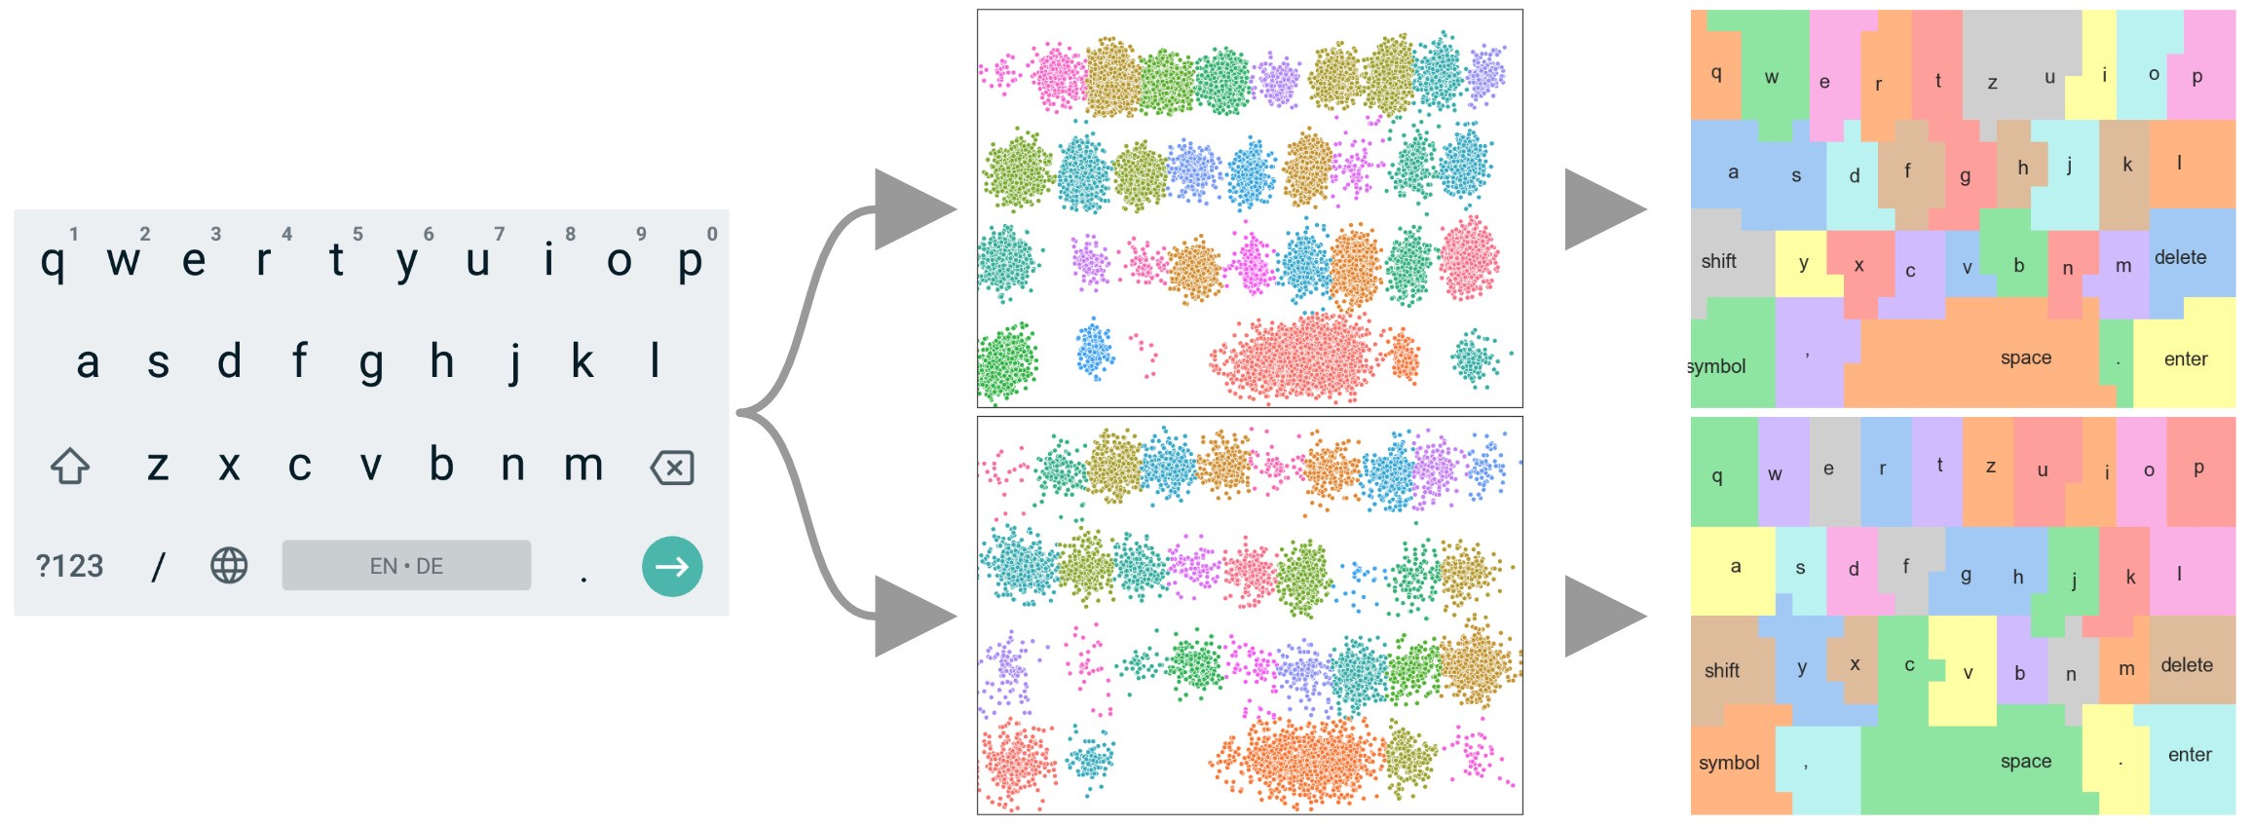
Context-Aware Keyboards
Adapt underlying key regions
Visible keyboard
Collect touches
Palm detection – input rejection
Finger identification, Finger Orientation – model improvement
Grip detection – model selection
Users' Context in Smart Environments

Slide 8
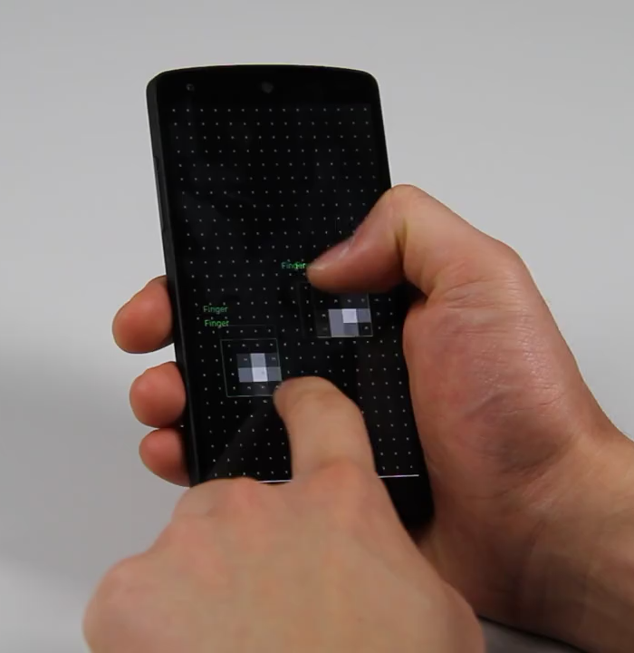
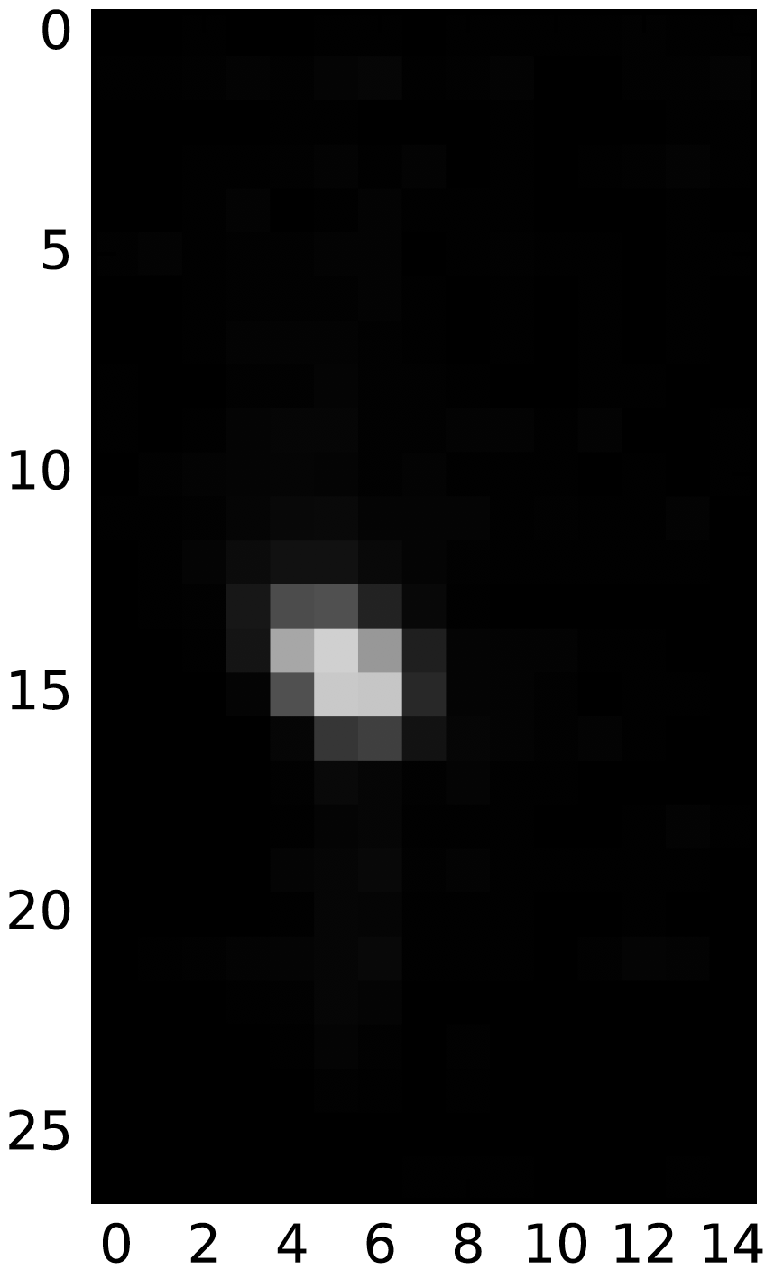
Palm Detection
Convolutional Neural Network
Classification
Representation Learning
Finger
CNN
Palm
Huy Viet Le, Thomas Kosch, Patrick Bader, Sven Mayer, and Niels Henze. 2018. PalmTouch: Using the Palm as an Additional Input Modality on Commodity Smartphones. In Proceedings of the 2018 CHI Conference on Human Factors in Computing Systems (CHI '18). ACM, New York, NY, USA, Paper 360, 1–13. DOI: https://doi.org/10.1145/3173574.3173934
Users' Context in Smart Environments

Slide 9
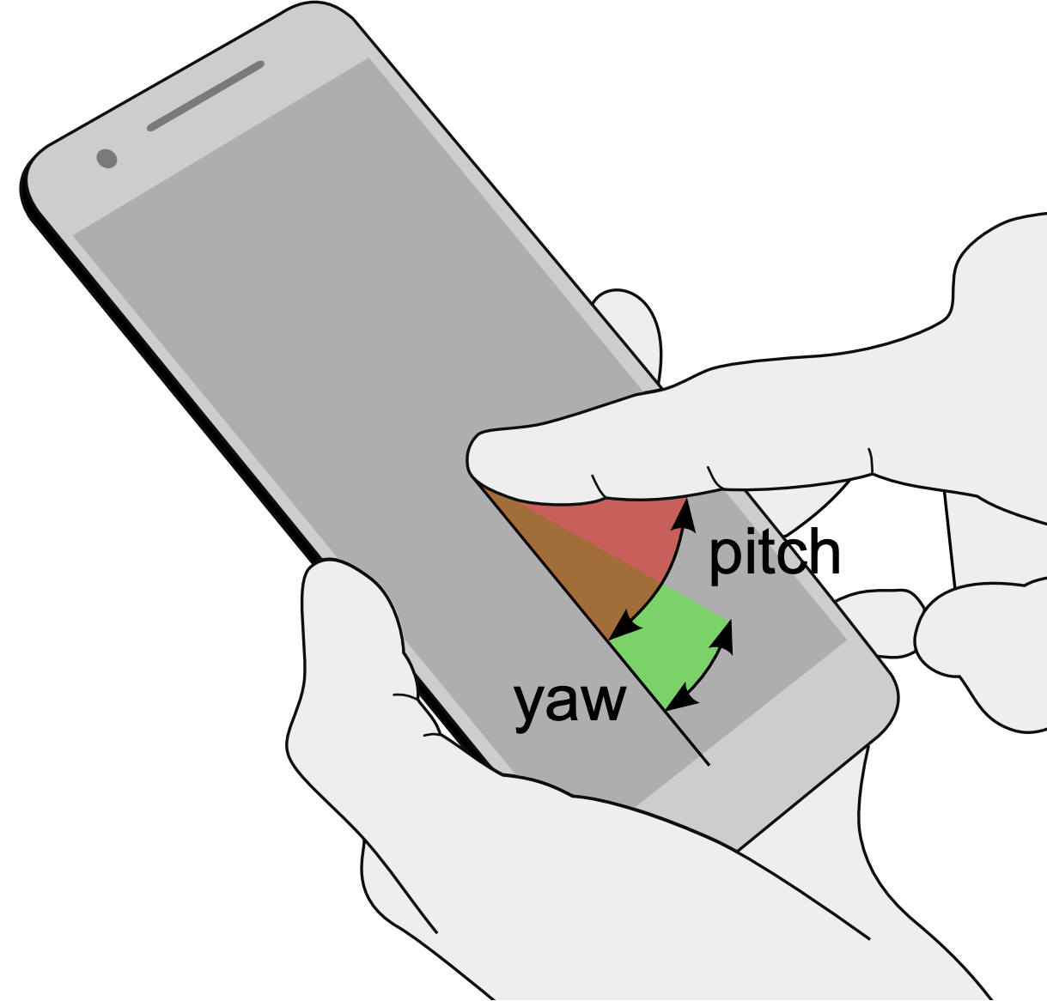
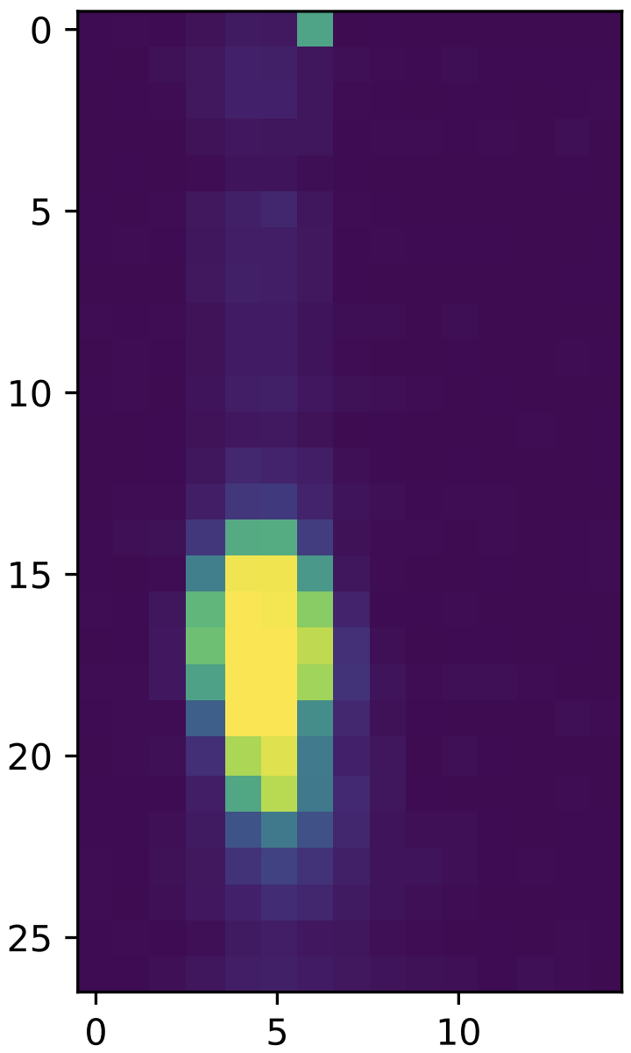
Finger Orientation
Convolutional Neural Network
Regression
Representation Learning
Pitch: 4°
CNN
Yaw: 17°
Sven Mayer, Huy Viet Le, and Niels Henze. 2017. Estimating the Finger Orientation on Capacitive Touchscreens Using Convolutional Neural Networks. In Proceedings of the 2017 ACM International Conference on Interactive Surfaces and Spaces (ISS '17). ACM, New York, NY, USA, 220–229. DOI: https://doi.org/10.1145/3132272.3134130
Users' Context in Smart Environments

Slide 10
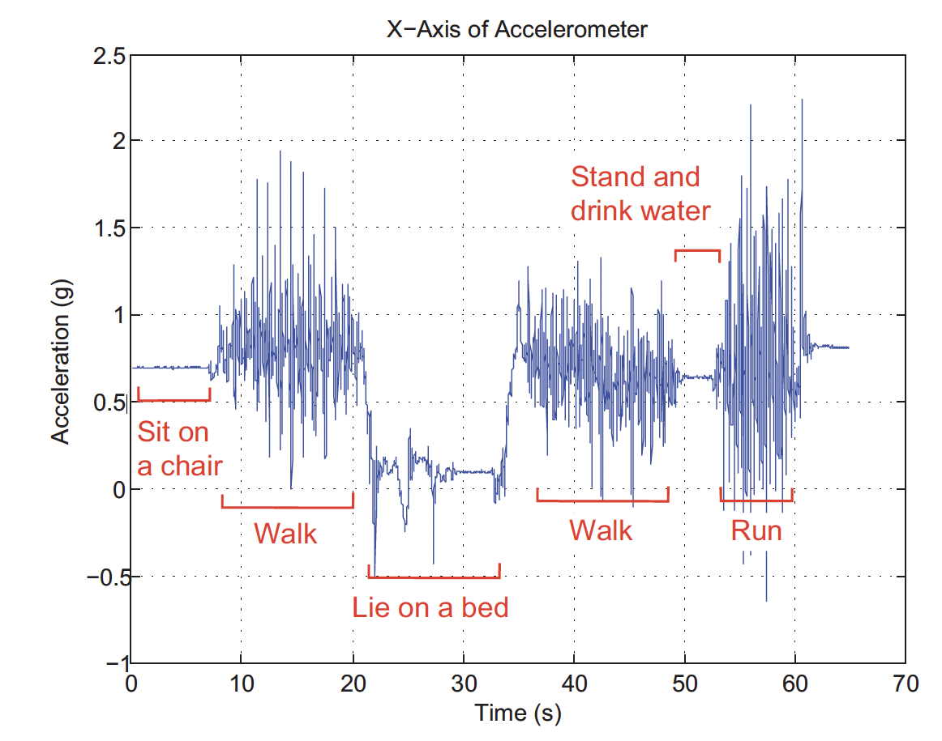
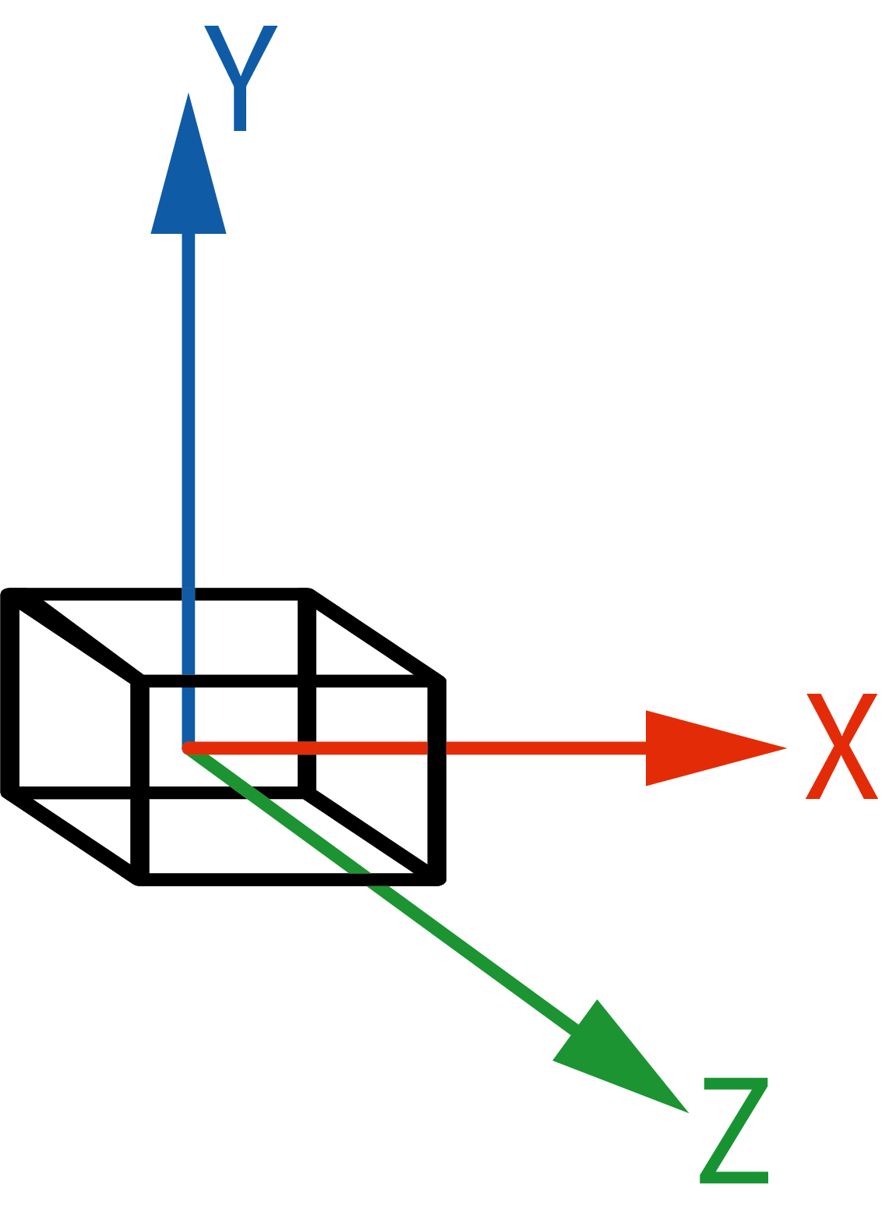
Activity Recognition – Accelerometers
Mi Zhang and Alexander A. Sawchuk. 2012. USC-HAD: a daily activity dataset for ubiquitous activity recognition using wearable sensors. In Proceedings of the 2012 ACM Conference on Ubiquitous Computing (UbiComp '12). Association for Computing Machinery, New York, NY, USA, 1036–1043. DOI: https://doi.org/10.1145/2370216.2370438
Users' Context in Smart Environments

Slide 11
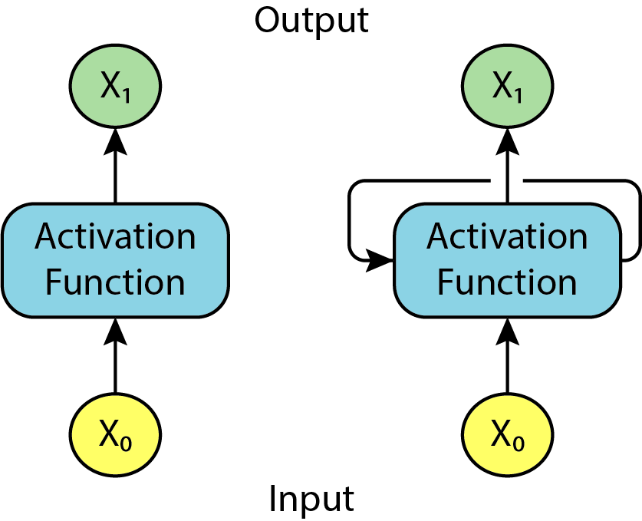
Neuronal Network With Timeseries Data
Recurrent Neural Network
Perceptron
RNN Unit
Side note:
Long short-term memory (LMST) is an advanced RNN
In depth LSTM tutorial: http://colah.github.io/posts/2015-08-Understanding-LSTMs/
Code Examples: https://github.com/cwi-dis/mobile-har-tutorial
Users' Context in Smart Environments

Slide 12
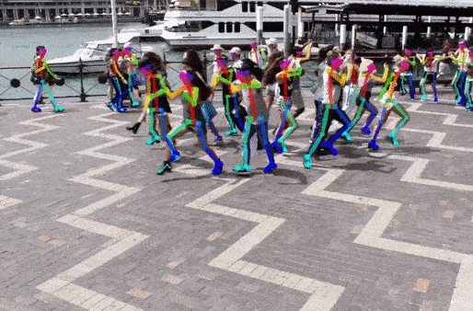
Human Pose Detection
Keypoint Estimation
Multi-stage CNN
Zhe Cao, Gines Hidalgo, Tomas Simon, Shih-En Wei, and Yaser Sheikh. OpenPose: realtime multi-person 2D pose estimation using Part Affinity Fields. IEEE transactions on pattern analysis and machine intelligence 43, no. 1 (2019): 172-186. DOI: https://doi.org/10.1109/TPAMI.2019.2929257
Users' Context in Smart Environments

Slide 13
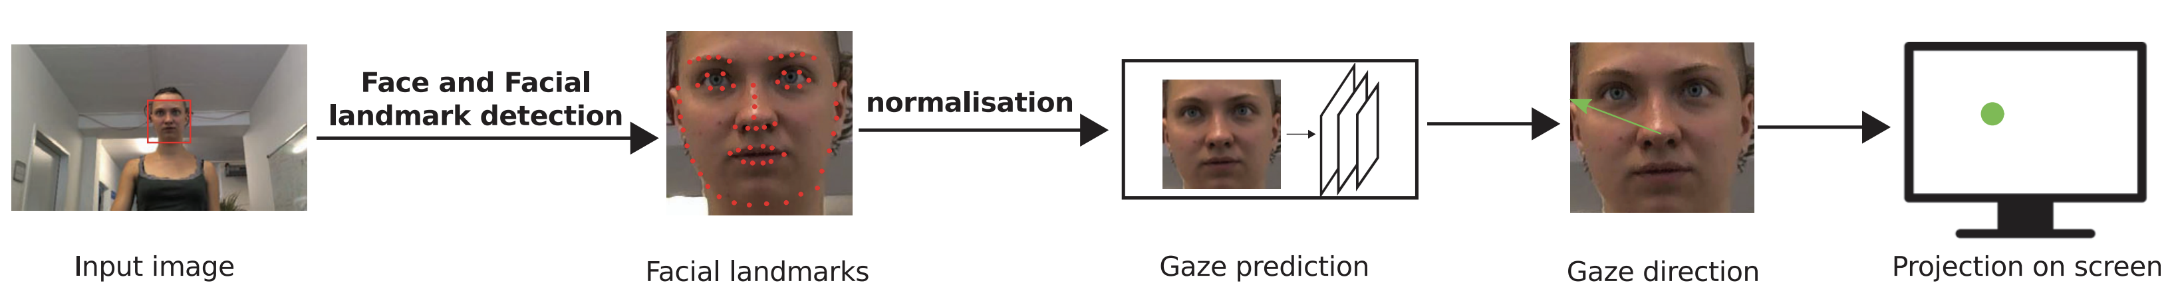
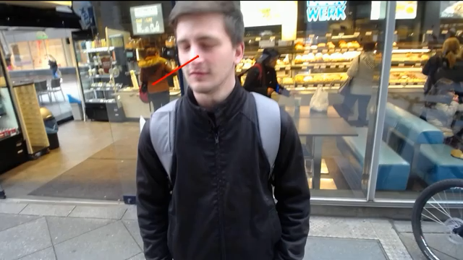
Camera based Gaze Estimation
https://youtu.be/9Lujg3beiYI
Xucong Zhang, Yusuke Sugano, and Andreas Bulling. 2019. Evaluation of Appearance-Based Methods and Implications for Gaze-Based Applications. In Proceedings of the 2019 CHI Conference on Human Factors in Computing Systems (CHI '19). ACM, New York, NY, USA, Paper 416, 1–13. DOI: https://doi.org/10.1145/3290605.3300646 URL: http://www.opengaze.org/
Users' Context in Smart Environments

Slide 14
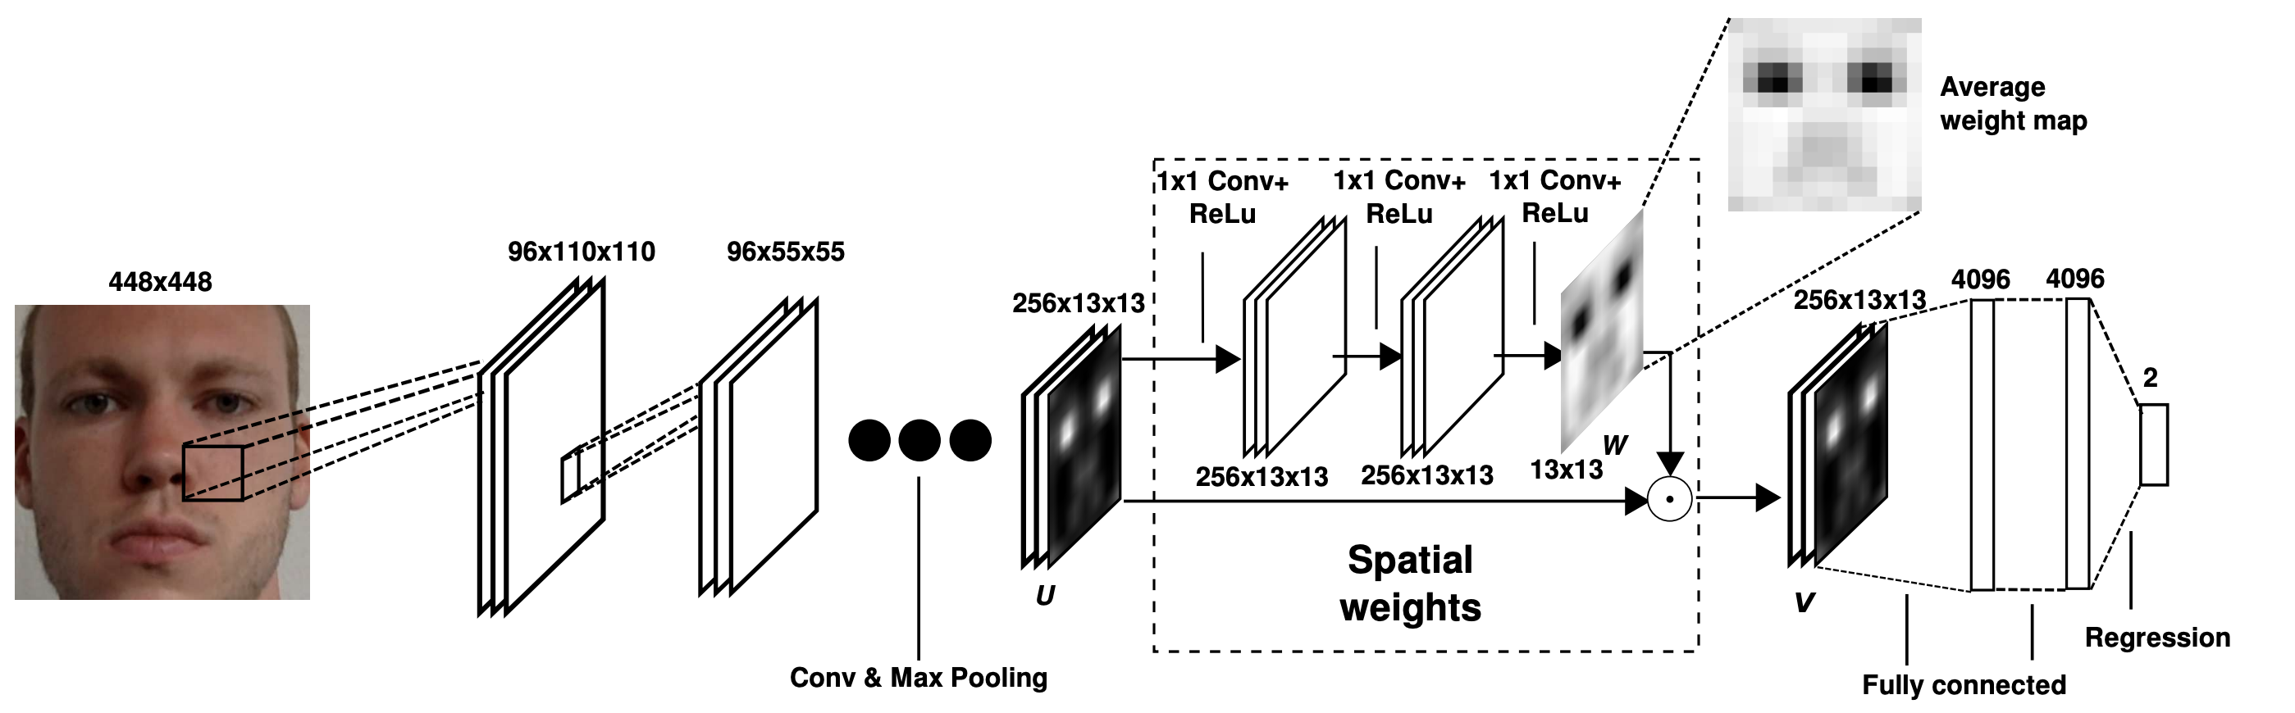
Camera based Gaze Estimation
Convolutional Neural Network
Regression – x/y cornindates
Xucong Zhang, Yusuke Sugano, Mario Fritz, and Andreas Bulling. 2017. It's written all over your face: Full-face appearance-based gaze estimation. In Proceedings of the IEEE Conference on Computer Vision and Pattern Recognition Workshops, pp. 51-60. 2017. DOI: https://doi.org/10.1109/CVPRW.2017.284
Users' Context in Smart Environments

Slide 15
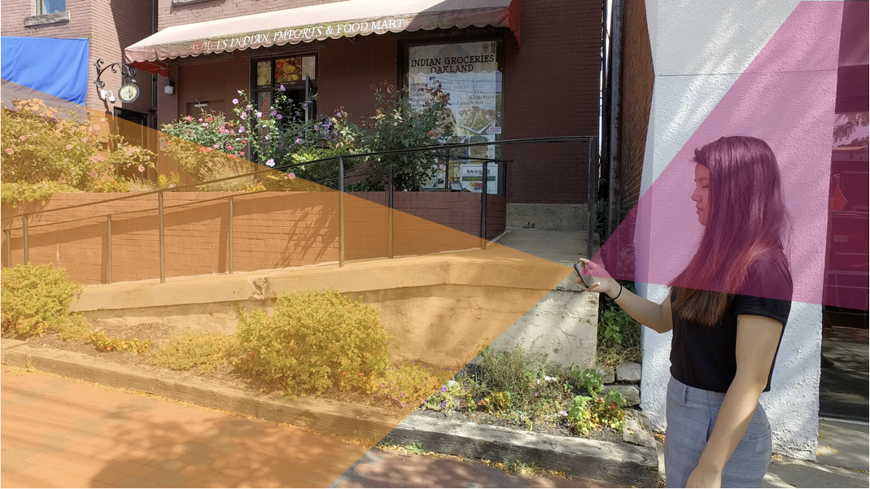
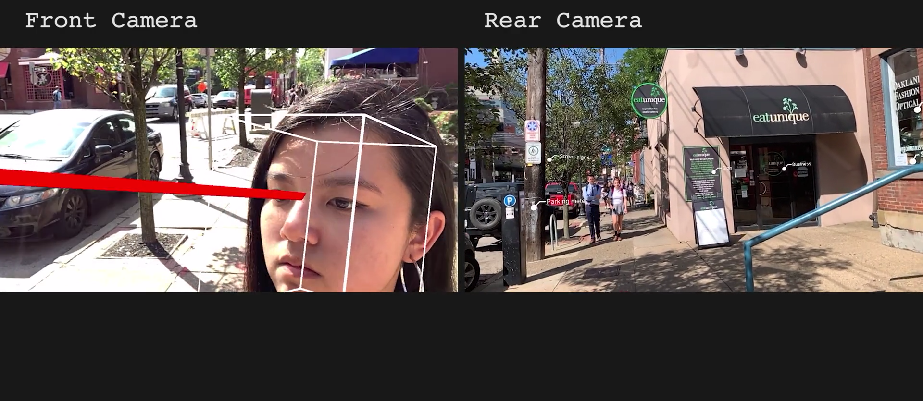
Enhanced Voice Assistants
Sven Mayer, Gierad Laput, and Chris Harrison. 2020. Enhancing Mobile Voice Assistants with WorldGaze. In Proceedings of the 2020 CHI Conference on Human Factors in Computing Systems (CHI '20). Association for Computing Machinery, New York, NY, USA, 1–10. DOI: https://doi.org/10.1145/3313831.3376479
Users' Context in Smart Environments

Slide 16
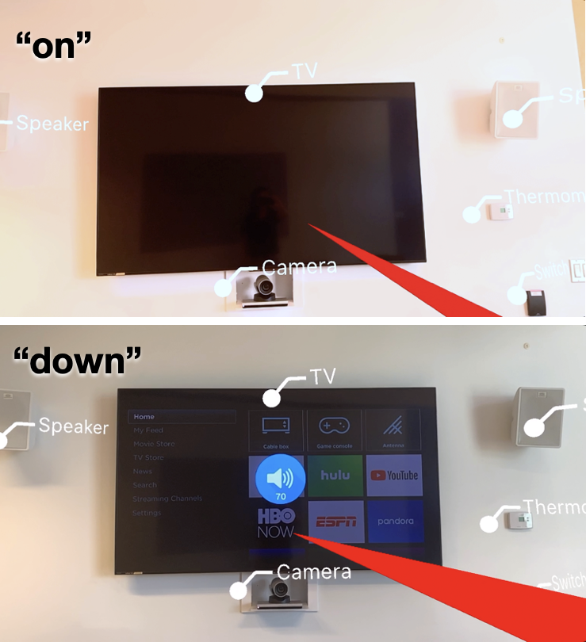
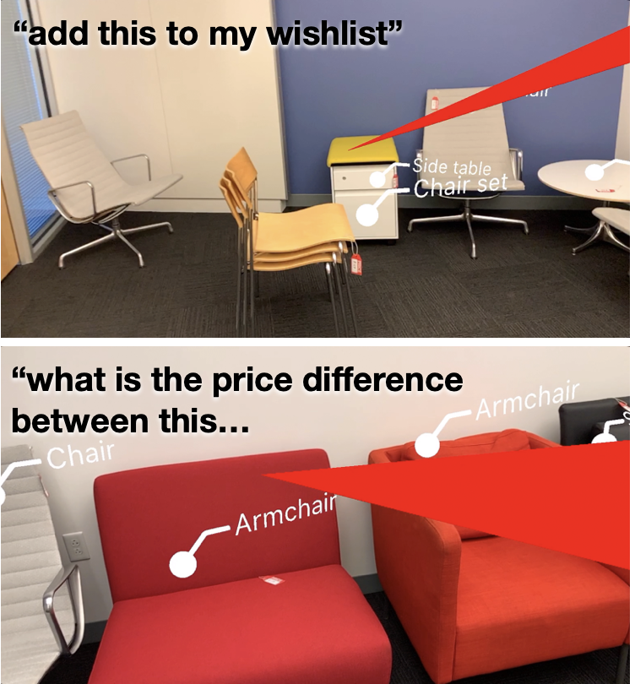
Object Detection
Sven Mayer, Gierad Laput, and Chris Harrison. 2020. Enhancing Mobile Voice Assistants with WorldGaze. In Proceedings of the 2020 CHI Conference on Human Factors in Computing Systems (CHI '20). Association for Computing Machinery, New York, NY, USA, 1–10. DOI: https://doi.org/10.1145/3313831.3376479
Users' Context in Smart Environments

Slide 17
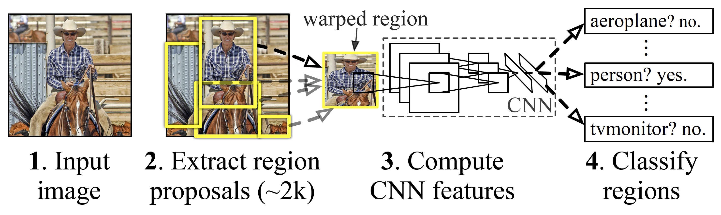
Object Detection
R-CNN: Regions with CNN feature
Ross Girshick, Jeff Donahue, Trevor Darrell, and Jitendra Malik. Rich feature hierarchies for accurate object detection and semantic segmentation (2014) In Proceedings of the IEEE conference on computer vision and pattern recognition, pp. 580-587. DOI: https://doi.org/10.1109/CVPR.2014.81 Source Code: https://github.com/rbgirshick/rcnn
Users' Context in Smart Environments

Slide 18
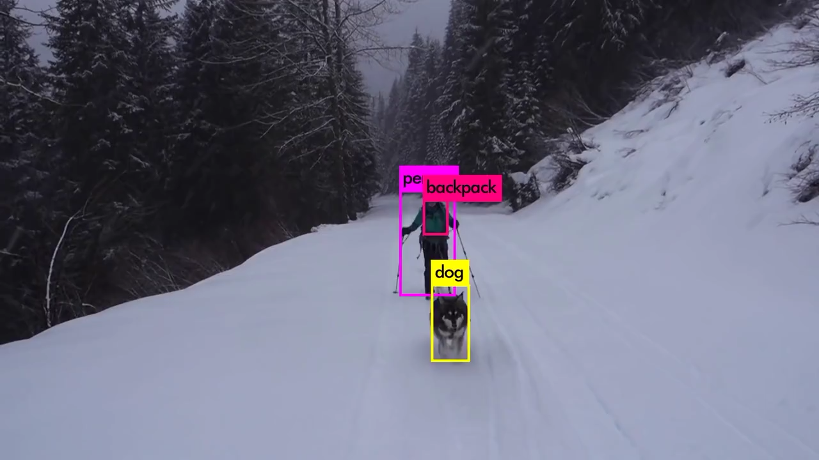
Object Detection
YOLO – You Only Look Once
https://youtu.be/MPU2HistivI
Joseph Redmon, and Ali Farhadi. "Yolov3: An incremental improvement." arXiv preprint arXiv:1804.02767 (2018).
URL: https://pjreddie.com/darknet/yolo/
Users' Context in Smart Environments

Slide 19
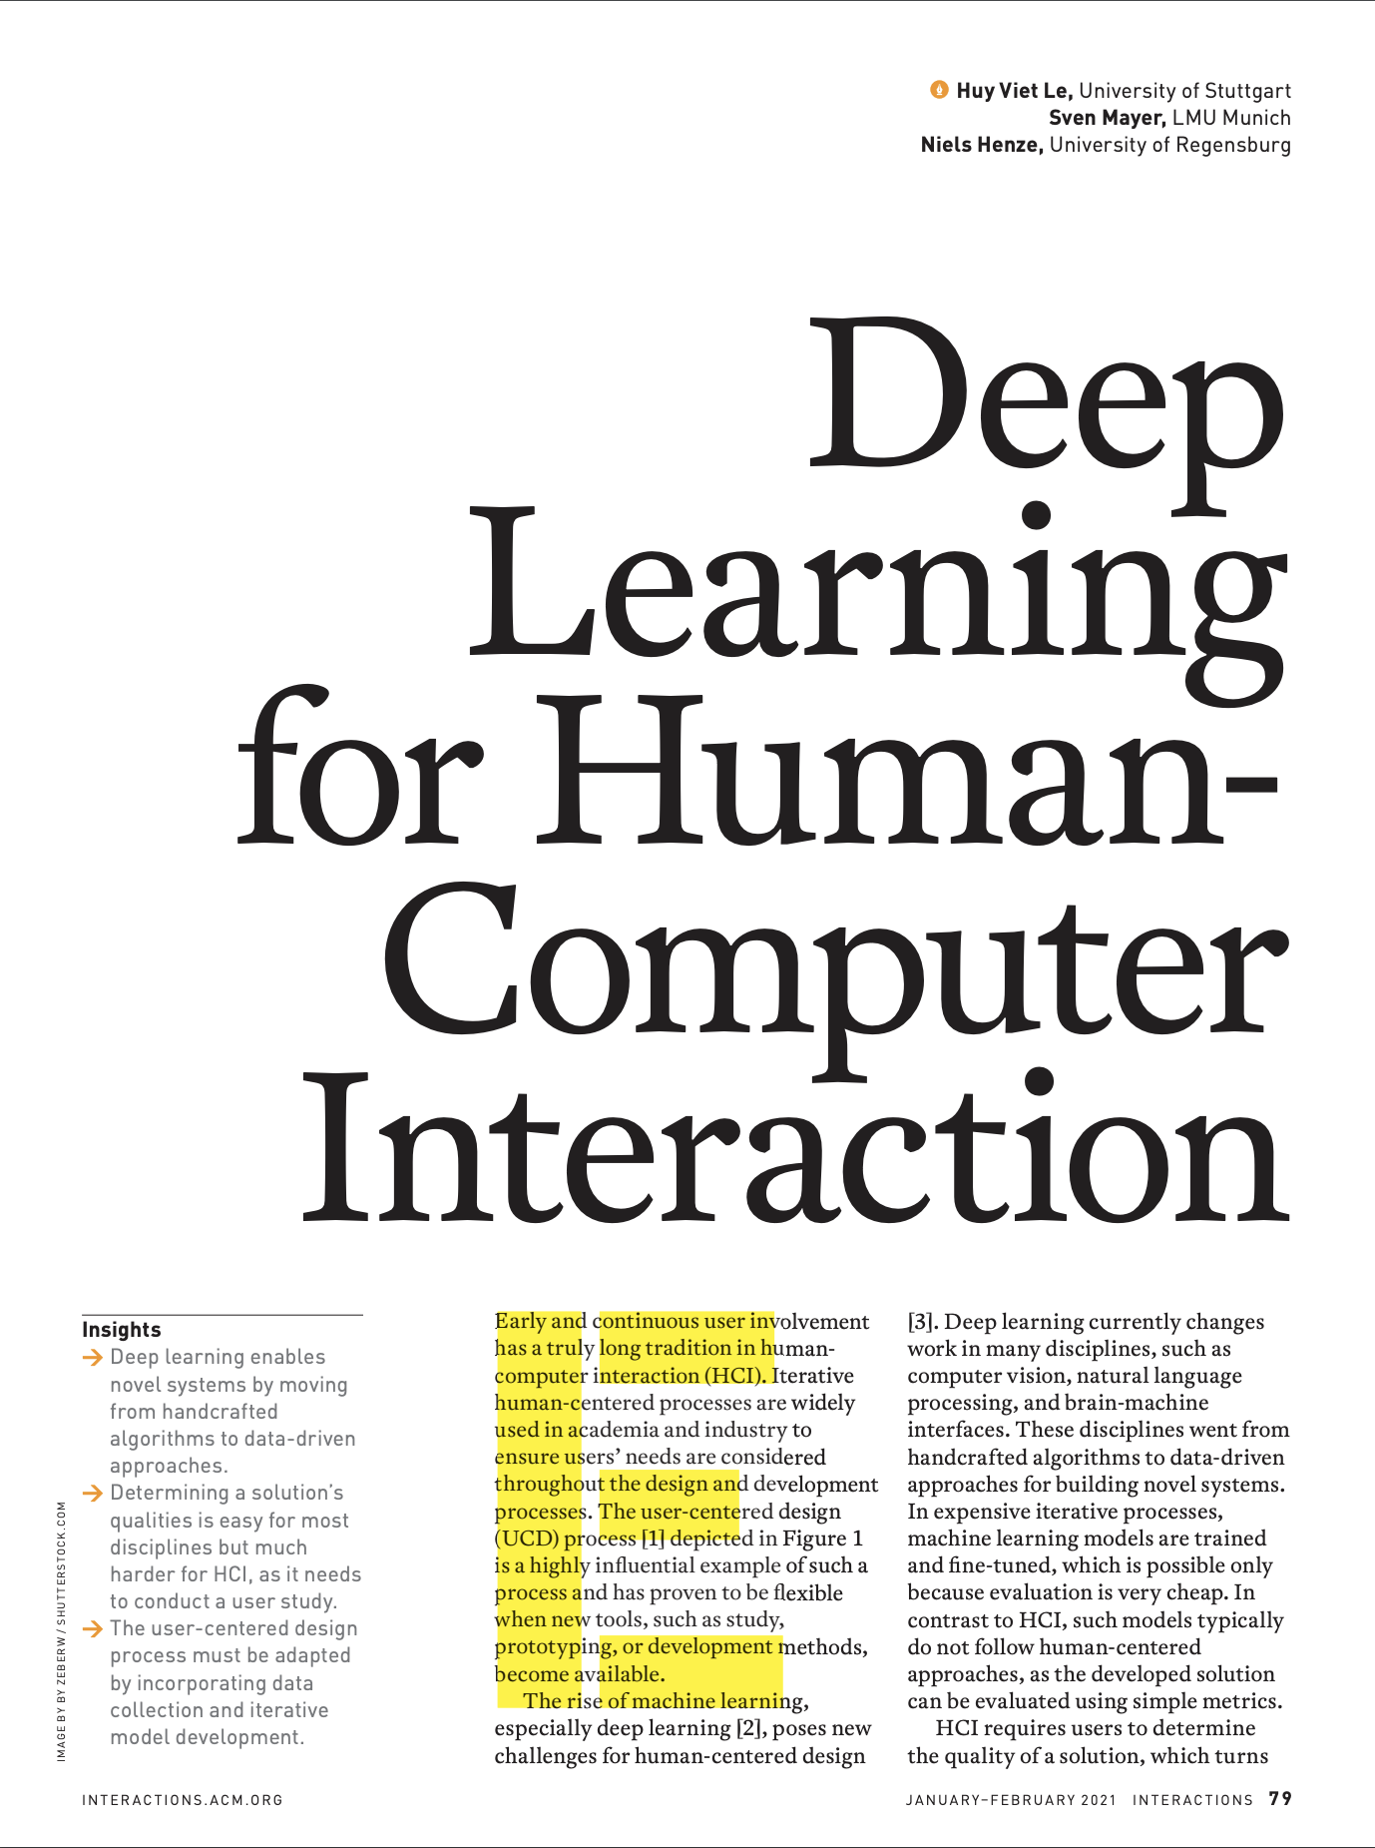
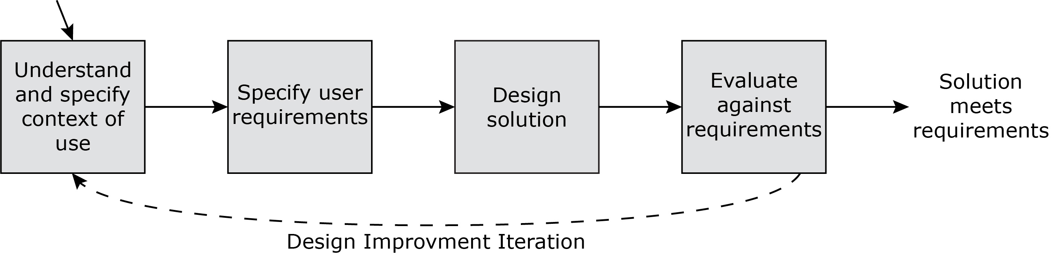
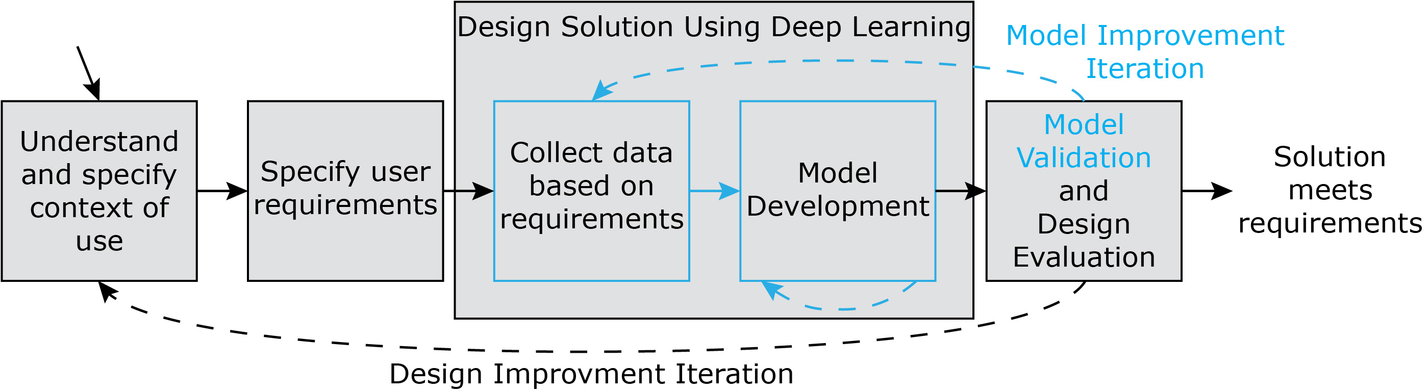
Machine Learning for HCI
User Centered Design Cycle ISO 9241
Adaptation for Machine Learning
Huy Viet Le, Sven Mayer, and Niels Henze. 2020. Deep learning for human-computer interaction. interactions 28, 1 (January - February 2021), 78–82. DOI: https://doi.org/10.1145/3436958
Users' Context in Smart Environments

Slide 20
Neuronal Network Concepts
Introduced concepts
Classification vs. Regression
Feature Extraction vs. Representation Learning
Model Structures
  Neuronal Network
  Convolutional Neural Network
  RNN
  Long short-term memory (LSTM)
Users' Context in Smart Environments

