Slide 1

Introduction to Intelligent User Interfaces | Sarah Theres Völkel | January 21st, 2020
Source: h heyerlein | Unsplash
Explainable AI

Slide 2

About Me
Sarah Theres Völkel
PhD student at Media Informatics Group
Contact: sarah.voelkel@ifi.lmu.de
Research Interests:
  Personalisation of Voice User Interfaces
  Personality-tailored Personalisation
  Transparency of intelligent systems

Slide 3
“By far the greatest danger of Artificial Intelligence is that people conclude too early that they understand it.”
[Yudkowsky 2008]

Slide 4
Overview
1
Transparency for Intelligent Systems
The Black Box Problem
Resulting Challenges for Society
Explainable AI
What Makes a Good Explanation
User Problems and Support
2
}
Transparency for Personality-Targeting
Personality and Personality-Targeting
Online
Requirements for Explanations for Personality-Targeting
How to Trick AI

Slide 5
Transparency for Intelligent Systems

Slide 6
Overview
1
Transparency for Intelligent Systems
The Black Box Problem
Resulting Challenges for Society
Explainable AI
What Makes a Good Explanation
User Problems and Support
2
Transparency for Personality-Targeting
Personality and Personality-Targeting
Requirements for Explanations for Personality-Targeting
How to Trick AI
Notes:
First of all, I’d like to talk with you about what this black box problem is and why we “suddenly” have this particular problem with machine learning algorithms.

Slide 7
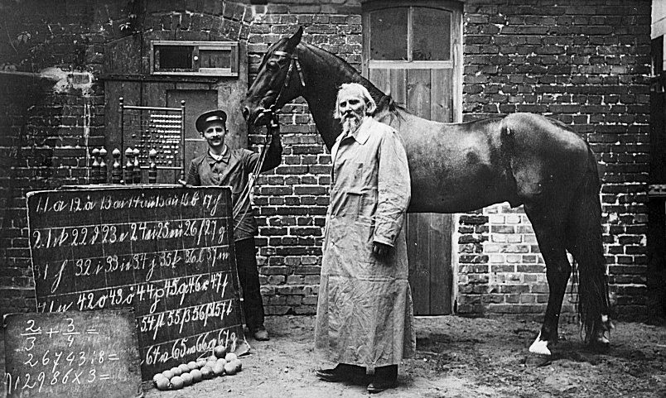
The “Clever Hans” Problem
Source: Unknown Author, Public domain, via Wikimedia Commons
Notes:
I would like to first explain the black box problem to you using an example.
On this picture you can see the horse “Clever Hans”
Around 1900 a German farmer claimed that he had taught his horse basic arithmetics, as well as reading and spelling
In public demonstrations, the horse was actually able to correctly answer all of its owner's questions with a series of hoof taps
However, a psychologist at the University of Berlin, did not believe that the animal really had such human-like abilities
After he conducted a series of experiment, he found out: Clever Hans would only give the correct answer if the owner who asked the question knew the answer!
The horse had not really learned to solve the question by calculating or reading, but instead recognized subtle clues in the experimenter's body language to figure out what answer was expected of him.
What does a horse from 1900 have to do with machine learning?
In today's deep learning or even simpler machine learning algorithms, we encounter a very similar problem:
False correlations can occur when the data has a characteristic that is strongly correlated to the correct result (such as the experimenter's body language) but is not the cause of the correct answer (e.g. a correct calculation).

Slide 8
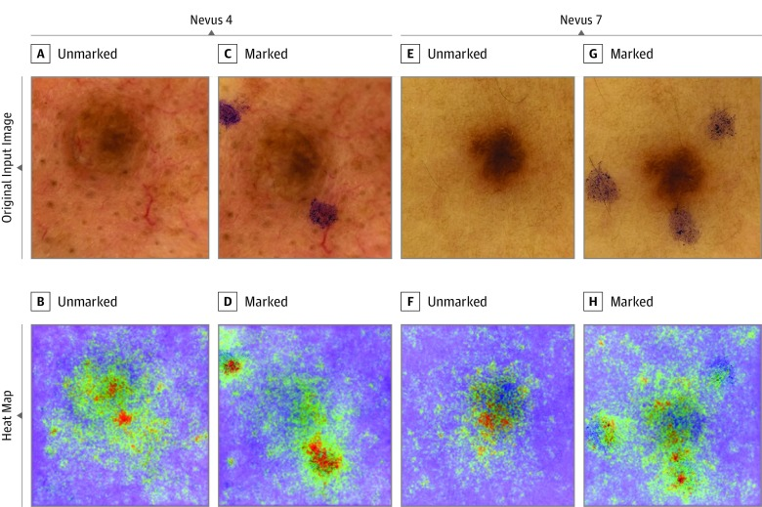
The “Clever Hans” Problem
Source: Winkler et al. 2019 American Medical Association
Notes:
You can see an example from today here. Scientists led by Winkler have found that melanomas were correctly identified by a Machine-Learning model, primarily based on medical markings.
Show in Image
So when medical professionals made marks around a birthmark with an ultraviolet pen, it was more likely to be recognized as a melanoma, which has led to a higher false-positive rate. The reason for this was a training set that primarily contained pictures with markings
The challenge is that it is not that easy to tell if we encounter a Clever Hans problem because it is not reflected in a value such as accuracy.
Therefore, these are black box problems because we do not know the exact processes of the algorithm

Slide 9

The Black Box Problem of Machine Learning
“[…] stems from the mismatch between mathematical optimization in high-dimensionality characteristic of machine learning and the demands of human-scale reasoning and styles of semantic interpretation.”
[Burrell 2016]
Source: Courtesy of Quay Au
Notes:
The black box problem of machine learning stems from the mismatch between mathematical optimization in high-dimensionality characteristic of machine learning and the demands of human-scale reasoning and styles of semantic interpretation.

Slide 10

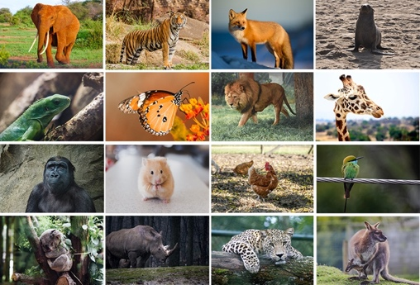
The Black Box Problem of Machine Learning
Input
Labelled Training Data
Output: Prediction
Machine Learning Process
Learned Function
This is a fox
(p=.93)
Notes:
Let's take a closer look at the individual steps:
We have a machine learning model that tells us for a given animal what kind of animal it is.
As you know, classified training data is used for so-called supervised machine learning, so we have a lot of pictures and they are each labelled with the animal to be recognized.
The developers then define a machine learning process, for example certain “features” that are considered in the model, and then the developers create a machine learning model on the data
If we now enter a new input into the system, such as a picture of a fox here, for example, we apply our learned function
And we then receive an output, a prediction from the machine learning model

Slide 11
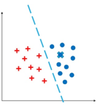
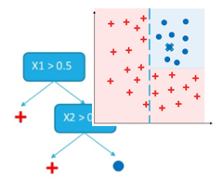
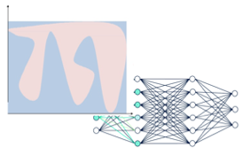
The Black Box Problem of Machine Learning
Input
Labelled Training Data
Output: Prediction
Black Box
Machine Learning Process
Learned Function
This is a fox
(p=.93)
Lineare Modelle
Decision Trees / Ensembles
Nicht-Lineare Modelle
(DNN, SVM)
Notes:
There are different possibilities for the machine learning model, the function.
However, Machine learning models are opaque in the sense that if one knows the output of the algorithm (the classification decision), one rarely knows exactly how or why one got a certain classification of the inputs
In addition, the inputs themselves may be completely unknown or only partially known.

Slide 12

The Black Box Problem of Machine Learning
Input
Labelled Training Data
Output: Prediction
User with a task
Black Box
Machine Learning Process
Learned Function
This is a fox
(p=.93)
Notes:
This can become a problem if we now have a user who wants to use this machine learning with a certain task. In this case, the user will probably not be surprised because the prediction seems correct and is easy to check

Slide 13


The Black Box Problem of Machine Learning
Input
Labelled Training Data
Output: Prediction
User with a task
Black Box
Machine Learning Process
Learned Function
This is a fox
(p=.93)
?
Why did you that?
Why not something else?
When do you succeed?
When do you fail?
When can I trust you?
How do I correct an error?
Notes:
But what if the prediction is obviously wrong, as here for example?
Or if the user does not want to classify animal images, but works in a bank and wants to know whether customers are creditworthy or a doctor wants to find out whether a birthmark is a melanoma? So when we don't know the actual solution, as in most machine learning applications
With this issue, how does the user know why the model came up with this result?
How does the user know when the system is right and when it is wrong?
And how can the user correct a mistake?

Slide 14

The Black Box Problem of Machine Learning
Input
Labelled Training Data
Output: Prediction
User with a task
Black Box
Machine Learning Process
Learned Function
This is a fox
(p=.93)
?
This is a fox because …
+ it has auburn fur
+ it has pointy ears
Explanation Interface
Notes:
To empower the user to know whether they can trust the black box model, explanation interfaces can help
The explanation interface explains to the user why the model came to this result. This enables the user to better assess whether the result is correct and where the error could be.

Slide 15
Discussion
There has always been proprietary, non-interpretable knowledge. What is different now?
We do not need to understand how a motor works to drive a car – why do we need to understand ML models now?
Discuss for 5min in breakout rooms
Notes:
But why do we need more transparency?
It has always been the case that we didn't have knowledge, for example because companies didn't want to publish it.
We also don't need to know how an engine works to drive a car. Why should we know how machine learning models work?
-> Breakout rooms
Solution:
In particular, the more comprehensive technologists and techniques of data acquisition are new, which lead to collecting huge amounts of personal data, such as online purchases, link clicks, geodata movements
On the other hand, machine learning models are increasingly being used for decisions in areas that were previously always made by humans.

Slide 16
Overview
1
Transparency for Intelligent Systems
The Black Box Problem
Resulting Challenges for Society
Explainable AI
What Makes a Good Explanation
User Problems and Support
2
Transparency for Personality-Targeting
Personality and Personality-Targeting
Requirements for Explanations for Personality-Targeting
How to Trick AI
Notes:
To further illustrate why explanations are important for black box model, I’ll show you some challenges and problems that have already occurred as a consequence of black box models.

Slide 17

AI in the Courtroom
Bias in training data set
Source: Andrey Popov in Kugler et al. 2018
Notes:
In the US, AI systems are already being used in the judiciary, for example to suggest a suitable sentence for a convict. For this, the algorithm uses personal data such as gender, age, employment relationships, etc.
Companies have developed these models and do not disclose the algorithm as this is their primary competitive advantage.
A typical black box problem. Hence, neither the judge nor the defendant know why the system came to this a decision accordingly cannot evaluate how good the recommendation is
Systems that determine how likely it is that someone will commit another crime have similar problems. Here it was found that the systems were often subject to a bias, and coloured people were labelled as future offenders twice as often as Caucasians
The idea was that you were trying to make decisions more rational because judges, for example, can have a bad day or are biased.
However, AI systems that are built on biased data naturally also have a bias.

Slide 18
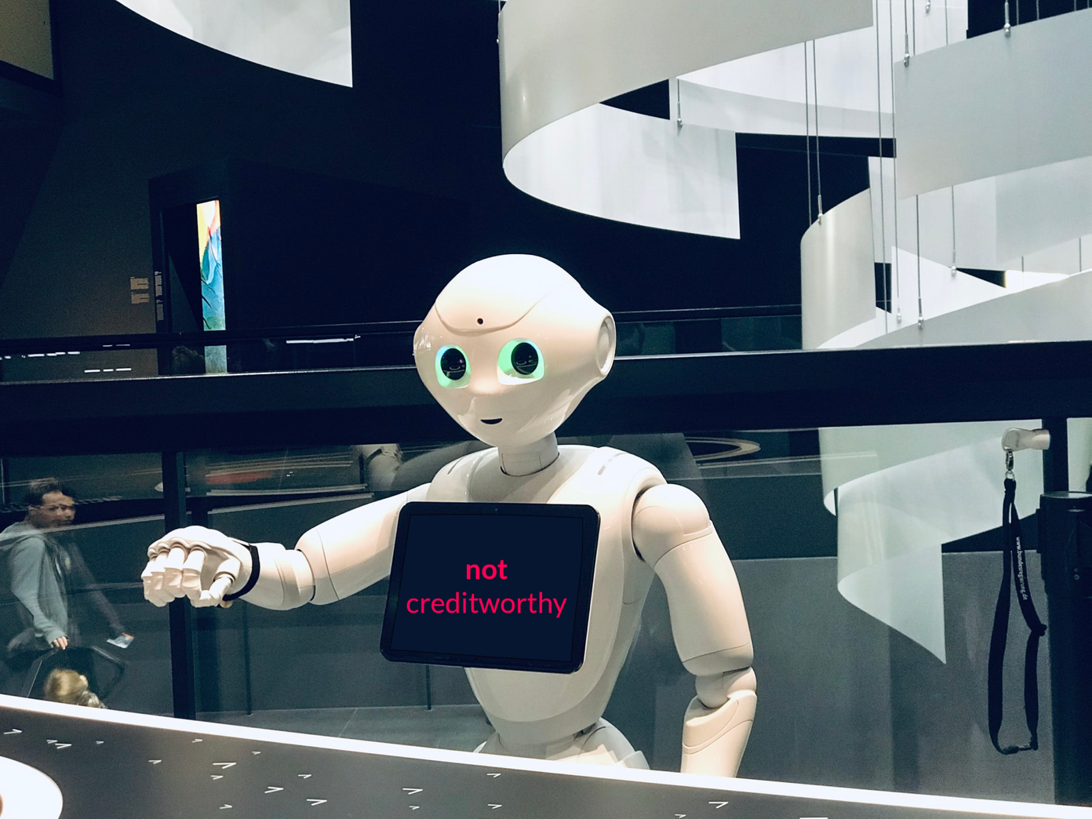
AI in Financing
Lack of transparency
Source: Photo by Fitore F. | Unsplash
Notes:
A similar problem arises for the finance and real estate industries.
AI systems calculate the value of a property or the creditworthiness of a customer.
At the end there is a number as an output.
However, neither customers nor employees, such as brokers or bank employees, have any insight into how this prediction came about.
Customers neither know whether this value is correct nor how they can improve it if necessary.

Slide 19

AI in Recruiting
Discrimination due to bias in training data set
Notes:
AI systems are also increasingly used in recruiting. For example, applicants are asked to chat with chatbots, which then determine the suitability of the applicant
At Amazon, for example, AI was used to analyse résumés and automatically filter out the best applicants. For this purpose, the résumés of employees who had already been hired from the last ten years were used as training data
For technical jobs, however, most of the résumés were made by men. As a result, résumés containing keywords such as "Chair of a women's chess club" were viewed as less suitable and Amazon discontinued the project after a short time.

Slide 20
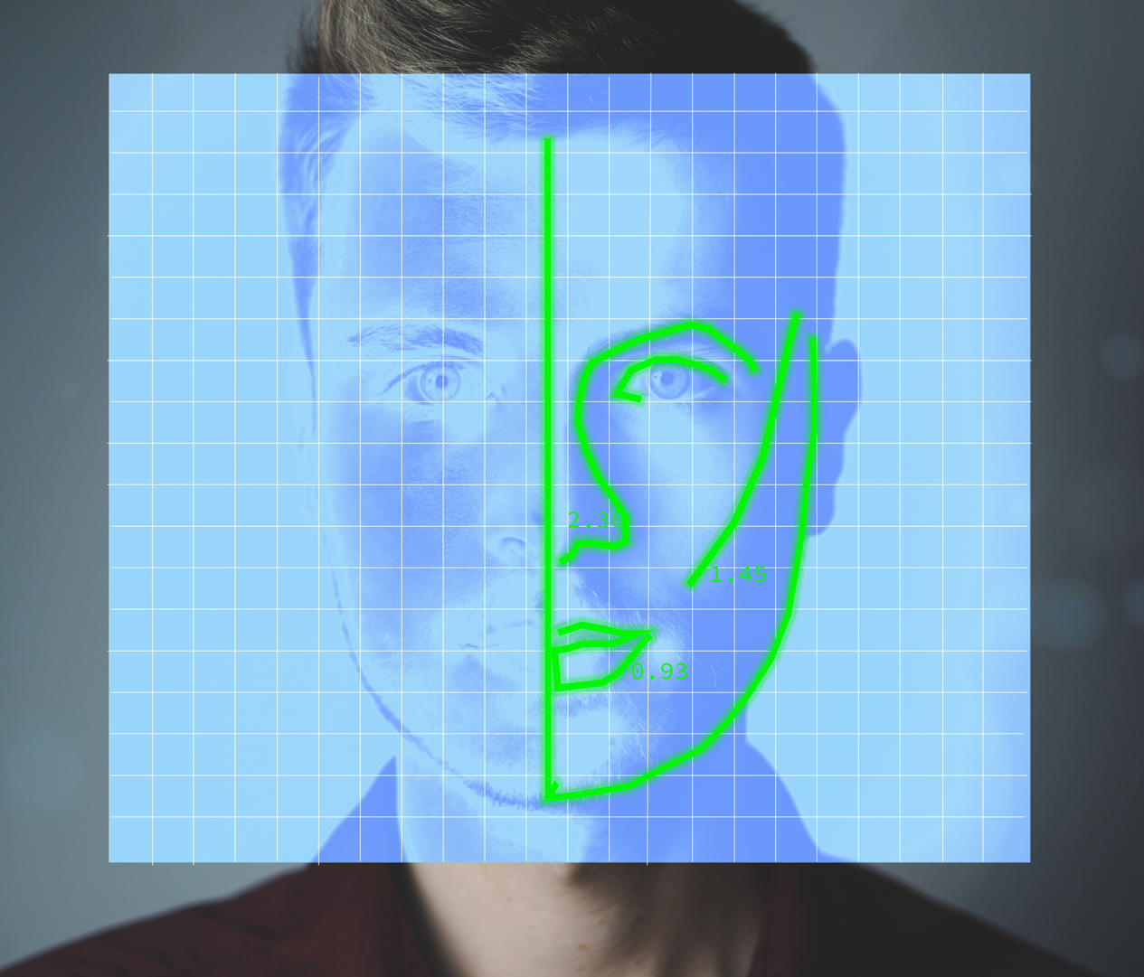
Does AI Have a “Gaydar”?
Lack of interpretability
Source : Own Design after Alami in Levin 2017
Notes:
In 2017, Wang and Konsinski published a study in the prestigious Journal of Personality and Social Psychology, in which they awarded AI a gaydar.
They trained a deep learning model based on photos on dating websites that predicts the sexual orientation of men and women based on the photos.
The authors attribute this prediction primarily to different facial structures, so they suspect that the faces of homosexual men look "more feminine" and the faces of homosexual women look "more masculine", caused by hormones.
This of course creates massive ethical problems and dangers, especially in countries where LGBTQ people are persecuted for their sexual orientation
But is that really the basis on which the algorithm came to the result? Here, too, the interpretability of deep learning algorithms is limited, so that only guesses can be made.
Research at Princeton University and Google suggest, however, that the algorithm rather recognizes patterns in fashion trends and cultural norms, such as wearing make-up, a beard or glasses and the position from which the photo was taken.

Slide 21

AI Acting Information Control?
Lack of feedback and correction
Source : Benton 2019
Notes:
You may still remember when the Notre Dame Cathedral in Paris burned down in 2019
Millions of people followed the terrible pictures live via YouTube
However, viewers saw an irritating hint under the video
"The attacks of September 11th were (...) the deadliest terrorist attack on American soil in US history." Below is a link to the entry about 9/11 in the Encyclopedia Britannica.
The reference is problematic in that it falsely evokes the association that terrorist attacks were responsible for the fire
The notice is produced by algorithms from YouTube, as optical similarities have been established between the videos about 9/11 and the burning Notre Dame
Actually, the function is intended to prevent the spread of fake news and conspiracy theories by linking to reputable sources. Google offers a similar function, for example, if you google for Covid-19 topics.
This is actually a good thing, of course, but it often doesn't work properly in practice, as numerous other examples show.
The main problem here is a lack of transparency and correction options: The users are not informed about why they see this notice and also have no opportunity to submit feedback about it

Slide 22
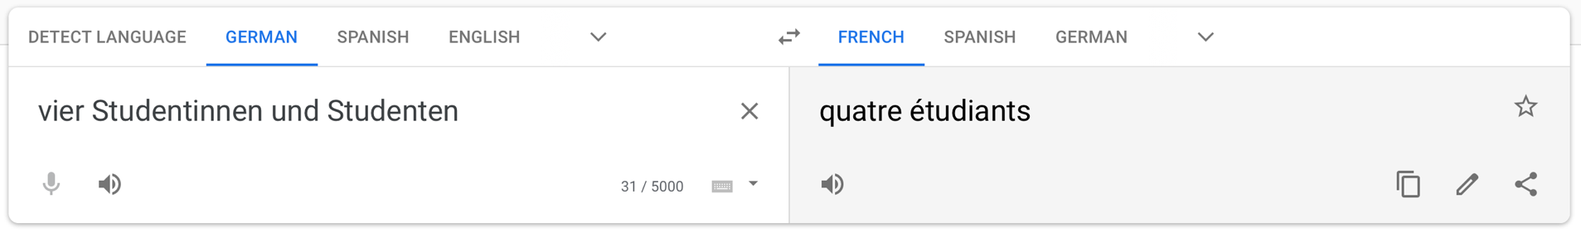
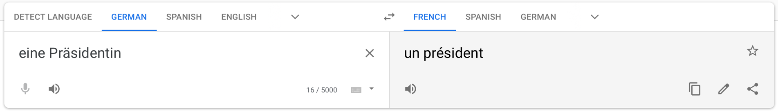
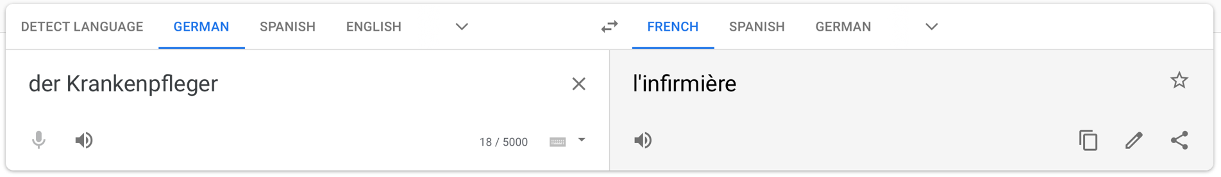
AI as Translator?
Source: www.translate.google.com
Lack of transparency about algorithm limitations
Notes:
When translating from one gender inflected language to another on Google Translate, for example from German to French, the gender of a word is often changed in a stereotypical way
For example, if you try to translate President from German into French, you get the translation "un president", although it should be "une présidente"
Likewise, a nurse is translated to the female "l‘infirmière"
The reason for this is that Google often first translates from a language into English, a non-gender inflected language, and only then into the target language, as insufficient data is available for many language pairs. This technique is called "bridging" and means that gender forms are often lost in translation. However, the translation usually works better if a coherent text is entered
Here, however, the problem is again that this algorithm’s limitations are not disclosed, so that users without basic language skills in the target language are not aware of these errors, which in turn contributes to a more stereotyped language

Slide 23
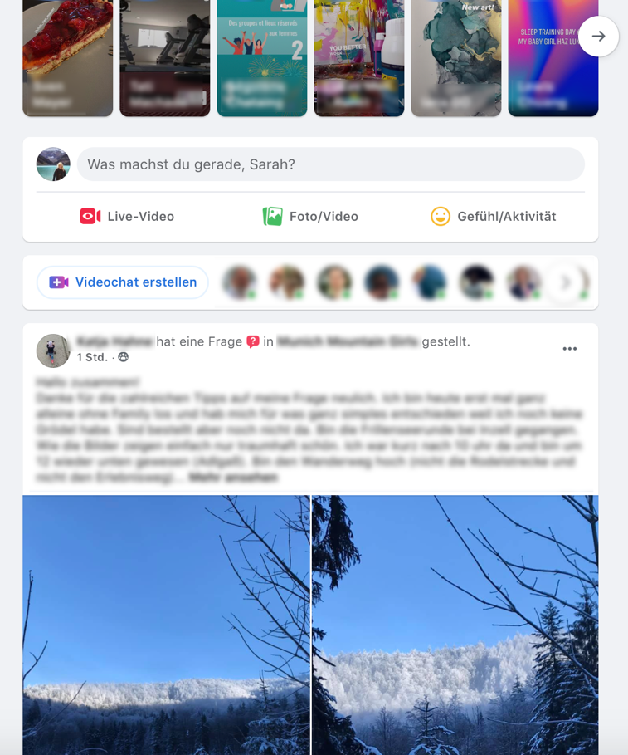


Everyday Challenges with Intelligent Systems
Source: www.facebook.com
Source: www.airbnb.com
Source: www.netflix.com
Lack of Algorithmic Awareness
Algorithmic Anxiety
Intransparent Recommendations
Notes:
Users also struggle with intelligent systems everyday
For example, several users are not aware that the facebook newsfeed is curated by an algorithm. They then thought that friends delibarately withhold posts from them
Jhaver et al. [28] looked into the effects of algorithmic evaluation on AirBnB hosts. They found that uncertainty about the workings of the algorithm and perceived lack of control caused what the researchers called “algorithmic anxiety”.
Users often complain about intransparent recommendations: why was a particular show recommended

Slide 24
Right to Explanation in the GDPR
Article 22
The data subject should have the right not to be subject to a decision, which may include a measure, evaluating personal aspects relating to him or her which is based solely on automated processing and which produces legal effects concerning him or her or similarly significantly affects him or her, such as automatic refusal of an online credit application or e-recruiting practices without any human intervention.
[…]
In any case, such processing should be subject to suitable safeguards, which should include specific information to the data subject and the right to obtain human intervention, to express his or her point of view, to obtain an explanation of the decision reached after such assessment and to challenge the decision.
Notes:
As a consequence of these problems, the right to transparency and explanation was also legally stipulated in the General Data Protection Regulation, which came into force in 2018
This means that users have the right to know what data is being collected about them, how it is processed and to give them the opportunity to correct them
It is also emphasized that these must be prepared in a transparent, understandable and easily accessible form. We'll take a closer look at why this is a particular challenge later.

Slide 25
Overview
1
Transparency for Intelligent Systems
The Black Box Problem
Resulting Challenges for Society
Explainable AI
What Makes a Good Explanation
User Problems and Support
2
Transparency for Personality-Targeting
Personality and Personality-Targeting
Requirements for Explanations for Personality-Targeting
How to Trick AI

Slide 26

Human-Centred Artificial Intelligence
Source: Andy Kelly | Unsplash
“Human-Centred Artificial Intelligence (HCAI) focuses on amplifying, augmenting, and enhancing human performance in ways that make systems reliable, safe, and trustworthy. These systems also support human self-efficacy, encourage creativity, clarify responsibility, and facilitate social participation.”
[Shneiderman 2020]
Notes:
In order to meet these challenges, there is currently a paradigm shift in research on artificial intelligence. In traditional research on Artificial Intelligence, attempts were made to simulate human behavior, while the application attempted to replace humans with AI.
In contrast, Human-Centered Artificial Intelligence, focuses on supporting, improving and expanding human performance so that systems are reliable, secure and trustworthy. These systems should then support human self-efficacy, strengthen creativity, clarify responsibility and simplify social participation.
Developing human-centered AI systems requires the involvement of designers, software developers and people who apply user-centered methods

Slide 27
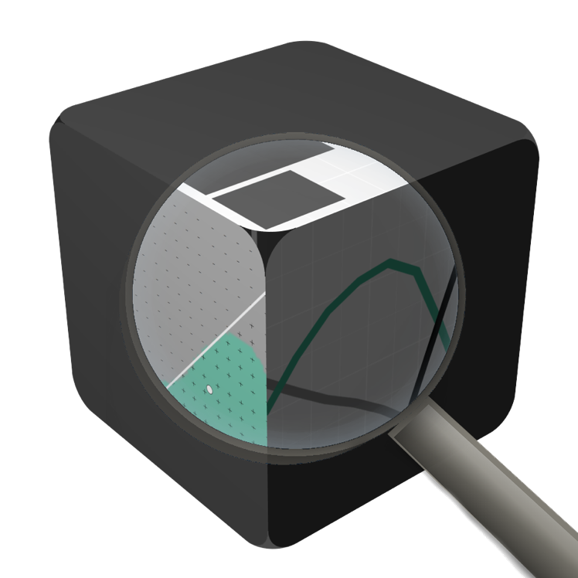
What is Explainability?
“… the ability to explain or to present in understandable terms to a human” [Doshi-Velez & Kim 2017]
“… is the degree to which a human can understand the cause of a decision” [Miller 2017]
“… is the degree to which a human can consistently predict the model's result” [Kim et al. 2016]
“Explainability”, “Interpretability”, and “Transparency” are often used interchangeably
Source: Courtesy of Quay Au
Notes:
The interpretability of artificial intelligence plays an important role in this
Instead of interpretability, one often reads about explainable AI or the transparency of artificial intelligence. The terms are used synonymously
There are also a number of definitions for the terms, a few of which I have listed here.
The interpretability of an intelligent system means the ability to explain this system in understandable language
Miller describes interpretability as the extent to which a person can understand the reasons for a decision made by the system
Kim et al. Emphasize the extent to which a human can consistently predict the results of a model

Slide 28
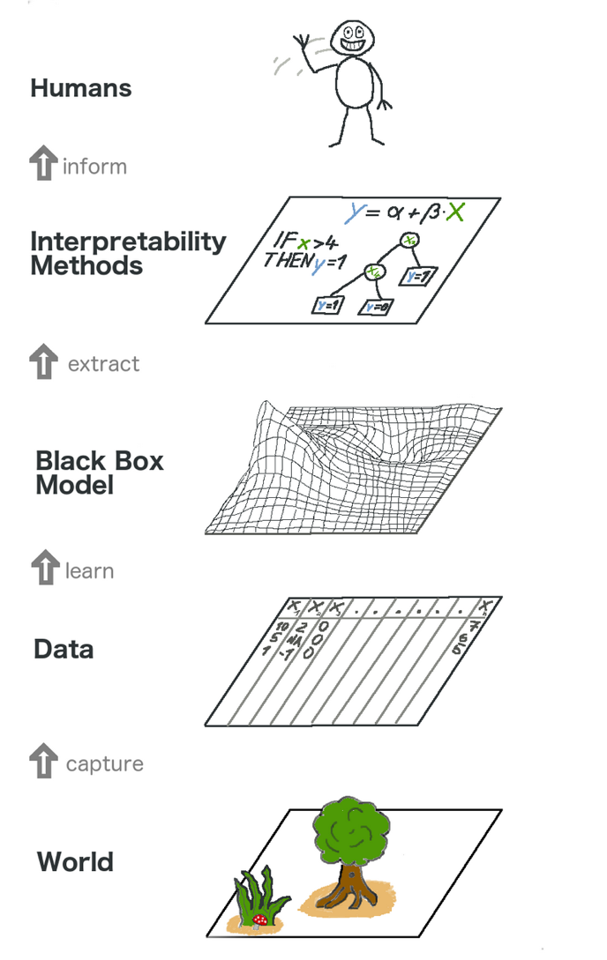
Applications of Explainability
Model Validation: Eliminate bias in the training data
Model Debugging: Debug models and analyse wrong predictions
Knowledge Discovery: Gain new insights through the analysis
Source: [Molnar 2019]
Notes:
We can look at explainability in machine learning models on two different levels.
The first level here is how we can extract an interpretable method from the black box model. So how can we ensure that at least the statistician or computer scientist who developed the model understands why the model delivered these results?
There are three different applications of explainability:
Model validation, so we want to know if there is a bias in the training data in our model;
Model debugging so that we can identify and analyze false predictions so that we can improve the model
and finally new knowledge can be gained through the declaration.
I would like to introduce these three applications to you in more detail now

Slide 29


Model Validation
Source: Brandon Messner | Unsplash
Source: Jose Carls Ichiro | Unsplash
Classified as Dog
Classified as Wolf
Notes:
One application of interpretability in machine learning algorithms is the validation of the model.
So we want to know whether there is a bias, i.e. a distortion, in our training data.
We discussed the problem, for example, with the use of AI technologies for punishment or in recruiting
One example is an image recognition neural network that learns the differences between wolves and dogs.
Here wolf and dog are properly classified

Slide 30


Model Validation
Source: Kateryna Babaieva | Pexels
Source : Kateryna Babaieva | Pexels, adapted after [Ribeiro et al. 2016]
Classified as Wolf
LIME-Explanation (idealised)
Notes:
Here, however, we see that this husky was mistakenly classified as a wolf
Do you have any idea why? [short break]
Explanations can help us here, for example the so-called LIME explanations by Ribeiro et al., Which mark which parts of an image or text were decisive for the prediction.
So we see that it was not the dog or the wolf that was learned, but whether it can be seen on snow. Accordingly, we should examine our training data set for a bias. Most likely wolves on snow and dogs on other surfaces can be seen here.
So the explanation can help us find these errors and identify the dataset as unsuitable

Slide 31


Model Debugging
Adversarial Attacks
+
=
“panda”
57.7% confidence
“gibbon”
99.3% confidence
Image Source: Own design after Goodfellow et al. 2014
Photo: Mélody P. | Unsplash
Notes:
Explanations can also be used to debug and analyze model failure when models make incorrect and unexpected predictions.
One example is what is known as adversarial attacks
Adversarial examples are inputs into a machine learning model that an attacker has deliberately manipulated in order to achieve a wrong result, i.e. optical illusions for machine learning models, so to speak
In machine learning models such as DNNs, these adversarial inputs can with a high degree of certainty lead to incorrect predictions.

Slide 32

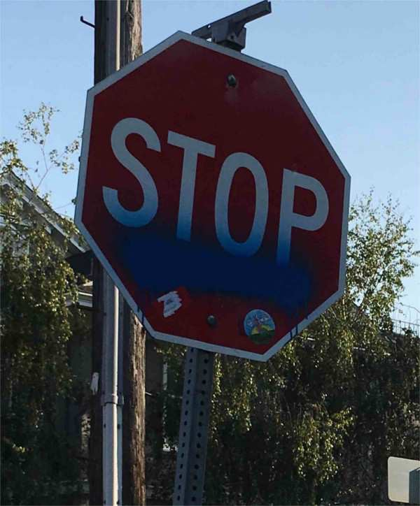

Model Debugging
Adversarial Attacks in Traffic
+
=
“stop sign”
76.0% confidence
“no stop sign”
97.3% confidence
Notes:
This can be particularly dangerous in road traffic, for example when autonomous vehicles recognize road signs.
Eykholt et al. were able to show, for example, that with the help of attacks, as can be seen here on the right stop sign, machine learning algorithms could no longer correctly classify it as a stop sign.
However, these errors are fairly easy to spot for humans
In this case, the explanation makes it easier for people to identify the possible model flaws and analyze why those models might fail.
More importantly, we can continue to use human knowledge to find possible solutions to improve the performance and accuracy of models.

Slide 33

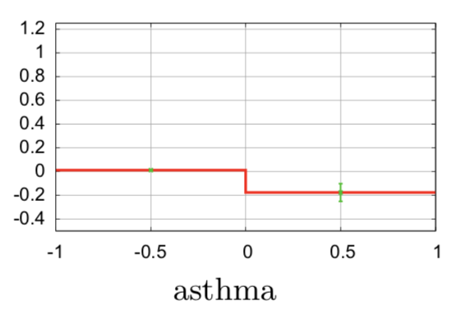
Knowledge Discovery
Source: CDC | Unsplash
Source: [Caruana et al. 2015]
Notes:
The derived explanations also make it possible to gain new insights from the machine learning model, as users understand the fundamental decision-making processes
In this way, new knowledge that was originally hidden in the data can be extracted.
For example, a rules-based interpretable model was used to predict mortality risk for patients with pneumonia
One of the rules of the model suggested that asthma might lower a patient's risk of dying from pneumonia.
It turns out that patients with asthma received more aggressive treatments, which led to better results.

Slide 34
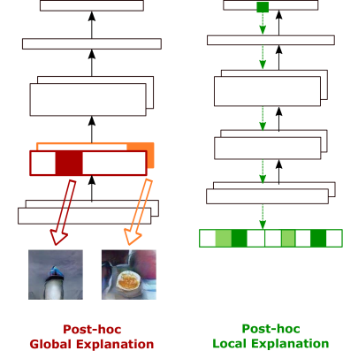
Local vs Global Interpretability
Local Interpretability: Explain individual predictions (causal relations between input and corresponding output) → why a certain prediction?
Global Interpretability: Explain structures and parameters for a global understanding (inner workings & mechanisms) → how are predictions made?
Notes:
In terms of interpretability, one can differentiate between different types.
Local interpretability considers an individual prediction of a model, so it tries to explain why these inputs led to this prediction -> GDPR relevant
Global interpretability, on the other hand, is achieved by providing users with information on how the entire model functions globally by giving them the opportunity to examine the structures and parameters of the complex model in more detail. Global interpretability makes the inner mechanisms of the machine learning model more transparent

Slide 35
Intrinsic vs Post-hoc Interpretability
Intrinsic Interpretability:
self-explanatory models which integrate interpretability directly in the structure
Brown fur?
True
False
Fox
Black & white fur?
True
False
Black spots around eyes?
Lion
True
False
Panda
Zebra
Notes:
Furthermore, we can differentiate between intrinsic and post-hoc interpretability.
On the one hand, there are machine learning models that can be interpreted intrinsically; these are self-explanatory models that directly integrate interpretability. For example decision trees or regressions

Slide 36
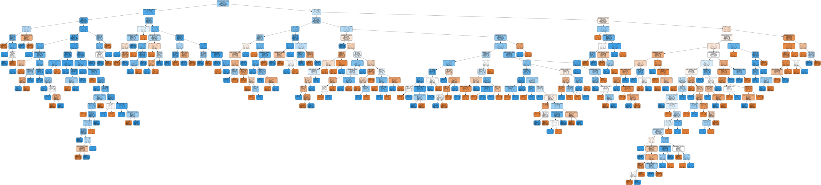
Intrinsic Interpretability
Notes:
But you may also remember decision tree we computed for the Titanic Data set in the tutorial which was also quite big and not easy to explain

Slide 37
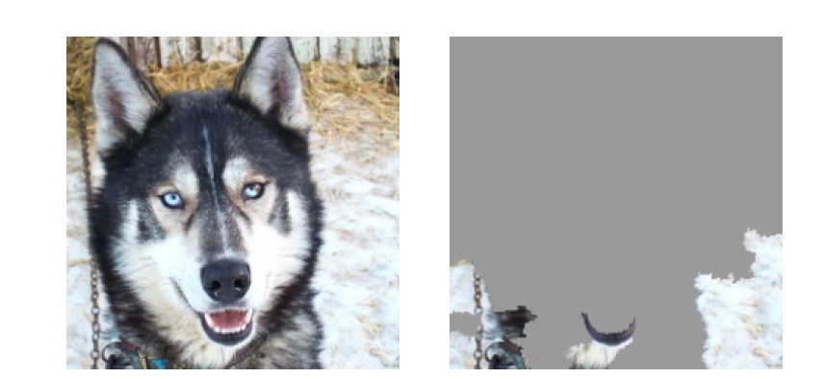
Intrinsic vs Post-hoc Interpretability
Intrinsic Interpretability:
self-explanatory models which integrate interpretability directly in the structure
Post-hoc Interpretability:
a second model is needed that creates explanations for the existing model
Brown fur?
True
False
Fox
Black & white fur?
True
False
Black spots around eyes?
Lion
True
False
Source: [Ribeiro et al. 2016]
Panda
Zebra
Notes:
On the other hand, we have machine learning models such as deep learning and neural networks, which cannot be explained by themselves. Here we need post-hoc interpretability, which requires a second model that creates explanations for the existing model.
It behaves similarly to the mental models: the explanation does not have to correspond exactly to the behavior, but it does explain the behavior

Slide 38
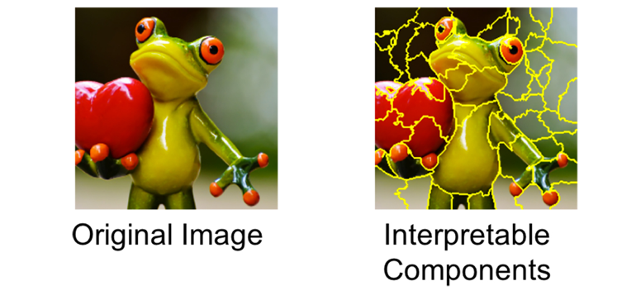
Local Interpretable Model-Agnostic Explanations (LIME)
Intuition
Divide input into interpretable components that
“make sense” to humans (e.g. words or parts of image)

Slide 39

Local Interpretable Model-Agnostic Explanations (LIME)
Intuition
Divide input into interpretable components that
“make sense” to humans (e.g. words or parts of image)
Generate random perturbations of data set

Slide 40
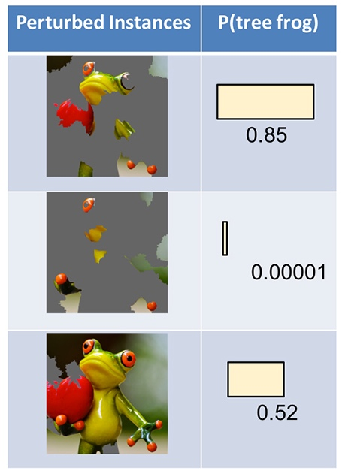
Local Interpretable Model-Agnostic Explanations (LIME)
Intuition
Divide input into interpretable components that
“make sense” to humans (e.g. words or parts of image)
Generate random perturbations of data set
Predict classes for these perturbations using your black box model

Slide 41

Local Interpretable Model-Agnostic Explanations (LIME)
Intuition
Divide input into interpretable components that
“make sense” to humans (e.g. words or parts of image)
Generate random perturbations of data set
Predict classes for these perturbations using your black box model
Weight the perturbations (importance) according to their proximity to the original input.

Slide 42
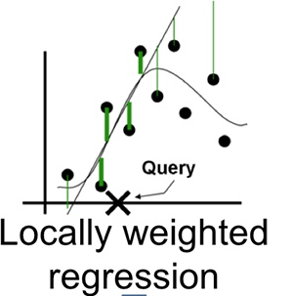
Local Interpretable Model-Agnostic Explanations (LIME)
Intuition
Divide input into interpretable components that
“make sense” to humans (e.g. words or parts of image)
Generate random perturbations of data set
Predict classes for these perturbations using your black box model
Weight the perturbations (importance) according to their proximity to the original input.
Train a weighted, interpretable model on the dataset with the variations.

Slide 43
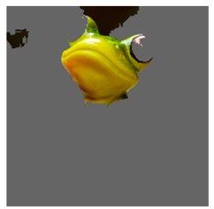
Local Interpretable Model-Agnostic Explanations (LIME)
Intuition
Divide input into interpretable components that
“make sense” to humans (e.g. words or parts of image)
Generate random perturbations of data set
Predict classes for these perturbations using your black box model
Weight the perturbations (importance) according to their proximity to the original input.
Train a weighted, interpretable model on the dataset with the variations.
Explain the prediction by interpreting the local model.

Slide 44
Local Interpretable Model-Agnostic Explanations (LIME)
Practical Example:
https://colab.research.google.com/github/arteagac/arteagac.github.io/blob/master/blog/lime_image.ipynb

Slide 45
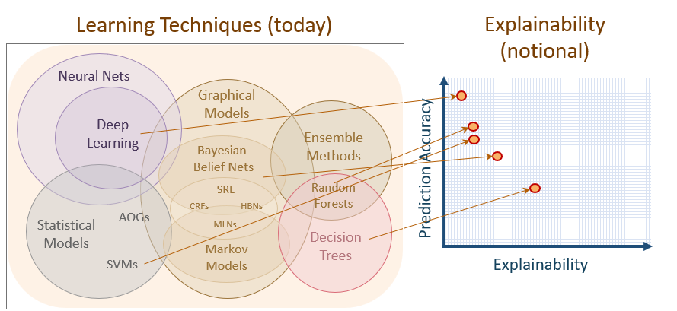
Trade-Off Interpretability & Accuracy
Notes:
Intrinsic interpretable models can provide precise and undistorted explanations, but unfortunately often have poorer performance. As you can see in the picture here, a higher prediction accuracy usually goes hand in hand with a worse explainability.

Slide 46
Overview
1
Transparency for Intelligent Systems
The Black Box Problem
Resulting Challenges for Society
Explainable AI
What Makes a Good Explanation
User Problems and Support
2
Transparency for Personality-Targeting
Personality and Personality-Targeting
Requirements for Explanations for Personality-Targeting
How to Trick AI
Notes:
- Example with decision tree, how can be now explain the output in human-understandable terms
- Remember GDPR

Slide 47
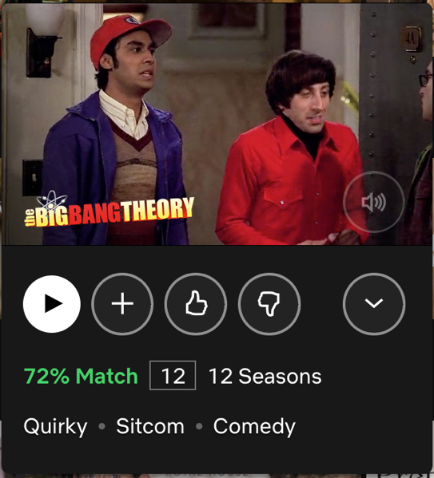

Discussion
How does Netflix explain why a movie / TV show is recommended to the user?
Do you think this explanation helps users?
Source: www.netflix.com
Discuss for 5min in breakout rooms

Slide 48

Challenges for HCI Research
Understand: Enable users to develop an appropriate mental model
Trust: Enable users to calibrate their trust in the model
Correct: Enable users to correct the model
Source: [Molnar 2019]
Notes:
Before, we looked at how you can make the black box models more interpretable so that they can be interpreted at all
Next, let's look at how - once we have the information about the model - we can explain it to the user
We are pursuing three goals:
Support users to develop an appropriate mental model of the processes, i.e. to understand the model
Help users to calibrate their confidence in the model so that they neither trust the model too much nor too little -> explain
And finally, support users in correcting the model in the event of errors

Slide 49
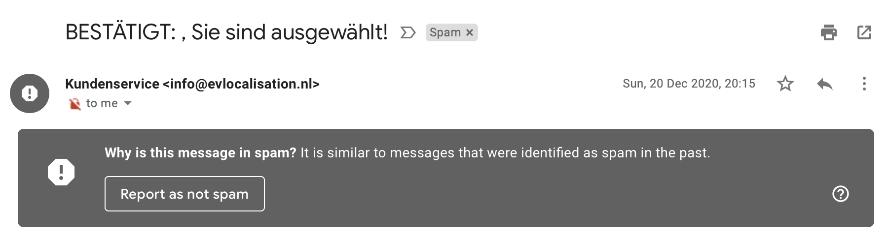
Local vs Global Explanation
Local Explanation
Source: mail.google.com
Notes:
Here, too, we can differentiate between a local explanation that explains to me why a certain decision was made, for example why a certain email was classified as spam
Even if you can argue here whether this explanation is really particularly helpful

Slide 50
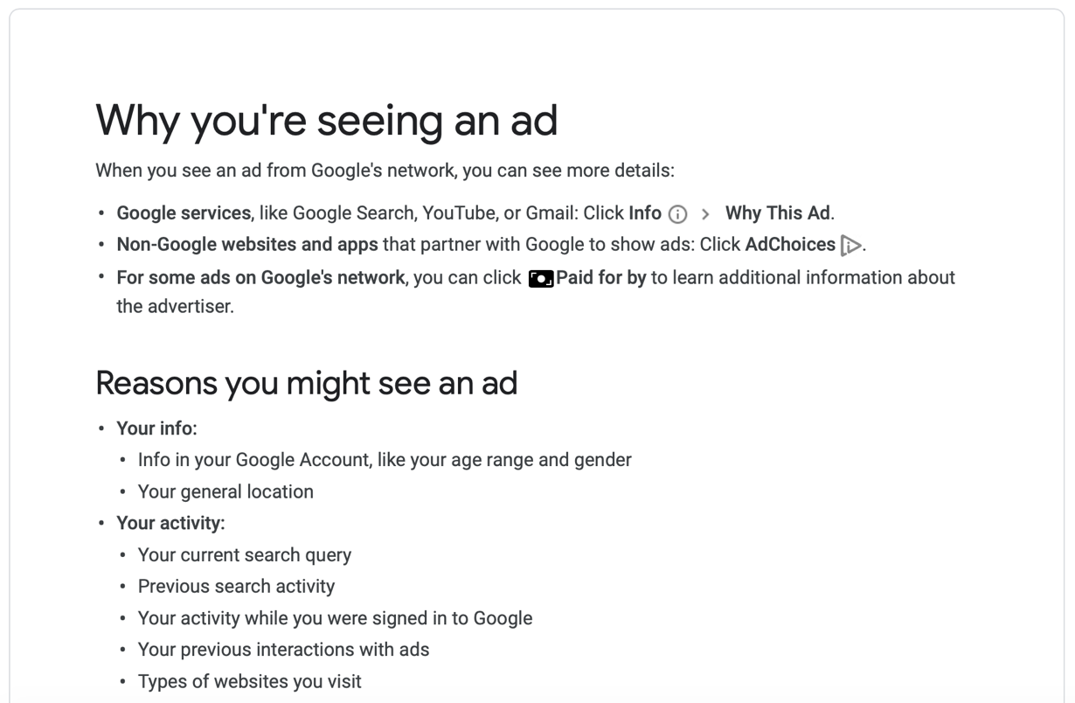
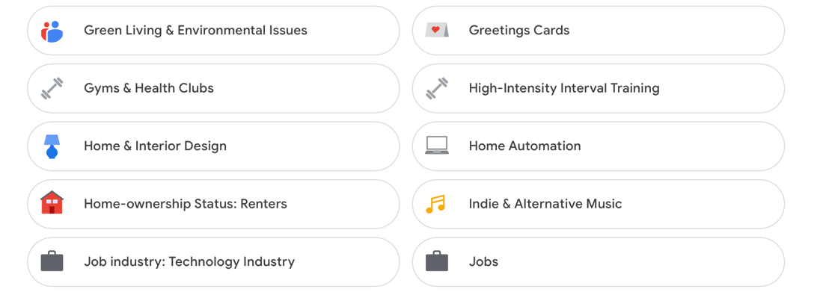
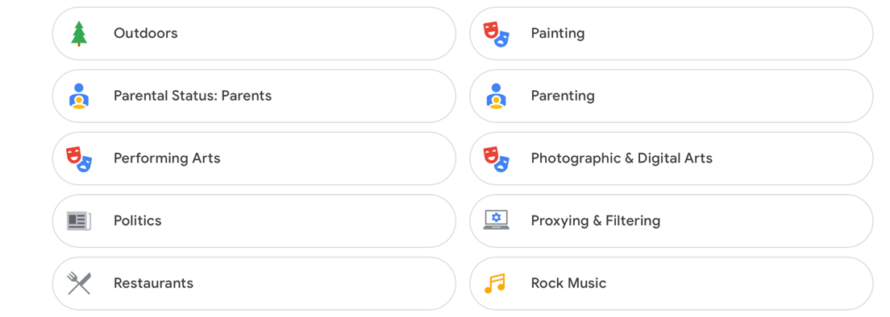
Local vs Global Explanation
Global Explanation
Source: https://adssettings.google.com
Notes:
Conversely, one can also try to give users an insight into the underlying mechanisms through global explanations.
So it does not explain individual decisions, but like here, for example, which information is used to personalize advertising on Google

Slide 51


What to Explain
Explanation Types
What?
Why?
Why not?
How to?
Inputs?
Outputs?
What if?
Certainty?
[Lim & Dey 2009, 2010, 2011]
Goals of Explanations
Transparency
Scrutability
Trust
Effectiveness
Persuasiveness
Efficiency
Satisfaction
[Tintarev & Masthoff 2012]
Notes:
Another challenge is what we should actually explain to users
Lim and Dey conducted several studies and came up 8 different explanation types, different questions that an explanation interface should answer
Most notably, an explanation interface should answer why it came to this decision
Tintarev and Masthoff looked into the goals that explanations in recommender systems should achieve
These goals are to some degree mutually exclusive so it is often not possible to fulfill all these goals to the same exten
Which goals are most important highly depends on the platform and context
I’ll show you this using some examples

Slide 52


Explanations in Today’s Systems
Transparency
Trust
Effectiveness
Persuasiveness
Satisfaction
“Why”
Explanation
Source: www.netflix.com
“Certainty” Explanation
Source: www.amazon.de

Slide 53

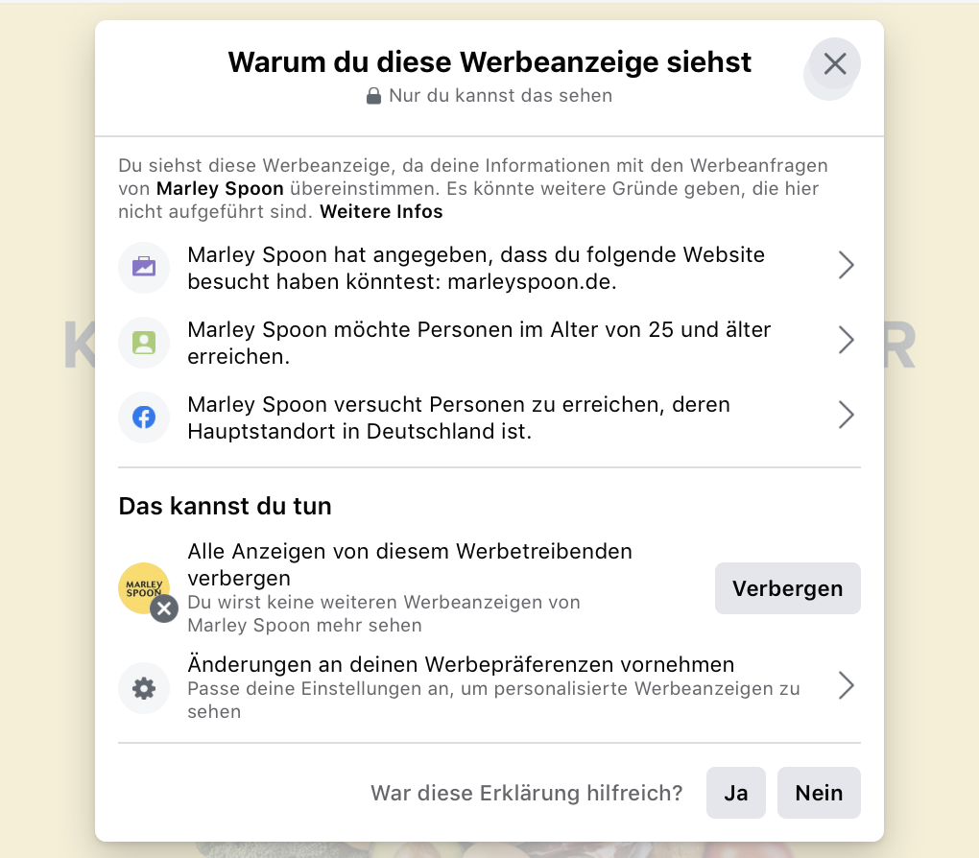
Explanations in Today’s Systems
“Inputs”
Explanation
“Why” Explanation
Transparency
Scrutability
Persuasiveness
Satisfaction
Source: www.facebook.com
Notes:
Wichtiger Aspekt: „Es könnte Gründe geben, die hier nicht aufgeführt sind.“

Slide 54
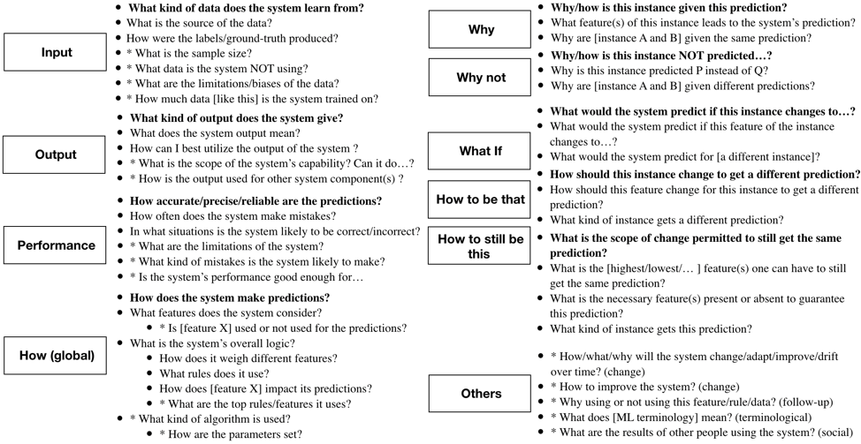
Which Questions Do Users Have?
Notes:
- Here you can see an algorithm-informed XAI question bank in which user needs for explainability are represented as prototypical questions users might ask about the AI
People want to be informed about the mistakes that biases a system has

Slide 55
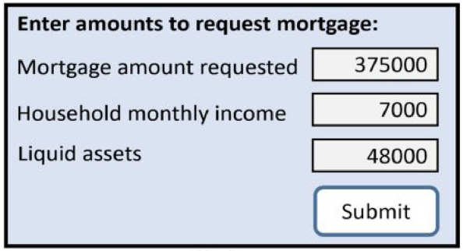
Insights from Social Sciences
Explanations are contrastive: Why X instead of Y?
Your Mortgage was rejected since your monthly income is smaller than your neighbour’s.
Source: [Shneiderman 2020]
Notes:
Explanations have long been researched before machine learning in social science. Hence, Miller has provided some directions towards user-oriented explanations, which might be more satisfying to humans as means of communication
Contrastive or counterfactual explanations do not tell why a specific prediction was made, but rather explain why this prediction was made instead of another, so as to answer questions like “Why Q rather than R?”
Here Q is the fact that requires explanation, and R is the comparing case, which could be a real one or virtual one.
Consider, for instance, a user is declined mortgage. The user may compare with another real case and raise question: “Why didn’t I get a mortgage when my neighborhood did?”
On the other hand, the user may ask: “Why was my mortgage rejected?”
Here is an implicit contrast case, and actually the user is requesting explanation for a virtual case “How to get my mortgage loan approved?”

Slide 56
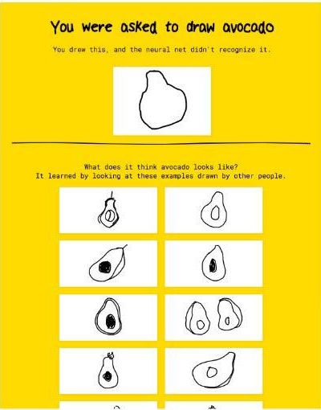
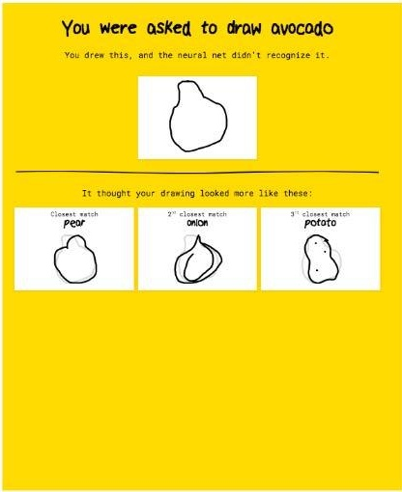
Contrastive example-based Explanations
Improves Undertrust
Avoids Overtrust
Normative Explanations
Comparative Explanations
Notes:
Normative explanations (left) establish a norm for the target class by showing training examples from that class (e.g. avocado).
Comparative explanations (right) show the most similar training example from each of the hypothesized classes (e.g. pear, onion, potato), overlaid on top of the user’s input so that users can compare their own drawing to those most-similar examples.

Slide 57
Insights from Social Sciences
Explanations are contrastive: Why C instead of Y?
Explanations are selective: Show the most important information that contributed to a decision (at the cost of completeness)
Notes:
Selective explanations. Usually, users do not expect an explanation can cover the complete cause of a decision.
Instead, they wish the explanation could convey the most important information that contributes to the decision.
A sparse explanation, which includes a minimal set of features that help justify the prediction is preferred, although incompletely.
Still use the mortgage case for example. One good explanation could be presenting users the top two reasons contributing to the decision, such as poor credit history or low income to debt ratio.

Slide 58
Explanations Are Selective
Source: www.facebook.com
Notes:
For Facebook‘s explanation why a particular ad was shown, we can also see a limited set of explanations
„There could be further reasons“

Slide 59
Insights from Social Sciences
Explanations are contrastive: Why C instead of Y?
Explanations are selective: Show the most important information that contributed to a decision (at the cost of completeness)
Explanations are credible: Be consistent with users‘ prior knowledge
Your mortgage was rejected because you have an A-level degree.
Source: [Shneiderman 2020]
Notes:
Good explanation have to be consistent with prior knowledge of general users.
Suppose the generated top reasons for the mortgage case include marital status is single and education status is high school graduate, then it would be less trustable than an explanation outputting poor credit history and low income to debt ratio, since the latter two are more reasonable causes leading to rejection.
Low credibility could be caused by the poor fidelity of explanation to the original model. On the other hand, the explanations maybe faithful, however, the machine learning model does not adopt correct evidences to make decisions.

Slide 60
Insights from Social Sciences
Explanations are contrastive: Why C instead of Y?
Explanations are selective: Show the most important information that contributed to a decision (at the cost of completeness)
Explanations are credible: Be consistent with users‘ prior knowledge
Explanations are conversational: Who reads an explanation? Allow users to raise queries
Notes:
Explanations might be delivered as a conversation between the explainer and explanation receivers.
It means we must consider the social context, that is, to whom an explanation is provided, in order to determine the content and formats of explanations.
For instance, a preferred format is verbal explanation if it is explaining to lay-users.

Slide 61

Explanations Are Conversational
What happens if…
Why not also book X?
Source: www.amazon.de
Why this book first?
Notes:
For example, this explanation by Amazon as to why specific books are recommended, uses the prhases: “customers who bought these articles, also bought..”
This phrase is more suitable when addressing lay users than writing a technical explanation such as “these books were recommended using a collaborative filting algorithm”
However, the conversational explanation approach would take this further and would suggest to allow the user to query on the result, asking follow-up questions, for example “what happens if…”

Slide 62
Post-hoc vs Interactive Explanations
Notes:
In user interface help systems, the designers found that post hoc explanations and error messages were difficult to design, leading them to shift to alternative methods
For example, exploratory user interfaces allow the users to probe the algorithm boundaries with different inputs
Exploration works best when the user inputs are actionable, that is, users have control and can change the inputs
Figures 2(a) and 2(b) show a post hoc explanation for a mortgage rejection, while Figure 2(c) shows an exploratory user interface that enables users to investigate how their input choices affect the outcome, thereby reducing the need for explanations
In general, exploratory user interfaces are welcomed by users who spend more time developing an understanding of the sensitivity of variables and digging more deeply into aspects that interest them, leading to greater satisfaction and compliance with recommendations

Slide 63
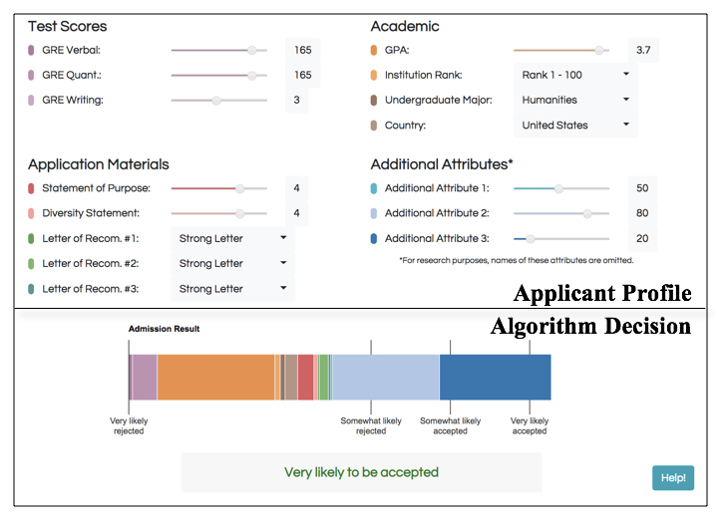
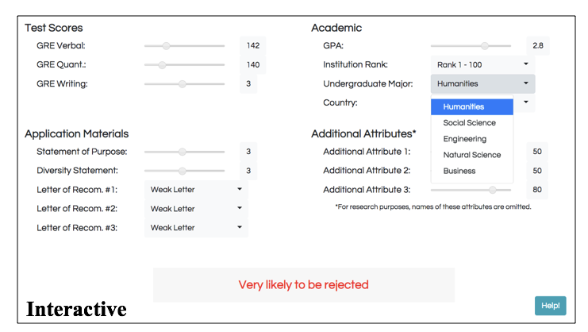
Interactive Explanations
Notes:
A recent trend is to make the explanation system interactive so users can drill down until they are satisfied with their understanding.
Here you can see another example for an application profile
Left: post-hoc white box explanations: how much does each aspect contribute to the decision
Right: interactive approach
While the interactive approach is more comprehensive, it is more timely

Slide 64

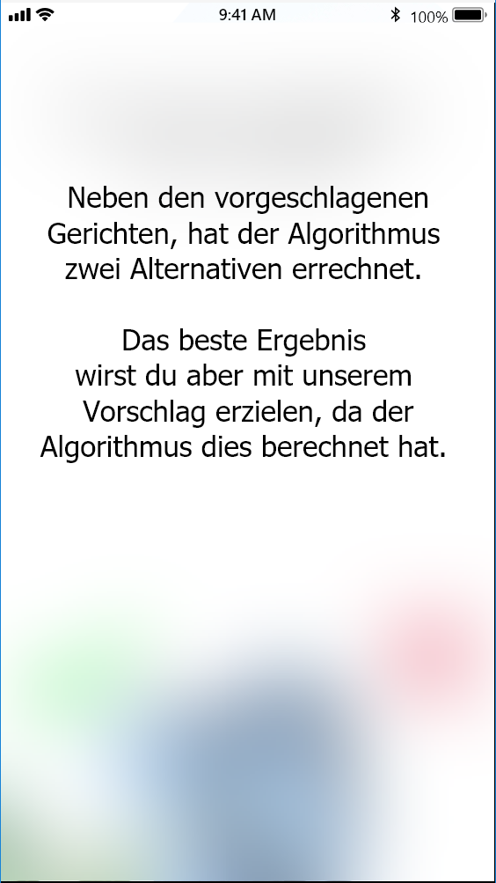
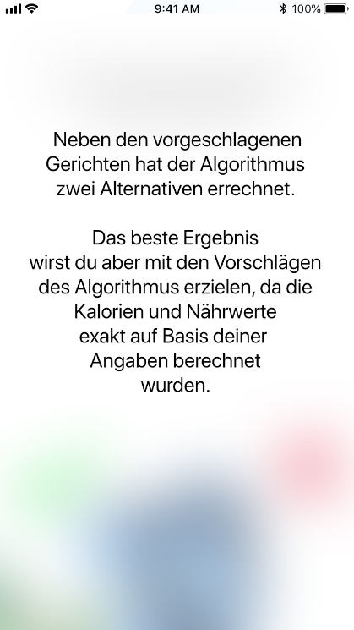
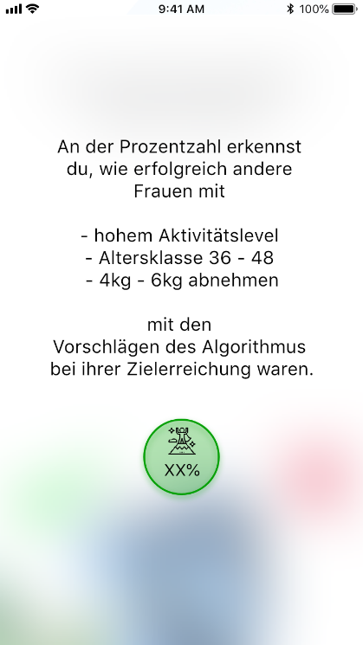
Placebo Explanations
No Explanation
Placebo Explanation
Actual Explanation
Notes:
Work in social psychology on interpersonal interaction [5] has demonstrated that people are more likely to comply to a request if they are presented with a justification – even if this justification conveys no information
Copy machine study (1977): no explanation: May I use the xerox machine, placebic: May I use the xerox machine, because I have to make copies, actual: May I use the xerox machine, because I’m in a rush
Placebo explanations may invoke a similar level of trust than real explanations

Slide 65
Discussion
How would you improve Netflix’ explanation of why a particular movie was recommended?
Source: www.netflix.com
Discuss for 5min in breakout rooms
Notes:
Based on what we discussed: how would you improve Netflix’ explanations?

Slide 66
Overview
1
Transparency for Intelligent Systems
The Black Box Problem
Resulting Challenges for Society
Explainable AI
What Makes a Good Explanation
User Problems and Support
2
Transparency for Personality-Targeting
Personality and Personality-Targeting
Requirements for Explanations for Personality-Targeting
How to Trick AI

Slide 67



Which Problems Do Users Face?
The app crashes too often
What is an algorithm?
Notes:
How do you find out what problems users have with intelligent systems?
The most obvious answer, of course, is to simply ask.
The problem, however, is that users often fail to understand terms like “algorithm” or report usability problems

Slide 68
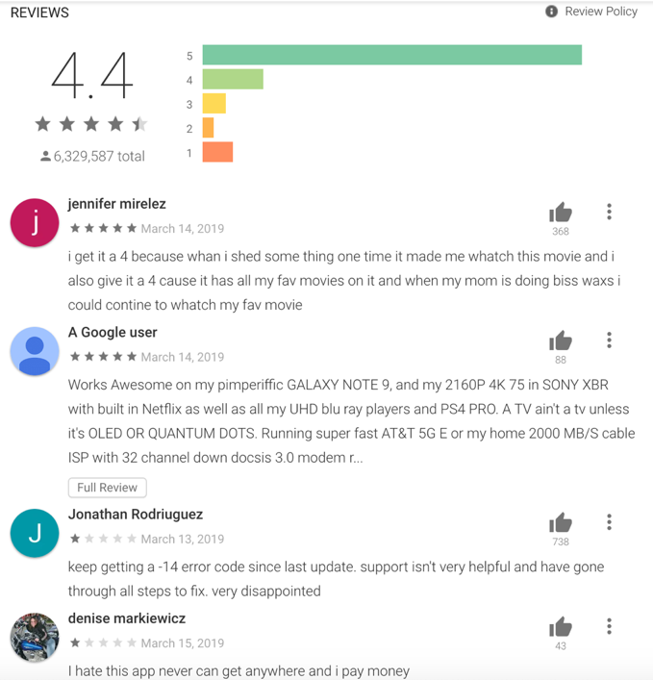
Research Design
1
Reviews
2
Topic Modeling
3
Problems
Problem 1
Problem 2
Problem 3
…
Problem n
Source: play.google.com
Notes:
In one of our research projects, we therefore developed a new method that is based on user reviews
Ratings or reviews, such as those found in the Google Play Store or on Amazon, reflect the attitudes of users towards an app and document the experiences they have had
As a first step, we therefore downloaded tens of thousands of reviews from the Google Play Store for the Google Maps, Facebook and Netflix apps
We then clustered the reviews using topic modeling. Topic Modeling is an unsupervised machine learning technique that automatically creates clusters based on text properties
We then analyzed these clusters manually in order to identify the users' problems

Slide 69

Research Design
1
2
3
4
Reviews
5
Topic Modeling
6
Problems
Scenarios
Online Survey
System Support
1
How often did you encounter a similar situation?
Problem 1
Scenario 1
Problem 2
Scenario 2
2
How did you cope with this situation?
Problem 3
Scenario 3
3
How could the app support you in this situation?
…
…
Problem n
Scenario n
Source: play.google.com
Notes:
Then we turned these problems into scenarios.
In an online survey, we showed test subjects these scenarios and asked them to indicate whether they had experienced this situation and, if so, what support they would have wished for in this case
Based on the suggestions of almost 300 participants, we then derived possible support strategies

Slide 70
Support Strategies
Notes:
You can see an overview of all support strategies here. If you are interested in this topic, please have a look at our paper.
In the following I would like to introduce you to two problems that we extracted based on the reviews, as well as possible solution strategies

Slide 71
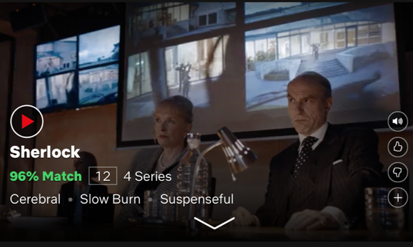
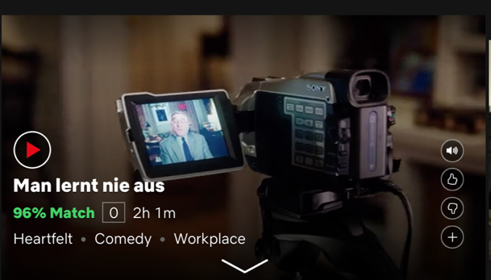



Lack of Feedback Opportunities
Source: www.netflix.com
Eden Thomson
August 3, 2018
The rating system is still horrible, every movie I look at says 98% match like how am I supposed to know if I should actually watch the movie if every movie is a match. Bring back the star system. […]
Bildquelle: eigene Anfertigung
Notes:
One point of criticism of intelligent systems was, for example, the lack of feedback options.
For example, users complain about the ability to give feedback about the film suggestions that Netflix makes them. This user writes that the “safety” explanation, the probability of how high the film is a match, doesn't help her because she has so many high hits.
She would therefore like to give more granular feedback, as she notes here in this review.

Slide 72

Lack of Feedback Opportunities
Source: www.netflix.com
“Suggest movies which only match my movies by 50% but have been received good ratings (by other users).“
“The system should show me more TV shows that all people like [….], not only those that I will probably like.”
Notes:
For example, the respondents in the online survey suggested that they wanted a higher variance of film suggestions, i.e. not only suggestions that were a very high match, but also lower matches
With this, the users hope to get a greater variety and new tips

Slide 73
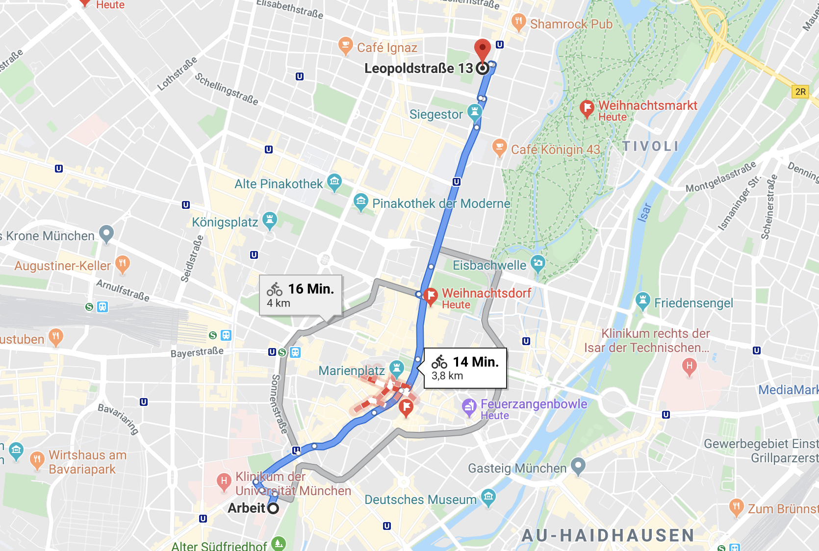
Lack of User Control
Charlotte Brooks
July 20, 2018
I choose [a route] because I want to take the s[ce]nic route. Then, without telling me just puts me back on the quickest route. Which drives me insane - not everyone its trying to get places fast some of us like to see the world while do it.
Source: www.maps.google.de
Notes:
Another problem that users often addressed in reviews is the lack of user control. For example, users reported that Google Maps overwrites their decisions. You have chosen a route that is not the shortest, for example because the landscape is more beautiful. Google maps then overwrites this decision and selects the shortest route again.
For example, something similar happens to me when I ride my bike through downtown Munich. Google Maps always wants to send me across the city center, even though this is a pedestrian zone. Although I have already noted this several times on Google Maps, the error still happens and Google Maps tries to change my selected route while driving

Slide 74
Lack of User Control
“Ask for permission bevor the route is changed.”
“At least offer the option “Don‘t change’.”
Source: www.maps.google.de
Notes:
To solve this problem, users * suggested in the online survey that permission should be asked before the route is changed or that at least the option should be offered that a route set by the user should not be changed .

Slide 75

Take Aways
Machine learning models are black boxes which are opaque to developers and end users
As a consequence, there are several challenges for individual users as well as society when employing machine learning
Machine learning models have to be explainable – either by choosing intrinsic or post-hoc models
Explanations have to be designed carefully to be easily understandable

Slide 76
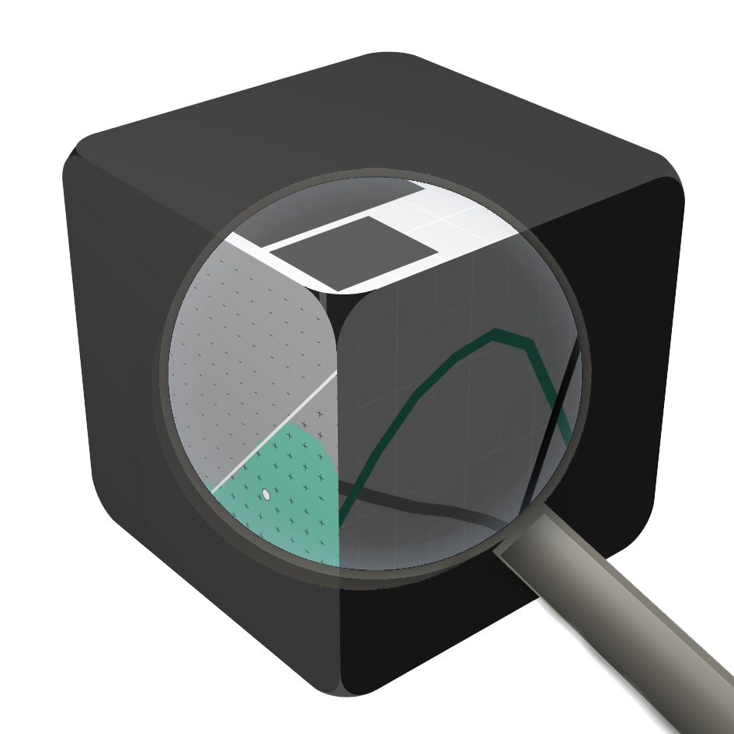
Beyond Explainability
Trustworthy Certification:
External Reviews
Safety Culture:
Organisational Design
Reliable Systems:
Software Engineering
Source: Courtesy of Quay Au

Slide 77
Overview
1
Transparency for Intelligent Systems
The Black Box Problem
Resulting Challenges for Society
Explainable AI
What Makes a Good Explanation
User Problems and Support
2
}
Transparency for Personality-Targeting
Personality and Personality-Targeting
Online
Requirements for Explanations for Personality-Targeting
How to Trick AI

Slide 78
Thank you to Malin Eiband and Michael Chromik
- who contributed to earlier versions of this slide deck

Slide 79
References
Balise Agüera y Arcas, Alexander Todorov, and Margaret Mitchell. 2018. Do algorithms reveal sexual orientation or just expose our stereotypes? https://medium.com/@blaisea/do-algorithms-reveal-sexual-orientation-or-just-expose-our-stereotypes-d998fafdf477
Danny Azucar, Davide Marengo, and Michele Settanni. 2018. Predicting the Big 5 personality traits from digital footprints on social media: A meta-analysis. Personality and individual differences 124: 150-159. DOI: https://doi.org/10.1016/j.paid.2017.12.018
Joshua Benton. 2019. As Notre Dame burned, an algorithmic error at YouTube put information about 9/11 under news videos. https://www.niemanlab.org/2019/04/as-notre-dame-burned-an-algorithmic-error-at-youtube-put-information-about-9-11-under-news-videos/
Jenna Burrell. 2016. How the machine ‘thinks’: Understanding opacity in machine learning algorithms. Big Data & Society 3, no. 1. DOI: https://doi.org/10.1177/2053951715622512
Carrie J. Cai, Jonas Jongejan, and Jess Holbrook. 2019. The effects of example-based explanations in a machine learning interface. In Proceedings of the 24th International Conference on Intelligent User Interfaces (IUI '19). Association for Computing Machinery, New York, NY, USA, 258–262. DOI:https://doi.org/10.1145/3301275.3302289
Rich Caruana, Yin Lou, Johannes Gehrke, Paul Koch, Marc Sturm, and Noemie Elhadad. 2015. Intelligible Models for HealthCare: Predicting Pneumonia Risk and Hospital 30-day Readmission. In Proceedings of the 21th ACM SIGKDD International Conference on Knowledge Discovery and Data Mining (KDD '15). Association for Computing Machinery, New York, NY, USA, 1721–1730. DOI:https://doi.org/10.1145/2783258.2788613
Hao-Fei Cheng, Ruotong Wang, Zheng Zhang, Fiona O'Connell, Terrance Gray, F. Maxwell Harper, and Haiyi Zhu. 2019. Explaining Decision-Making Algorithms through UI: Strategies to Help Non-Expert Stakeholders. In Proceedings of the 2019 CHI Conference on Human Factors in Computing Systems (CHI '19). Association for Computing Machinery, New York, NY, USA, Paper 559, 1–12. DOI:https://doi.org/10.1145/3290605.3300789
Finale Doshi-Velez and Been Kim. 2017. Towards a rigorous science of interpretable machine learning. arXiv preprint arXiv:1702.08608. https://arxiv.org/abs/1702.08608
Mengnan Du, Ninghao Liu, and Xia Hu. 2019. Techniques for Interpretable Machine Learning. Commun. ACM 63, 1 (December 2019), 68–77. DOI: https://doi.org/10.1145/3359786
Malin Eiband, Sarah Theres Völkel, Daniel Buschek, Sophia Cook, and Heinrich Hussmann. 2019. When People and Algorithms Meet: User-reported Problems in Intelligent Everyday Applications. In Proceedings of the 24th International Conference on Intelligent User Interfaces (IUI ’19). ACM, New York, NY, USA, 96–106. DOI: http://dx.doi.org/10.1145/3301275.3302262

Slide 80
References
Malin Eiband, Daniel Buschek, Alexander Kremer, and Heinrich Hussmann. 2019. The Impact of Placebic Explanations on Trust in Intelligent Systems. In Extended Abstracts of the 2019 CHI Conference on Human Factors in Computing Systems (CHI EA '19). Association for Computing Machinery, New York, NY, USA, Paper LBW0243, 1–6. DOI: https://doi.org/10.1145/3290607.3312787
Motahhare Eslami, Sneha R. Krishna Kumaran, Christian Sandvig, and Karrie Karahalios. 2018. Communicating Algorithmic Process in Online Behavioral Advertising. In Proceedings of the 2018 CHI Conference on Human Factors in Computing Systems (CHI '18). ACM, New York, NY, USA, Article Paper 432, 13 pages. DOI: http://dx.doi.org/10.1145/3173574.3174006
Kevin Eykholt, Ivan Evtimov, Earlence Fernandes, Bo Li, Amir Rahmati, Chaowei Xiao, Atul Prakash, Tadayoshi Kohno, and Dawn Song. 2018. Robust physical-world attacks on deep learning visual classification. In Proceedings of the IEEE Conference on Computer Vision and Pattern Recognition, pp. 1625-1634. http://openaccess.thecvf.com/content_cvpr_2018/papers/Eykholt_Robust_Physical-World_Attacks_CVPR_2018_paper.pdf
Ian J. Goodfellow, Jonathon Shlens, and Christian Szegedy. 2014. Explaining and harnessing adversarial examples. arXiv preprint arXiv:1412.6572. https://arxiv.org/pdf/1412.6572.pdf
Guardian. 2018. https://www.theguardian.com/technology/2018/oct/10/amazon-hiring-ai-gender-bias-recruiting-engine
David Gunning. 2017. Explainable Artificial Intelligence (XAI). Defense Advanced Research Projects Agency (DARPA), nd Web, 2. https://www.darpa.mil/attachments/XAIProgramUpdate.pdf
Karen Hao. 2019. AI is sending people to jail—and getting it wrong. https://www.technologyreview.com/2019/01/21/137783/algorithms-criminal-justice-ai/
Simon Hurtz. 2019. Youtube verwechselt Feuer in Paris mit 9/11. Süddeutsche Zeitung. https://www.sueddeutsche.de/digital/paris-notre-dame-youtube-algorithmus-filter-1.4411910
Shagun Jhaver, Yoni Karpfen, and Judd Antin. 2018. Algorithmic Anxiety and Coping Strategies of Airbnb Hosts. In Proceedings of the 2018 CHI Conference on Human Factors in Computing Systems (CHI ’18). ACM, New York, NY, USA, Article 421, 12 pages. DOI: https://doi.org/10.1145/3173574.3173995
Kevin Eykholt, Ivan Evtimov, Earlence Fernandes, Bo Li, Amir Rahmati, Chaowei Xiao, Atul Prakash, Tadayoshi Kohno, and Dawn Song. 2018. Robust physical-world attacks on deep learning visual classification. In Proceedings of the IEEE Conference on Computer Vision and Pattern Recognition, pp. 1625-1634. http://openaccess.thecvf.com/content_cvpr_2018/papers/Eykholt_Robust_Physical-World_Attacks_CVPR_2018_paper.pdf
Ian J. Goodfellow, Jonathon Shlens, and Christian Szegedy. 2014. Explaining and harnessing adversarial examples. arXiv preprint arXiv:1412.6572. https://arxiv.org/pdf/1412.6572.pdf

Slide 81
References
Guardian. 2018. https://www.theguardian.com/technology/2018/oct/10/amazon-hiring-ai-gender-bias-recruiting-engine
David Gunning. 2017. Explainable Artificial Intelligence (XAI). Defense Advanced Research Projects Agency (DARPA), nd Web, 2. https://www.darpa.mil/attachments/XAIProgramUpdate.pdf
Karen Hao. 2019. AI is sending people to jail—and getting it wrong. https://www.technologyreview.com/2019/01/21/137783/algorithms-criminal-justice-ai/
Simon Hurtz. 2019. Youtube verwechselt Feuer in Paris mit 9/11. Süddeutsche Zeitung. https://www.sueddeutsche.de/digital/paris-notre-dame-youtube-algorithmus-filter-1.4411910
Shagun Jhaver, Yoni Karpfen, and Judd Antin. 2018. Algorithmic Anxiety and Coping Strategies of Airbnb Hosts. In Proceedings of the 2018 CHI Conference on Human Factors in Computing Systems (CHI ’18). ACM, New York, NY, USA, Article 421, 12 pages. DOI: https://doi.org/10.1145/3173574.3173995
Kayser-Brill, Nicolas. 2020a. Female historians and male nurses do not exist, Google Translate tells its European users. Algorithm Watch. https://algorithmwatch.org/en/story/google-translate-gender-bias/
Kayser-Brill, Nicolas. 2020b. Dutch city uses algorithm to assess home value, but has no idea how it works. Algorithm Watch. https://algorithmwatch.org/en/story/woz-castricum-gdpr-art-22/
Been Kim, Rajiv Khanna, and Oluwasanmi O. Koyejo. "Examples are not enough, learn to criticize! criticism for interpretability." Advances in neural information processing systems 29 (2016): 2280-2288.
Logan Kugler. 2018. AI judges and juries. Commun. ACM 61, 12 (December 2018), 19–21. DOI:https://doi.org/10.1145/3283222
Sam Levin. 2017. New AI can guess whether you're gay or straight from a photograph. Guardian. https://www.theguardian.com/technology/2017/sep/07/new-artificial-intelligence-can-tell-whether-youre-gay-or-straight-from-a-photograph
Q. Vera Liao, Daniel Gruen, and Sarah Miller. 2020. Questioning the AI: Informing Design Practices for Explainable AI User Experiences. Proceedings of the 2020 CHI Conference on Human Factors in Computing Systems. Association for Computing Machinery, New York, NY, USA, 1–15. DOI:https://doi.org/10.1145/3313831.3376590
Brian Y. Lim and Anind K. Dey. 2009. Assessing demand for intelligibility in context-aware applications. In Proceedings of the 11th international conference on Ubiquitous computing (UbiComp '09). ACM, New York, NY, USA, 195-204. DOI: https://doi.org/10.1145/1620545.1620576

Slide 82
References
Brian Y. Lim and Anind K. Dey. 2010. Toolkit to support intelligibility in context-aware applications. In Proceedings of the 12th ACM international conference on Ubiquitous computing (UbiComp '10). ACM, New York, NY, USA, 13-22. DOI: https://doi.org/10.1145/1864349.1864353
Brian Y. Lim and Anind K. Dey. 2011. Design of an Intelligible Mobile Context- aware Application. In Proceedings of the 2011 International Conference on Human Computer Interaction with Mobile Devices and Services (MobileHCI ’11). ACM, New York, NY, USA, 157–166. https://doi.org/10.1145/2037373.2037399
Sandra C. Matz, Michal Kosinski, Gideon Nave, and David J. Stillwell. 2017. Psychological targeting as an effective approach to digital mass persuasion. Proceedings of the national academy of sciences 114, no. 48: 12714-12719. https://doi.org/10.1073/pnas.1710966114
Robert R. McCrae and Paul T. Costa, Jr. 2008. The five-factor theory of personality. In O. P. John, R. W. Robins, & L. A. Pervin (Eds.), Handbook of personality: Theory and research (p. 159–181). The Guilford Press.
Tim Miller. 2019. Explanation in artificial intelligence: Insights from the social sciences. Artificial Intelligence 267: 1-38. DOI: https://doi.org/10.1016/j.artint.2018.07.007
Christoph Molnar. 2019. Interpretable Machine Learning: A Guide for Making Black Box Models Explainable. https://christophm.github.io/interpretable-ml-book/
Hervé Phaure and Erwan Robin. 2020. Explain Artificial Intelligence for Credit Risk Management. Deloitte. https://www2.deloitte.com/content/dam/Deloitte/fr/Documents/risk/Publications/deloitte_artificial-intelligence-credit-risk.pdf
Marco Tulio Ribeiro, Sameer Singh, and Carlos Guestrin. 2016. "Why Should I Trust You?": Explaining the Predictions of Any Classifier. In Proceedings of the 22nd ACM SIGKDD International Conference on Knowledge Discovery and Data Mining (KDD '16). Association for Computing Machinery, New York, NY, USA, 1135–1144. DOI:https://doi.org/10.1145/2939672.2939778
Ben Shneiderman. 2020. Bridging the Gap Between Ethics and Practice: Guidelines for Reliable, Safe, and Trustworthy Human-centered AI Systems. ACM Trans. Interact. Intell. Syst.10, 4, Article 26 (December 2020), 31 pages. DOI:https://doi.org/10.1145/3419764
Clemens Stachl, Quay Au, Ramona Schoedel, Samuel D. Gosling, Gabriella M. Harari, Daniel Buschek, Sarah Theres Völkel et al. 2020. Predicting personality from patterns of behavior collected with smartphones. Proceedings of the National Academy of Sciences 117, no. 30: 17680-17687. DOI: https://doi.org/10.1073/pnas.1920484117

Slide 83
References
Nava Tintarev and Judith Masthoff. 2012. Evaluating the effectiveness of explanations for recommender systems. User Modeling and User-Adapted Interaction 22.4-5: 399-439. DOI: https://doi.org/10.1007/s11257-011-9117-5
Sarah Theres Völkel, Renate Haeuslschmid, Anna Werner, Heinrich Hussmann, and Andreas Butz. 2020. How to Trick AI: Users' Strategies for Protecting Themselves from Automatic Personality Assessment. Proceedings of the 2020 CHI Conference on Human Factors in Computing Systems. Association for Computing Machinery, New York, NY, USA, 1–15. DOI:https://doi.org/10.1145/3313831.3376877
Yilun Wang and Michal Kosinski. 2018. Deep neural networks are more accurate than humans at detecting sexual orientation from facial images. Journal of personality and social psychology 114.2: 246. DOI: https://doi.org/10.1037/pspa0000098
Julia K. Winkler, Christine Fink, Ferdinand Toberer, Alexander Enk, Teresa Deinlein, Rainer Hofmann-Wellenhof, Luc Thomas et al. 2019. Association between surgical skin markings in dermoscopic images and diagnostic performance of a deep learning convolutional neural network for melanoma recognition. JAMA dermatology 155, no. 10: 1135-1141. DOI:10.1001/jamadermatol.2019.1735
Yudkowsky, Eliezer. 2008. Artificial Intelligence as a Positive and Negative Factor in Global Risk. In Global Catastrophic Risks, edited by Nick Bostrom and Milan M. Ćirković, 308–345. New York: Oxford University Press. https://intelligence.org/files/AIPosNegFactor.pdf

