Slide 1


Introduction to Intelligent User Interfaces
Introduction into Human-Robot Interaction

Slide 2
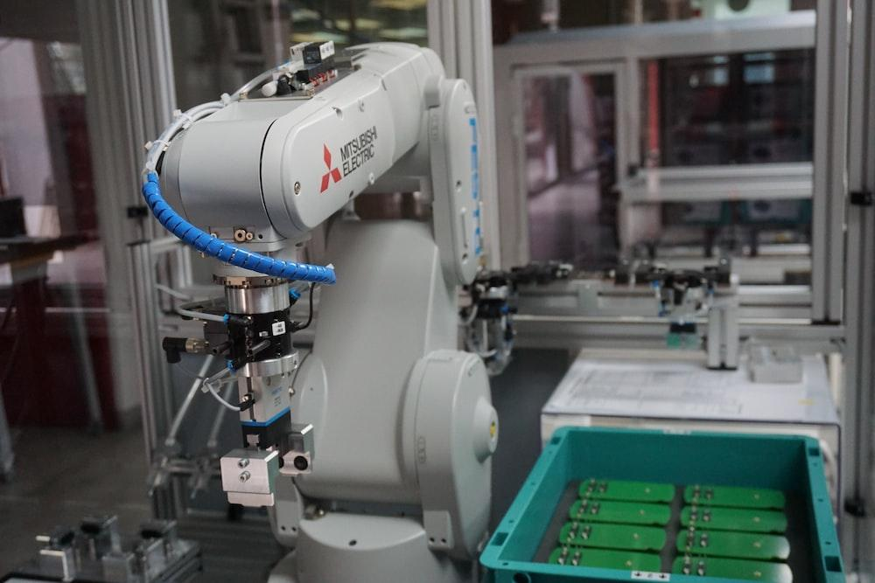
Motivation of PhD Topic
Notes:
So lets start with the motivation of my topic and also todays talk.
For now robots are mostly used in industry settings to do the heavy lifting tasks and automated tasks for us
These robots are mostly operated with out any direct human input or contact.
Often times it would even be dangerous to get near these robots, due to the forces they can output.

Slide 3
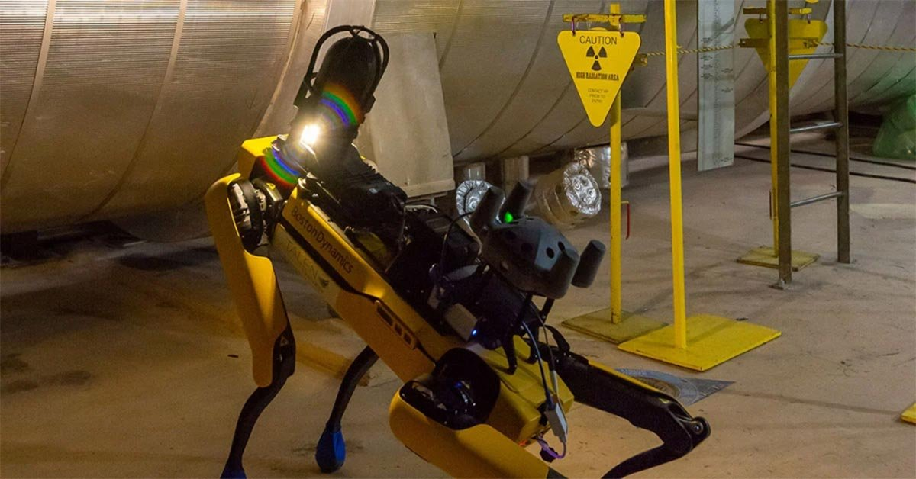
Motivation of PhD Topic
https://www.bostondynamics.com/resources/blog/how-much-radiation-can-spot-withstand
Notes:
Robots are also great for these scenarios where humans cant go, due to in this case radiation
However, these robots still often times require human input to solve problems they cant solve on their own.

Slide 4
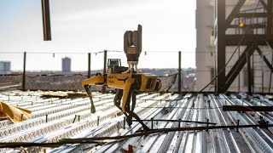
Human-Robot Interaction

Slide 5
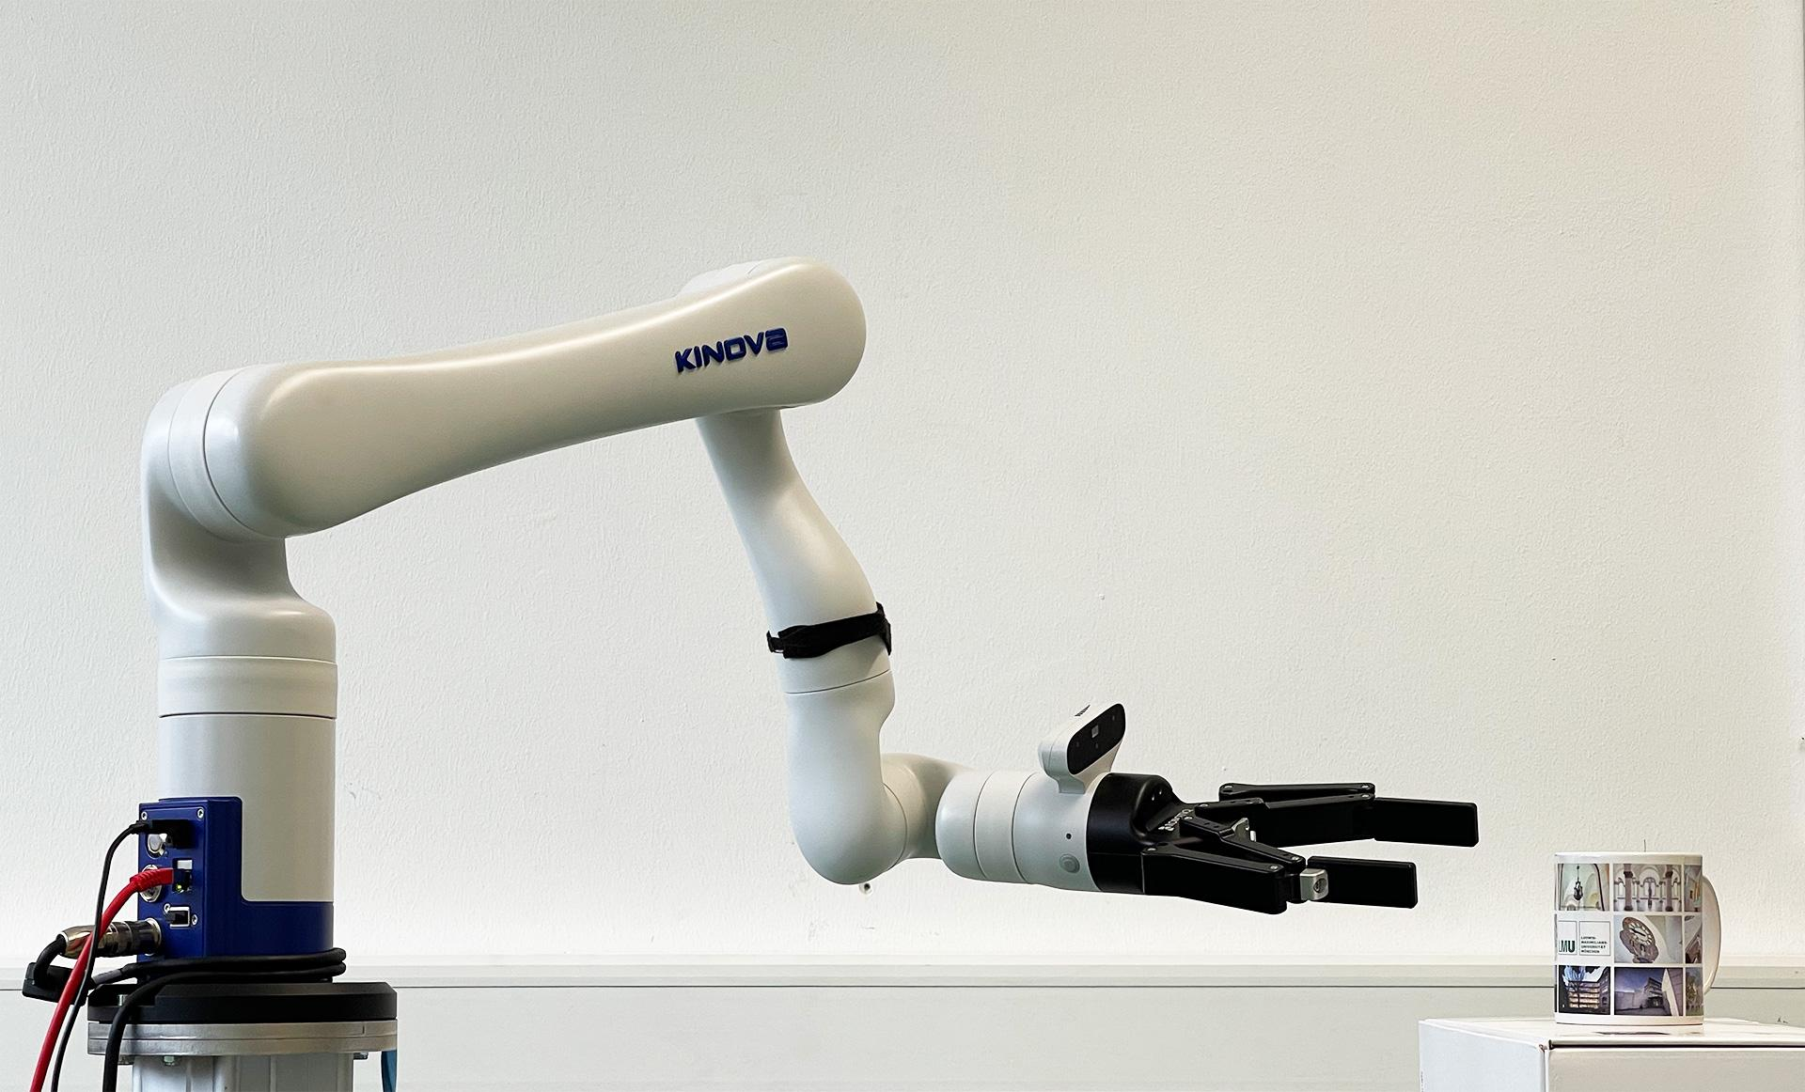
Motivation of PhD Topic
Notes:
Nowadays, there are now also collaborative robots, which can already do more human like tasks.
They are used for direct human interaction in shared spaces.
How should future interaction with them look like?

Slide 6
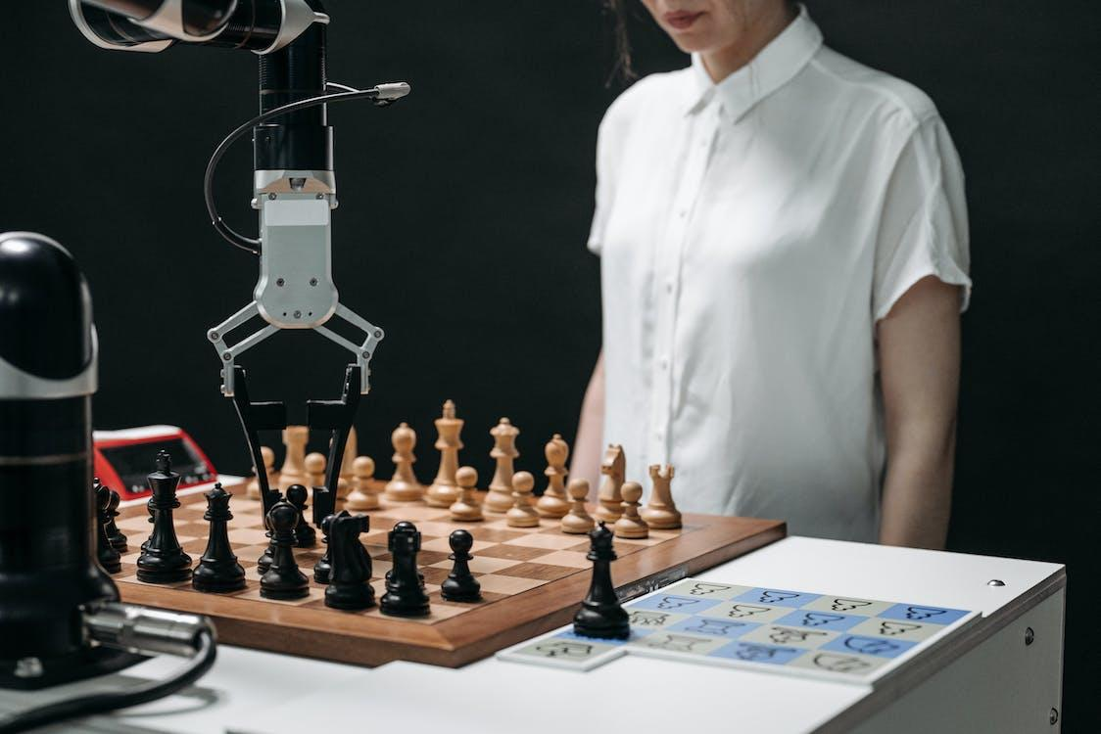
Notes:
This way we can directly interact with robots, like we would do with humans.
In this case it is obviously the same as playing against a chess computer on a game level.
But seeing the robot taking the turns is making the whole thing a bit more tangible.

Slide 7
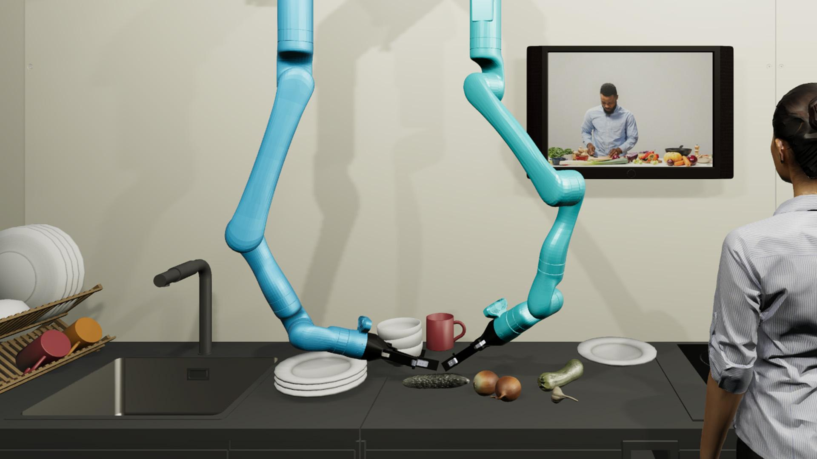
Motivation of PhD Topic
Carl Oechsner, Sven Mayer, Andreas Butz (2022) Challenges and Opportunities of Cooperative Robots as Cooking Appliances. In Proc. of the 2022 Workshop on Engaging with Automation.
Notes:
In other cases, this tangibility is not only nice to have but can help with various household tasks like helping to cook etc.
Not only how the robot moves – but also how does the robot decide – dialogue between robot and human
Doorbell ring example
Elderly example

Slide 8
Human-Robot Interaction != Robotics
HRI
Robotics
Interaction, communication, and collaboration between humans and robots in the social world
Creation, design, construction, and operation of robots
Human-Robot Interaction
Notes:
https://www.youtube.com/watch?v=2QX-yESGaHY
https://www.human-robot-interaction.org/

Slide 9
Human-Robot Interaction
HRI is a subfield of HCI, which includes a physical, embodied entity - robots.
Challenges of HRI are often times more diverse due to the inclusion of physical movements, sensors, and the need to understand human social cues.
Main differences:
  Interaction Entity: Robotic systems instead of traditional computing devices
  Communication Medium: verbal communication, gestures, physical manipulation, AR instead of GUIs, touchscreens, and keyboards & mice
  Purpose: Emphasis on integration of robots into human environments. Aim is to create effective, safe, and intuitive interactions between humans and robots
  Scope: Applied domains like healthcare, manufacturing, entertainment, and domestic settings in shared spaces
HRI focuses on developing robots that can interact with people in various everyday environments.
Human-Robot Interaction

Slide 10
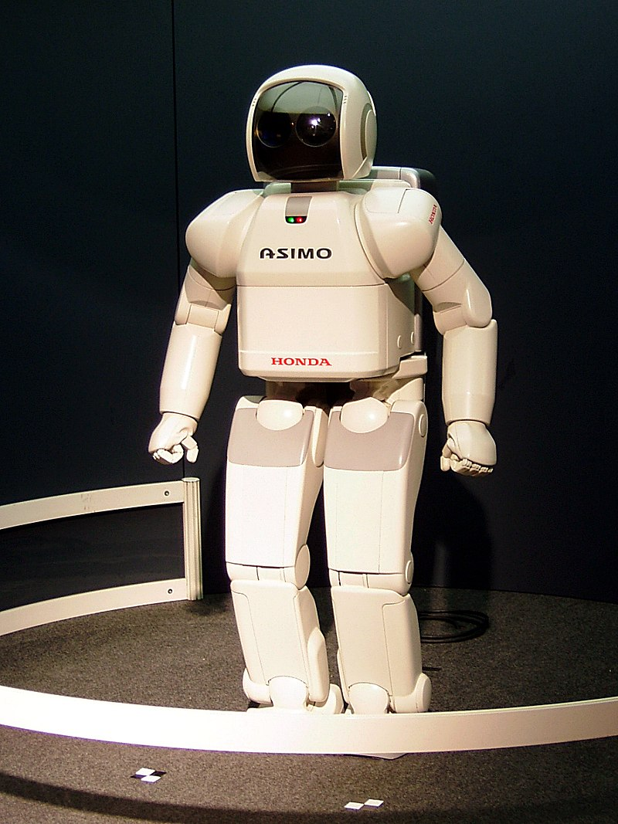
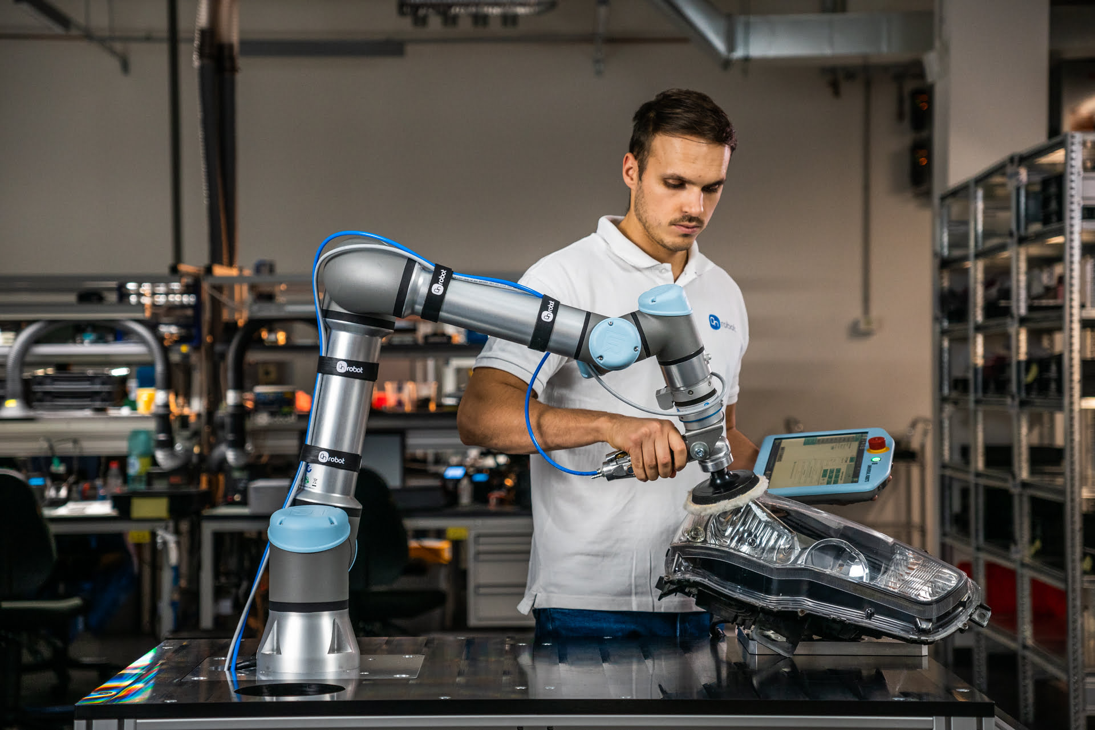
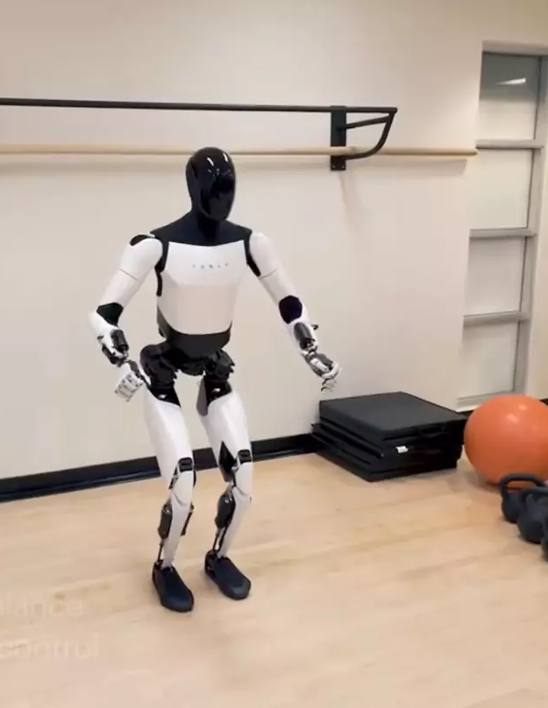
Advances in Robotics enable HRI Research
Humanoid Robots
Sensory enhancements
Collaborative Robots (Cobots)
Better build quality
Advances in AI
  Natural language processing
  Gesture Recognition
Human-Robot Interaction

Slide 11
Domains of HRI Research
Accessibility
Supporting Elderly
Educating Children
Supporting Communication
Supporting with Household Tasks
Human-Robot Interaction
Notes:
https://dl.acm.org/doi/pdf/10.1145/3568162.3576999

Slide 12
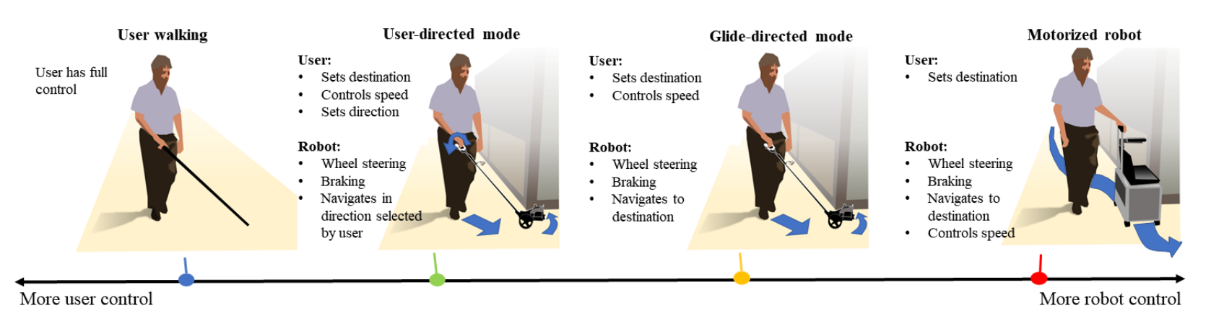
Accessibility
Exploring Levels of Control for a Navigation Assistant for Blind Travelers
Robot guiding blind people while walking
Different levels of user and robot control
Users prefer different levels of autonomy
Ranganeni, V., Sinclair, M., Ofek, E., Miller, A., Campbell, J., Kolobov, A., & Cutrell, E. (2023, March). Exploring Levels of Control for a Navigation Assistant for Blind Travelers. In Proceedings of the 2023 ACM/IEEE International Conference on Human-Robot Interaction (pp. 4-12).
Human-Robot Interaction

Slide 13
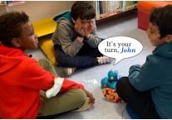
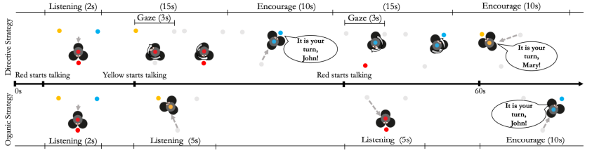
Accessibility
"The Robot Made Us Hear Each Other": Fostering Inclusive Conversations among Mixed-Visual Ability Children
Robot as mediator in conversations between children
Encouraging the least participative child to speak
Fosters inclusion in mixed-visual ability group conversations
Neto, I., Correia, F., Rocha, F., Piedade, P., Paiva, A., & Nicolau, H. (2023, March). The Robot Made Us Hear Each Other: Fostering Inclusive Conversations among Mixed-Visual Ability Children. In Proceedings of the 2023 ACM/IEEE International Conference on Human-Robot Interaction (pp. 13-23).
Human-Robot Interaction

Slide 14
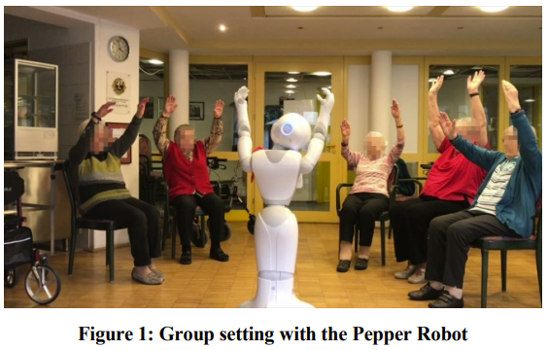
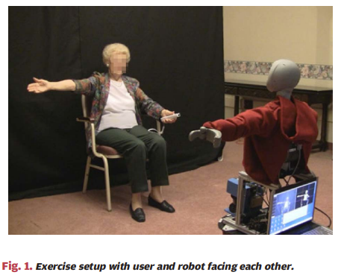
Supporting Elderly People
Socially Assistive Robots to support elderly
Humanoid robots (e.g., Pepper) can work in a care home, but moderating person is needed
Elderly residents are positively engaged in robot trainings sessions
Carros, F., Meurer, J., Löffler, D., Unbehaun, D., Matthies, S., Koch, I., ... & Wulf, V. (2020, April). Exploring human-robot interaction with the elderly: results from a ten-week case study in a care home. In Proceedings of the 2020 CHI Conference on Human Factors in Computing Systems (pp. 1-12).
Fasola, J., & Mataric, M. J. (2012). Using socially assistive human–robot interaction to motivate physical exercise for older adults. Proceedings of the IEEE, 100(8), 2512-2526.
Human-Robot Interaction

Slide 15
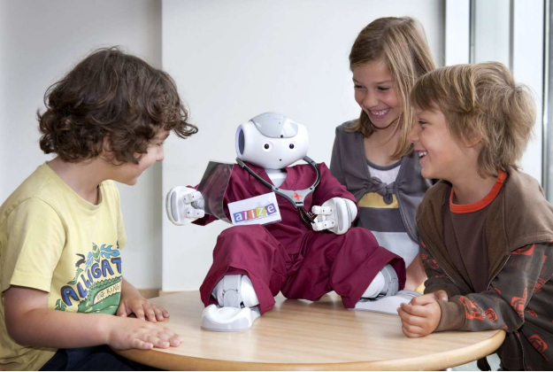
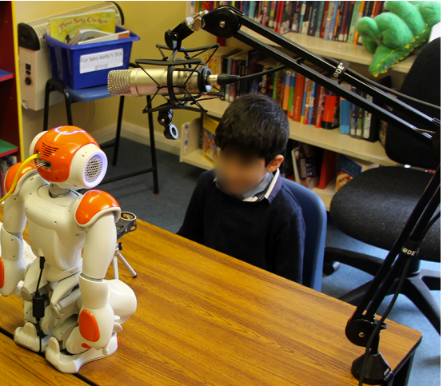
Supporting & Educating Children
NAO robot used for applied studies to train child speech and fostering interaction
Baxter, P., Belpaeme, T., Canamero, L., Cosi, P., Demiris, Y., Enescu, V., ... & Wood, R. (2011, March). Long-term human-robot interaction with young users. In IEEE/ACM human-robot interaction 2011 conference (robots with children workshop) (Vol. 80). IEEE/ACM.
Kennedy, J., Lemaignan, S., Montassier, C., Lavalade, P., Irfan, B., Papadopoulos, F., ... & Belpaeme, T. (2017, March). Child speech recognition in human-robot interaction: evaluations and recommendations. In Proceedings of the 2017 ACM/IEEE international conference on human-robot interaction (pp. 82-90).
Human-Robot Interaction

Slide 16
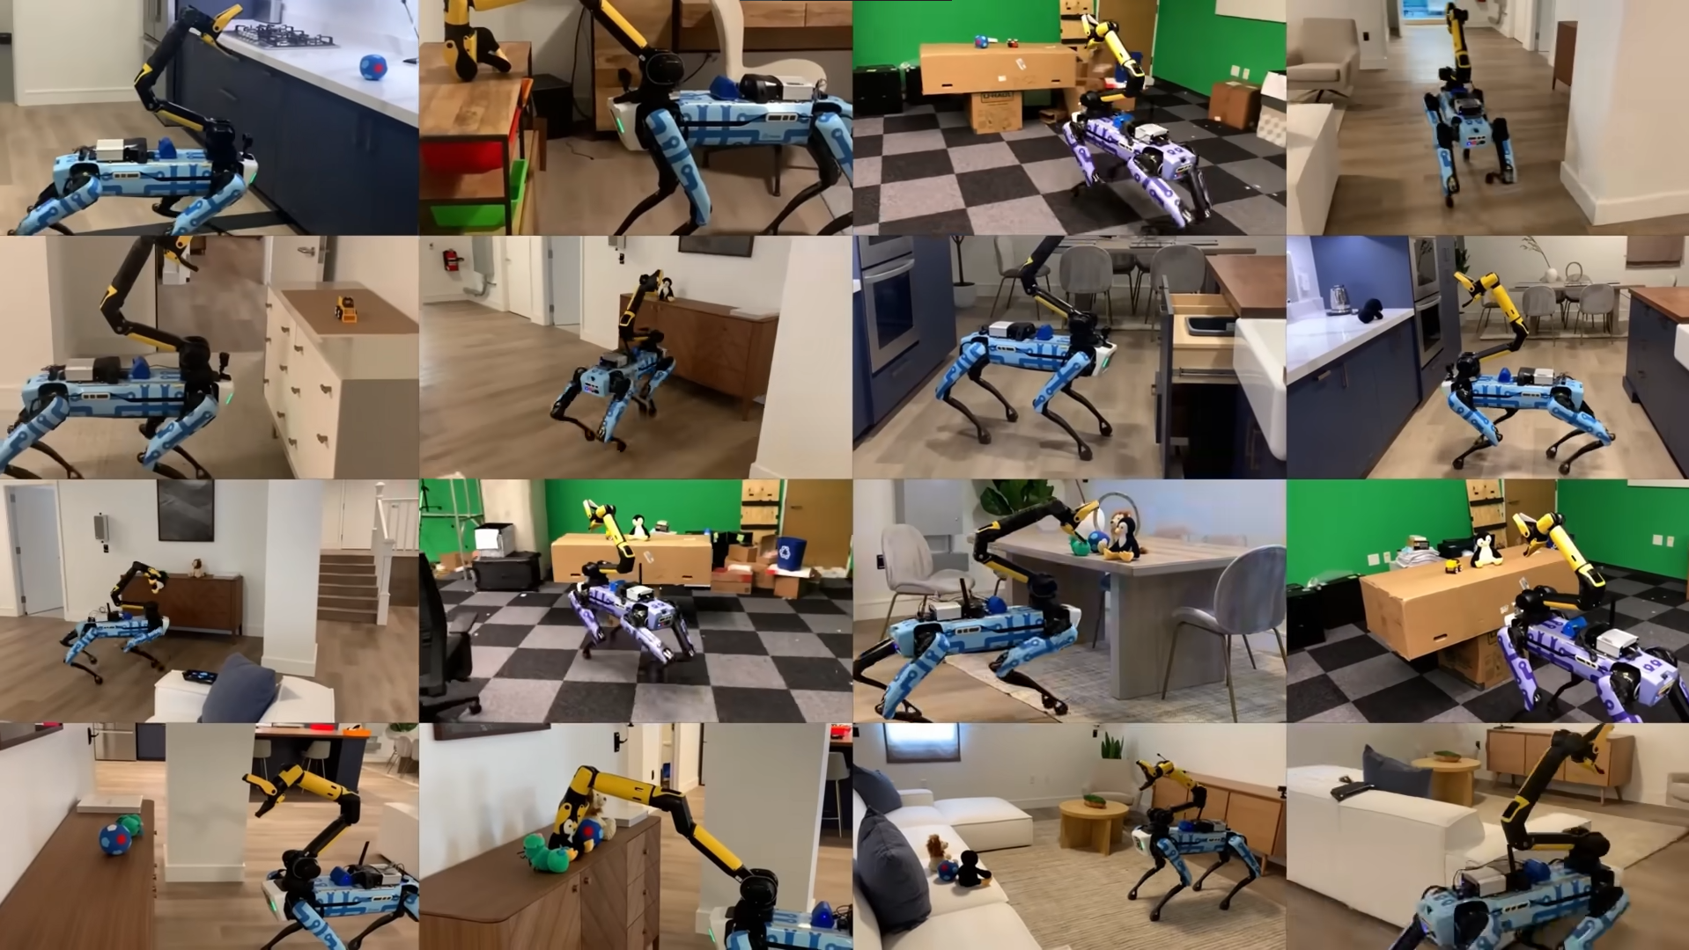
Robots in Domestic Settings
Human-Robot Interaction

Slide 17
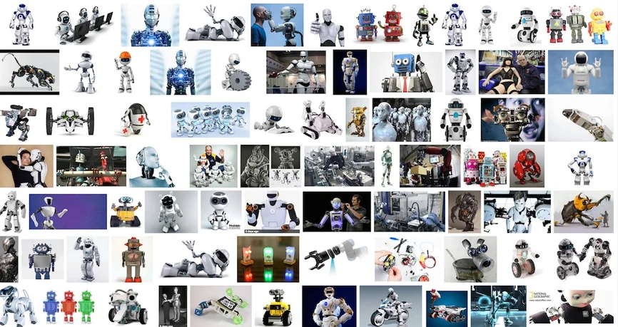
What is a Robot?
https://spectrum.ieee.org/robots-and-racism
Human-Robot Interaction

Slide 18

Humanoid Robots

Slide 19
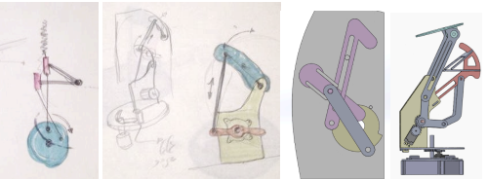
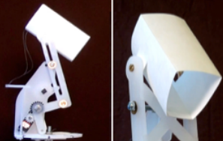
Non-humanoid Robots
Hoffman, G., Zuckerman, O., Hirschberger, G., Luria, M., & Shani Sherman, T. (2015, March). Design and evaluation of a peripheral robotic conversation companion. In Proceedings of the tenth annual ACM/IEEE international conference on human-robot interaction (pp. 3-10).
Human-Robot Interaction

Slide 20
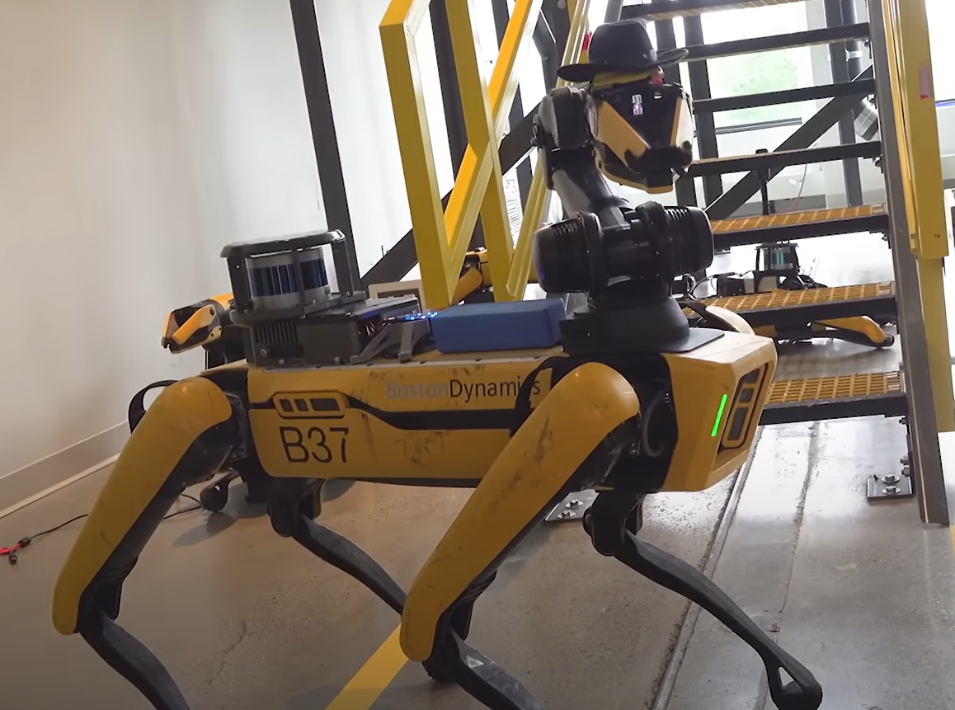
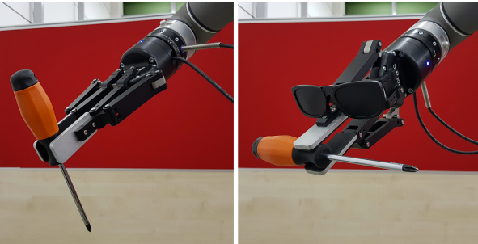
Anthropomorphism
Definition: Anthropomorphism is the idea that an object has feelings or characteristics like those of a human being. In other words, it means that humans regard the object as a person to communicate with, and moreover try to read its mind. [1]
Gradient in how many human traits we can describe a machine with
How to Measure: Godspeed Questionnaire [2]
Already minor adjustments can increase the levels of perceived anthropomorphism of non-humanoid robots [3]
[1] Ono, T.; Imai, M.; Ishiguro, H. (2000) Anthropomorphic communications in the emerging relationship between humans and robots. Proceedings 9th IEEE International Workshop on Robot and Human Interactive Communication. IEEE RO-MAN 2000.. https://doi.org/10.1109/roman.2000.892519
[2] Bartneck, C., Croft, E., Kulic, D. & Zoghbi, S. (2009) Measurement instruments for the anthropomorphism, animacy, likeability, perceived intelligence, and perceived safety of robots. International Journal of Social Robotics, https://doi.org/10.1007/s12369-008-0001-3
[3] Terzioğlu, Y., Mutlu, B., & Şahin, E. (2020, March). Designing social cues for collaborative robots: the role of gaze and breathing in human-robot collaboration. In Proceedings of the 2020 ACM/IEEE international conference on human-robot interaction (pp. 343-357).
Human-Robot Interaction
Notes:
https://www.youtube.com/watch?v=Lpp1FjkOyN4 (Lecture)

Slide 21
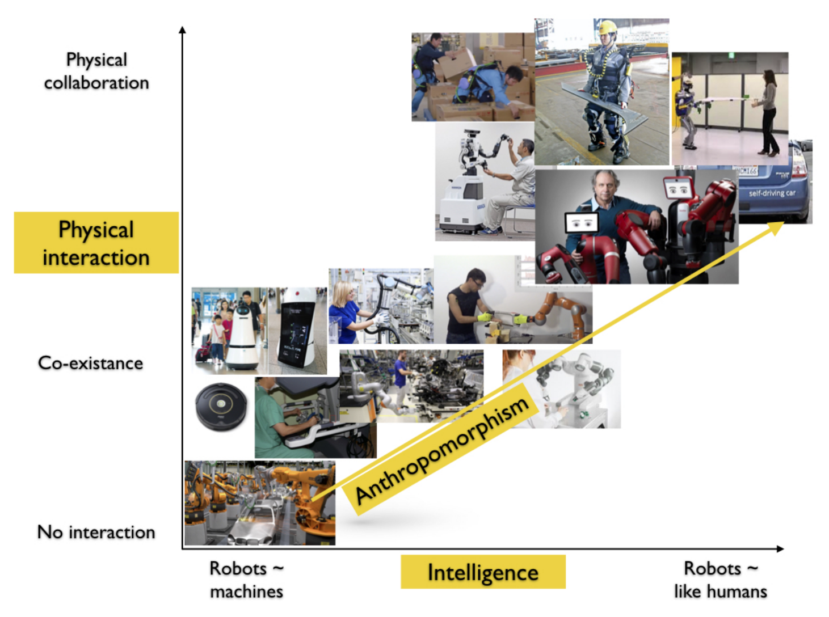
Ivaldi, S. (2018). Intelligent human-robot collaboration with prediction and anticipation. ERCIM news.
Human-Robot Interaction

Slide 22
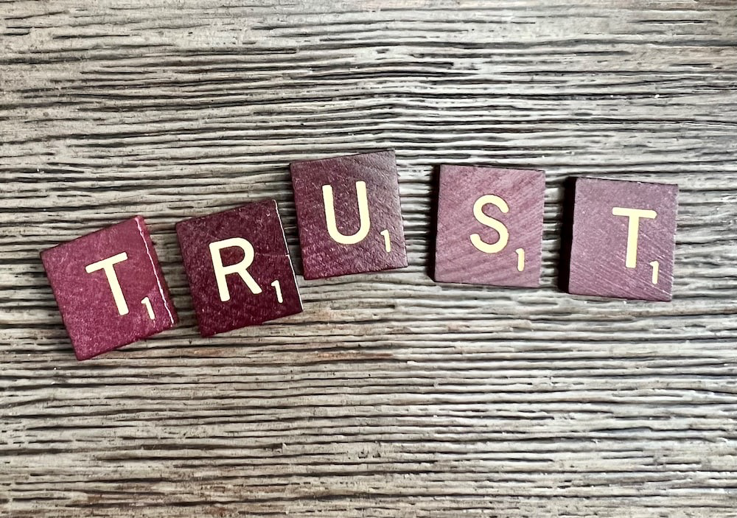
Trust in Human-Robot Interaction
The Psychology of Interpersonal Trust
“to believe that someone is good and honest and will not harm you, or that something is safe and reliable”
https://dictionary.cambridge.org/dictionary/english/trust
Human-Robot Interaction
Notes:
https://www.youtube.com/watch?v=Lpp1FjkOyN4 (Lecture)

Slide 23
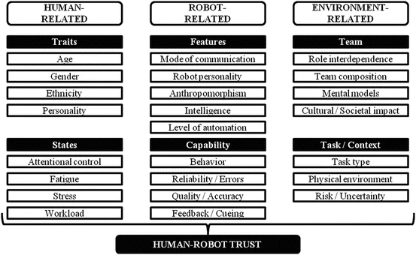
Trust in Human-Robot Interaction
What’s the difference between human-human trust and trust in computers/robots?
Schaefer, K. E. (2016). Measuring trust in human robot interactions: Development of the “trust perception scale-HRI”. In Robust intelligence and trust in autonomous systems (pp. 191-218). Boston, MA: Springer US.
Human-Robot Interaction
Notes:
https://www.youtube.com/watch?v=Lpp1FjkOyN4 (Lecture)

Slide 24
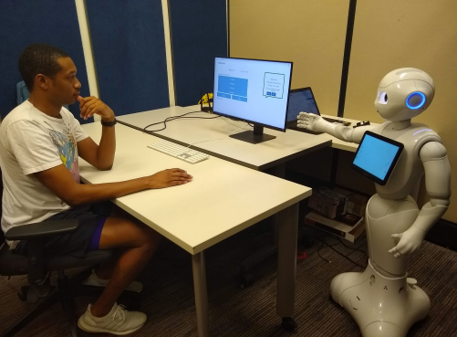
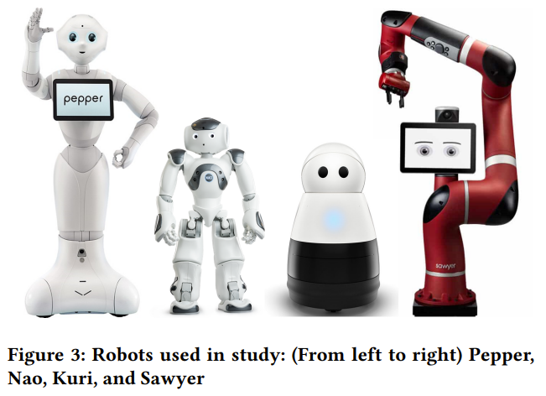
Trust and Anthropomorphism
Higher levels of anthropomorphism lead to higher level of trust [2]
Appearance and behaviour of robot can lead to overestimation of its functionality [1]
Perceived anthropomorphism is not only limited to the appearance of the robot but also its behaviour [3]
Users often assume and expect a humanoid robot can do everything another human could do based on its appearance [3]
[1] Sharkey, A., & Sharkey, N. (2021). We need to talk about deception in social robotics!. Ethics and Information Technology, 23, 309-316.
[2] Natarajan, M., & Gombolay, M. (2020, March). Effects of anthropomorphism and accountability on trust in human robot interaction. In Proceedings of the 2020 ACM/IEEE international conference on human-robot interaction (pp. 33-42).
[3] Złotowski, J., Proudfoot, D., Yogeeswaran, K., & Bartneck, C. (2015). Anthropomorphism: opportunities and challenges in human–robot interaction. International journal of social robotics, 7, 347-360.
Human-Robot Interaction
Notes:
https://www.youtube.com/watch?v=Lpp1FjkOyN4 (Lecture)

Slide 25
How can we use this Information? How can robots communicate their intents?

Slide 26
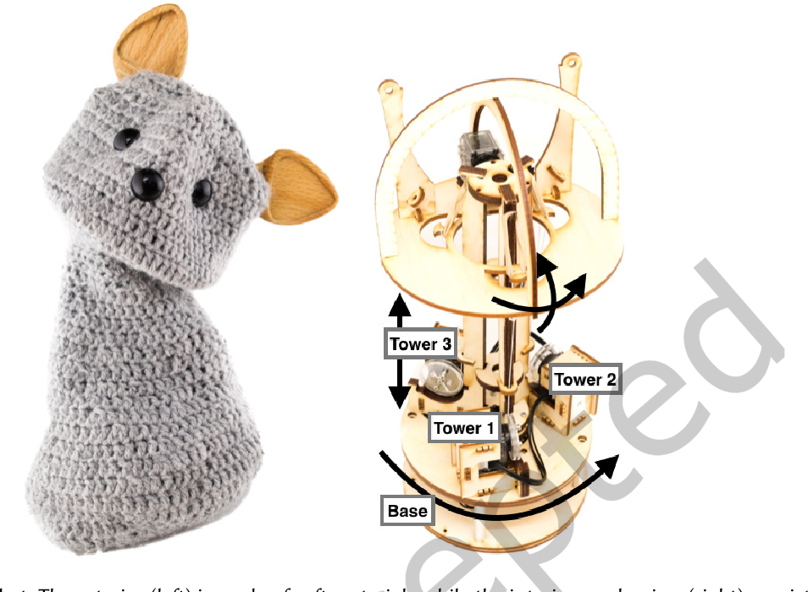
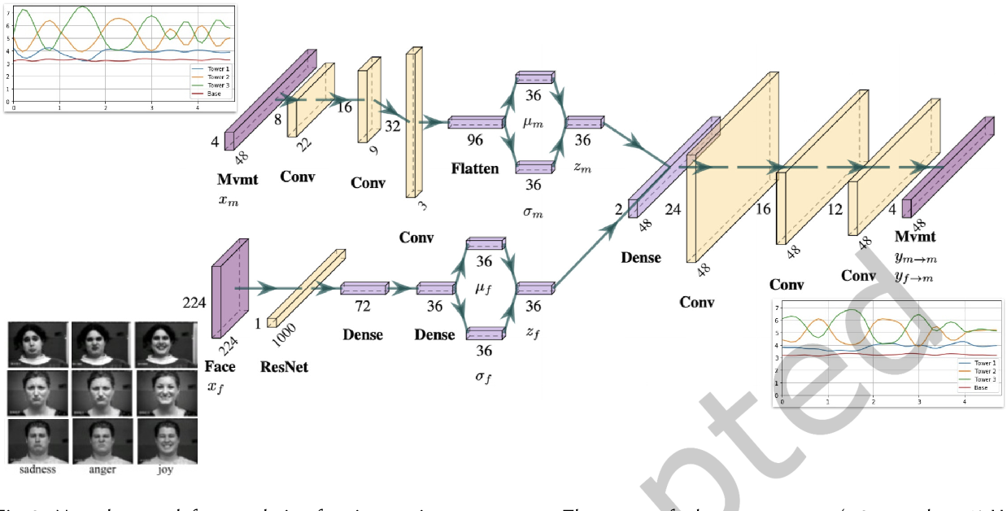
Understandability of Robot Expressions
Face2Gesture
Automatically generate and map affective robot movements to emotional facial expressions of humans
Suguitan, M., DePalma, N., Hoffman, G., & Hodgins, J. (2023). Face2Gesture: Translating Facial Expressions Into Robot Movements Through Shared Latent Space Neural Networks. ACM Transactions on Human-Robot Interaction.
Human-Robot Interaction
Notes:
So if we now know that humans tend to trust robots with higher levels of antropomorphsim more, and we want robots to use non-verbal communication to interact with us - a first idea is to make robots mimic humans with their communication. So for this there are two challenges: first creating these human like gestures, and second figuring out - do humans now also understand these gestures correctly

Slide 27
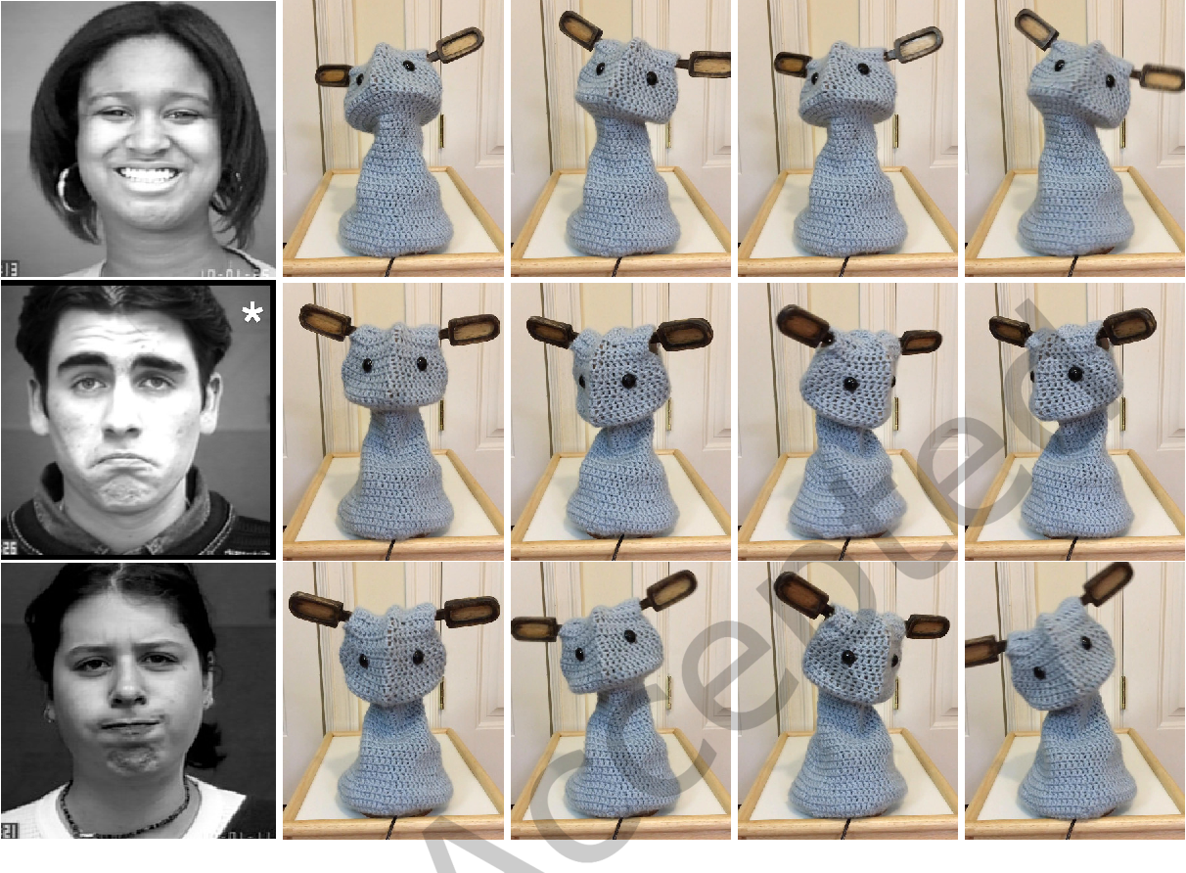
Understandability of Robot Expressions
Face2Gesture
Subjective user evaluation reveals that users could recognize happy and sad movements, but not angry
Suguitan, M., DePalma, N., Hoffman, G., & Hodgins, J. (2023). Face2Gesture: Translating Facial Expressions Into Robot Movements Through Shared Latent Space Neural Networks. ACM Transactions on Human-Robot Interaction.
Human-Robot Interaction

Slide 28
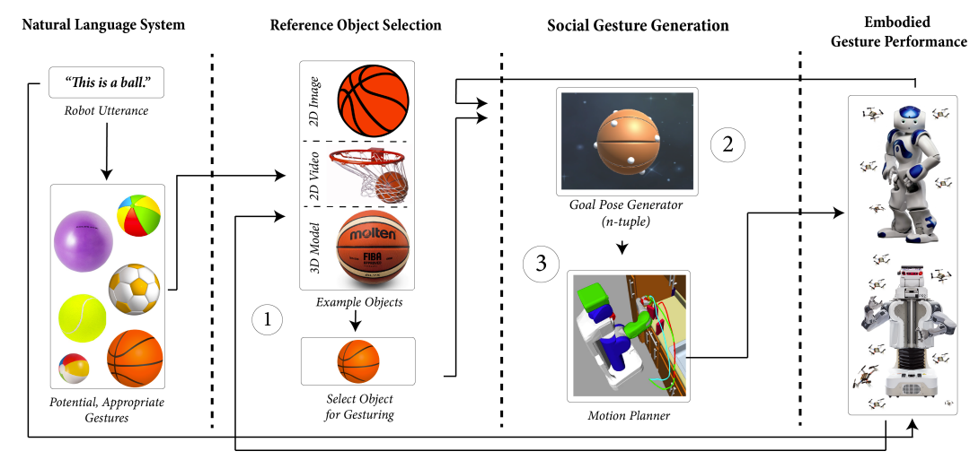
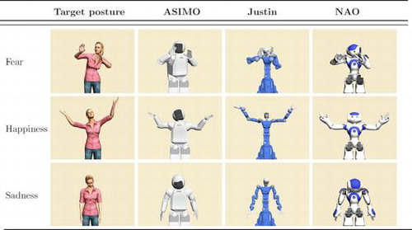
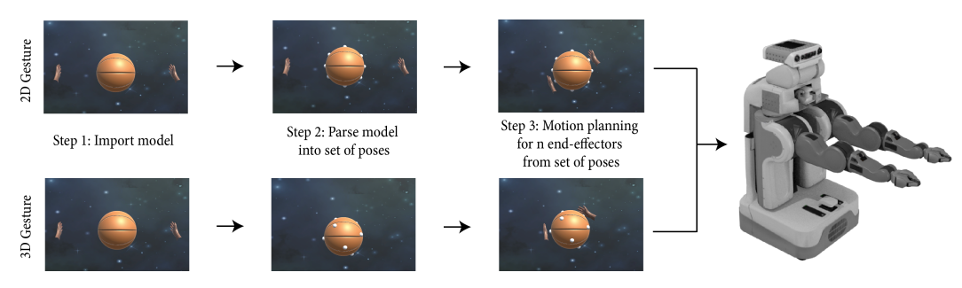
Generating Robot Gestures
Deng, E. C., & Mataric, M. J. (2018). Generative Methods for Object-Based Gestures for Socially Interactive Robots.
Van de Perre, G., Van Damme, M., Lefeber, D., & Vanderborght, B. (2015). Development of a generic method to generate upper-body emotional expressions for different social robots. Advanced Robotics, 29(9), 597-609.
Human-Robot Interaction
Notes:
https://static1.squarespace.com/static/558995bbe4b0157c14e90f83/t/5b121823f950b792dfd50d9f/1527912491586/generative-methods-object+%281%29.pdf

Slide 29
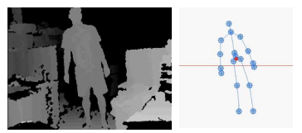
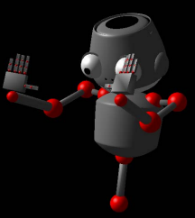
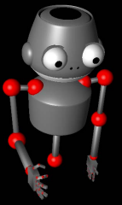
Generating Robot Gestures for Non-Verbal Communication
Robotic Gesture Generation based on a Cognitive Basis for Non-Verbal Communication
Yang, J. Y., & Kwon, D. S. (2014, November). Robotic gesture generation based on a cognitive basis for non-verbal communication. In 2014 11th International Conference on Ubiquitous Robots and Ambient Intelligence (URAI) IEEE.
Human-Robot Interaction

Slide 30
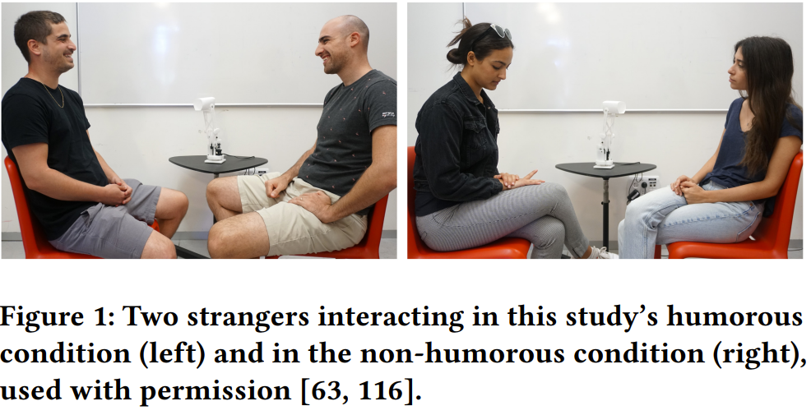
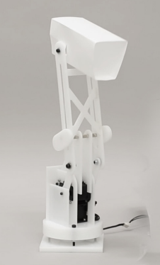
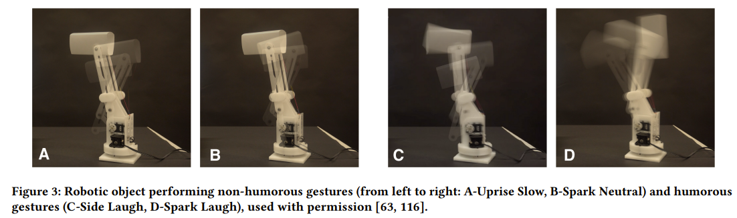
Humorous Robotic Behavior as a New Approach to Mitigating Social Awkwardness
Press, V. S., & Erel, H. (2023, April). Humorous Robotic Behavior as a New Approach to Mitigating Social Awkwardness. In Proceedings of the 2023 CHI Conference on Human Factors in Computing Systems (pp. 1-16).
Human-Robot Interaction

Slide 31

Creating Understandable Robotic Expressions
Human-Robot Interaction

Slide 32
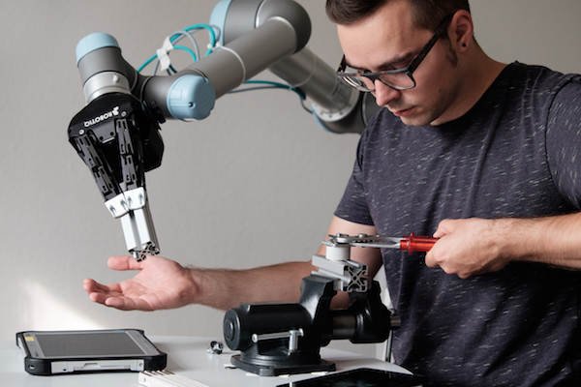
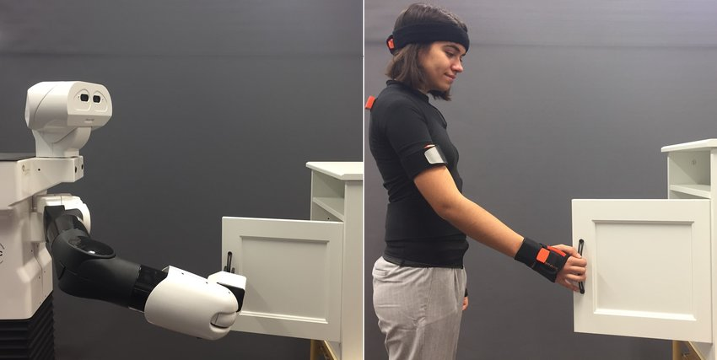
How can we teach robots new tasks?
https://research.engineering.asu.edu/exploring-new-frontiers-in-human-robot-collaborations/
Arduengo, M., Colomé, A., Lobo-Prat, J., Sentis, L., & Torras, C. (2023). Gaussian-process-based robot learning from demonstration. Journal of Ambient Intelligence and Humanized Computing, 1-14.
Human-Robot Interaction

Slide 33
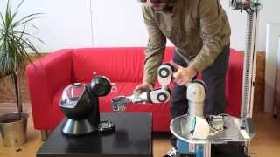
Robot Learning From Demonstration
Human-Robot Interaction

Slide 34
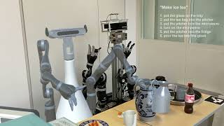
Explainable Human-Robot Training
Wang, C., Belardinelli, A., Hasler, S., Stouraitis, T., Tanneberg, D., & Gienger, M. (2023, April). Explainable Human-Robot Training and Cooperation with Augmented Reality. In Extended Abstracts of the 2023 CHI Conference on Human Factors in Computing Systems (pp. 1-5).
Human-Robot Interaction
Notes:
Learning from demonstration can be hard for novice users which do not know the capabilities of the robot so there is also research on how to improve that.

Slide 35
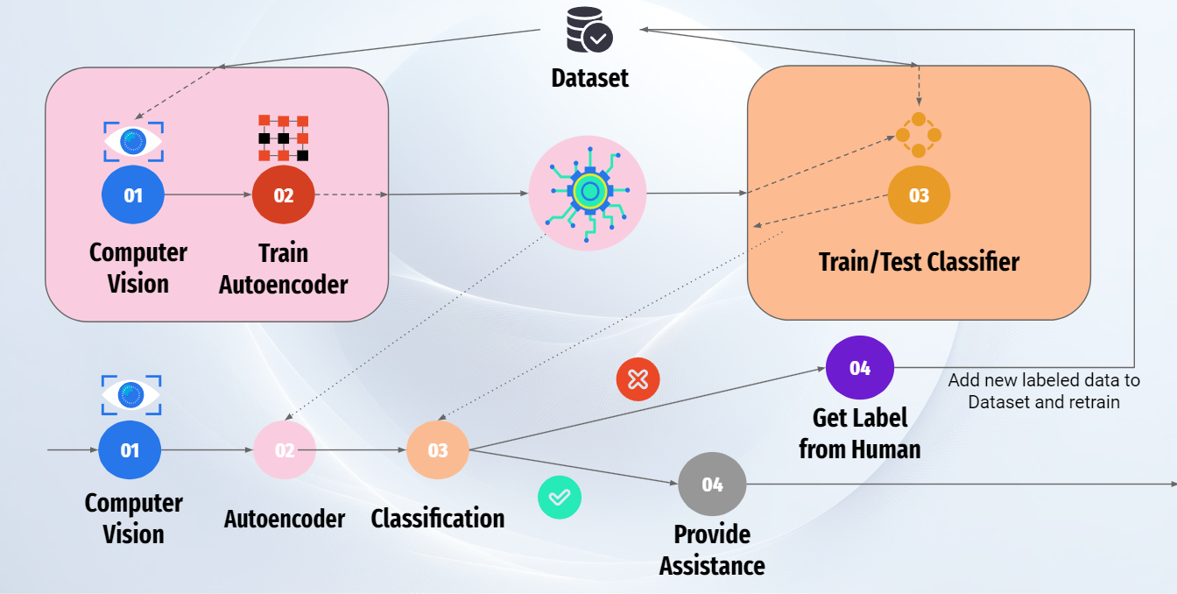
Making Robots Learn Implicitly
The Curious Robot
Human-Robot Interaction

Slide 36
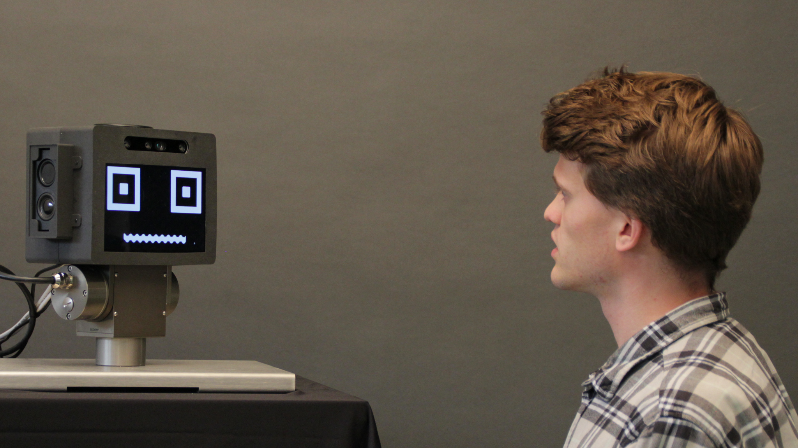
Investigating Opportunities for Active Smart Assistants to Initiate Interactions With Users
When should the robot interrupt?
How should the robot interrupt?
How often should the robot ask questions?
Leusmann, J., Wiese, J., Ziarko, M., & Mayer, S. (2023, December). Investigating Opportunities for Active Smart Assistants to Initiate Interactions With Users. In Proceedings of the 22nd International Conference on Mobile and Ubiquitous Multimedia (pp. 495-498).
Human-Robot Interaction

Slide 37
Investigating Opportunities for Active Smart Assistants to Initiate Interactions With Users
When should the robot interrupt?
How should the robot interrupt?
How often should the robot ask questions?
Leusmann, J., Wiese, J., Ziarko, M., & Mayer, S. (2023, December). Investigating Opportunities for Active Smart Assistants to Initiate Interactions With Users. In Proceedings of the 22nd International Conference on Mobile and Ubiquitous Multimedia (pp. 495-498).
Human-Robot Interaction

Slide 38
Human-Robot Collaboration
Human-Robot Interaction
Notes:
The robot should now actually support us with tasks
What are the important factors?
How can it support?
Do tasks on its own vs supporting
Handing over objects

Slide 39
Human-Robot Handovers
One of the most important tasks in Human-Robot Interaction as its needed for almost all collaborative tasks
Technical Challenges:
  How to grab objects?
  How to hand over objects?
  Tracking the human hand?
  How to indicate different stages of the handover?
  Properties of the objects?
Human-Robot Interaction
Notes:
https://www.youtube.com/watch?v=YYXqxRY76qY
https://www.youtube.com/watch?v=UOntVfjizGg
https://www.youtube.com/watch?v=QIr2IYrp2rY
https://www.youtube.com/watch?v=TKyEbTcFW5M

Slide 40
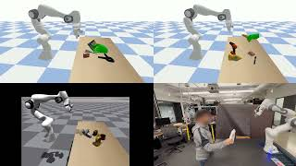
Learning Human-to-Robot Handovers from Point Clouds
Christen, S., Yang, W., Pérez-D’Arpino, C., Hilliges, O., Fox, D., & Chao, Y. W. (2023). Learning Human-to-Robot Handovers from Point Clouds. In Proceedings of the IEEE/CVF Conference on Computer Vision and Pattern Recognition (pp. 9654-9664).
Human-Robot Interaction

Slide 41
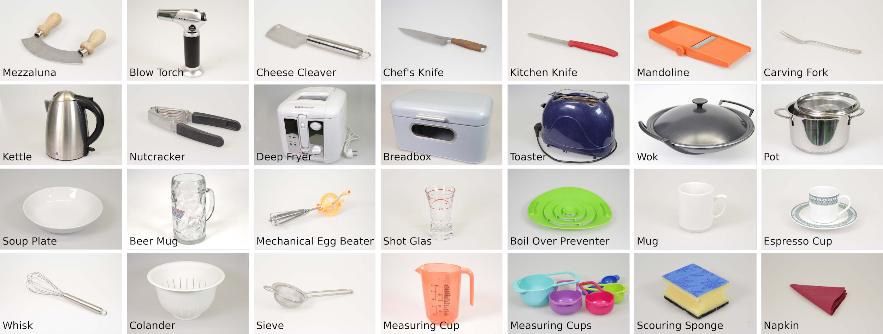
A Database for Kitchen Objects: Investigating Danger Perception in the Context of Human-Robot Interaction
Dataset of 153 kitchen objects
Human-Robot Interaction

Slide 42
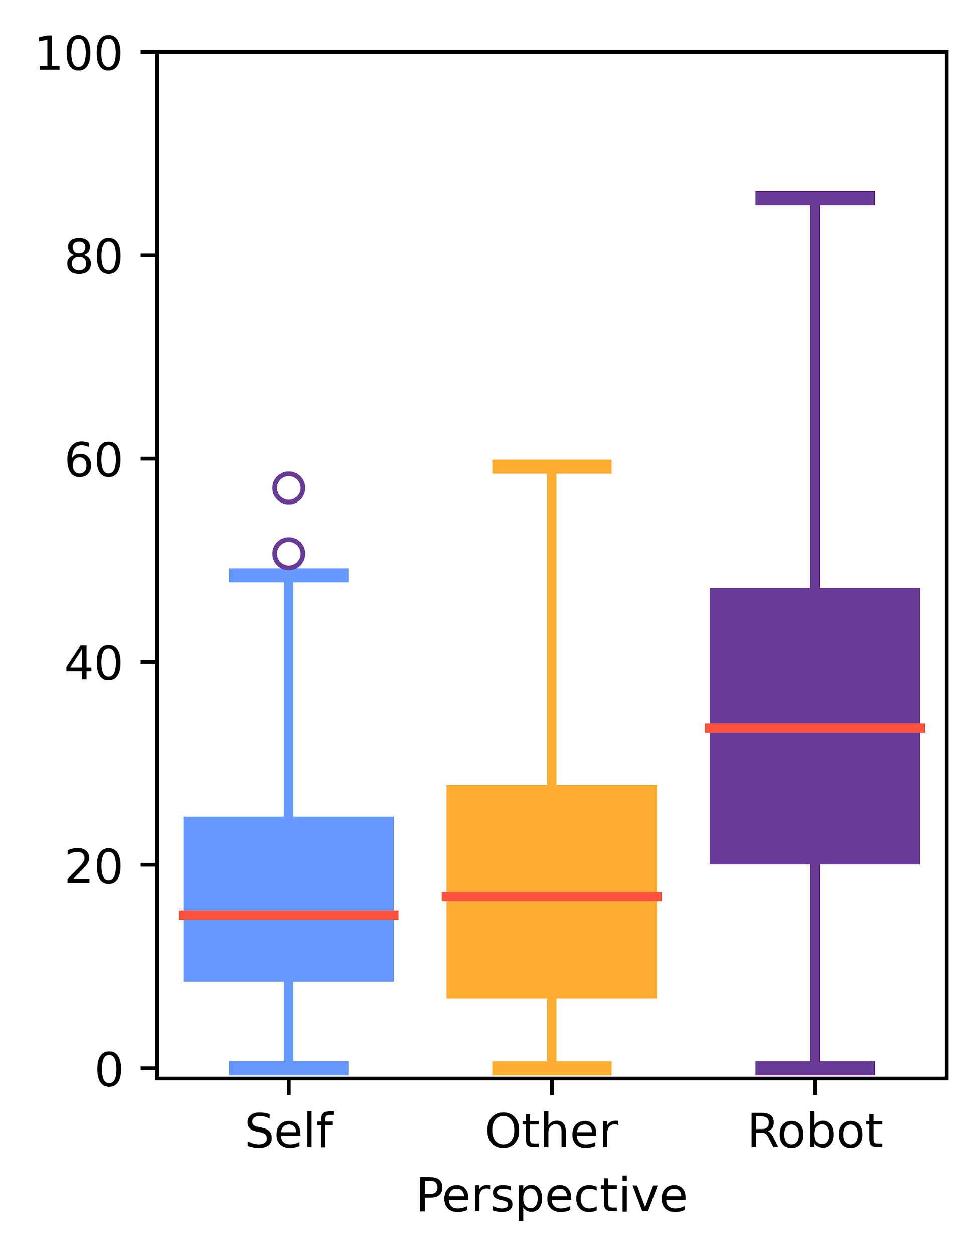
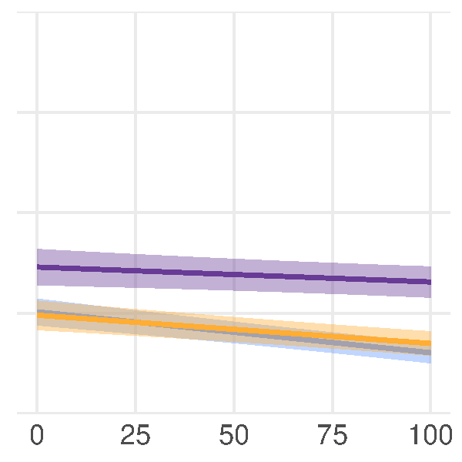
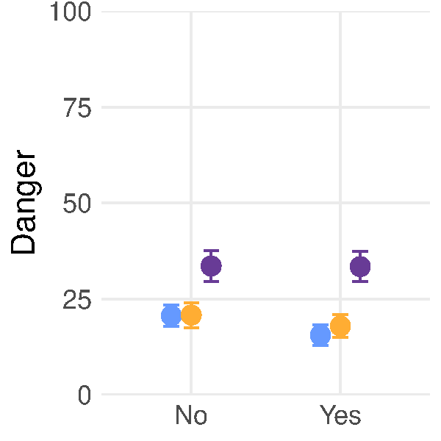

A Database for Kitchen Objects: Investigating Danger Perception in the Context of Human-Robot Interaction
Results
Owning
Familiarity
Human-Robot Interaction

Slide 43

Timing in Human-Robot Handovers
Pan, M. K., Knoop, E., Bächer, M., & Niemeyer, G. (2019, November). Fast handovers with a robot character: Small sensorimotor delays improve perceived qualities. In 2019 IEEE/RSJ International Conference on Intelligent Robots and Systems (IROS) (pp. 6735-6741). IEEE.
Human-Robot Interaction

Slide 44

Predictive Human-Robot Handovers
Motivation
Goal: Figure out what timing humans prefer for the robot to start moving when the human hands over an object to the robot
Prediction & classification model for human handovers based on human motion data
5 different conditions: very early detection, early detection, intermediate detection, late detection, very late detection
Human-Robot Interaction

Slide 45
Predictive Human-Robot Handovers
Study
Delay
No Delay/Prediction
Prediction
Human-Robot Interaction

Slide 46

Predictive Human-Robot Handovers
Results
Human-Robot Interaction

Slide 47
Proxemics in HRI
Nonverbal Communication
Facial expressions
Gestures
Paralinguistics
Body language
Proxemics or personal space
Eye gaze, haptics (touch)
Appearance
Artifacts (objects and images)
Hall, Judith A., and Mark L. Knapp, eds. Nonverbal communication. Vol. 2. Walter de Gruyter, 2013.
Human-Robot Interaction
Notes:
We saw Non-verbal communication is essential for Cobots
Paralinguistics: tone or loudness of voice
Body language: e.g. posture → extrovert, introvert
Appearance: e.g. what you wear
basically everything but words
NVC among humans is a common denominator
essential for us to interpret intention
impact the relationship you have with another person

Slide 48
Proxemics in HRI
Nonverbal Communication
Facial expressions
Gestures
Paralinguistics
Body language
Proxemics or personal space
Eye gaze, haptics (touch)
Appearance
Artifacts (objects and images)
Hall, Judith A., and Mark L. Knapp, eds. Nonverbal communication. Vol. 2. Walter de Gruyter, 2013.
Human-Robot Interaction
Notes:
Proxemics is one of the modalities
Especially important in HRI bc
In contrast to conventional industrial robotics, here we share the same space \w the robot

Slide 49

Proxemics in HRI
Origins
The study of the cultural, behavioral, and sociological aspects of spatial distances between individuals.
45
120
300 cm
The American Heritage® Dictionary of the English Language, 5th Edition.
Edward Twitchell Hall. 1966. The hidden dimension (Anchor Books, 1990 ed.). Doubleday, New York.
Human-Robot Interaction
Notes:
Hall came up with the term “Proxemics”, 4 regions, concentric circles
Explain how humans use space in social interactions
When we interact with each other, depending on how well we know the other person, automatically find the appropriate distance on this scale
If distance and type of interaction don’t match, it causes discomfort
Personal: close enough for handshake, still can see whole body

Slide 50

Proxemics in HRI
Personal Space
Margot M. E. Neggers, Raymond H. Cuijpers, Peter A. M. Ruijten, and Wijnand A. IJsselsteijn. 2022. Determining Shape and Size of Personal Space of a Human when Passed by a Robot. Int J of Soc Robotics 14, 2 (March 2022), 561–572. https://doi.org/10.1007/s12369-021-00805-6
Human-Robot Interaction
Notes:
Since then a lot of research has been done to refine this (more space in front/back, dominant hand, traffic)
When it becomes unpleasant highly depends on context (culture, eye-contact, relationship, level of interaction, object, speed, direction)
Nevertheless these approximate boundaries continue to be quite universal

Slide 51
Proxemics in HRI
Do we also need this for (non-humanoid) robots? → Yes
Can we apply the same rules to robots? → 🤷‍♀️ possibly no
Study Designs:
  Robot approaches Human [1]
  Human stops Robot [2]
  Robot passes Human [3]
  Robot crosses path with Human [4,5]
  Robot hands over to Human
Matthias Luber, Luciano Spinello, Jens Silva, and Kai O. Arras. 2012. Socially-aware robot navigation: A learning approach. In 2012 IEEE/RSJ International Conference on Intelligent Robots and Systems, October 2012, Vilamoura-Algarve, Portugal. IEEE, Vilamoura-Algarve, Portugal, 902–907. . https://doi.org/10.1109/IROS.2012.6385716
Human-Robot Interaction
Notes:
Types of scenarios typically explored in HR proxemic studies
to evaluate speed and distance effect on human (dis)comfort

Slide 52





Proxemics in HRI
Validity of Results
[1] M.L. Walters, et al. 2005. The influence of subjects’ personality traits on personal spatial zones in a human-robot interaction experiment. https://doi.org/10.1109/ROMAN.2005.1513803
[2] Elena Torta, et al. 2013. Design of a Parametric Model of Personal Space for Robotic Social Navigation. https://doi.org/10.1007/s12369-013-0188-9
[3] Margot M. E. Neggers, et al. 2018. Comfortable Passing Distances for Robots. https://doi.org/10.1007/978-3-030-05204-1_42
[4] Christina Lichtenthaler,et al. 2013. Be a robot! Robot navigation patterns in a path crossing scenario. https://doi.org/10.1109/HRI.2013.6483561
[5] Shih-Yun Lo,et al. 2019. Perception of Pedestrian Avoidance Strategies of a Self-Balancing Mobile Robot. https://doi.org/10.1109/IROS40897.2019.8968191
Human-Robot Interaction
Notes:
What do you think could be a problem with the results of these studies?

Slide 53



Proxemics in HRI
Influence of Anthropomorphism on User Comfort while Passing
(a)
(b)
Raymond H. Cuijpers, Peter A. M. Ruijten, and Wijnand A. IJsselsteijn. 2022. Determining Shape and Size of Personal Space of a Human when Passed by a Robot. Int J of Soc Robotics 14, 2 (March 2022), 561–572. https://doi.org/10.1007/s12369-021-00805-6
Human-Robot Interaction
Notes:
One influencing factor seems to be anthropomorphism
Results:
humanoid more uncomfortable in back → seen as social actor?
people want more distance in the back → uncertainty
Limitations:
participants were told to keep their position → influence on ratings
participants had no task → no distraction
A lot of factors have to be considered when conducting Robot Proxemic Studies

Slide 54
Proxemics in HRI
Validity of Results
Effects on User Comfort
  Robot Appearance
  Novelty Effect
  Trust ← Predictability of Actions
  (Laboratory) Setting
  Type of Interaction
Challenges
  Reproducibility
  Cost & Effort
  Safety
  Physics
Human-Robot Interaction
Notes:
Novelty Effect wears off or:
users learn the capabilities and ways of a robot and can anticipate them → Trust ← predictability of actions ← character ---
Physics: we had handovers, you can see shape but not weight

Slide 55

Proxemics in HRI
Media Informatics Robot Lab
Human-Robot Interaction
Notes:
Build our own robotic lab for HRI studies
Look and Feel like a kitchen at home → overcome effect of lab settings
Features:
2 Robotic Arms
Smart Kitchen Appliances

Slide 56

Proxemics in HRI
Media Informatics Robot Lab
Human-Robot Interaction
Notes:
Build our own robotic lab for HRI studies
Look and Feel like a kitchen at home → overcome effect of lab settings
Features:
2 Robotic Arms
Smart Kitchen Appliances

Slide 57



Proxemics in HRI
Investigating the effect of robot movement speed and velocity on user comfort and perceived danger during the handover of everyday kitchen objects
User comfort depends on: context, speed, distance
Approach the user with different objects, 3 of each group
Let the user decide on speed v and handover distance d
Goal: get average kinetic and proxemic settings depending on “danger index”, starting point for interactions that don’t startle the user
d
v
Human-Robot Interaction

Slide 58

Communicating Robot’s Intentions while Assisting Users via Augmented Reality
Wang, C., Stouraitis, T., Belardinelli, A., Hasler, S., & Gienger, M. (2023). Communicating Robot's Intentions while Assisting Users via Augmented Reality. arXiv preprint arXiv:2308.10552.
Human-Robot Interaction

Slide 59

LLMs + Robots
Human-Robot Interaction

Slide 60
CoPAL: Corrective Planning of Robot Actions with Large Language Models
https://hri-eu.github.io/Loom/index.html
Human-Robot Interaction

Slide 61


When are Robots coming to Households?
Human-Robot Interaction
Notes:
Amazon Astro already out (glorified roomba)
Give them arms so they can actually interact with the environment
Intent Communication
Resolving Conflicts
https://dl.acm.org/doi/pdf/10.1145/3568162.3576969
Safety
Trust

Slide 62
Conclusion
Human-Robot Interaction
Application areas for HRI
Anthropomorphism
Robot gesture generation
Human-robot collaboration
Human-robot handovers
Teaching robots: Robot learning from demonstration
Visualizing robot intent
LLMs + robots

Slide 63

License
This file is licensed under the Creative Commons Attribution-Share Alike 4.0 (CC BY-SA) license:
https://creativecommons.org/licenses/by-sa/4.0
Attribution: Jan Leusmann, Sven Mayer

